Slide 1
Presenting: George Naydenov Position: outside Hitter

Slide 2
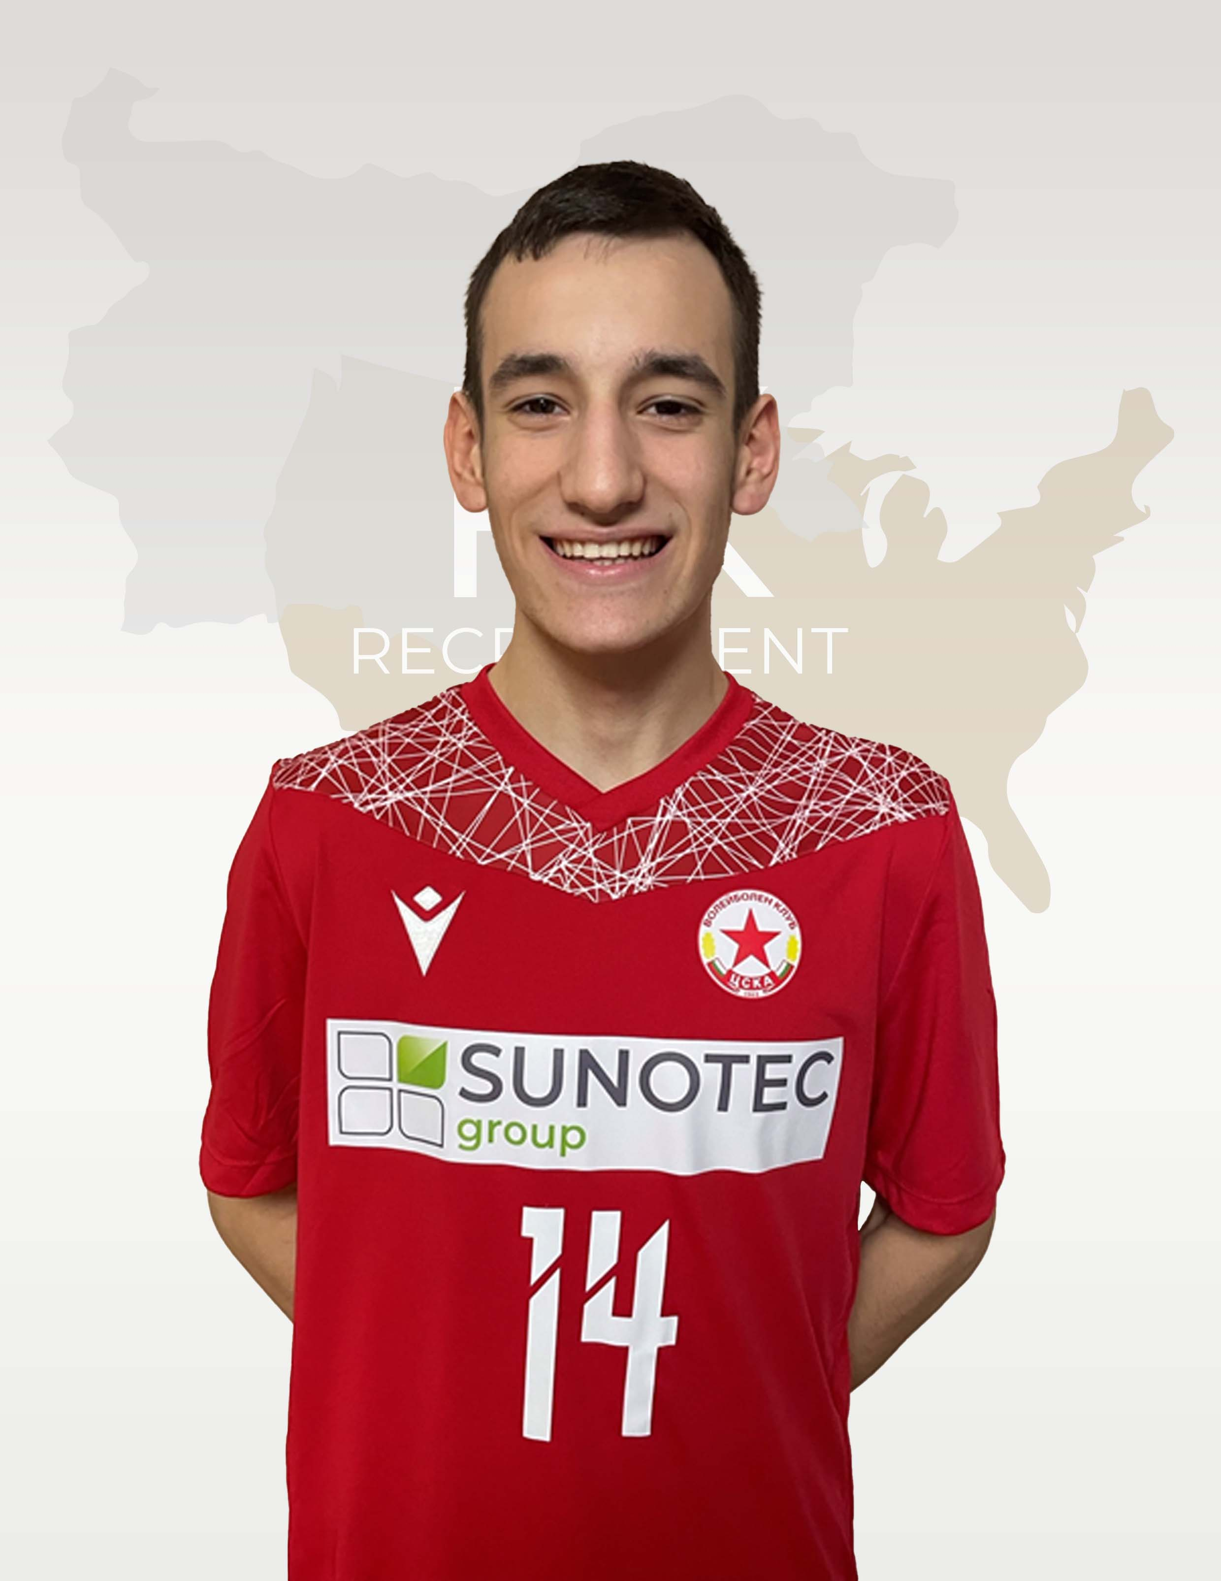
Status: Available
Gender: Male
Position: Outside Hitter
Date of Birth: 03.05.2006
Graduation date: June 2025
Club team: CSKA SOFIA

Slide 3
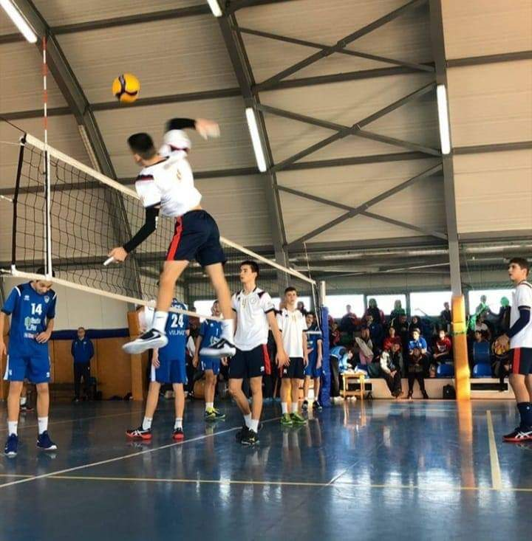

Slide 4
Additional Information
Height: 183 cm.
Weight: 61 kg.
Reach: 237 cm.
Approach high jump: 320 cm.
Standing block jump: 308 cm.
High school: 35th Language Highschool "Dobri Voynikov", Sofia
Languages: Bulgarian, English, French, Russian
Desired degree: TBA
SAT grade/date: TBA
TOEFL grade/date: TBA

Slide 5
Year | Tournament | Ranking
2016/2017 | National Championship of Bulgaria U12 | 4
2016/ 2017 | National Championship of Bulgaria U13 | 3
2016/ 2017 | Volleyball Competition "Dryanovo Cup" | 2
2016/ 2017 | Volleyball Competition "Sofia Sport Cup" | 2
2016/ 2017 | Volleyball Competition "ProMarket Cup", Sofia | 3
2016/ 2017 | Volleyball Competition "Allianz Cup" | 1
2017/ 2018 | Volleyball Competition "Yablanitza Cup" | 1
2017/ 2018 | Regular season 1st half | 1
2017/ 2018 | Regular season 2nd half | 1
2017/ 2018 | National Championship of Bulgaria U13 | 2
2017/ 2018 | Qualification for National Championship | 1
2017/ 2018 | National Championship of Bulgaria U14 | 2
2017/ 2018 | Volleyball Competition "Dryanovo Cup" | 1
2017/ 2018 | Volleyball Competition "Children and their sport club" | 1
2017/ 2018 | Volleyball Competition "Children and their sport club" | 2
2017/ 2018 | Volleyball Competition "ProMarket Cup", Sofia | 1
2018/ 2019 | Volleyball Competition "Nikola Dimanov Cup", Plovdiv | 1
2018/ 2019 | Volleyball Competition "Yablanitza Cup" | 2
2018/ 2019 | Regular season 1st half | 2
2018/ 2019 | Regular season 2nd half | 1
2018/ 2019 | Qualification for National Championship | 1
2018/ 2019 | National Championship of Bulgaria U14 | 3
2018/ 2019 | National Championship of Bulgaria U15 | 1
2018/ 2019 | Volleyball Competition "Dryanovo Cup" | 1
2019/ 2020 | Volleyball School Games, Sofia | 1
2019/ 2020 | Volleyball Competition "Volleyball Academy Stoychev-Kaziyski Cup" | 2
2019/ 2020 | Regular season 1st half | 2
2019/ 2020 | Qualification for National Championship | 1
2020/ 2021 | Regular season 1st half | 2
2020/ 2021 | Regular season 2nd half | 2
2020/ 2021 | Qualification for National Championship | 1
2020/ 2021 | National Championship of Bulgaria U15 | 2
2021/ 2022 | Regular season 1st half | 2
:

Slide 6
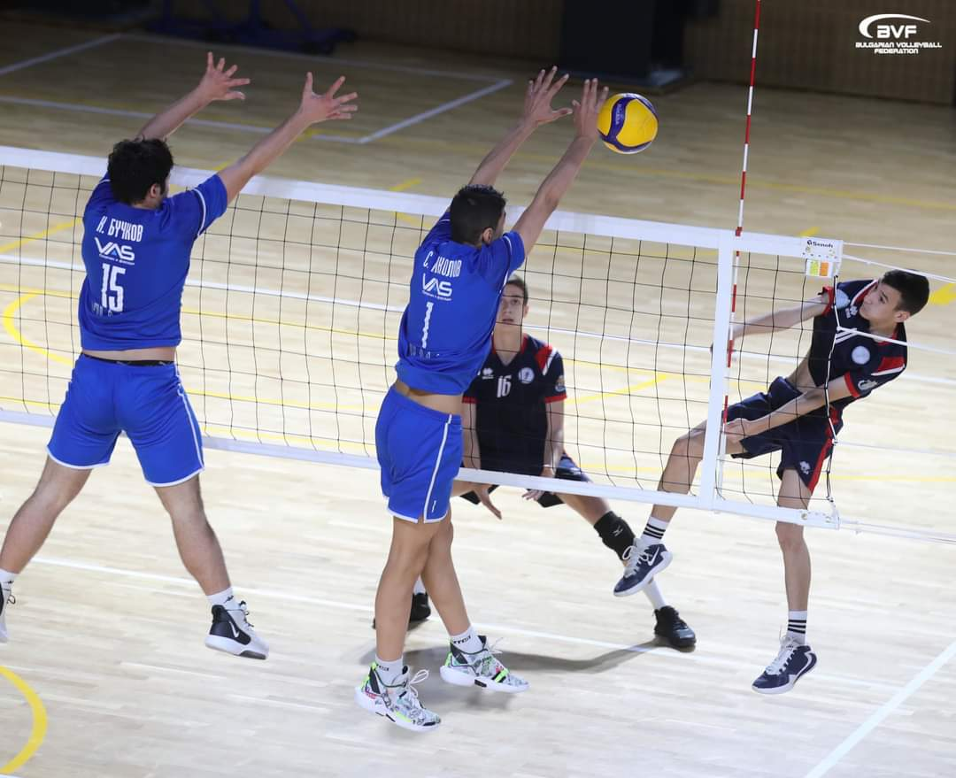
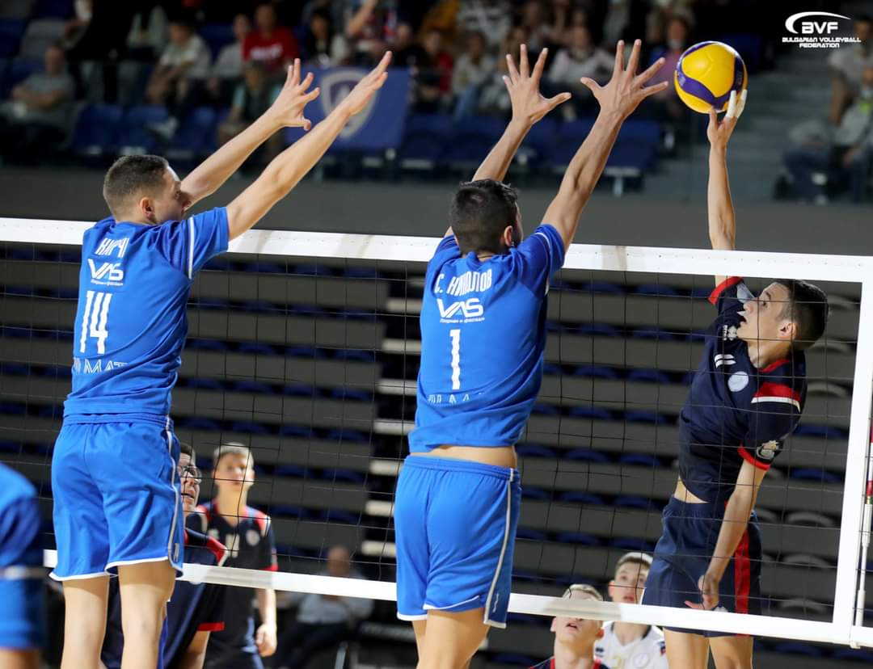

Slide 7
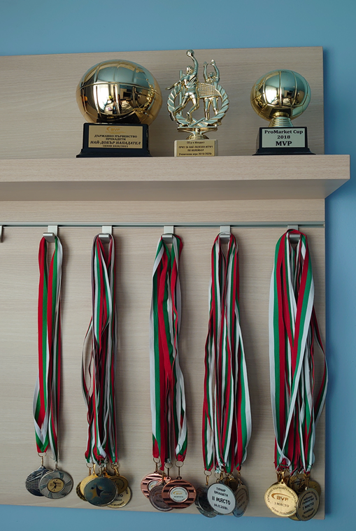
Volleyball – individual achievements:
Best Outside hitter at National Championship of Bulgaria - 2020/ 2021 (U15);
MVP at School Volleyball Games in Bulgaria - 2019/ 2020 (U14);
MVP at Volleyball Competition "ProMarket Cup", Sofia - 2018 (U13);
21 medals: 9 golden medals, 8 silver medals, 4 bronze medals.

Slide 9
Interview questions
Describe yourself with a few sentences:
According to my close friends I am an intelligent, responsible and ambitious person who has a great sense of humor. My family and friends are very important to me and that's why I am always ready to help them. In the difficult situations I reveal my leader skills as I deal with tension and calm down the people around me. I am eager to learn and grasp quickly. Because I don't like losing, I exert efforts to achieve the purpose.
What does volleyball mean to you?
I love volleyball - it is the best sport for me because I glow for this game, it is my love and passion. I was only 9-year-old when I started playing. For me it is lifestyle. Volleyball has taught me to be disciplined, accurate, confident, reliable, and I can rely on others, too. It is the right place to realize what the teamwork is. The most valuable thing is to do your best if you want success.

Slide 10
What does your education mean to you?
My main life goal is to be high-educated, because it is an important value for me - knowledge is power. Nowadays education is a significant part of our global world - if you want to be competitive and able to adjust to various situations, you have to develop your skills constantly and gain some knowledge of different cultures. That would be a great treasure for me. That is why I would like to be cosmopolitan as I broaden my horizons.

Slide 11
What are your main goals as a student-athlete in the USA?
To be a student-athlete is an enormous responsibility, because I have to cope with my education and at the same time I have to get better of volleyball. If I wish to succeed, I am required to be strictly focused on both of them. It is very important for me to combine my volleyball achievements with academic development, because I would like to graduate my Bachelor degree with honors and meanwhile to win prizes at the National Collegiate Men's Volleyball Championship.

Slide 12
Video Analysis
Highlight Video:
https://www.youtube.com/watch?v=yfjMIgThEB4
Two full matches:
https://www.youtube.com/watch?v=BbhiYg93KZU&t=48s
https://www.youtube.com/watch?v=a7xcJsV48nI&t=2582s

Slide 13
The presentation provides all the basic information for the student-athlete. More details and video can be provided if needed. Contact us.

