Slide 1

Dimitar Lazarov
Center Midfielder

Slide 2
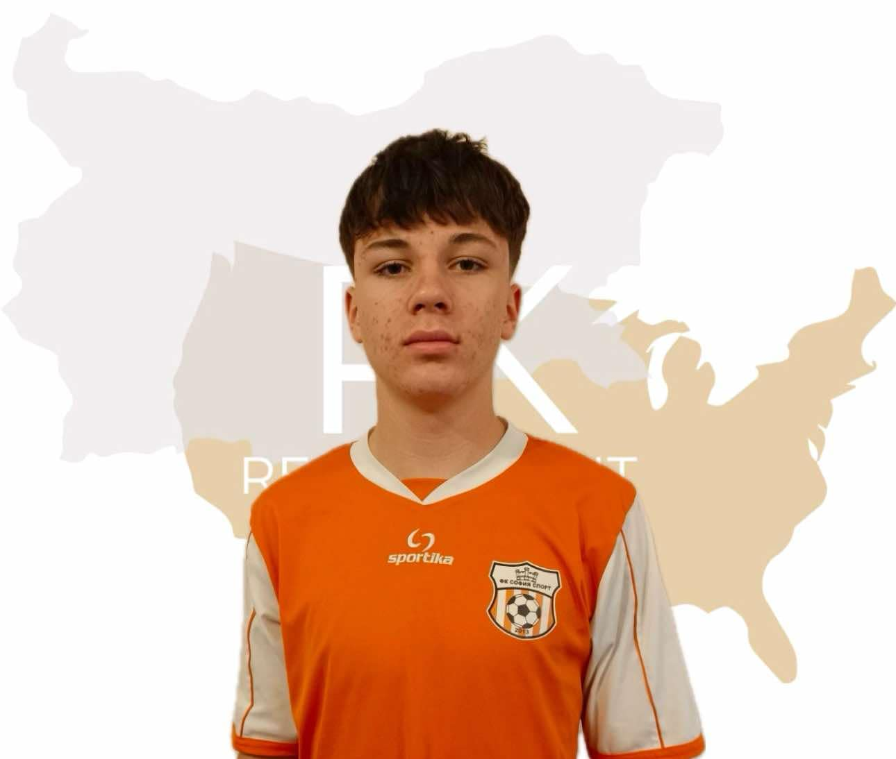
Status: Available
Gender: Male
Position: Center Midfielder
Date of Birth: 04. 10. 2006
Graduation Date: June 2025
Club Team: FC Sofia Sport

Slide 3
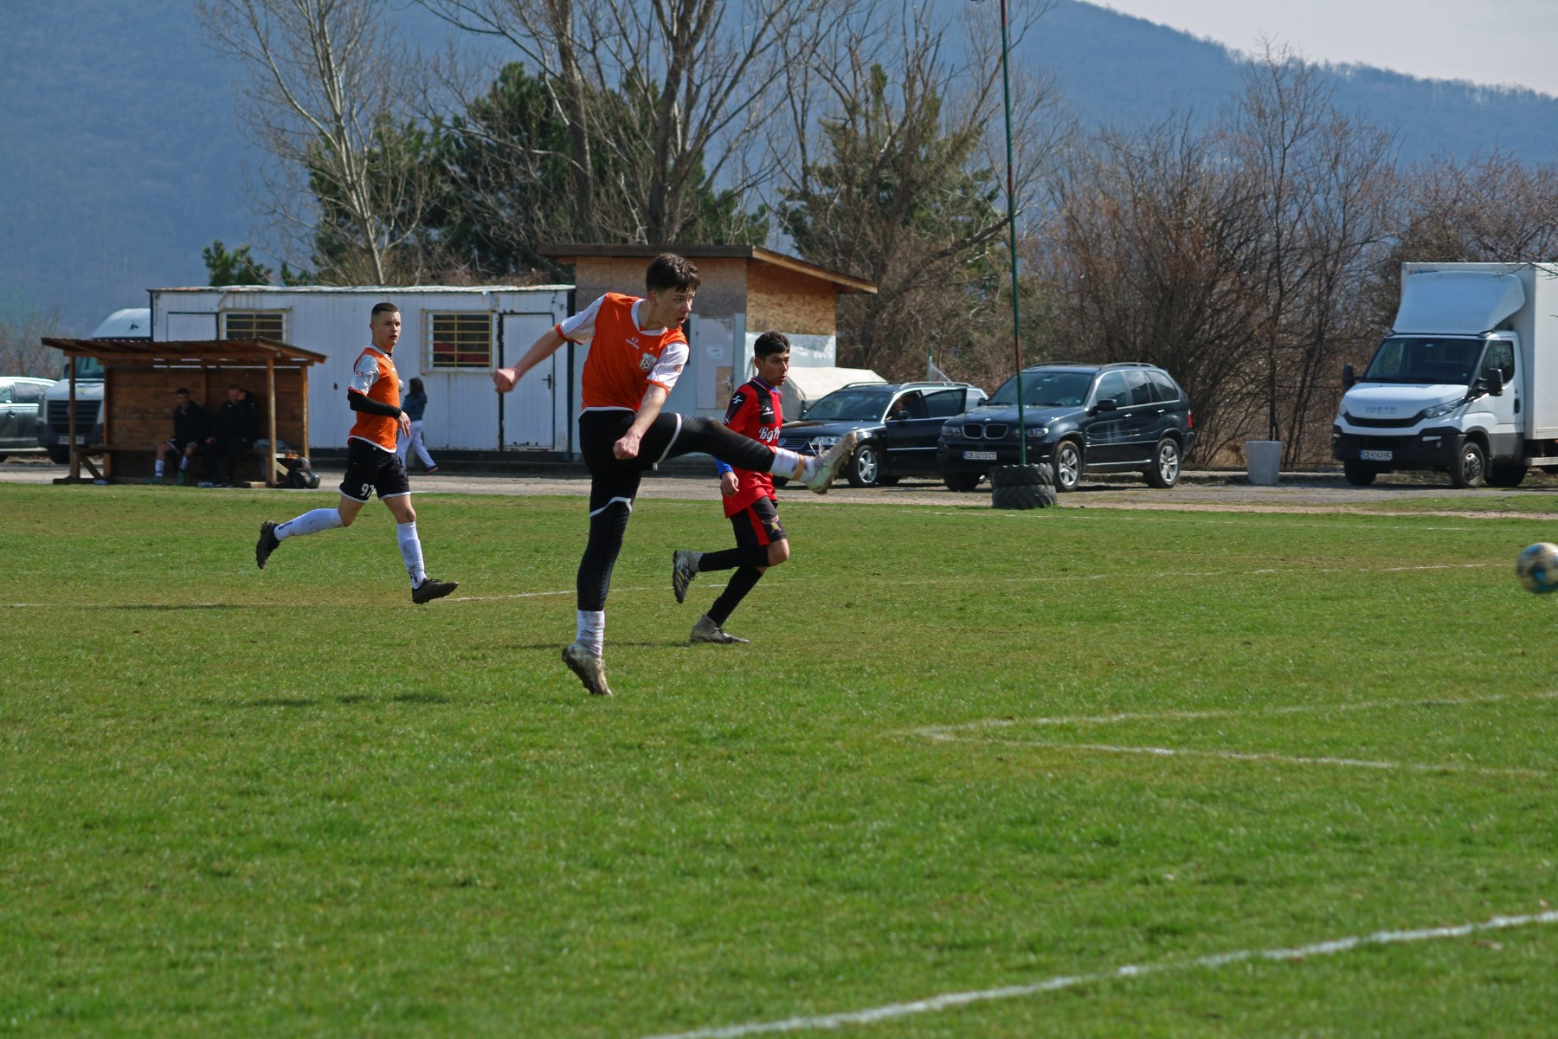

Slide 4
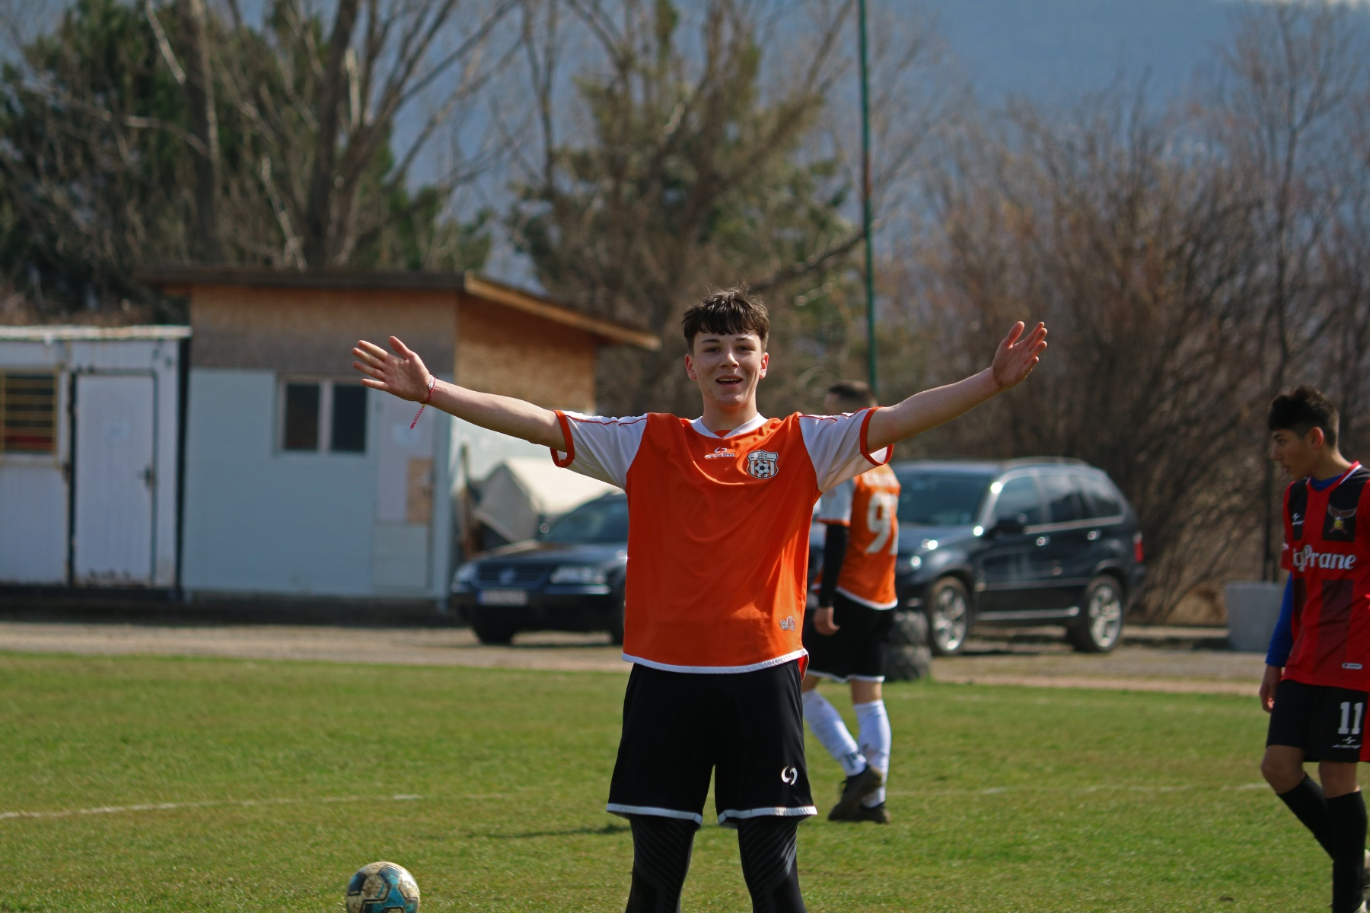
Height: 185 cm.
Weight: 74 kg.
Languages: Bulgarian, English
High School: Sofia High School of Mathematics
Desired degree:
Major – Mechanical Engineering
Minors – Mathematics
SAT – 1490 (700 English, 790 Mathematics), August 2024
Cambridge English C1 (CAE) – 197, June 2nd 2024
ADDITIONAL INFORMATION

Slide 5
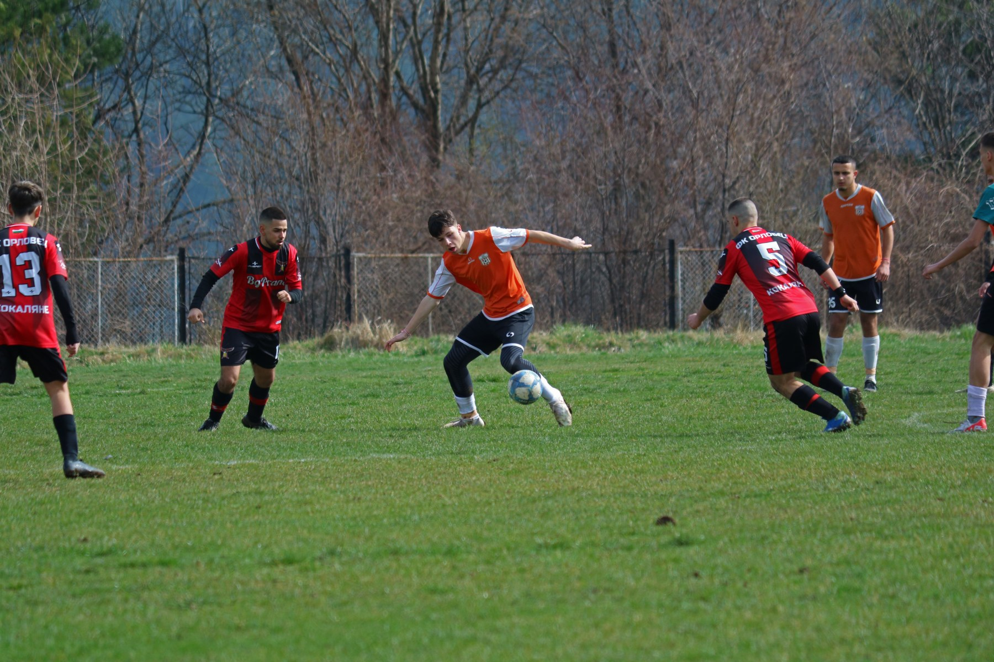

Slide 6
Athletic Achievements:
Football Tournament for National Trophy 2016 – 1st place
Nesebar Cup 2023 – 3rd place
TrueBlue Foundation Charity Football Tournament 2024 – 4th place
Intraschool football tournament SMG CL 2024 – 3rd place (captain of the team)

Slide 7
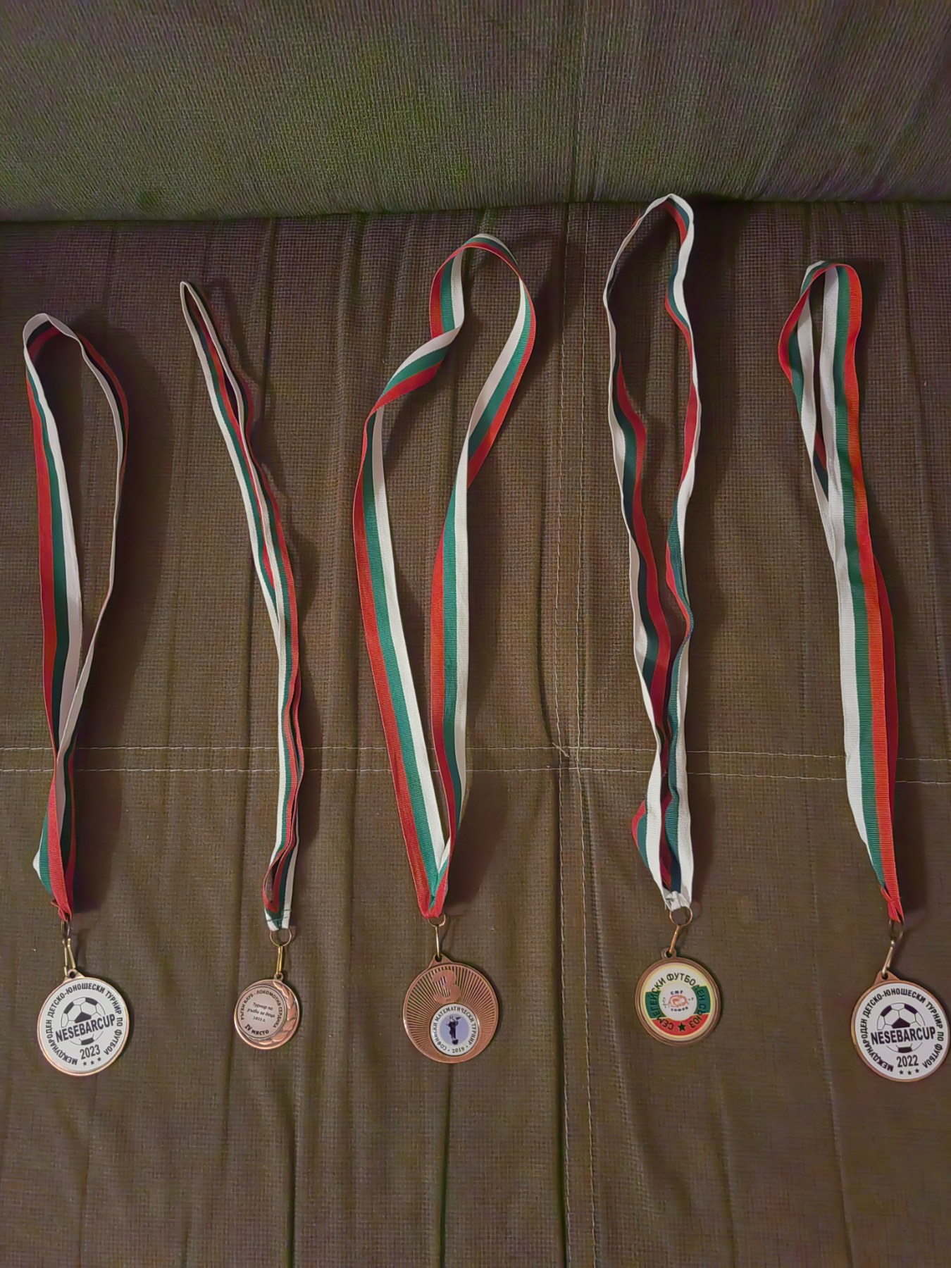
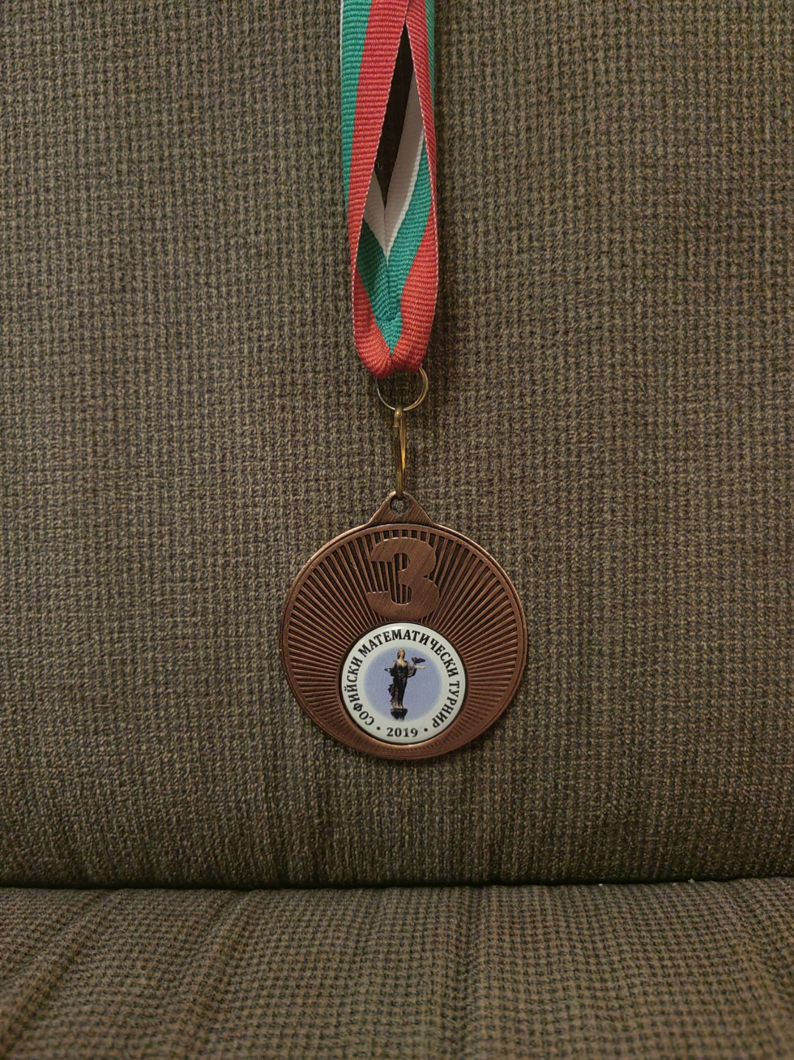
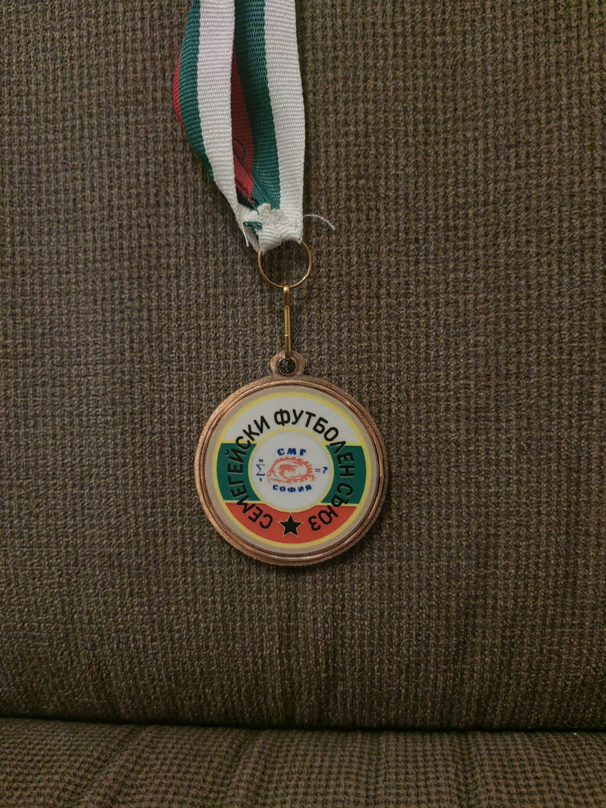

Slide 8
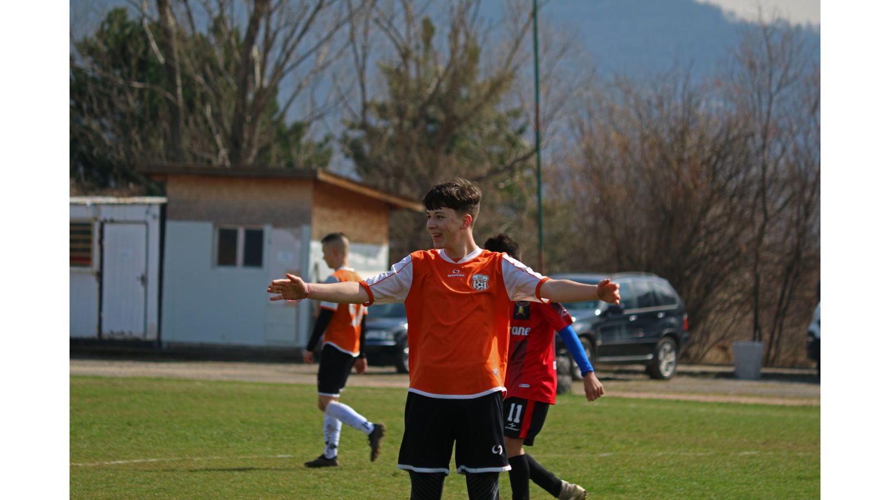

Slide 9
Academic Achievements:
Sofia Math Tournament 2019 – 3rd place
National Math Olympiad Regional round reaches – 2014/2015, 2015/2016, 2016/2017, 2017/2018, 2019/2020, 2022/2023, 2023/2024
Ranked 1/85 graduating middle school
Nominated Student of the Year 2019/2020 (6.OU “Graf Ignatiev”)
Numerous/regular participations in mathematical tournaments 1st – 12th grade (i.e. European Kangaroo, National Mathematical Olympiad, Sofia Math Tournaments, others)

Slide 10
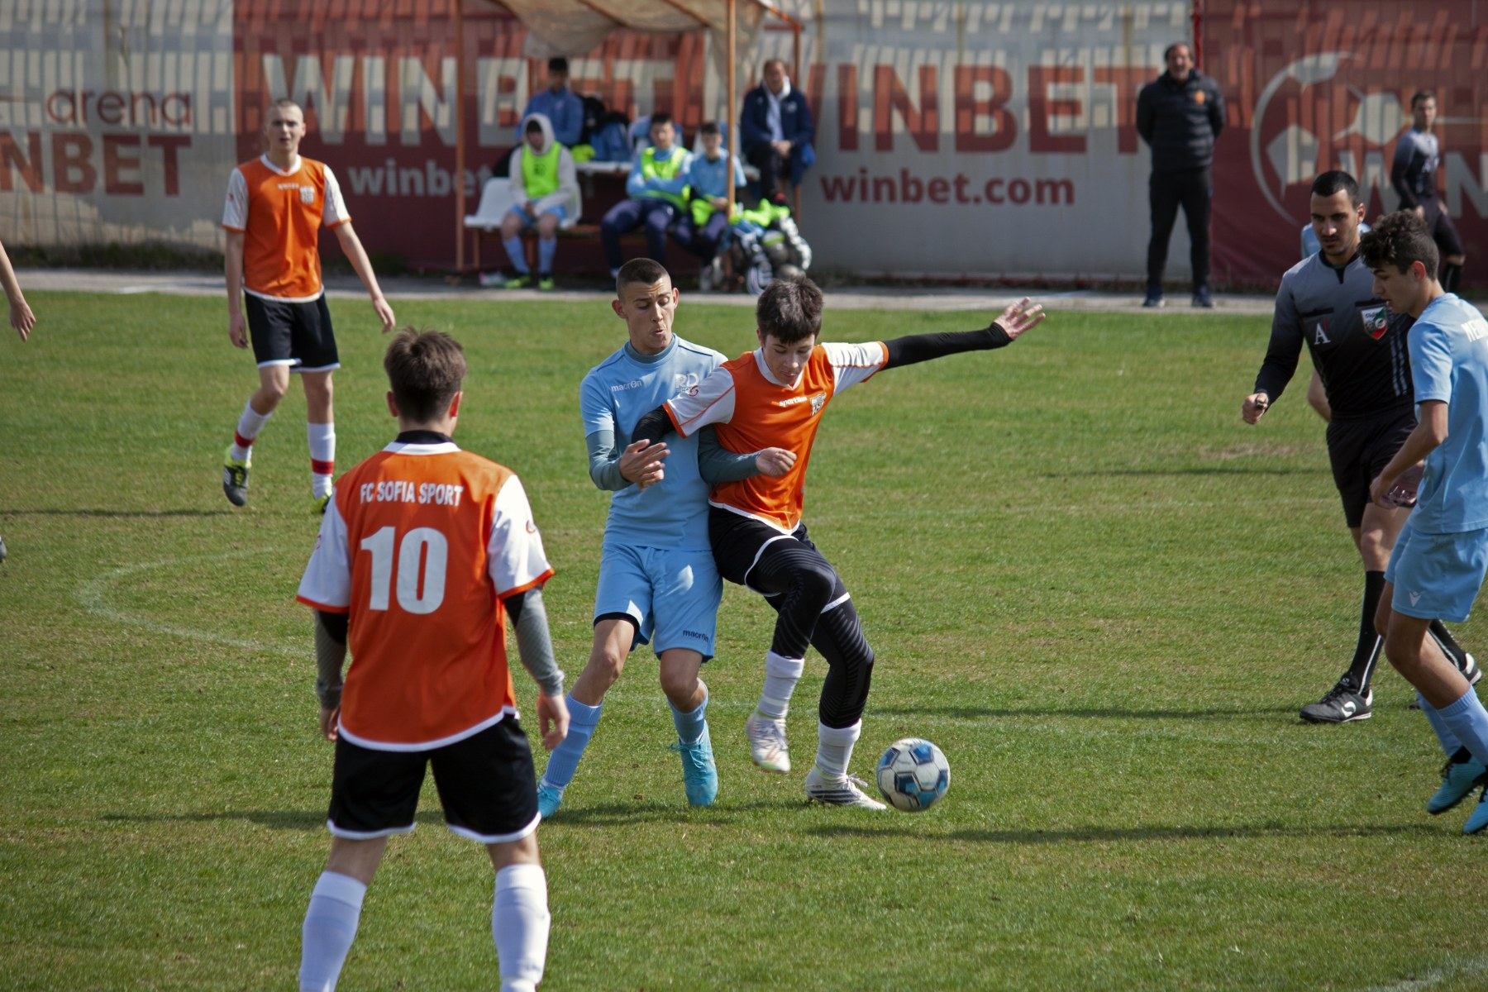

Slide 11
Interview:
From the moment my feet touched the ball, soccer became an eternal part of me. As I grew older, I even took an interest in numerous other sports and, without hesitation, tried many of them. Despite being open to different activities and ideas, soccer has been my true passion for as long as I can remember. It doesn’t matter if it’s a serious match or just kicking a ball around during lunch—whenever I step on the field, everything else fades away. The mental stress of school, relationships, and other responsibilities—all of it disappears; I can be unapologetically myself.
Soccer has taught me discipline and teamwork. But it’s not just about the physical game; sports help me maintain my balance. While soccer has been my lifelong dedication, my love for learning, especially mathematics, has made an equally strong impact on who I am.
Throughout my life, I’ve had the privilege of thriving in an educated environment. From a young age, I have had a knack for mathematics and have strived to learn at Sofia High School of Mathematics. Studying in the most competitive high school in Bulgaria has encouraged me to stay curious and engage with diverse people and ideas. Tackling challenging concepts and topics may not always be easy, but this is exactly when I can rest my muscles and recover physically.
Continuing my life in the USA would be challenging, but it would also serve as an opportunity to keep developing academically and as an athlete. It would provide a chance to truly step out of my comfort zone and meet new people: temporarily letting go of my past, the people and places I know and love, while taking on a new perspective in life and seeking self-improvement. I see the USA as the ideal place to grow as a player, student, and, above all, as a person.

Slide 12
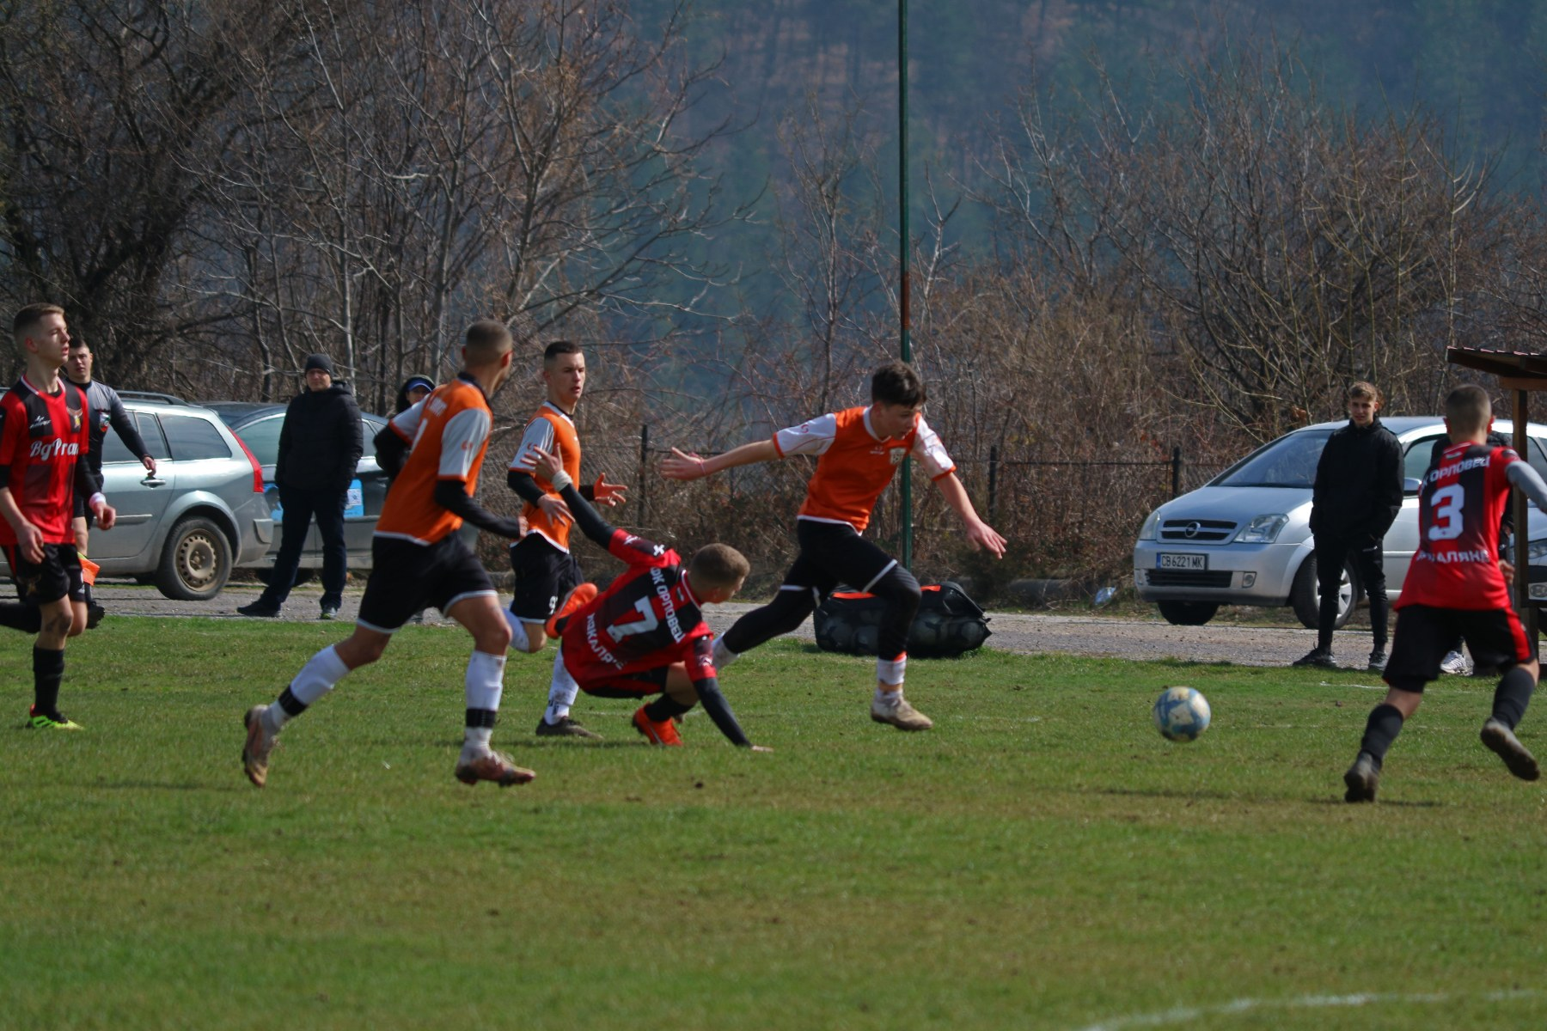

Slide 13
Video Analysis
Highlight Video:
https://www.youtube.com/watch?v=NyI2wRqShpI

Slide 14
