Slide 1
Steve Katsarov Setter

Slide 2
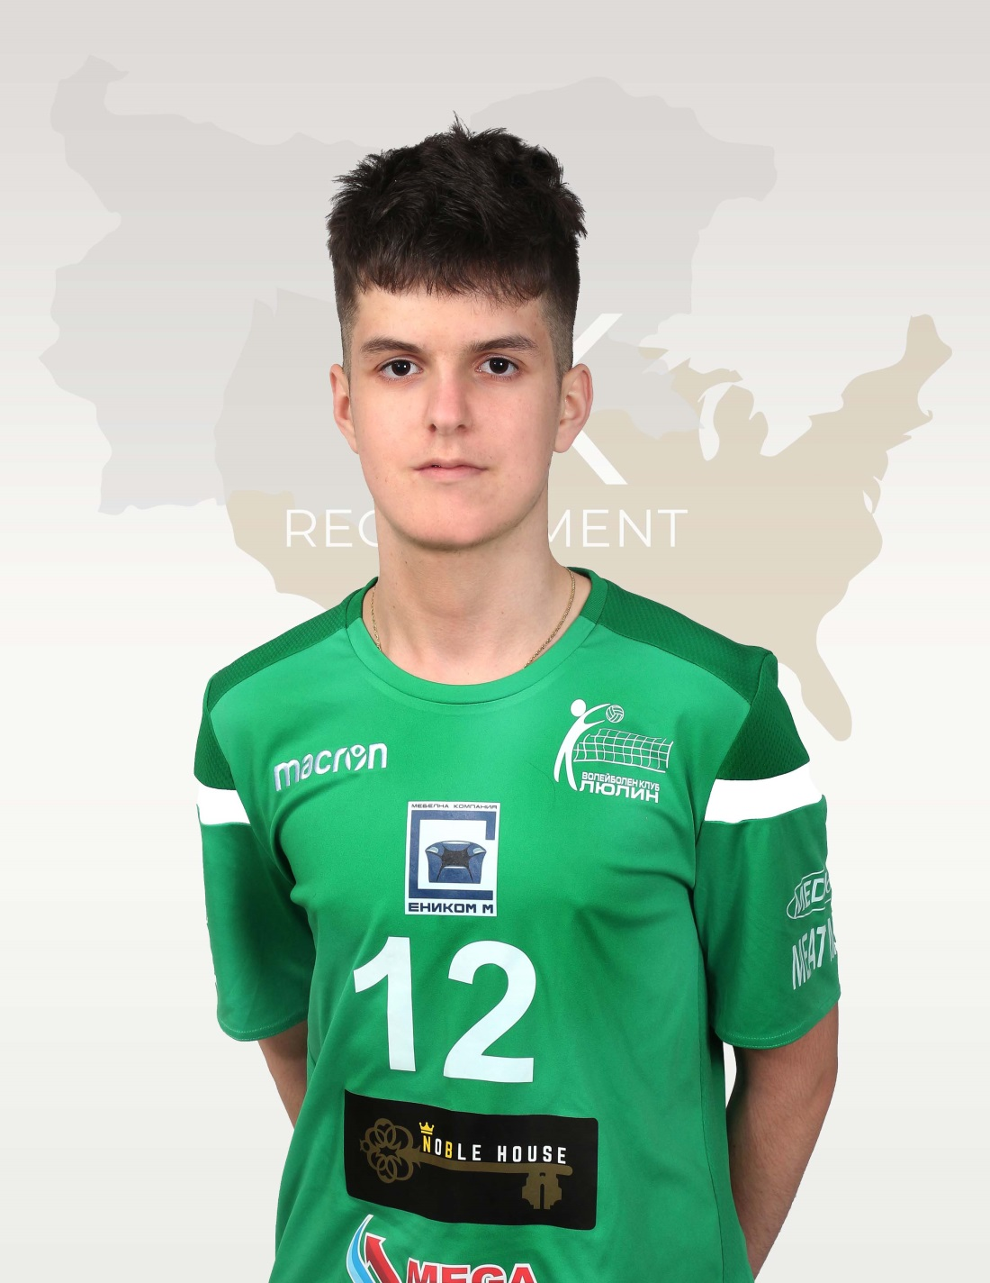
Status: Available
Gender: Male
Position: Setter
Date of Birth: 12.02.2005
Graduation date: June, 2024
Club team: Lulin Volley Sofia

Slide 3
Additional information
Height: 192 cm.
Weight: 75 kg.
Reach: 245 cm.
Approach high jump: 320 cm.
Standing block jump: 300 cm.
High school: name: 157.Instituto Bilingue “Cesar Vallejo”,Sofia
Languages: Bulgarian, English and Spanish
Desired degree: TBA
SAT grade/date: TBA
TOEFL grade/date: TBA

Slide 4
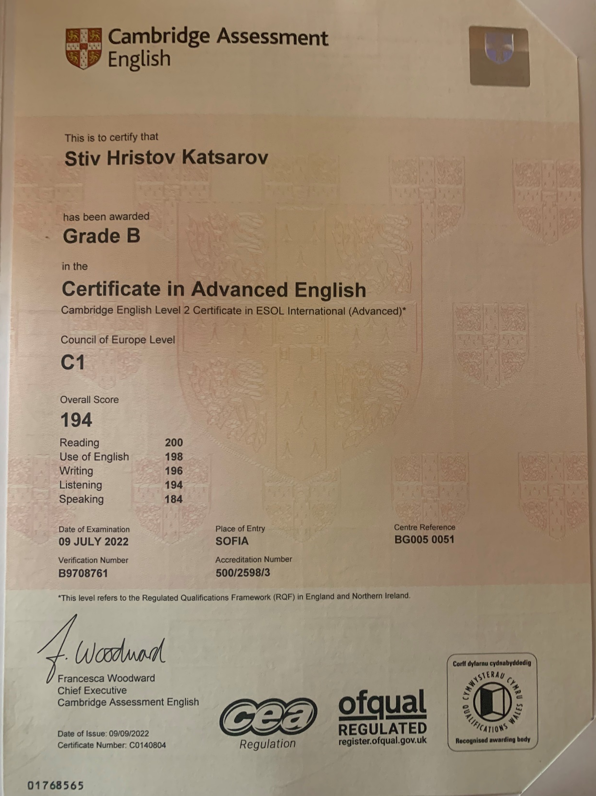

Slide 5
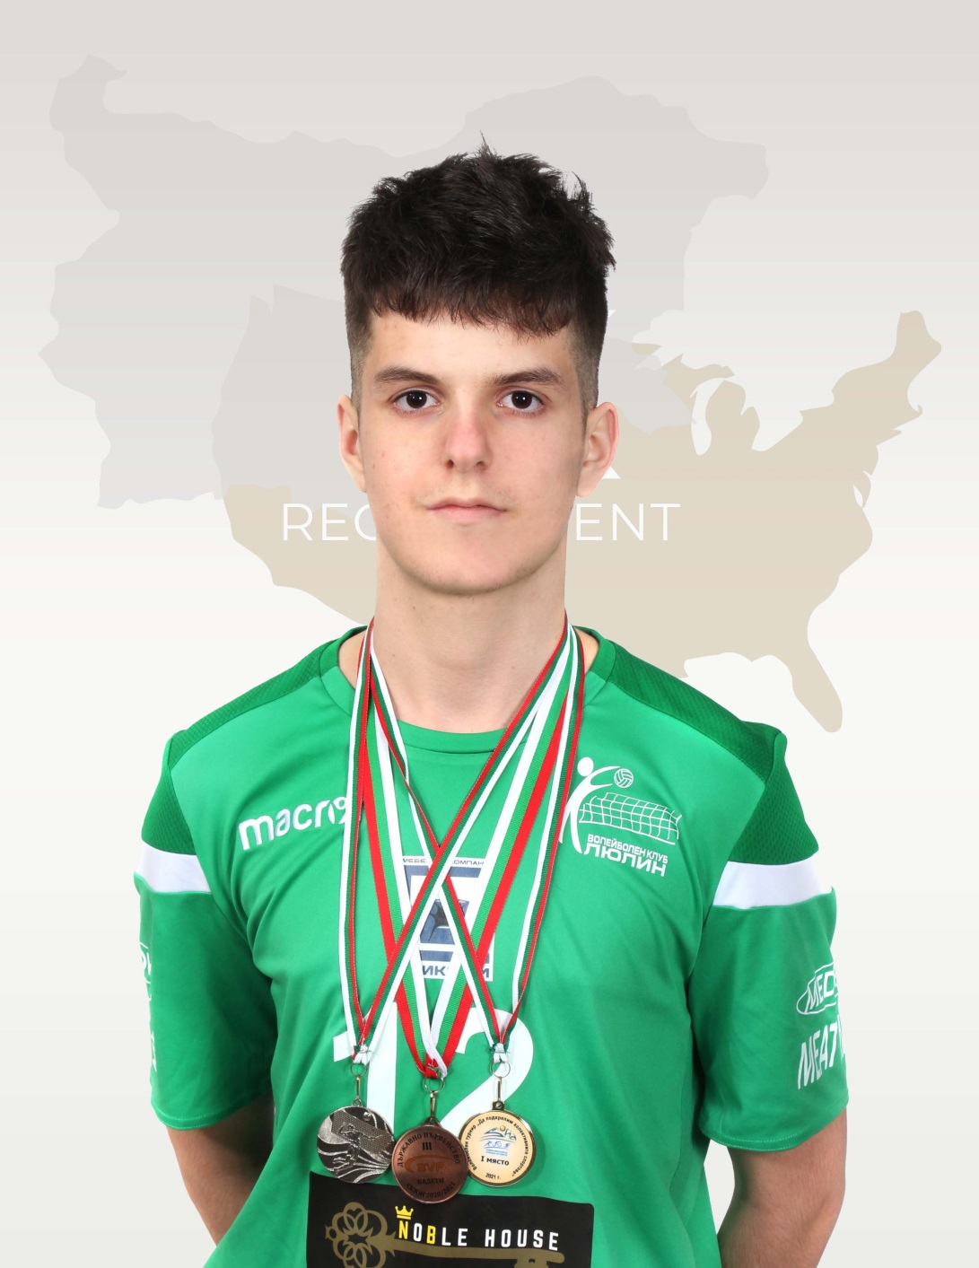
Volleyball Achievements
1.Bulgarian Youth National Volleyball Championship u18 2022- 4th place
2.Bulgarian Youth National Volleyball Championship u17 2021-3rd place
3.Bulgarian Youth National Volleyball Championship u20 2021-7th place
4.VGF Tournament-2nd place

Slide 6
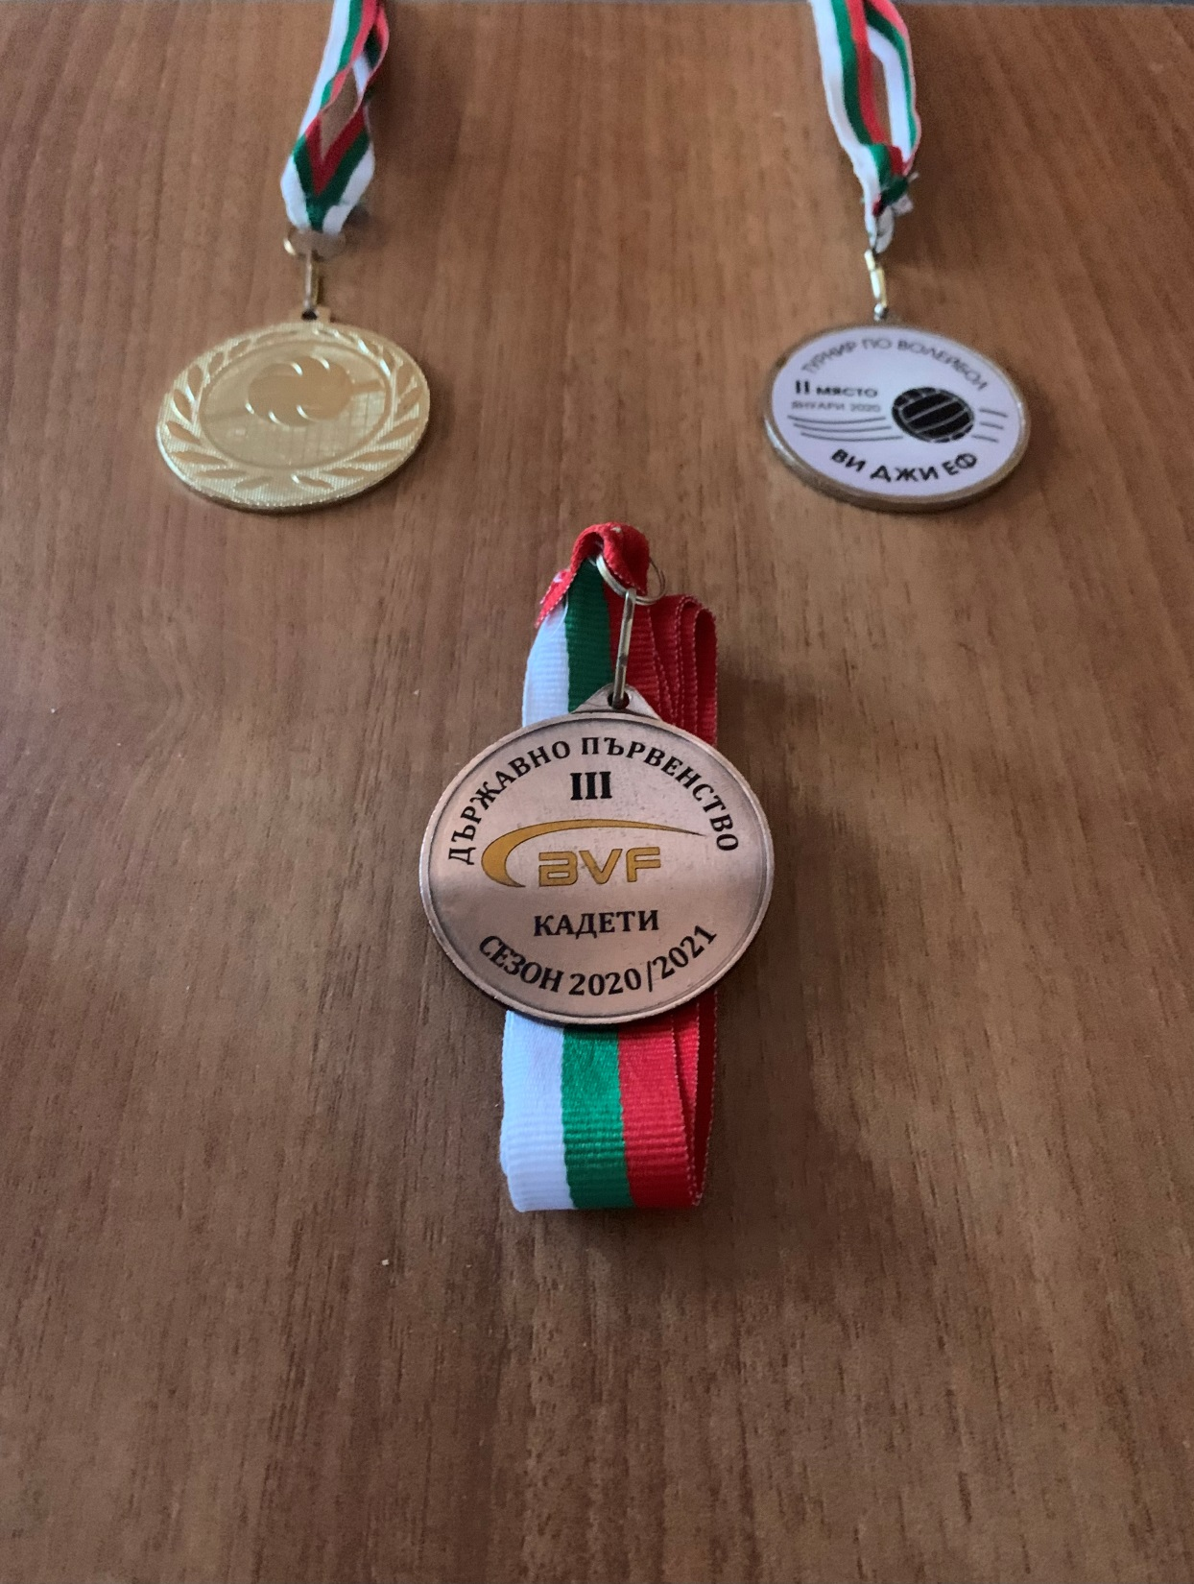

Slide 7
Interview questions
Describe yourself with a few sentences:
I would describe myself as a very competitive and adaptable person who always gives his best. I always try to improve in every aspect, learn from the people around me and most importantly grab every chance to grow as a person and athlete with both hands. I am sure that the people close to me would describe me as a winner.
What does volleyball mean to you?
Volleyball became a vital part in my life since the first time I stepped into the court. My coaches always say that volleyball is a social phenomenon as it meets you with new people almost every day and I could not agree more. I have many memories made in the hall which I’ll always cherish and remember, but the best things that came with my passion for volleyball are the friendships that it gave me which I believe will stick with me for the rest of my life and for this I am grateful to the game.

Slide 8
What does your education mean to you?
Education is the most important asset that a human being can have and i want to master it. I know that my volleyball career will not last forever and I want to transfer the passion that I have for the sport into something that will help me in the future and will make me a much more skilled person.
What are your main goals as a student-athlete in the USA?
My main goals as a student-athlete will be to learn a new style of volleyball, explore a new culture, make new friendships, win games and most importantly get my degree.

Slide 9
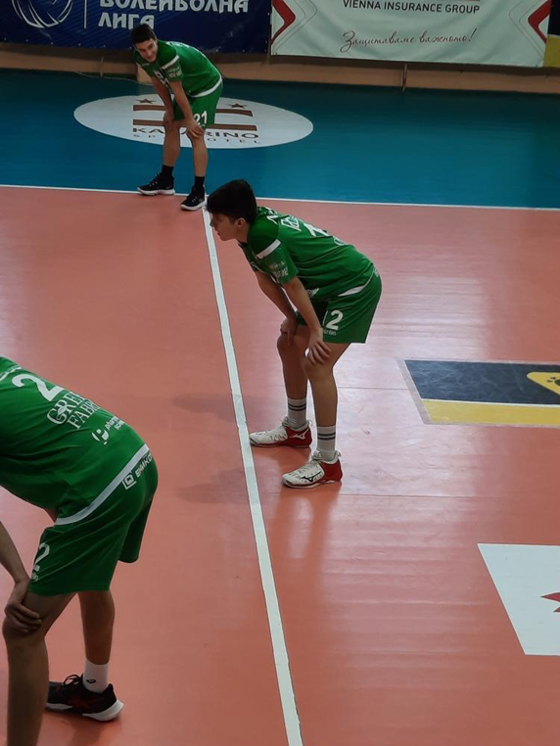
Video Analysis
Highlight Video:
https://youtu.be/gjFVvk7uvP8 NEW
https://youtu.be/F5qJOozM-E0
Full Matches:
https://fb.watch/nzEOMFumeQ/
https://fb.watch/edjt216qEL/ NEW
https://youtu.be/ca5IsnoUI0Y NEW
https://youtu.be/NFR2q3UNT78
https://fb.watch/aC3rHjRIXN/

Slide 10
The presentation provides all the basic information for the student-athlete. More details and video can be provided if needed. Contact us.

