Slide 1

The “Art of Gratitude”
Angie Cominos Koehler

Slide 2


Slide 3
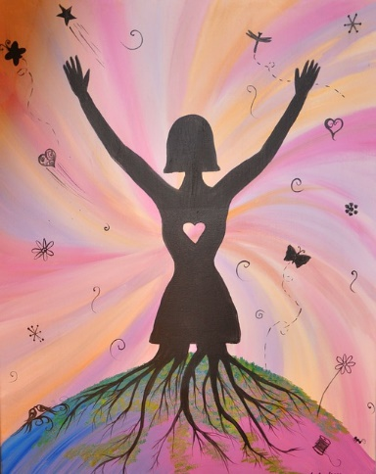


Slide 4

Workshop Purpose and VISION
Stress hormone cortisol is 3% lower in grateful people
To celebrate our varied and amazing journeys with a focus on mindfulness and tools to achieve
To support one another and share knowledge and gratitude
New ways to inspire and express gratitude
Knowledge and kindness PINKK pillars expression and GIFT from PINKK to all

Slide 5
THANK YOU!
Thanks to each of you for carving out time in your busy day, in this busy holiday season to pause and take care of you
Gratitude is part of Mindfulness practice- getting us into this moment so we can be here now
Mindfulness involves really listening, not multitasking, taming the monkey mind and being in this moment
Tool to Presence- our BREATH
PRACTICE TOGETHER…

Slide 6
Angie’s Story
32-year career in Reinsurance and Career Development
RYT 200 Yoga Instructor
Launched Career Coaching Business October 2019
www.Pathfindercoaching4u.com

Slide 7
1. My Gratitude Story
Told in “By the Seats of Their Skirts” – PINKK Storybook (first book in series) by Creator of PINKK and author Athena Golianis Walker – out in early December
Sometimes there is a person that comes into your life to awaken you, to make you realize there are other options, other ways to view and experience your life
For me, this came during a yoga class with a particular teacher by pausing and reflecting and opening one breath at at time, I became both softer and stronger at the same time and for the first time in a long time put me first and found my heart to follow
It is what provided the strength to me to make several moves in my personal life and become a yoga teacher and want to give back to others in helping them find the strength within themselves to uncover possibilities they never knew existed

Slide 8
Quote from Melodie Beattie, Author
“Gratitude unlocks the fullest of life. It turns what we have into enough and more. It turns denial into acceptance, chaos to order, confusion to clarity. It can turn a meal into a feast, a house into a home, a stranger into a friend”

Slide 9
Gratitude
Definition- the quality of being thankful; readiness to show appreciation for and to return kindness
Grateful is a FEELING while thankful is an ACTION(ie: When someone does something nice for you , you FEEL grateful and offer your thanks as an action)
Part of Mindful Practice- being in the moment
How these two simple words “Thank You “ can change everything
Turn scarcity to abundance

Slide 10
2. Practicing Gratitude Benefits YOU
Stress hormone cortisol is 23% lower in grateful people
Reduce affects of aging on brain
Improves physical and psychological health
Enhances empathy
Helps improve self esteem
Improves sleep
Produces higher levels of activity in the hypothalamus engaging the brain in a virtuous cycle. Your brain only has so much power to focus its attention
We are all connected so if we practice positive thoughts of abundance, we affect our neighbors, family and friends and in turn, the world

Slide 11
3. Gratitude Tools
Gratitude Journal
Meditation- Practice Together
Mantra/Intention
Say and/or write “Thank You “ more often
No Complaint day
Volunteer

Slide 12
Gratitude Journal
How many of you keep a gratitude journal?
Benefits:
Reduces stress
Improves self esteem- personal activity allowing you to be present with your achievements
Increases positivity- as you are focusing on the good
Helps you sleep better
Makes you happier

Slide 13

Quote from Kathy McCabe on the value of setting an Intention
  “Thoughts create your feelings which create your behaviors, which create your outcomes”
  A simple change in thoughts can lead to a change in your life
  21 days to develop a habits
  If you are looking to change anything in your life, start by change your thoughts

Slide 14
Gratitude Meditation
Let's try this together…
Was this hard or easy for you?
Does anyone want to share what they are thankful for?

Slide 15
Gratitude Mantra
BE, RECEIVE, GIVE THANKS
  BE in the moment
  RECEIVE- Be open to what the universe is giving you
  GIVE THANKS- Be grateful, practice gratitude

Slide 16

Volunteer
  Share your time and talents with others
  The more you GIVE the more you receive
  Upcoming holiday THANKS GIVING-Reminder to be thankful and give

Slide 17
Say “Thank You” more often
How do you FEEL when you receive a handwritten thank you note?
  SPEAK this to those we live and work with
  WRITE it in cards and notes
  We have an opportunity with upcoming holiday to express our gratitude – to speak and write , to communicate from the HEART, to those we care about

Slide 18

No Complaint Day
Become aware of your habits, observe them and choose another reaction

Slide 19
Gratitude Quote
“Gratitude is the inward feeling of kindness received. Thankfulness is the natural impulse to express that feeling. Thanksgiving is the following of that Impulse”
-Henry Van Dyke

Slide 20
Thanksgiving Gratitude Challenge
Pick one practice to incorporate into YOUR gratitude practice
1
Give it 21 Days
2
Let me know how you feel- email each of you a link to my website following today’s session so we can stay in touch
3
Create an Attitude of Gratitude- make it a habit to express thankfulness on a regular basis for big and small things in your life
4

Slide 21
THANK YOU!!
Happy Thanksgiving to you and your family!
angiecominos@pathfindercoaching4u.com
www.pinkknow.com

