Slide 1
Pavel Mihaylov Opposite Hitter

Slide 2
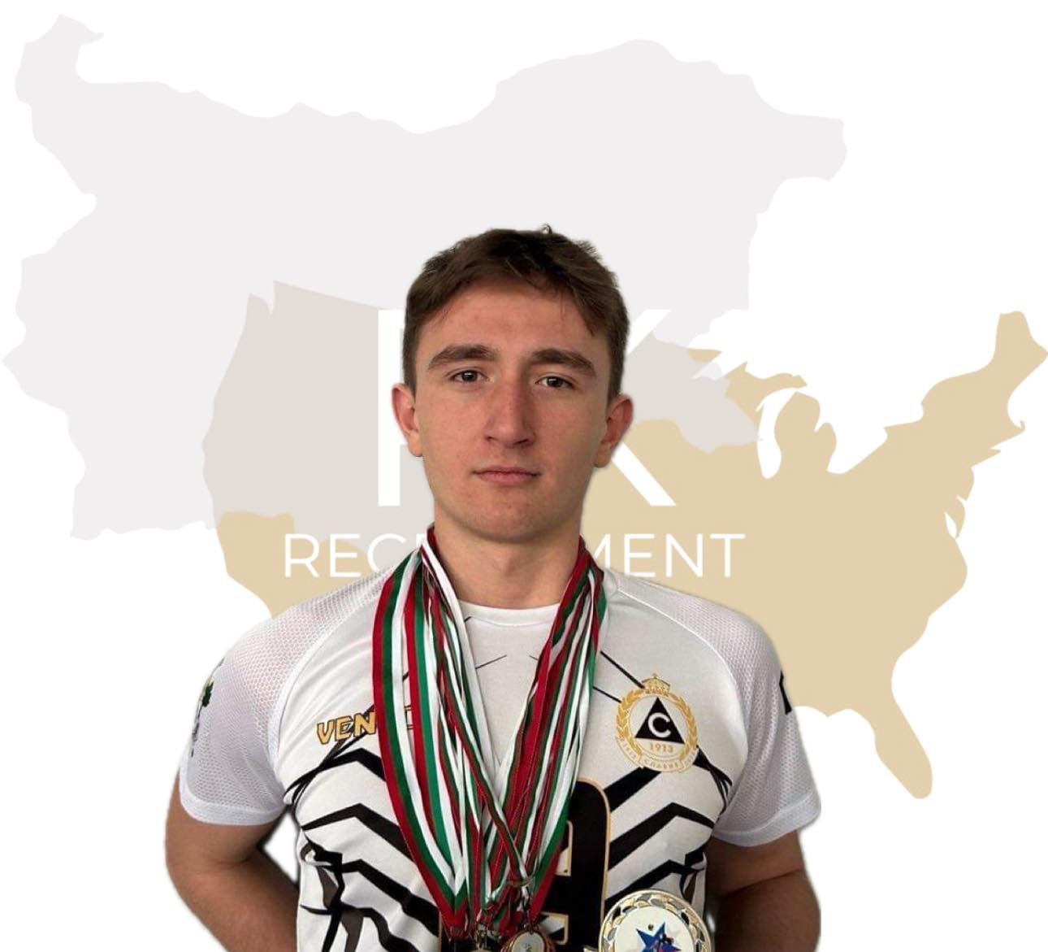
Status: Available
Gender: Male
Position: Opposite Hitter
Date of Birth: 22.06.2006
Graduation date: June, 2025
Club team: Volleyball Club
Slavia Sofia

Slide 4
Additional Information
Height: 192 cm.
Weight: 80 kg.
Reach: 244 cm
Standing high jump: 307 cm
Approach high jump: 330 cm
High School: 2 SU ,, Akademic Emiliyan Stanev”
Languages: Bulgarian, English, Spanish
Desired degree: TBA
TOEFL grade: TBA

Slide 6
Athletic achievements:
Individual award from ,,Barutov Camp”: The most talented camper,
4 years captain of the team,
2nd and 3rd place - ,,Vuzrajdane tournament” ,
2nd place - ,,Play with Levski” ,
Twice 4th place in republican championship,
4th place in ,,Bulgaria cup” 2022

Slide 8
Describe yourself with a few sentences:
I am a hardworking, out-going and purposeful individual with a sprinkle of uniqueness. I
work on setting goals and striving to achieve them no matter what is the cost.
What does volleyball mean to you?
Since the first day I set foot in the sports hall, I have had the perception of volleyball not
only as an engaging and health-promoting activity, but also as a competitive space that
helps me balance the rigorous school life.
What does your education mean to you?
In my book, education is on top of my priority list as after getting a degree in computer
science from a renowned university in the US, I plan to start a computer science related
career.

Slide 9
What are your main goals as a student-athlete in the USA?
My main goal is to taste the American dream in all its aspects, whether it is receiving education from distinguished professors, playing volleyball amongst prospective superstar athletes, exploring the enormous cities or getting acquainted with foreign cultures. This will undoubtedly broaden my horizons and become an experience to remember.

Slide 10
Video Analysis
Highlight video:
https://youtu.be/9ElWmIczY5I

Slide 11
The presentation provides all the basic information for the student-athlete. More details and video can be provided if needed. Contact us.

