Slide 1
Konstantin Dinov middle blocker

Slide 2
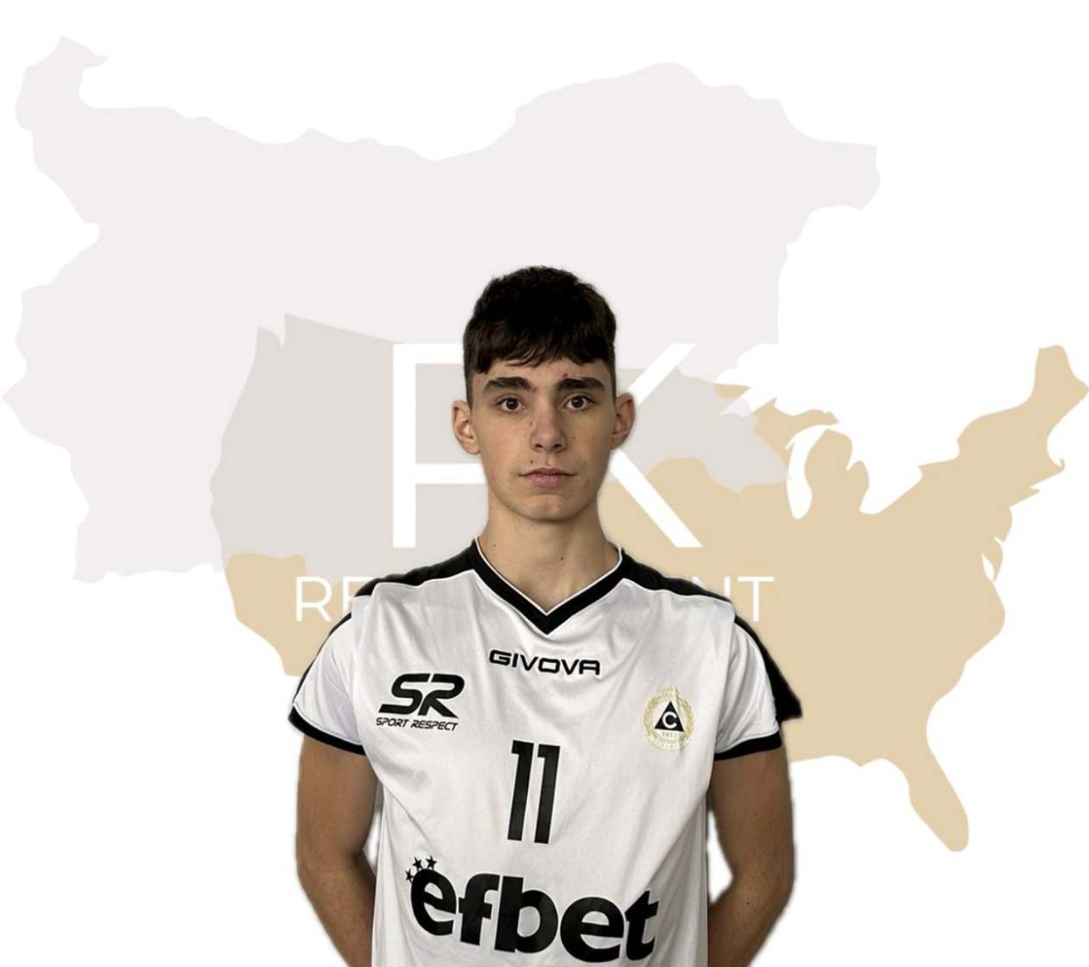
Status: Available
Gender: Male
Position: Middle Blocker
Date of Birth: 02.06.2006
Graduation date: June, 2025
Club team: Volleyball Club Slavia, Sofia

Slide 3
Additional information
Height: 204 cm.
Weight: 86 kg.
Reach: 255 cm.
Approach high jump: 339 cm.
Standing block jump: 325 cm.
High school: „57 SU Saint Naum Ohridski“ Sofia
Languages: Bulgarian, English
Desired degree: TBA
SAT grade/date: TBA TOEFL grade/date: TBA

Slide 4
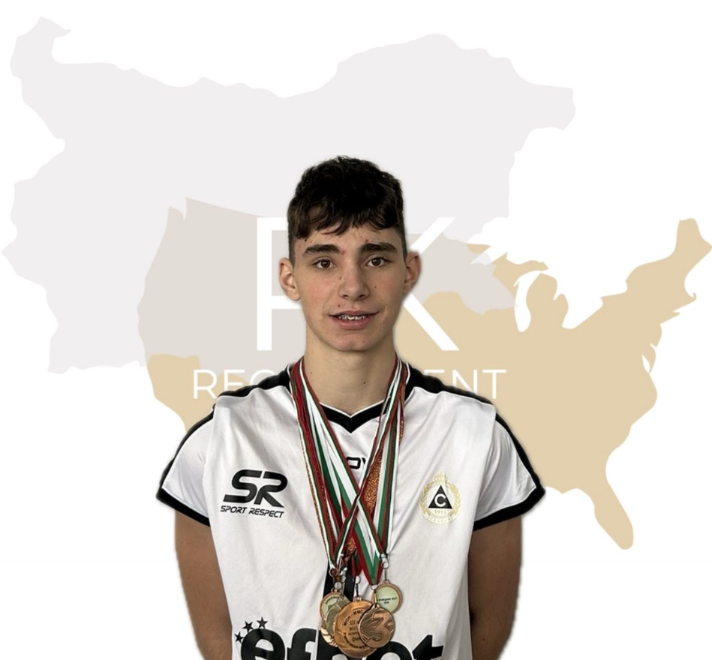
Volleyball Achievements
Bulgarian National Championship- 2022/23- 4rd place U18; 2022/23- 6th place U20; 2022/23-6th place U18; 2021/22-4rd place U18;
4th place in ,,Bulgaria cup” 2023
2nd and 3rd place - ,,Vuzrajdane tournament”
2nd place - ,,Play with Levski”
National Championship in Dryanovo 3rd place

Slide 5
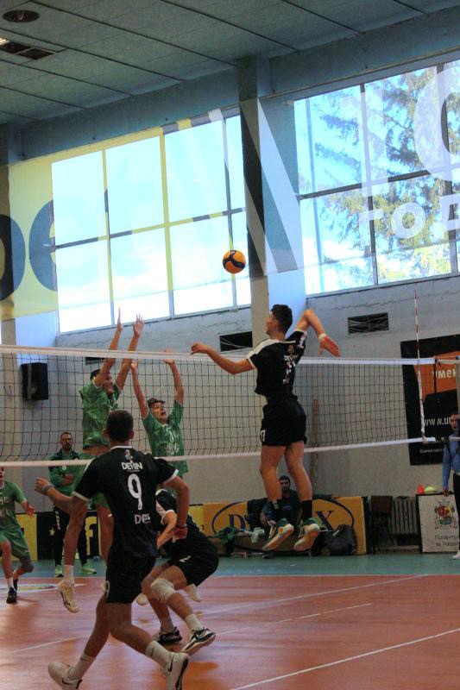

Slide 6
Video Analysis
Highlight Video:
https://youtu.be/nA4y1sRkP1g
Full Matches:
https://youtu.be/VFhM5LManKc?si=oOP-T118TLojEq7s

Slide 7
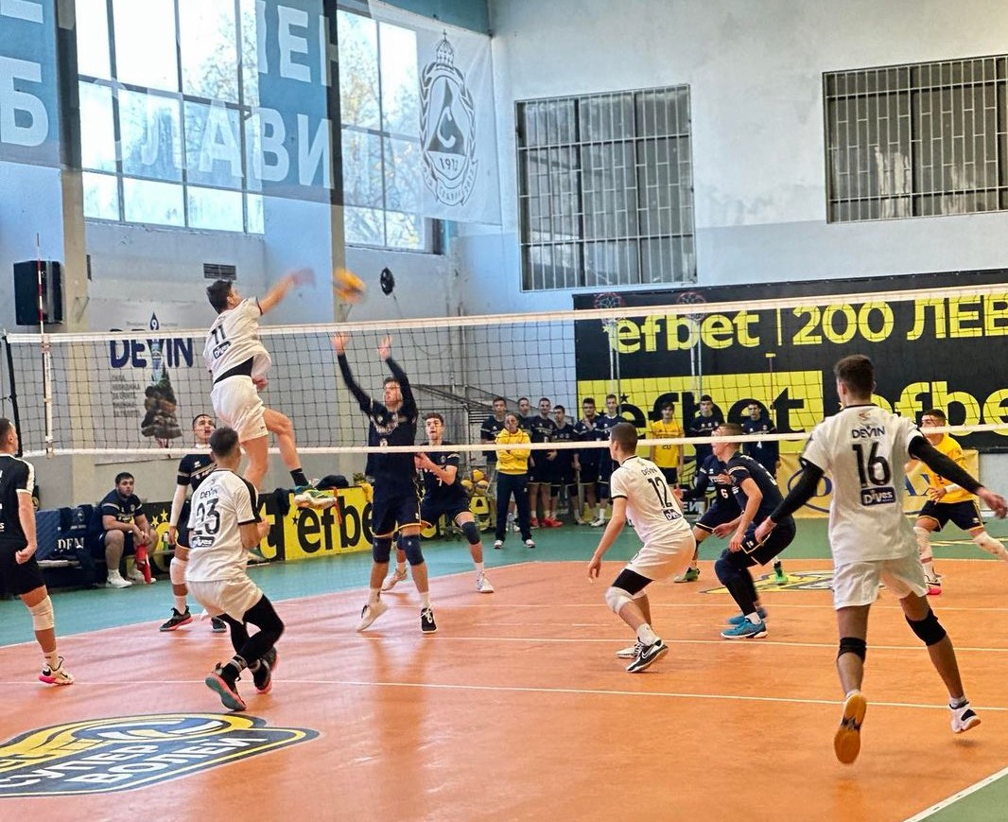

Slide 8
Interview questions
Describe yourself with a few sentences:
I am ambitious, reliable, serious, diligent in training. I fit in quickly in an unfamiliar environment. I am creative and avoid conflicts. I would always help a friend in need and I am responsible. I am ready to give a 100% of myself to make my dreams come true.
What does volleyball mean to you?
I remember my first volleyball practice. It was 6 years ago, as soon as I stepped into the hall, I fell in love with the sport. I liked the joy of the collective game, I liked being part of the collective itself. And I realized for myself that volleyball is what I want to do and earn money from it. And after that moment, I started spending more ad more time in to my training. I was the competitor who came first to training and left last. And at one point, all the work I put in paid off. In one year I progressed so much - from the reserve I started playing for U18 and U20 at the same time. But my progress didn’t stop there, I continued the hard work in training and currently I consider to be one of the best middle blockers in my country. Now Volleyball is not just a sport for me it’s a Lifestyle

Slide 9
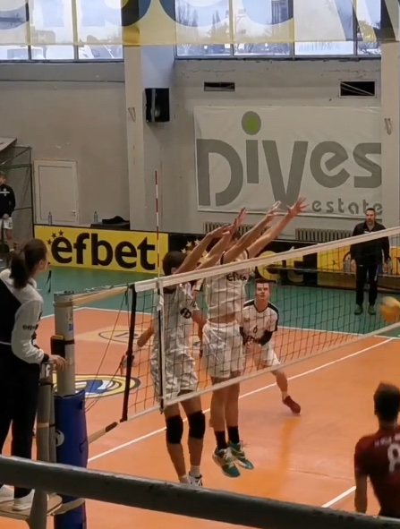

Slide 10
What does your education mean to you?
For me, education is the most valuable wealth. I believe that a good education is one of the most important factors in the formation of a person as a personality. Education creates the habits and culture of people. It will nurture and develop the abilities and skills in my life, as well as open doors to the future and windows to the world.
What are your main goals as a student-athlete in the USA?
As a student-athlete in USA my main goals are to combine sports and education. I want to develop my skills on the highest level and become the best version of myself.

Slide 11
The presentation provides all the basic information for the student-athlete. More details and video can be provided if needed. Contact us.

