Slide 1
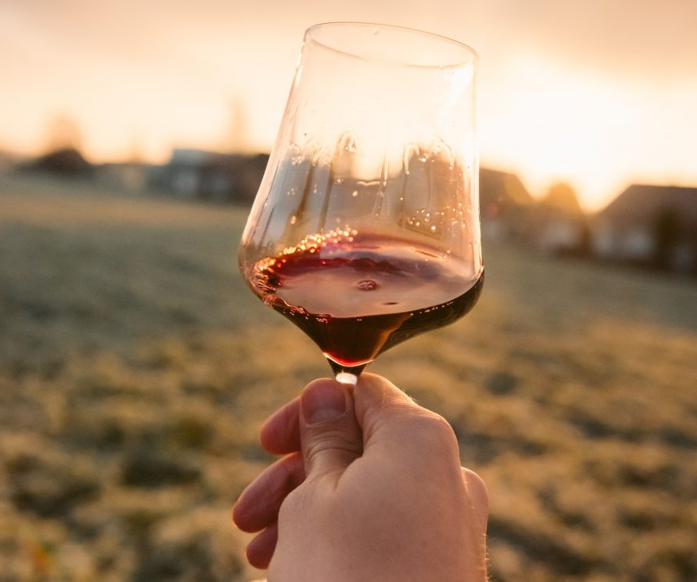
Clarity: Absence of suspended particles.
Veiled
Fairly clear
Clear
Crystal clear
Bright

Slide 2
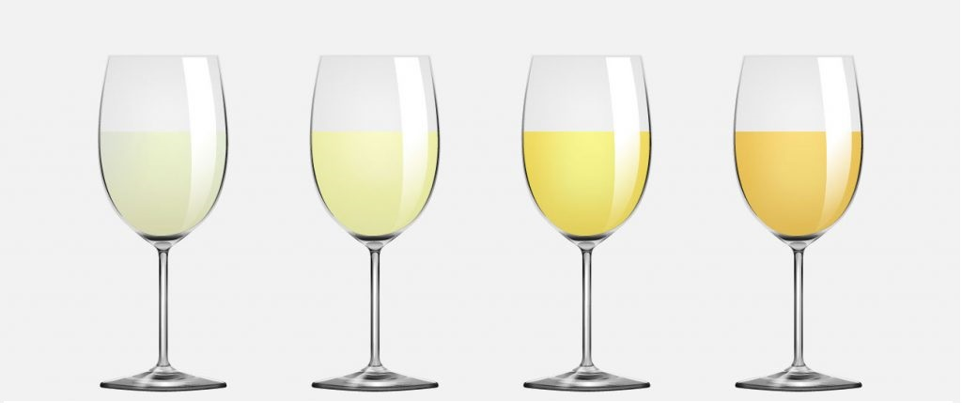
COLOUR:
Yellowish-green
Straw yellow
Golden yellow
Amber yellow

Slide 3
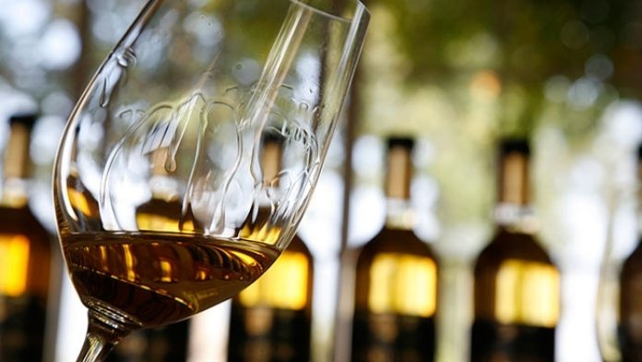
CONSISTENCY: Observation of "arches" and "tears"
Fluid
Not very consistent
Fairly consistent
Consistent
Viscous

Slide 4
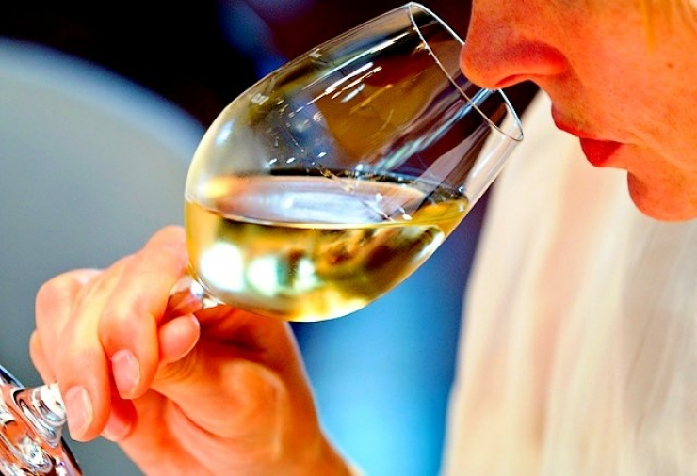
INTENSITY: Impact and sharpness of the aromas
Lacking
Not very intense
Fairly intense
Intense
Very intense

Slide 5
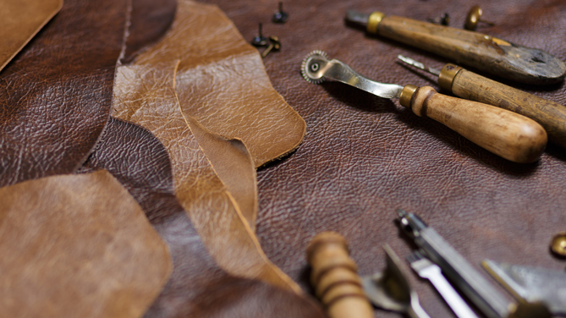
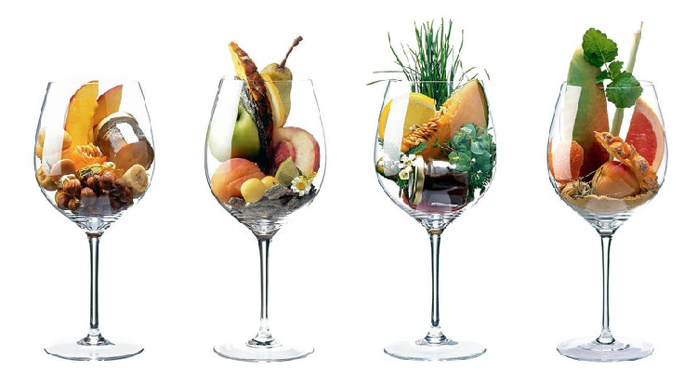
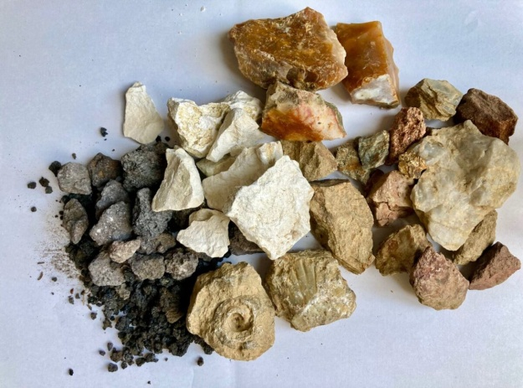
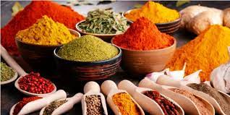
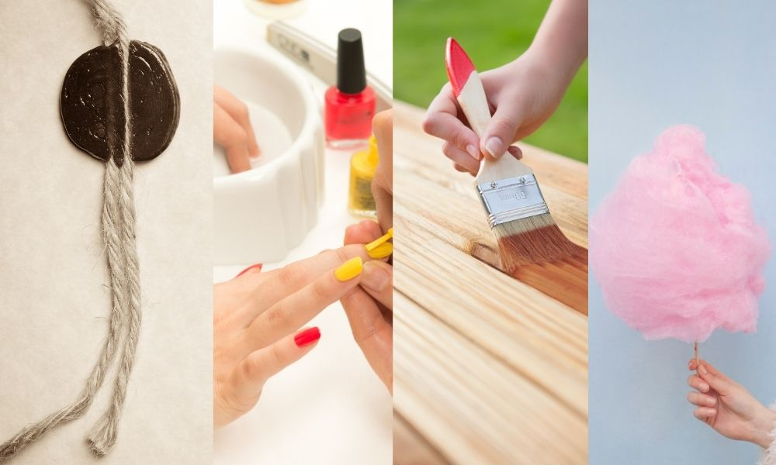
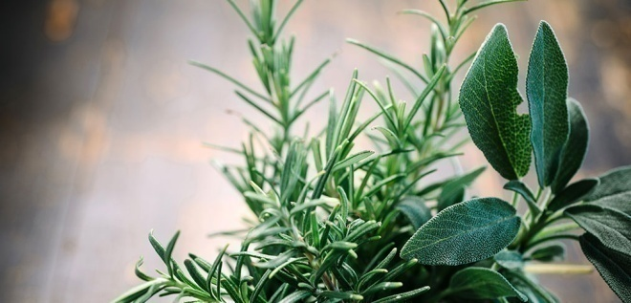
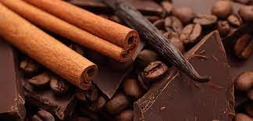
COMPLEXITY: How many families do you recognize?
Leather
Floreal
Fruity
Mineral
spicy
Aromatic herbs
Ethereal
Toasted

Slide 6
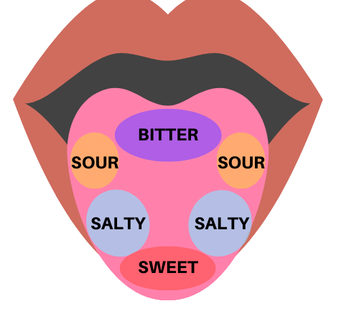
TASTE-OLFACTORY EXAMINATION: Through the taste buds and receptors in the oral cavity, you can perceive...
TASTE SENSATIONS
Sweetness
Acidity
Mineral substances (savoriness))
TACTILE SENSATIONS
Astringency (tannins)
Smoothness
Pseudo-warmth sensations
Acidity
Acidity
RETRO-NASAL SENSATIONS
Intensity
IAP

Slide 7
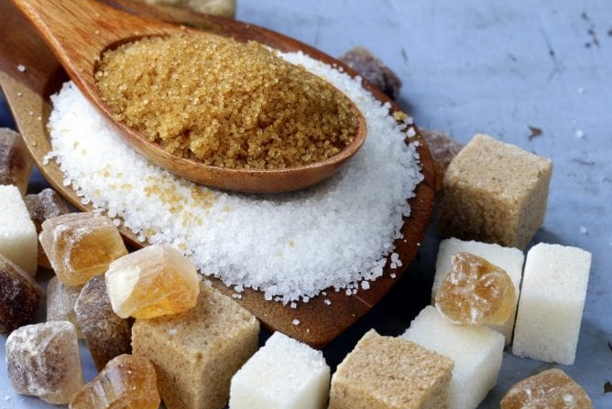
SUGARS: Fermented alcohol (%) and Potential alcohol
C₆H₁₂O₆
_{SUGAR}
2 CH₃CH₂OH + 2 CO₂
_{Ethyl alcohol}
+ ENERGY
Carbon dioxide
Dry (1-15 g/L)
Medium dry (15-30 g/L)
Medium sweet (30-50 g/L)
Sweet (50-180 g/L)
Cloyingly sweet (>180 g/L)

Slide 8
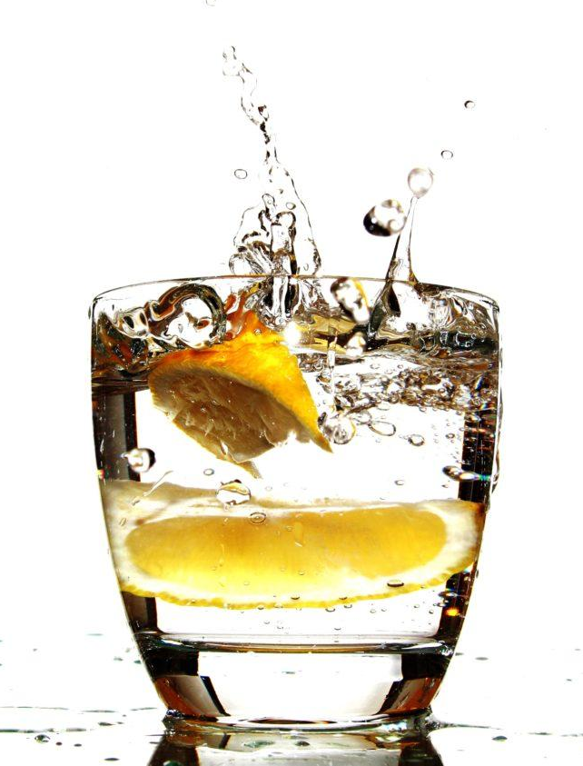
ACIDS (pH): Responsible of the freshness and salivation
Flat
Not very fresh
Fairly fresh
Fresh
Tangy

Slide 9
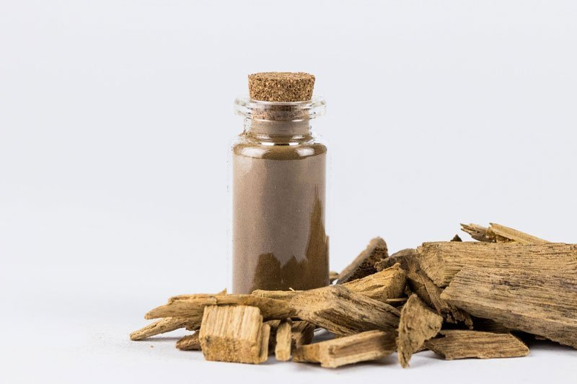
TANNINS: Responsible of roughness and taste astringency.
Soft
Not very tannic
Fairly tannic
Tannic
Astringent
CATECHINS AND LEUCOANTHOCYANINS (grape skins)
TANNINS
GALLIC (oak barrels and barriques)

Slide 10
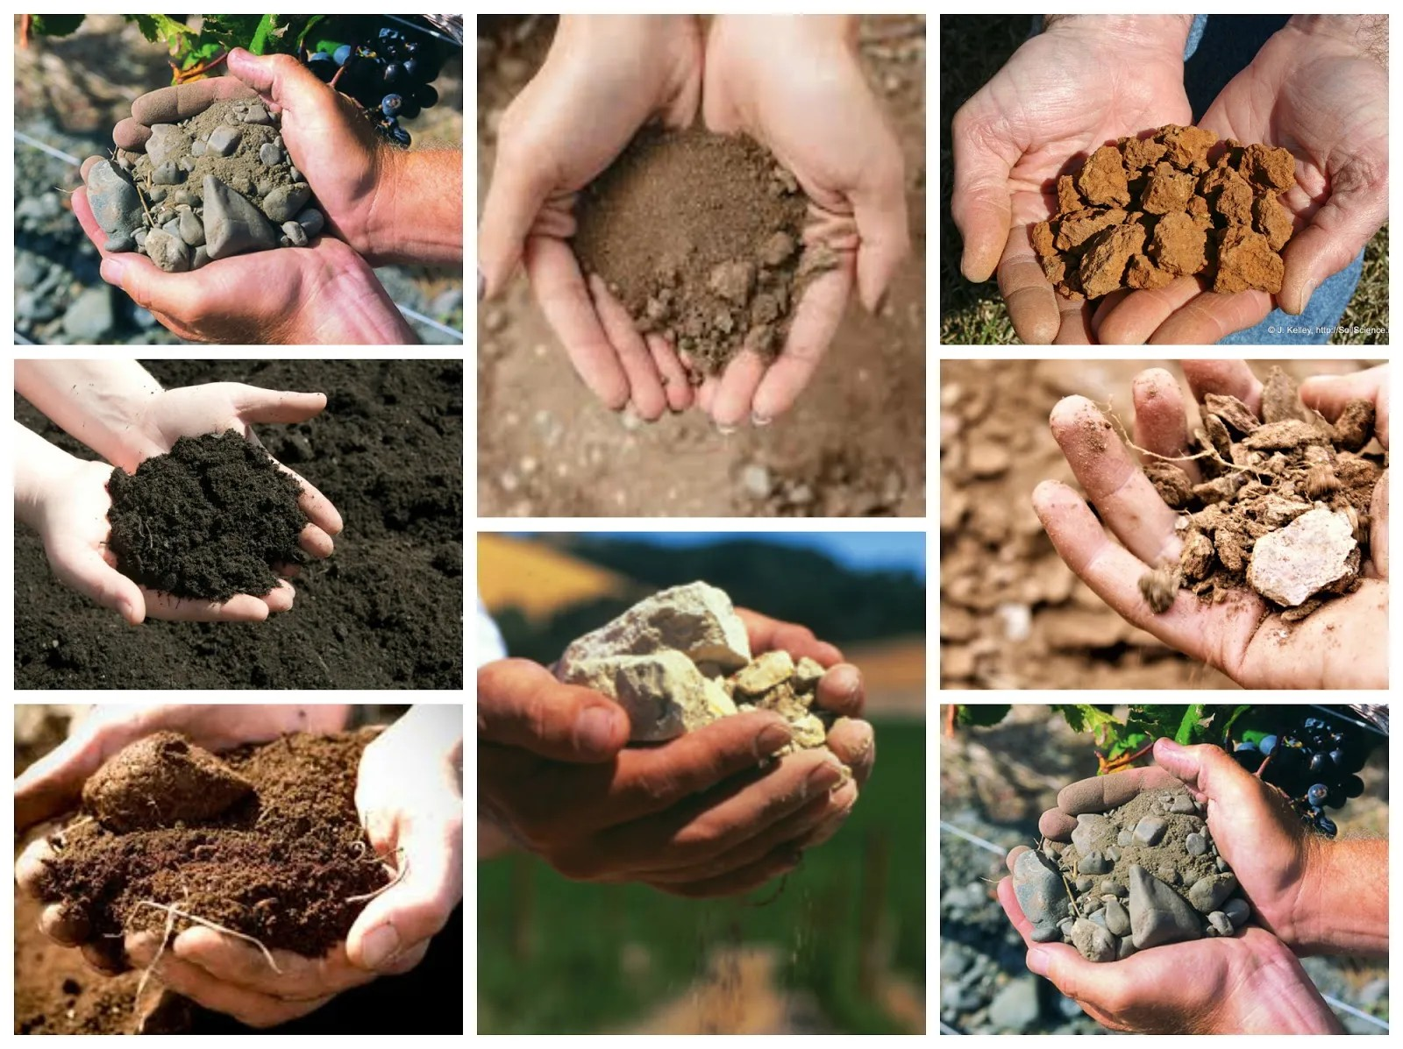
MINERAL SUBSTANCES: Savoriness (salty taste)
Insipid
Not very savory
Fairly savory
Savory
Salty

Slide 11
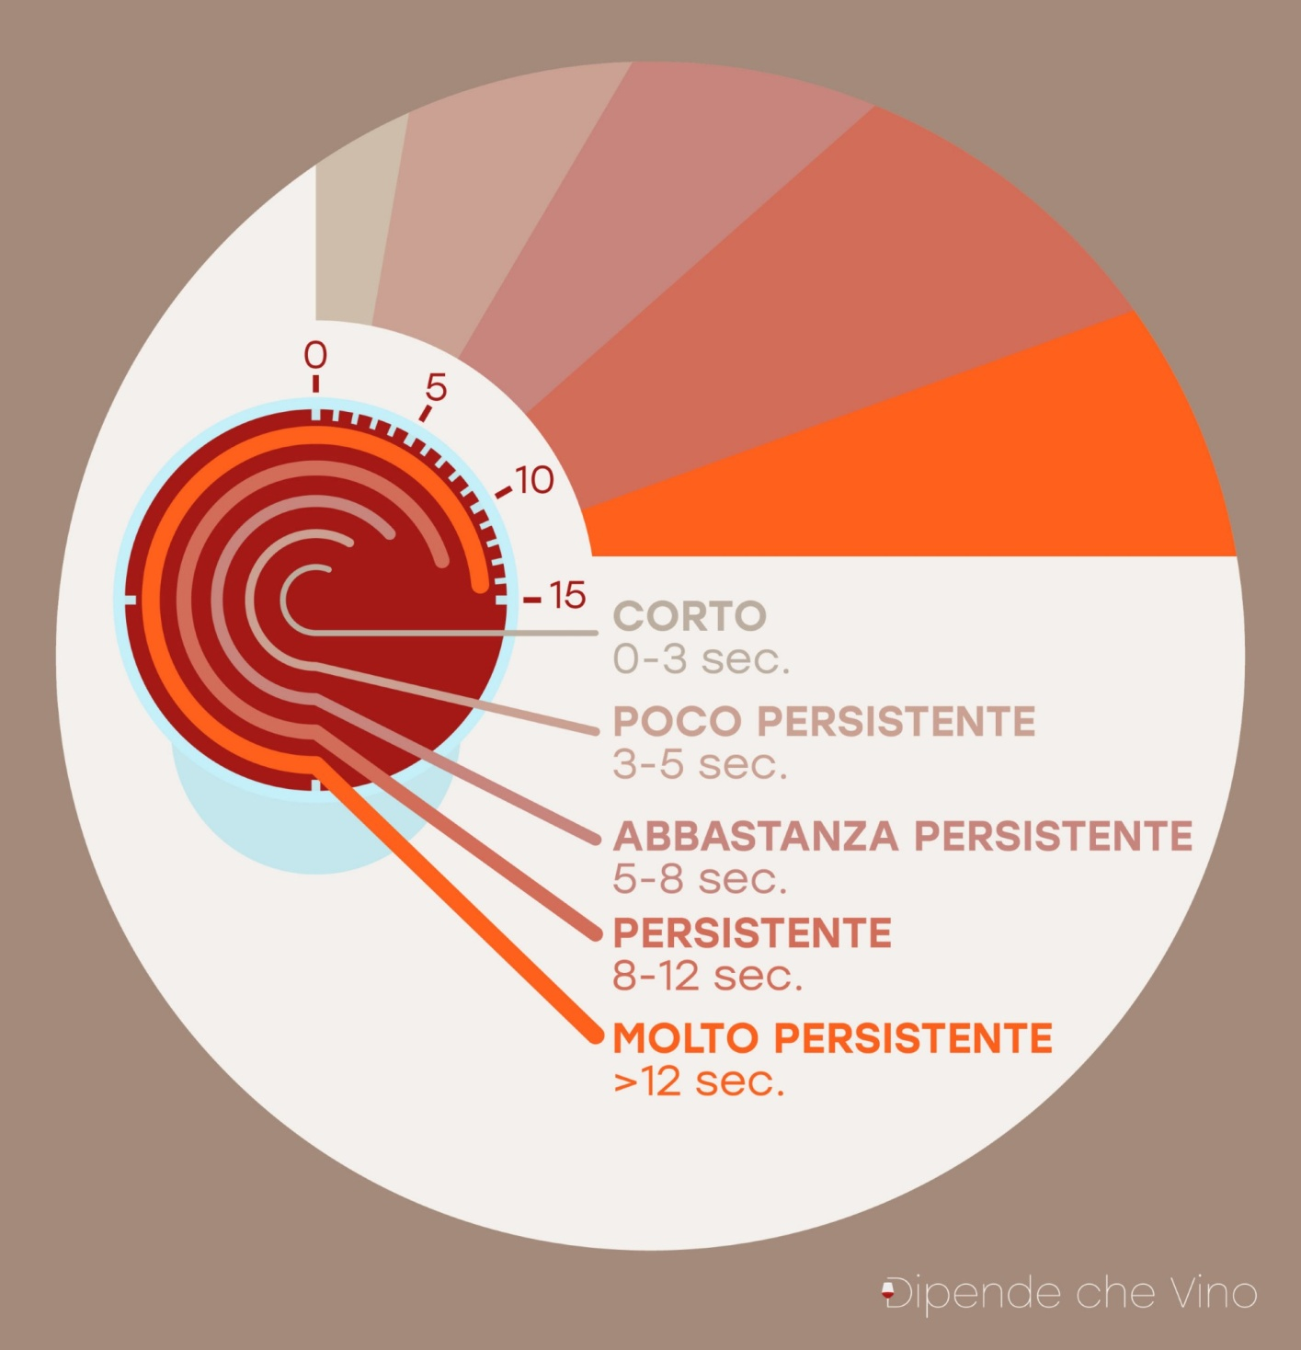
IAP:
Intense Aromatic Persistence
Short
Not very persistent
Fairly persistent
Persistent
Very persistent

Slide 12
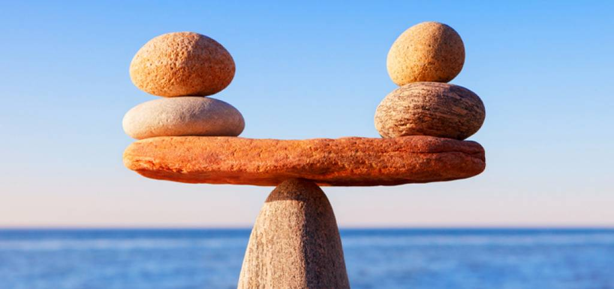
BALANCE:
Consistency in the three phases of sensory evaluation.
Not very balanced
Fairly balanced
Balanced

Slide 13
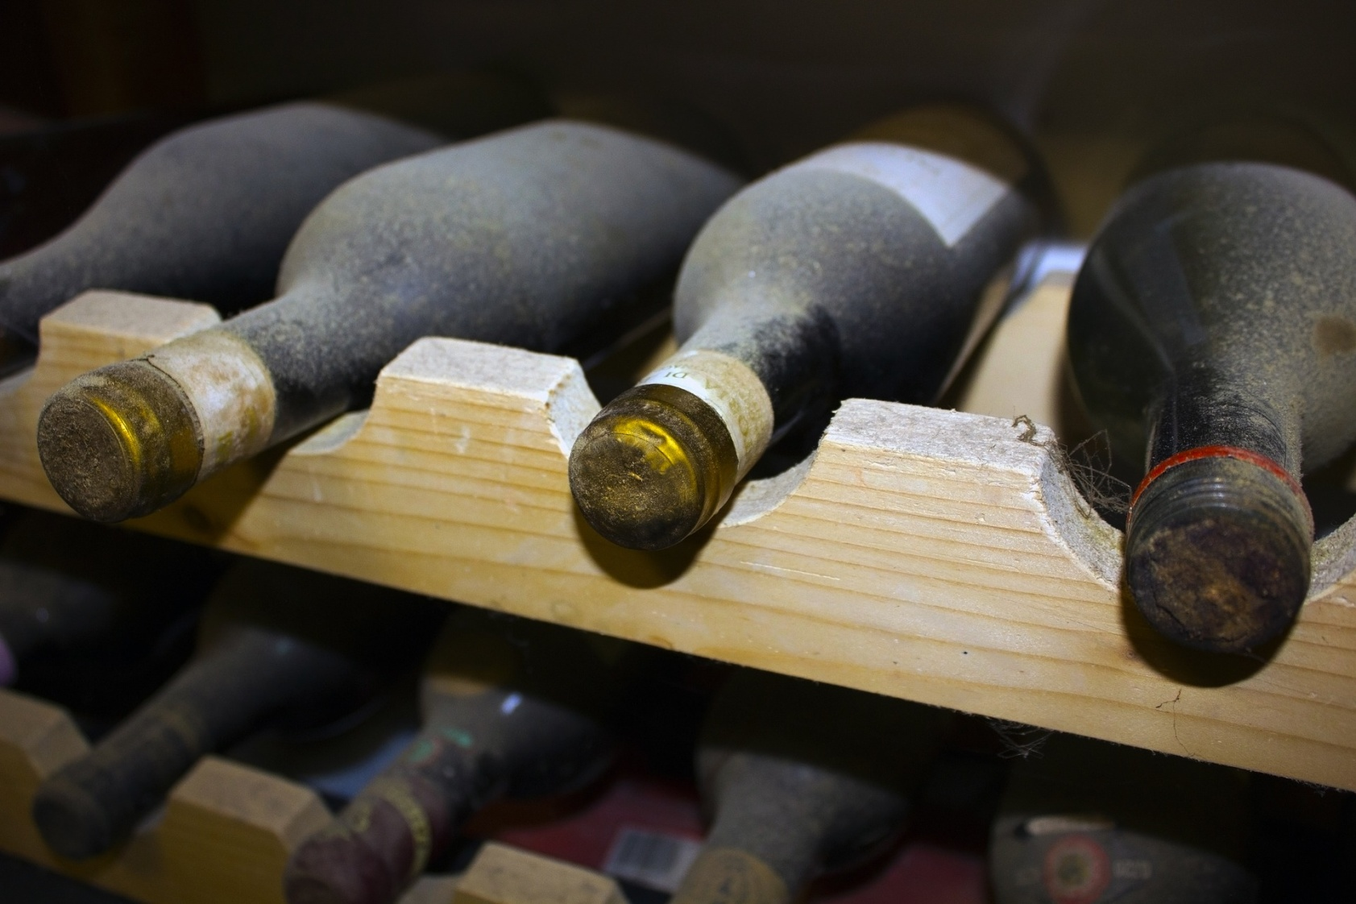
EVOLUTIONARY STATE: The wine’s quality in relation to its evolution.
Immature
Young
Ready
Mature
Old

