Slide 1
Daniel Yeniy
Setter

Slide 2
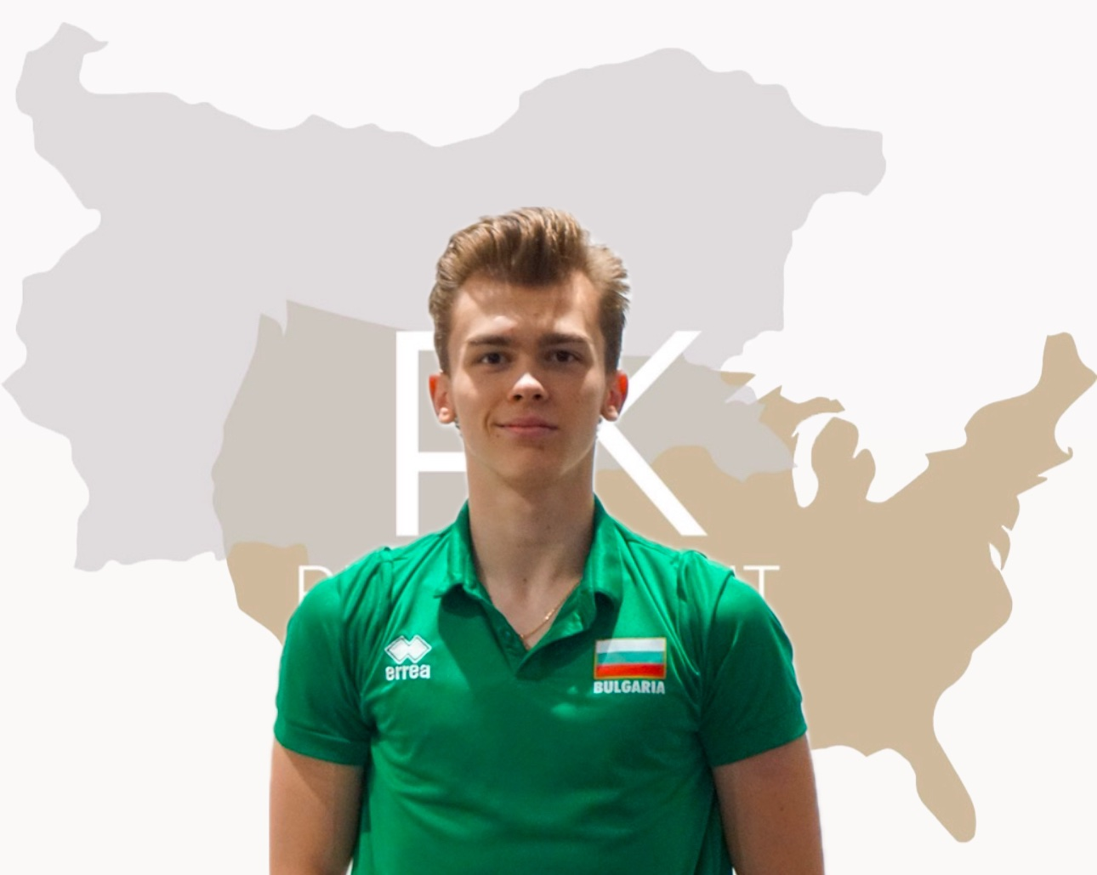
Status: Available Gender: Male Position: Setter Date of Birth: 17. 08. 2007 Graduation Date: June 2026 Club Team: Volleyball Club Lulin, Sofia

Slide 3
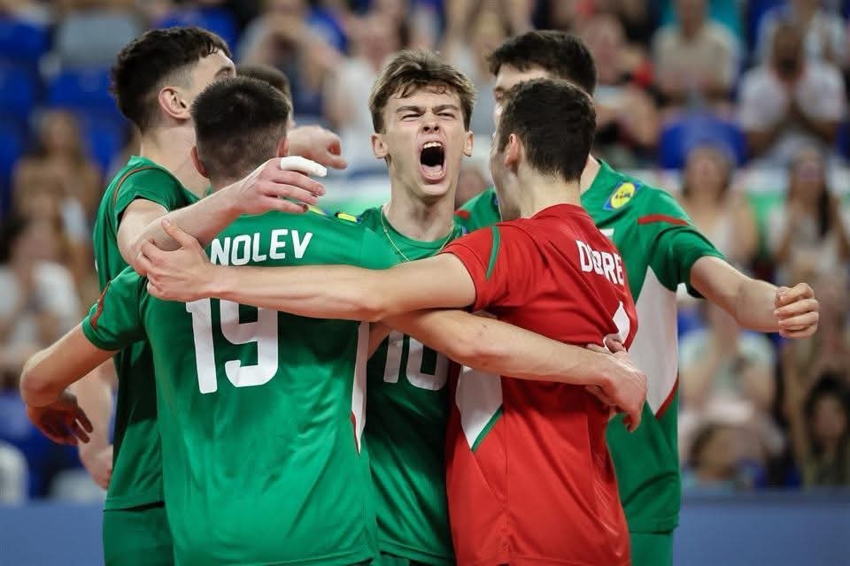
Height: 186 cm. Weight: 70 kg. Reach: 245 cm. Approach High Jump: 330 cm. Standing Block Jump: 310 cm. Languages: Bulgarian, English, Russian Desired Degree: Business Administration
ADDITIONAL INFORMATION

Slide 4
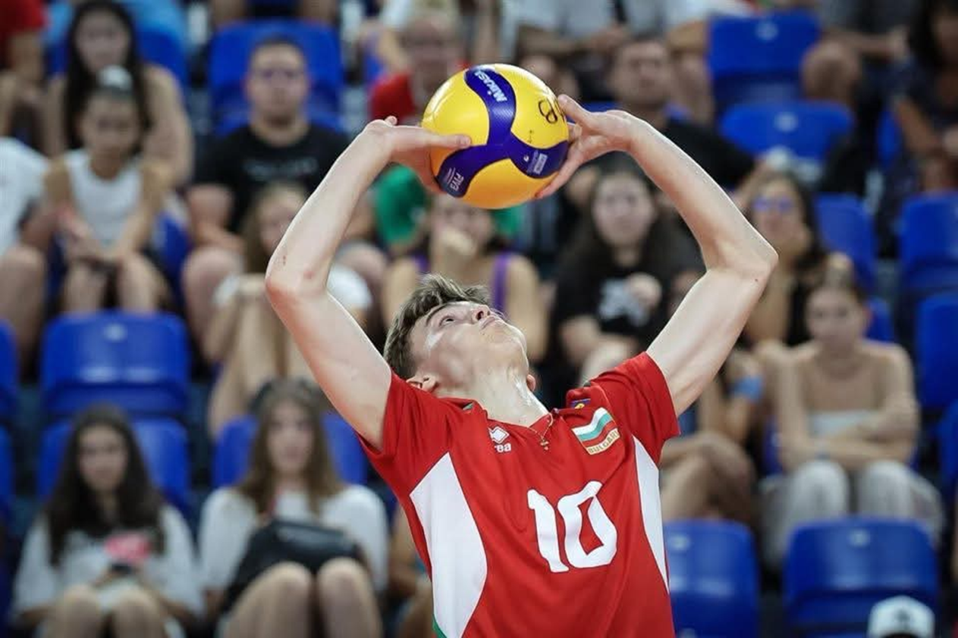

Slide 5
Athletic Achievements:
Second place Bulgarian Finals U18 (2023/2024)
Second place Bulgarian Finals U18 (2022/2023)
First Place Bulgarian ANVG Men
Fourth place Bulgarian Finals U20 (2023/2024)
Third place “Byala Open” Beach Volleyball U20 2023
Participated in the 2024 European Volleyball Championship U18

Slide 7
Interview Questions:
Describe yourself with a few sentences:
My name is Daniel Yeniy, and I was born in Tampa, Florida. I consider myself a clever, disciplined, and outgoing individual who enjoys taking on leadership roles. I work seamlessly in a team environment and rarely have conflicts with others. Determined and versatile, I can handle multiple responsibilities at once with ease. I thrive on achieving outstanding results - they fuel my hunger for even greater accomplishments.
What does volleyball mean to you?
Volleyball, to me, is more than a sport - it’s a way of life. From the moment I step onto the court, I feel an electric thrill, an undeniable sense of purpose that drives me forward. The hours spent practicing, the bruises, the sacrifices are all worth it because volleyball gives back more than it takes. It has taught me resilience, teamwork, and discipline, and it’s where I find a version of myself that feels complete. Volleyball isn’t just something I do, it’s what I need, what grounds me, and what brings out my absolute best.

Slide 8
Interview Questions:
What does your education mean to you?
Education, to me, is the partner to my passion for volleyball, each fueling the other in a journey toward growth and achievement. From the beginning, my drive to succeed on the court naturally extended into the classroom, pushing me to strive for excellence in every area of life. The discipline, focus, and resilience I’ve developed through volleyball have shaped my approach to learning, making school not just an obligation but an opportunity to expand my potential. Education has become my way of building a future as strong and resilient as my athletic spirit, empowering me to achieve not just victories on the court, but success in every arena of life.
What are your main goals as a student-athlete in the USA?
My main goals as a student-athlete in the USA are to excel both academically and athletically. I aim to continuously improve my skills, gain valuable knowledge, and embrace new opportunities, all contributing to building the life I have always envisioned and worked toward.

Slide 9
Video Analysis
Highlight Videos:
https://www.youtube.com/watch?v=RpIlJjY_ZbE

