Slide 1
GSS 6.0 Spine System

Slide 2
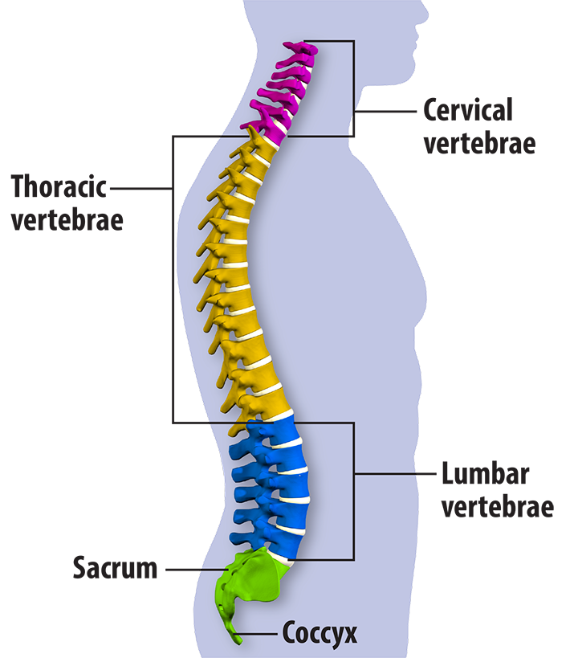
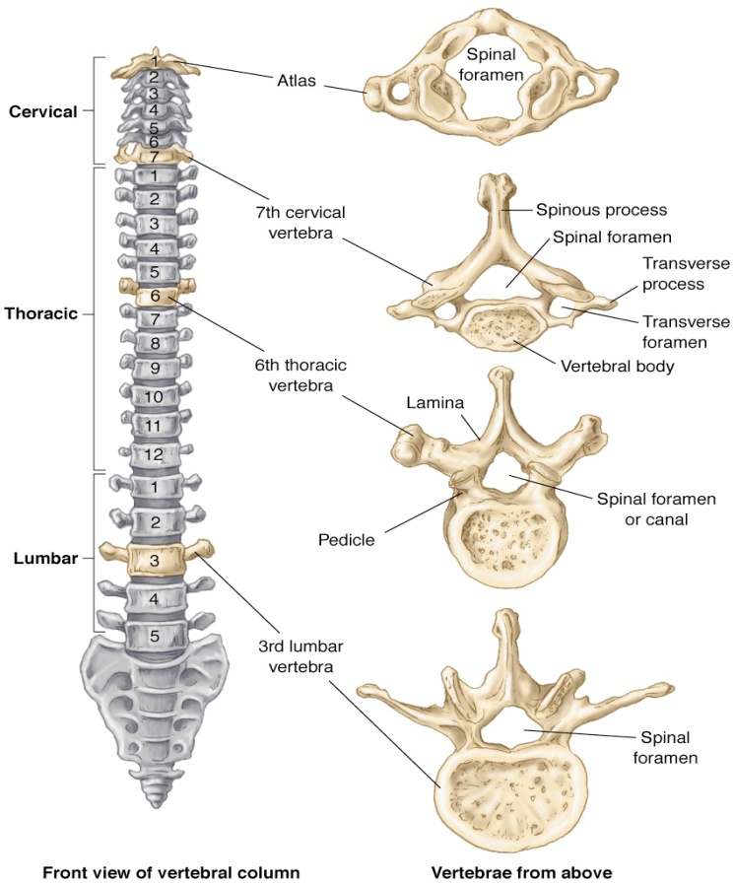
Anatomy of the spine
Cervical vertebrae (7)
Thoracic vertebrae (12)
Lumbar vertebrae (5)
Sacrum (5)
Coccyx (4)
Total 33 vertebrae
Notes:
Thoracic [θɔː'ræsɪk] Sacrum ['seɪkrəm} coccyx ['kɒksɪks] vertebrae [ˈvəːtɪbrə
Anatomy [ə'nætəmɪ] spinous ['spaɪnəs]

Slide 3
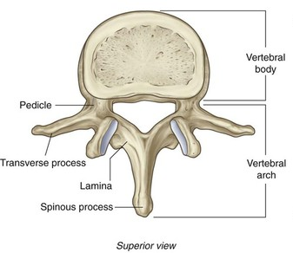
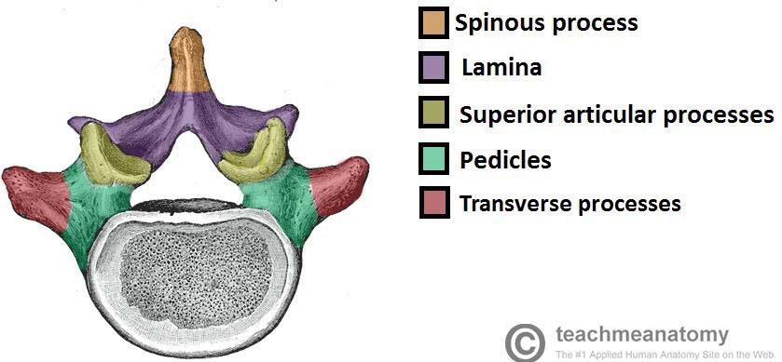
General anatomy of vertebrae
Vertebral Body: the primary area of weight bearing
Vertebral arch: made up of Pedicle and Lamina
Vertebral Foramen: containing the spinal cord
Spinous process: extends posteriorly
Transverse process: project sideways
Vertebral Foramen
Notes:
Body is the Large, round portion of bone, is the primary area of weight bearing. The pedicle is the two thick processes which project posteriorly from the body, uniting with the laminae. Laminae is the flat pieces of bone forming the posterior portion of the vertebral arch. The vertevral arch is formed by pedicle and lamina. The Vertebral Foramen is the space between the vertebral arch and body containing the spinal cord. Spinous process extends posteriorly from the junction of the lamina. The paired transverse processes project sideways (laterally) and provide attachment for back muscles

Slide 4
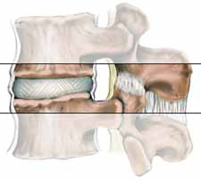
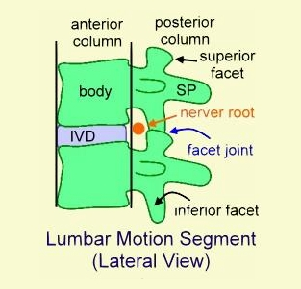
The motion segment
Basic functioning unit of the spine
Comprises of
Two adjacent vertebrae
Intervertebral disc
Two Facet jonits
Connecting ligaments
Notes:
A motion segment of the spine consists of the intervertebral disc and facet joints connecting any two adjacent vertebrae. The motion segment is referred to as the“functional unit of the spine” because a combination of adjacent motion segments allows the spine to move in six degrees of freedom.

Slide 5
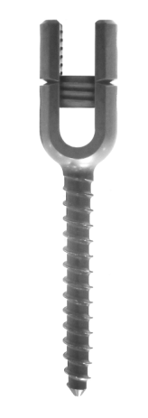
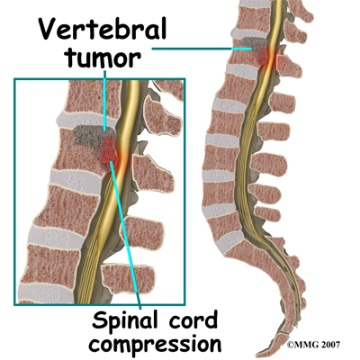
Indication of GSS 6.0
Posterior spinal fusion
Including:
Fractures
Degenerative
Spinal tumor and infections

Slide 6
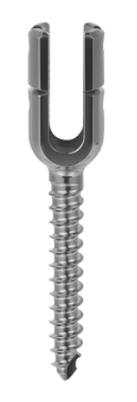
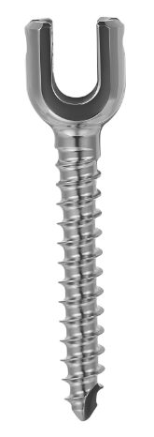
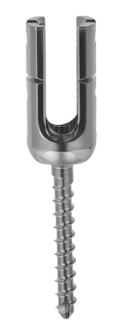
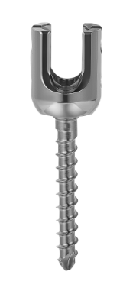
Pedicle & Reduction screws
A
B
C
D
Set screw
StarDrive recess
Specification
Φ4.5*30/35/40/45mm
Φ5.0*30/35/40/45/50mm
Φ5.5*30/35/40/45/50mm
Φ6.0*30/35/40/45/50mm
Φ6.5*30/35/40/45/50mm
Φ7.0*30/35/40/45/50mm
Cortical thread profile design fits well in the pedicle
Cancellous thread profile design fits well in the body
A : Monoaxial Reduction Screw
B: Monoaxial Pedicle Screw
C: Polyaxial Reduction Screw
D: Polyaxial Pedicle Screw
The tip shape makes insertion easily
Notes:
The cortical part is inserted in the pedicle and the cancellous part is inserted into the body.

Slide 7
Connector & Rod
Type I with block
Very convenience to operate, press directly
Type II with hooks
Attaches directly and firmly to rod
Specification: Φ4.0*60/70mm
Specification:Φ3.0*50/60/70/80/90mm
Type III Multi-Axial
Not influenced by the processes
Rod : can be cut or contour
Specification:Φ3.0*50/60/70/80/90mm
Specification
Φ6.0*50-180mm increased every 10mm
Φ6.0*200/250/300/350/400mm
Notes:
The connectors can increase the rigidity.

Slide 8
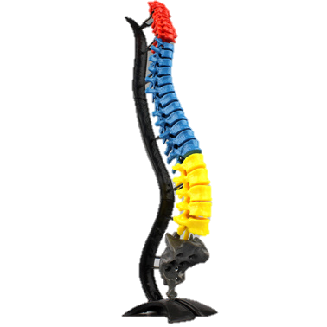
Usage recommendation
Usage
Recommendation
GSS 6.0 is recommended to be used for Lumbar vertebrae for its strong fixation strength
GSS 5.5 is recommended to be used for Thoracic vertebrae for its low profile design
GSS 5.5 can also be used for Lumbar vertebrae of small size patients
GSS5.5
GSS6.0

Slide 9
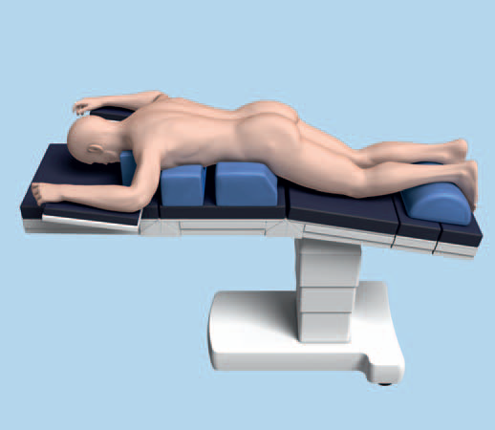
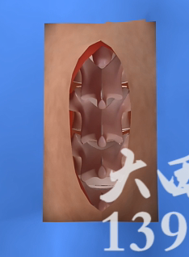
Patient position and incision
Place the patient in the prone position
Make a midline incision through skin down to the spinous processes of the appropriate vertebrae
Dissection is carried laterally to expose the facets and the transverse processes

Slide 10
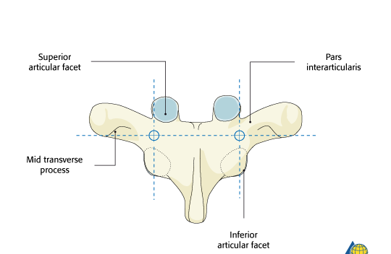
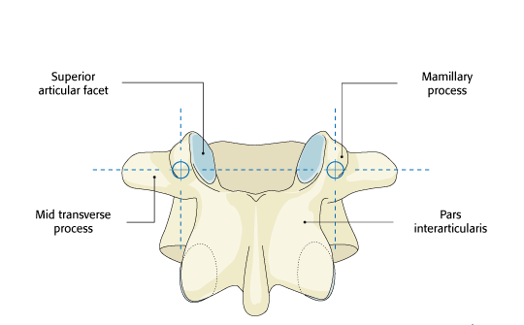
Entry point of pedicle screw
The entry point of Thoracic vertebrae is the intersection of
The line of the inferior edge of the transverse process
The vertical line border of the superior articular facet
The entry point of Lumbar vertebrae is the intersection of
The line of middle of the transverse process
The vertical line border of the superior articular facet

Slide 11
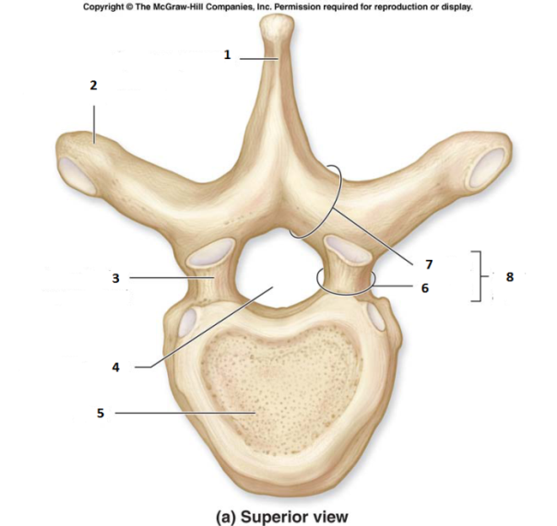
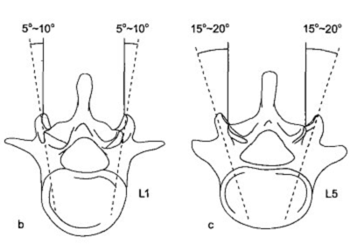
Preparation of the pedicle cannel
Three key points need to be noticed
Instruments can not penetrate the walls of the pedicle to avoid to injure the adjacent never and vessel
The entry angle should be varied according to the anatomical feature in different vertebrates
The anterior cortex of the vertebral body should not be violated unless additional purchase if needed
The entry angle is decreased
T1&T2: 30°- 40°
T3 to T11: 20°- 25°
T12: 10°
The entry angle is increased
L1 to L3: 5°- 10°
L4: 10°- 15°
L5: 15°- 20°

Slide 12
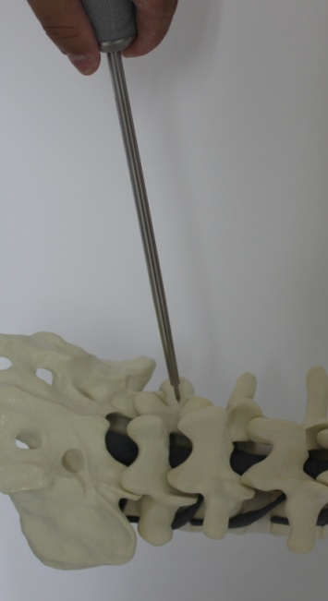
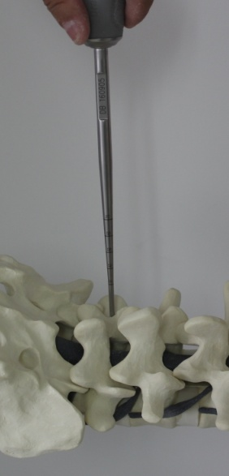
Open the vertebrae
Open with the awl at the entry point
Prepare the pedicle cannel with the Lumbar Ball Probe
Make appropriate adjustments of the entry point and pedicle cannel if there is resistance during the open process.
AWL
Lumbar Ball Probe
Notes:
There are three probe, Thoracic prone is used for Thoracic vertebrae or the small size Lumbar vertebrae, Lumber Ball Probe, straight is used for lumbar vertebrae, and Lumber Ball Probe, curved is optional, if the physician wants to make some adjustments for the pedicle cannel this one can be used.

Slide 13
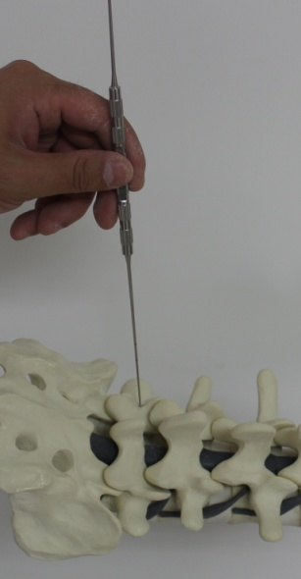
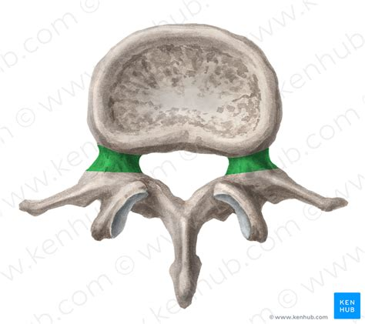
Probe the screw channel
Use the Dual Ended Feeler to probe the screw cannel
Ensure the pedicle walls and the cortex of anterior end of the body are not violated
Dual Ended Feeler
Notes:
Usually used the straight side, if the physicians want to confirm the whether the pedicle is intact, the curved side can be used.

Slide 14
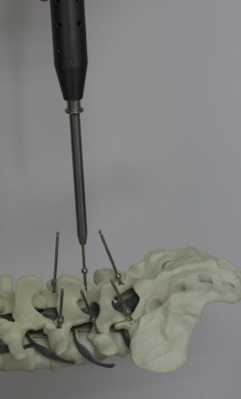
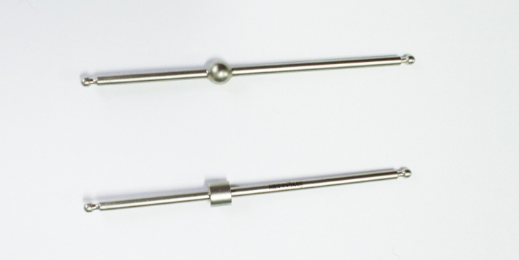
Confirm the screw angle and length
Place the Marker with the Inserter through the pedicle and into the vertebral body (the screw cannel)
Confirm the angle and depth of the pedicle cannel by the C-arm of X-ray, appropriate length of the screw can also be confirmed
Inserter for Marker
Marker, ball
Marker, cylinder
Notes:
The same shape marker must be used in the same side, the physicians can choose different lengths of the marker according to the depth of the cannel. The screws should extend 50-80% into the vertebral body. Usually, for the fracture, 30-35mm should be selected, others. 40-45mm should be used.

Slide 15
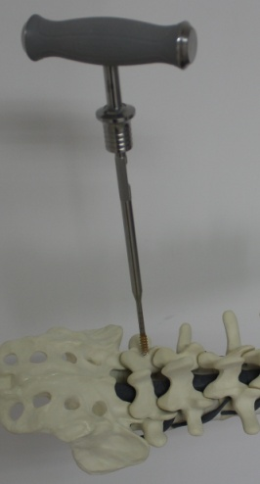
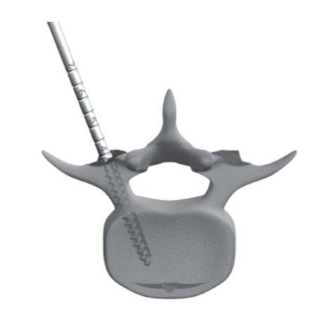
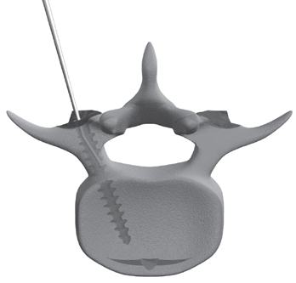
Tap the pedicles
Select the appropriate diameter Tap (usual 0.5mm-1mm diameter smaller than the screw) to insert through the pedicle and into the body
After tapping, the feeler need to be used to ensure the pedicle walls and the cortex of the body are not violated
Notes: the diameter 6.5mm of pedicle and reduction screws are most used
Notes:
There are 3 different sizes of the tap, usually, 4.5mm screw can used with 4.5 tap or without tapping, for the osteoporosis, tapping might not be used, it is recommended to tap if the bone quality is good.

Slide 16
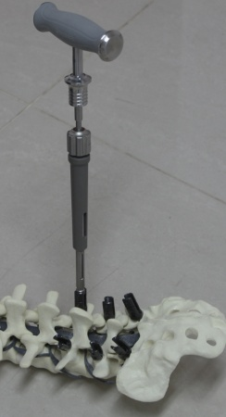
Screw insertion
After the pedicles prepared and the proper screw lengths determined, insert the appropriate screws (Monoaxial or Polyaxial) with the Fixed Angle Screwdriver or Multi Axial Screwdriver into the vertebrae
Multi Axial Screwdriver
Fixed Angle Screwdriver
Notes: Each Screwdriver can be used for the pedicle & reduction screws
Notes:
For 4 screws set, the 4 screws can be all monoaxial screws, and for 6 screws set, the middle 2 screws should be used polyaxial screws. The advantage of reduction screws is the operation is must more easy ( it is easy to place the set screw with the rod)

Slide 17
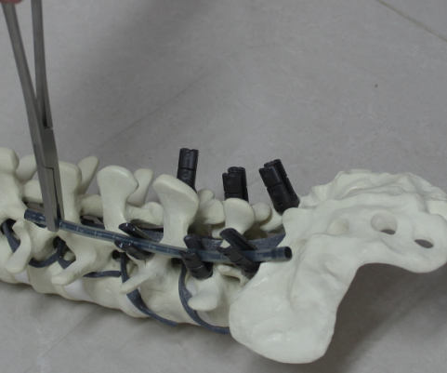
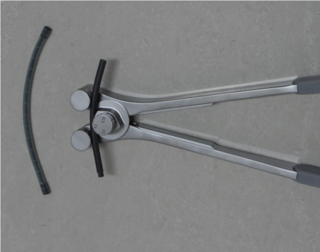
Rod bending and insertion
The rod template is used to determine the curvature and length of the rod needed based on the screw position
The rod may be bent using the French Bender
Place the rod into the implant heads using the Forceps Rod Holder
French Bender
Notes:
The rod does not have to be precisely bent for attachment to the pedicle screws, especially for a Polyaxial Screw
The Rod can not be bended repeatedly
It is not recommended to bend the rod over 45°
Notes:
Use the rod template to determine the length and the arc of the rod. Usually the 5-10mm beyond the screw head is recommended. There is a line in the middle of the rod, this line can be used as the reference when bending and placing.
There are 3 different arc in the French Bender (4.5,5.5,6.5), 5.5 is commonly used.

Slide 18
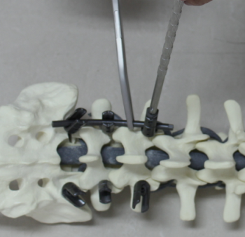
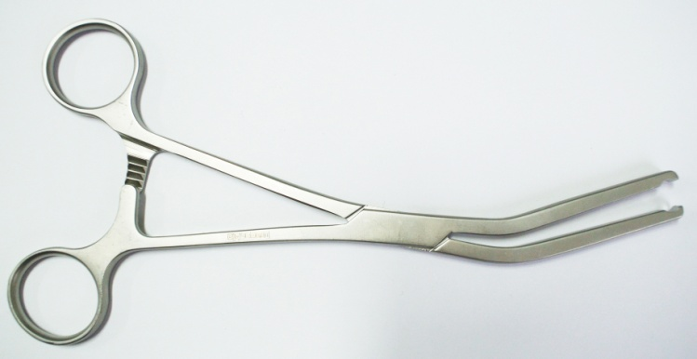
Set screw insertion & Rod Placement
Place the rod into the screw head with the Forceps Rod Holder
Place the set screw to the screw head with the Dual Ended Plug Screwdriver for provisionally tighten
The Forceps can be used to facilitate the insertion
Dual Ended Plug Screwdriver
Forceps Rod Holder
Notes:
The screwdriver can be used with T handle or Handle with quick coupling. This screwdriver can firmly hold the set screw

Slide 19
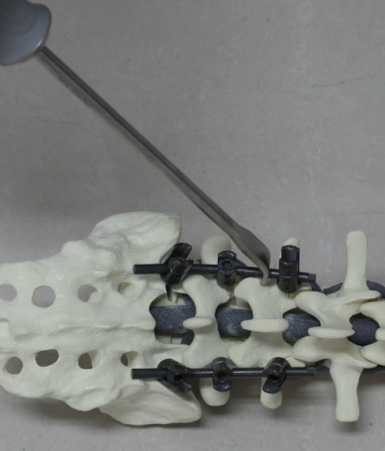
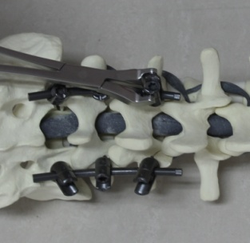
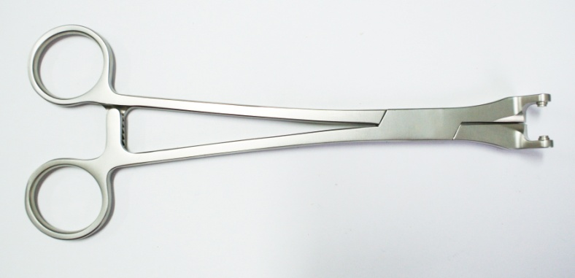
Rod Placement(optional)
Use the Rod Pusher or Forceps Rocker to press the rod seated into the bottom of the screw head
Tighten the set screw with the StarDriver screwdriver, this is not the finally tightening
Rod Pusher
Forceps Rocker
StarDriver screwdriver, shaft

Slide 20
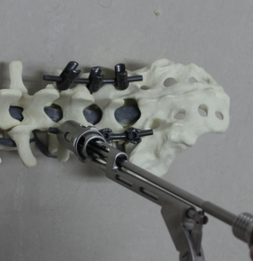
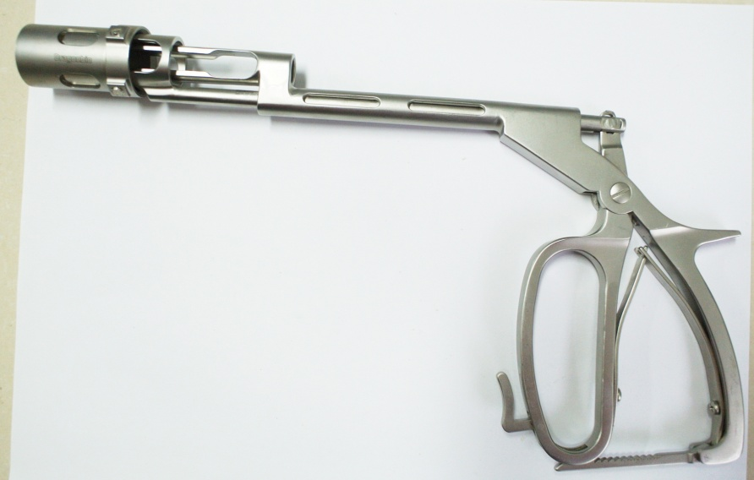
Rod Placement(optional)
If the rod is not easily captured in the screw head or there is any dislocation of the vertebrae, the Rod Reducer with Pistol Grip can be used to fully seat the rod and simplify set screw introduction
Place the Rod Reducer over the rod, and grasp the screw head notches from above. As the Rod Reducer handle is gently squeezed, the reducer sleeve will slide down and seat the rod.
Rod Reducer with Pistol Grip
& De-rotation sleeve
Notes:
Use the same method to place the set screw(first place the set screw with the Dual Ended Plug Screwdriver, then tighten it with the StarDriver screwdriver, shaft

Slide 21
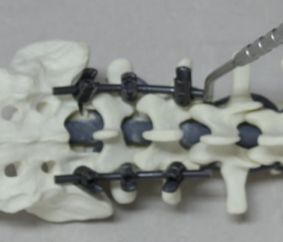
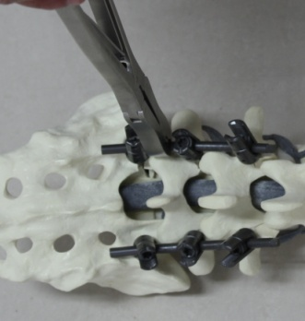
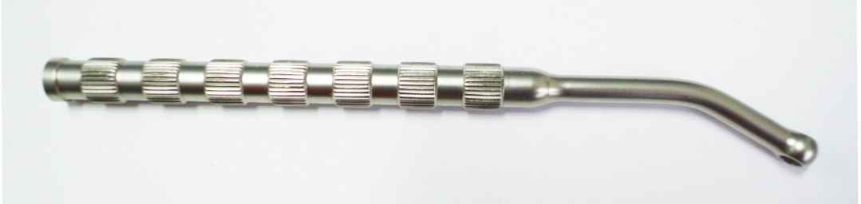
Rod Placement (optional)
Rod Pusher or Rod Gripper can be used to adjust the rod to maintain the lordotic curve of the spine
Rod Pusher, curved
Rod Gripper

Slide 22
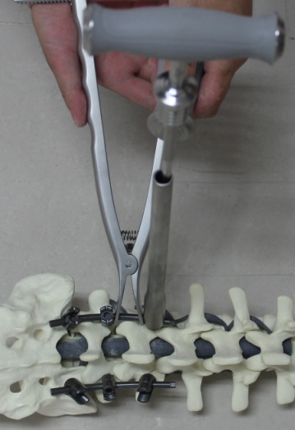
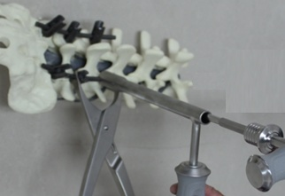
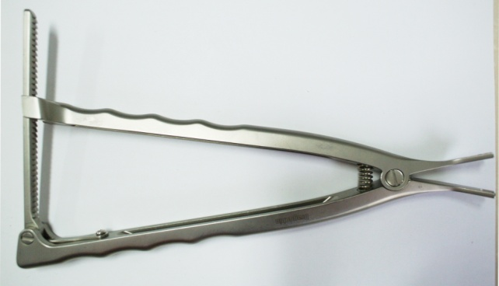
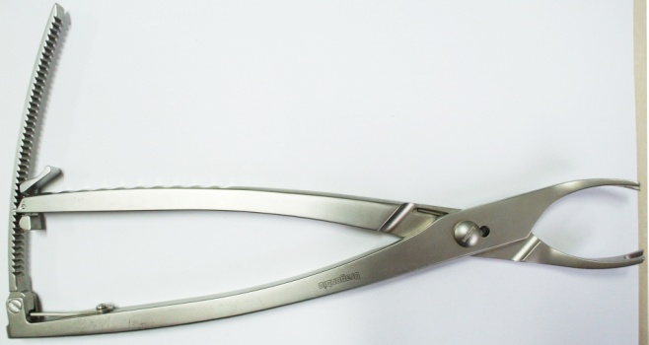
Compression/Distraction
Distractor Forceps
Compressor Forceps
Once the rod is secured in the implants, compression/distraction may be performed to place the implants in the final position
Distractor Forceps and Counter Torque can be used for distraction, and Compressor Forceps and Counter Torque for compression
Notes:
The set screw must be loosened in the compression or distraction side

Slide 23
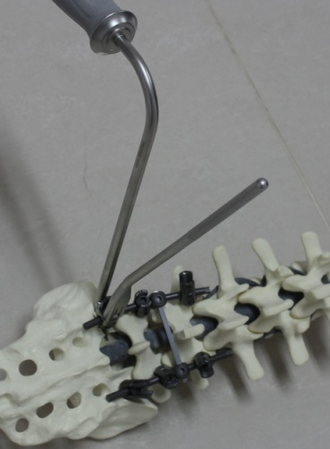
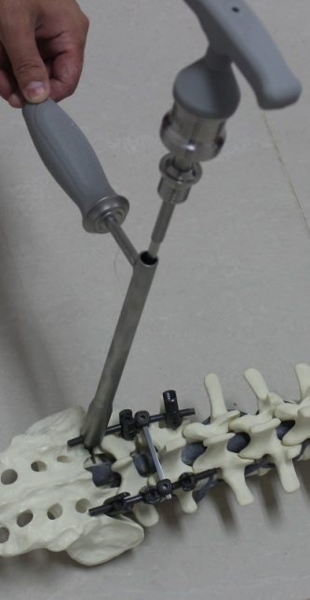
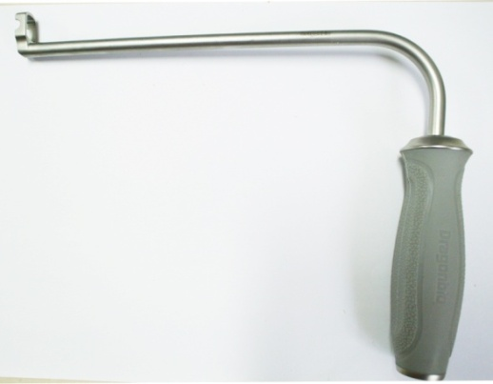
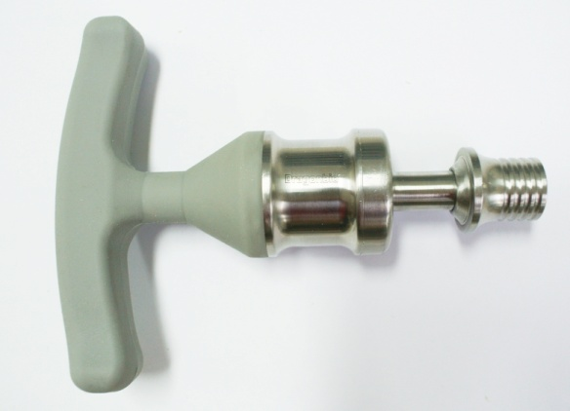
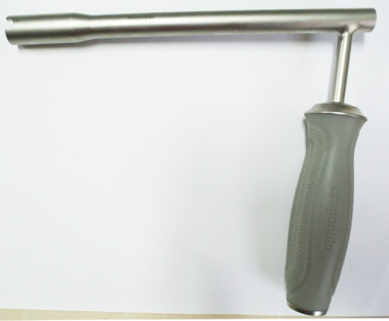
Final Tightening
When all implants are securely in place, place the Hold sleeve onto the reduction screw and break the tail with the Tap Breaker
Final tightening the set screw with the Counter Torque and Torque-Limiting Driver
Tap Breaker
Hold Sleeve
Counter Torque
Torque-Limiting Driver

Slide 24
Connector Placement
Select the appropriate connector, place the connector on the rod with the Crosslink Holder
Adjust the position, and tighten the screw by the Screwdriver for connector
Crosslink Holder
Hexagonal Screwdriver

Slide 25
Q&A
Is a connector necessary?
It is recommended to use the connector to increase the rigidity of the whole construction
The length of the screws
The screws should extend 50-80% into the vertebral body. 40-45mm should be commonly used.
The length of the rods
Usually, 60-70mm is used for 4 screws and 80-100mm is used for 6 screws
The angle of the Reduction Screw
30°angle of variability
The different instruments of GSS5.5 & GSS 6.0?
Multi Axial Screwdriver, Fixed Angle Screwdriver, Rod Template, Hold sleeve, Tap Breaker & Rod Reducer with Pistol Grip

Slide 26
Thank You

