Slide 1
PFNA(Proximal Femoral Nail, Anti-rotation)

Slide 2
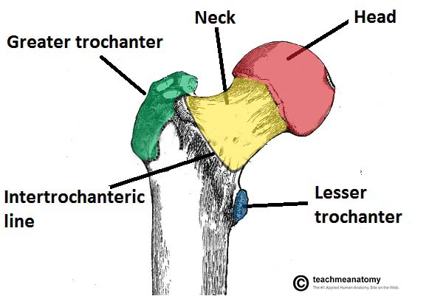
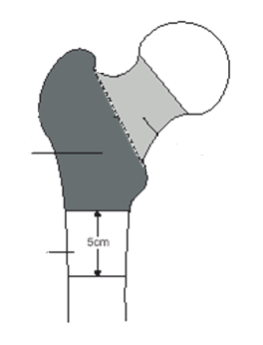
Anatomy of Proximal Femur
Femur neck
Intertrochanteric
Subtrochanteric
Common types of hip fractures

Slide 3
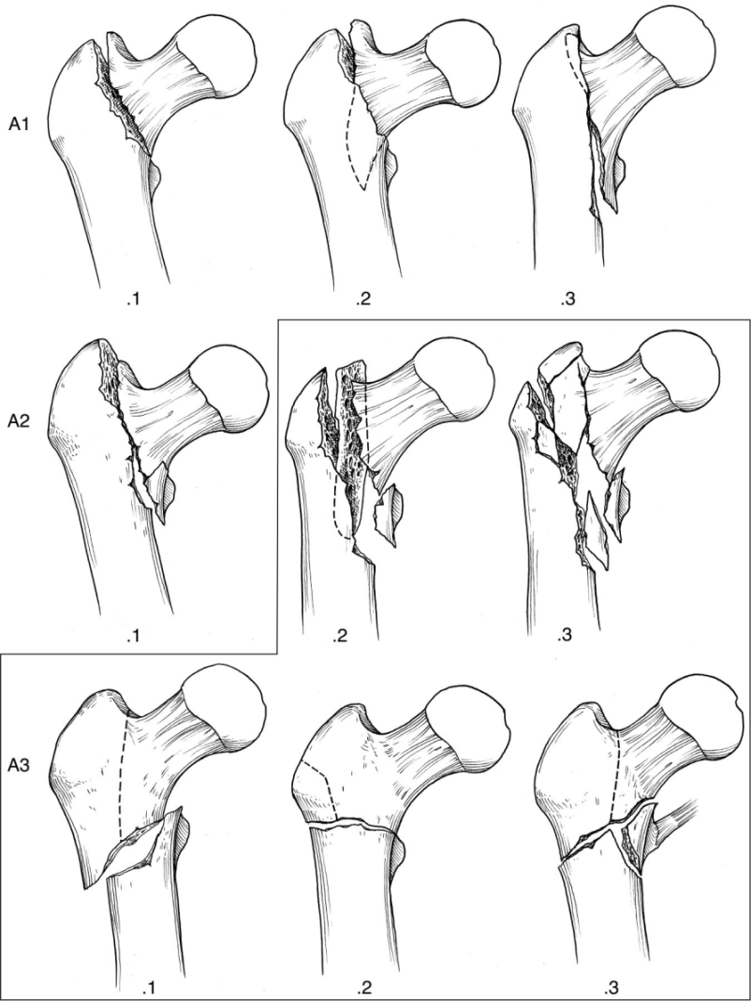
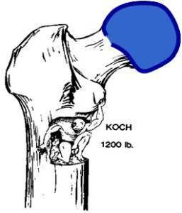
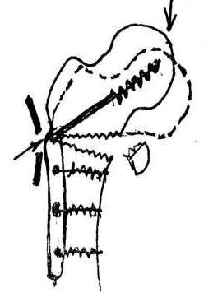
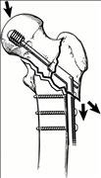
Fractures types
Stable
Lost of Medial Buttress
Unstable
For Stable fractures, Plates & Nail both can be used
For Unstable fractures, it is recommended to use IM nail
A1:simple trochanteric fractures:
A2 multifragmentary trochanteric fractures:
A3 intertrochanteric fractures:
No lateral Wall

Slide 4
Advantage of IM nail
Bear less loading force
Motion of Force = F* D/d
D > d
Mini Invasive
IM nail is the first choice for the unstable fractures

Slide 5
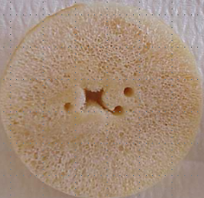
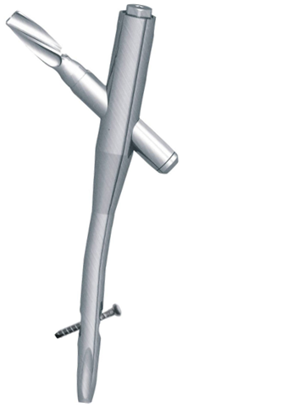
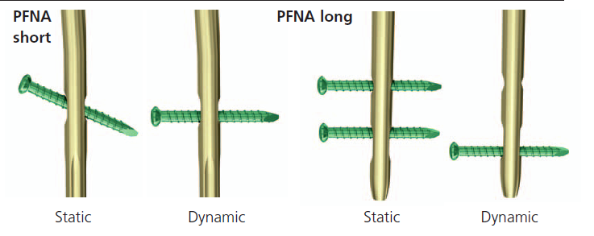
Features of PFNA
PFNA Lag screw
Compaction of cancellous bone, especially for elderly & osteoporosis patients
Higher cut-out resistance
Anti-rotation
5°
Optimal fit: medial-lateral angle of 5°
This allows insertion at the tip of the greater trochanter
Several distal locking options
Standard
Long
Notes:
Static locking: usually used for comminuted fractures,
Dynamic locking: usually used for transverse or distracted fractures

Slide 6
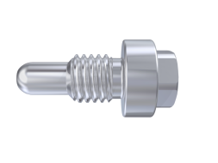
Components of PFNA
End Cap
PFNA Lag screw
Nail
Femoral Nail Locking Screw
short
Long

Slide 7
Indications
Short
Long
PFNA short (Length 170 mm –240 mm)
Pertrochanteric fractures
Intertrochanteric fractures
High subtrochanteric fractures
PFNA long (Length 300 mm –420 mm)
Low and extended subtrochanteric fractures
Ipsilateral trochanteric fractures
Combination fractures (in the proximal femur)

Slide 8
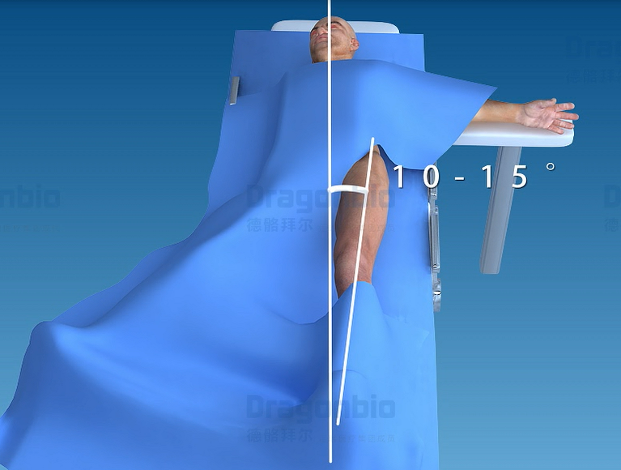
Patient Position & Fracture Reduction
Place the patient on the supine position.
.Adduct the affected leg by 10 –15°
Perform closed reduction of the fracture under image intensifier control. Perform open reduction when necessary

Slide 9
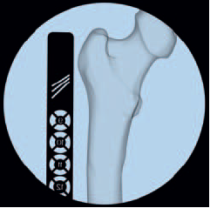
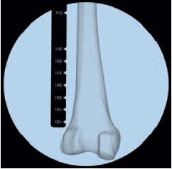
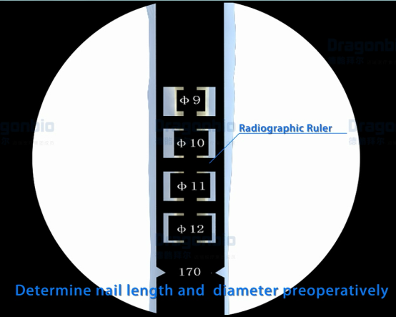
Confirm nail length and diameter
Use the Radiographic Ruler to determine the length and the diameter of the nail under the C-arm

Slide 10
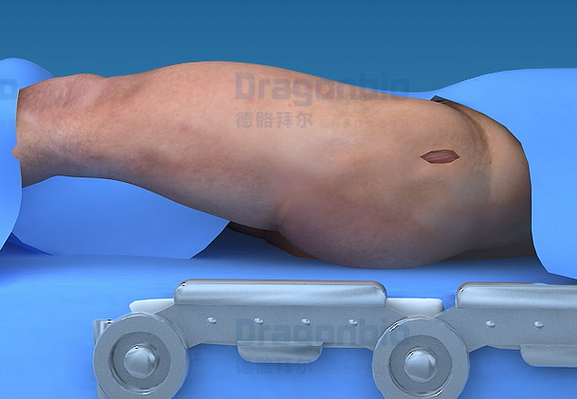
Approach
Make a 5 cm incision proximal from the tip of the greater trochanter

Slide 11
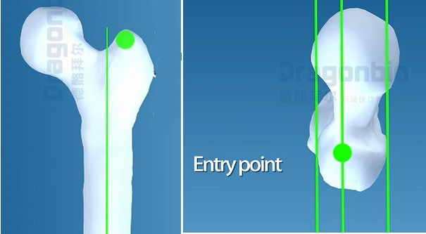
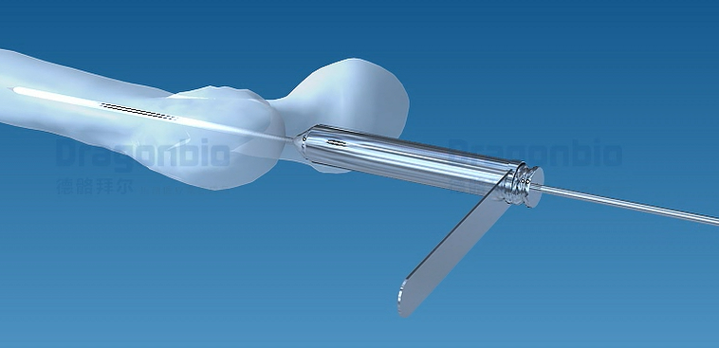
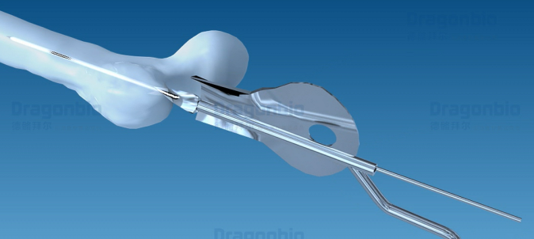
Open Femur
Step 1 Entry Point:
AP view: on the tip or slightly lateral to the tip of the greater trochanter
Lateral view: in line with the axis of the intramedullary canal
Step 2 Insert Guide Wire
Insert the guide wire through the protection sleeve and the drill sleeve
Step 3 Open Femur with awl
AP view

Slide 12
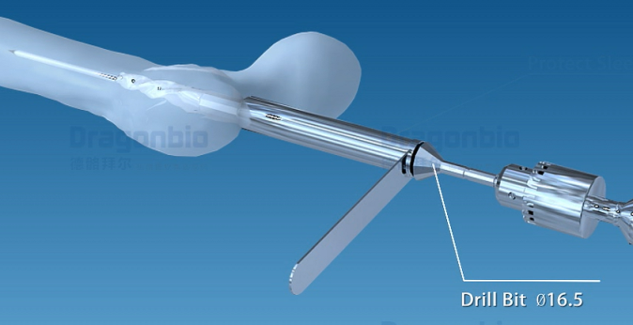
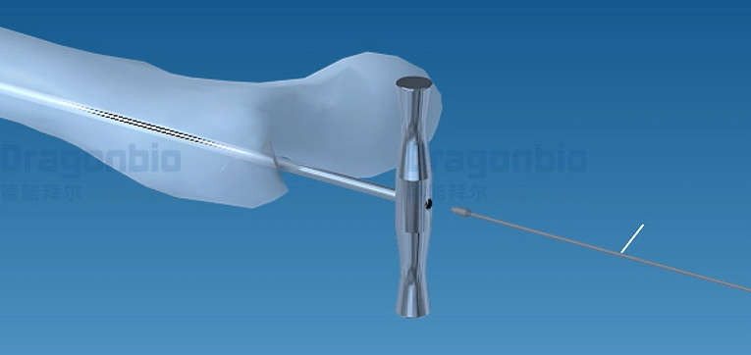
Open Femur(continue)
Step 4 Open Femur
Guide the cannulated drill bit through the protection sleeve over the guide wire and drill to the stop on the protection sleeve
Step 5 Ream medullary canal
Ream the cannal with the flexible reamer and the reamer head
It is recommended to start with the 8.5 mm diameter reaming head, ream to a diameter of 0.5 to 1.5 mm greater than the nail diameter

Slide 13
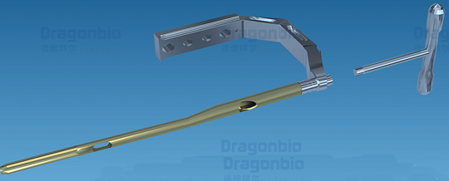
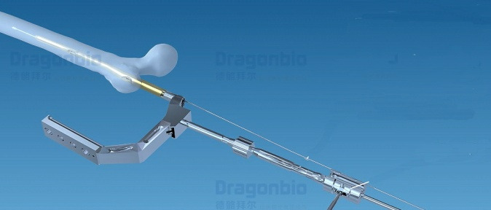
Insert Nail
Step 1 Assemble PFNA
Step 2 Insert PFNA
Insert the PFNA with the Hammer Guide and the Slotted Hammer

Slide 14
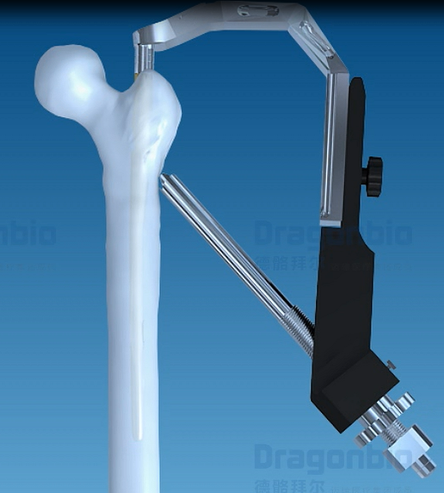
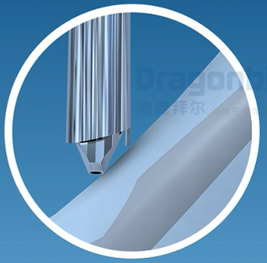
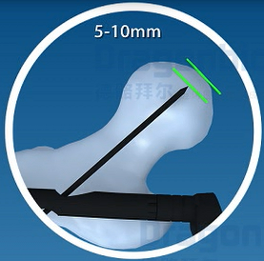
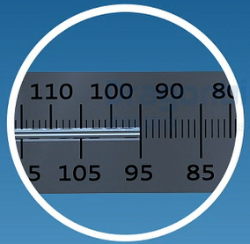
Proximal Locking
Step 1 Prepare Guide Wire insertion:
Fix the aiming arm firmly to the insertion handle
Insert the sleeve assembly to the aiming arm
Step 2 Insert Guide Wire
Insert a new guide wire through the drill sleeve into the bone
The optimal position of the guide wire in the 1/3 part of the middle low femoral neck and at a distance of 5-10 mm below the joint level
Step 3 Measure the length
The measuring device indicates the exact length of the guide wire in the bone
Notes:
The sleeve assembly must be in contact with the bone during the entire blade implantation
Insert the guide wire for the PFNA blade carefully to avoid penetration into the joint

Slide 15
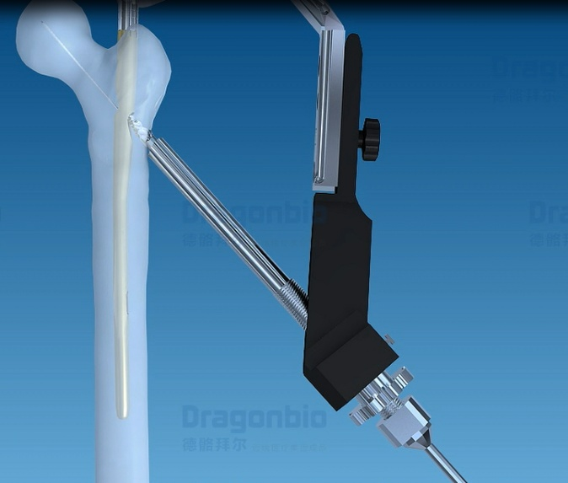
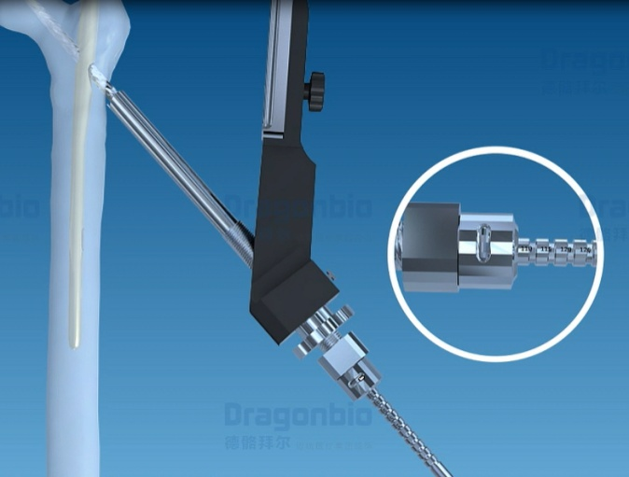
Proximal Locking(Continue)
Step 4 Open lateral cortex
Push the cannulated drill bit Ø3.2 over the guide wire. Drill to the stop
Step 5 Drill for PFNA blade
Set the chosen blade length of the measure length by fixing the fixation sleeve in the corresponding position
Push the reamer over the guide wire. Drill to the stop

Slide 16
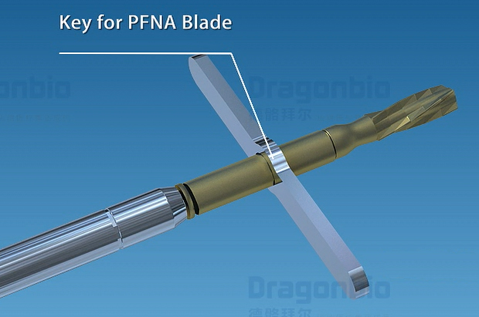
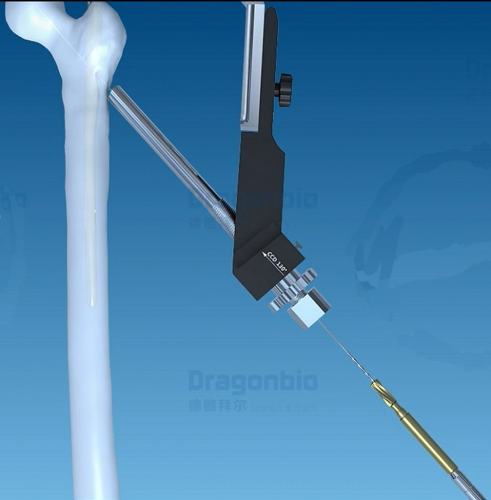
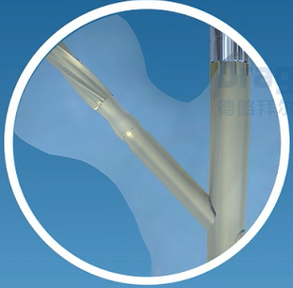
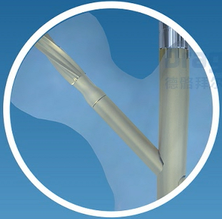
Insert PFNA Lag Screw
Step 6 Assemble PFNA blade
Insert the PFNA blade into the key and then attach them to the impactor. Screw the impactor counterclockwise to unlock
Step 7 Insert PFNA blade
Insert the PFNA blade to the stop by applying gentle blows with the hammer
Step 8 Lock PFNA blade
To lock the PFNA blade, turn the impactor clockwise and tighten the blade
Unlocked
Locked
Notes:
The PFNA blade is supplied in a locked state.

Slide 17
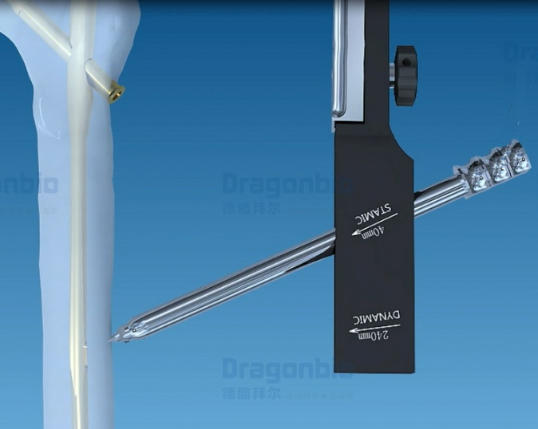
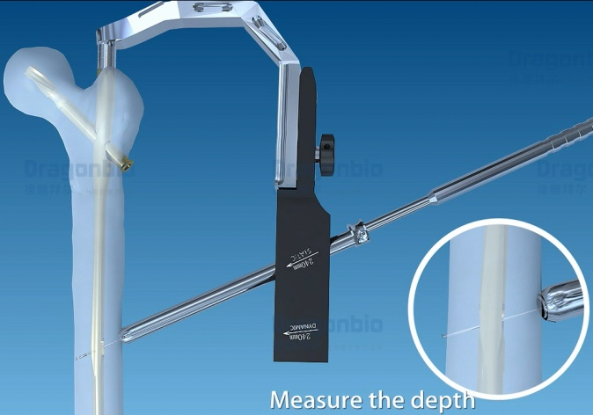
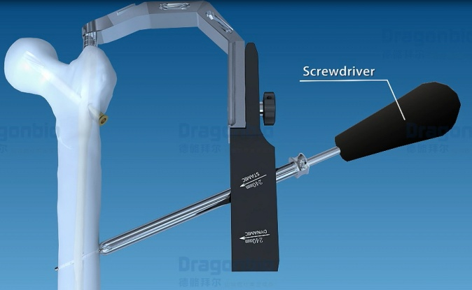
Distal Locking for PFNA(short)
Step 1 Assemble distal aiming arm
Static locking and dynamic locking are available for standard PFNA
Fix the chosen aiming arm firmly to the insertion handle
Step 2 Drill & Measure the depth
Use the drill bit to drill through both cortices
Measure the depth with the Depth Gauge
Step 3 Insert screw
Insert a femoral locking screw of the measured length with the screwdriver

Slide 18
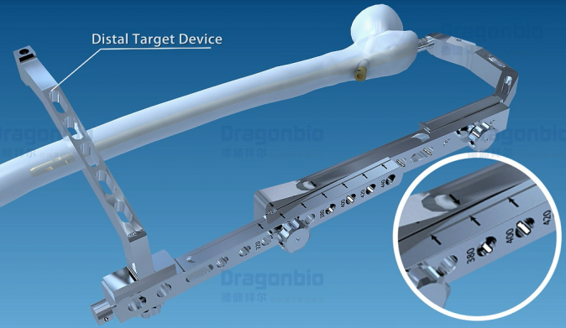
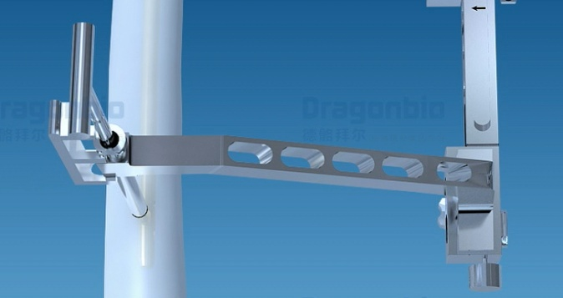
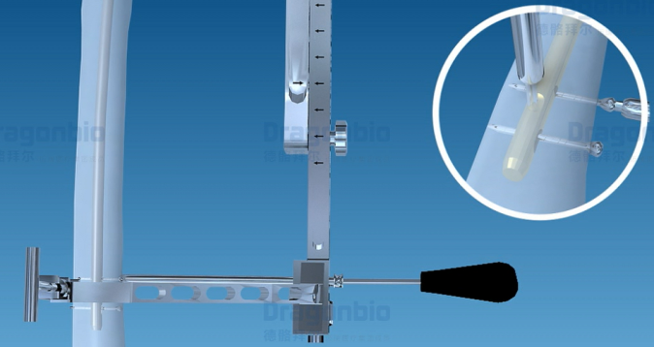
Distal Locking for PFNA(long)
Step 1 Assemble distal aiming arm
Assemble the distal aiming arm according to the selected nail length & L/R
Attach the distal target device to the distal aiming arm
Step 2 calibrating
Drill with the drill bit Ø5.2 until to the PFNA platform
Insert the Positioning Rod and fix it to the platform with the Locking Block
Step 3 Insert locking screw
Insert a femoral locking screw of the measured length with the screwdriver
Static locking and dynamic locking can be chosen accordingly

Slide 19
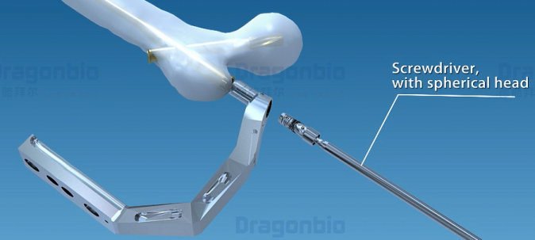
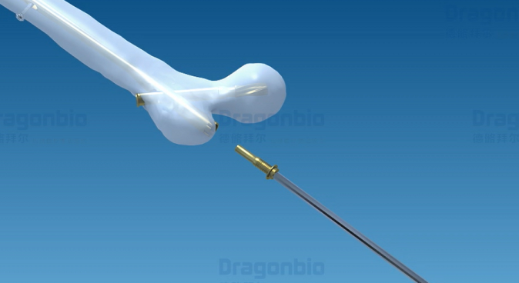
Insert End cap
Step 1 Remove instruments
Remove all the connecting instruments
Step 2 Insert End Cap
Screw the end cap into the proximal end of the nail and tighten it firmly

Slide 20
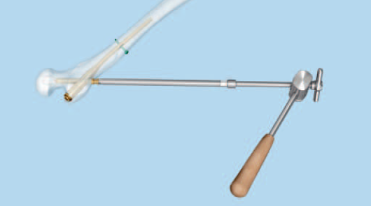
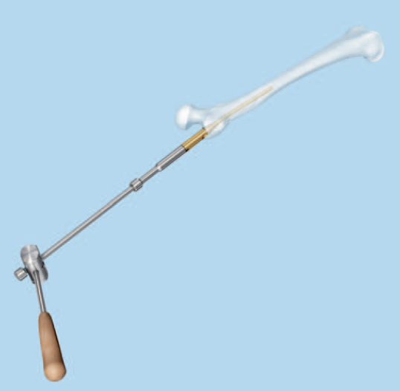
Implant Removal
Step 1 Remove end cap
Remove the end cap with the Hexagonal screwdriver
Step 2 Remove PFNA Lag Screw
Extract the PFNA Lag Screw with the Extraction Screw
Step 3 Remove distal locking screw and nail
Remove the distal locking screw with the Hexagonal screwdriver
Screw the hammer guide into the PFNA and tighten it and Extract the nail by applying gentle blows with the slottled hammer

Slide 21
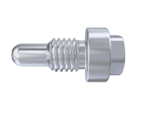
Specification
PFNA(short)
Diameter: φ9.5, φ10, φ11&φ12
Length: 170mm, 200mm, 240mm
PFNA(long)
Diameter: φ9.5, φ10, φ11
Length: 300-420 mm Increased every 20mm, L/R
PFNA End Cap
Length: 0, 5, 10, 15
Femoral Nail Locking Screw
Diameter: φ4.5
Length:25-80mm, Increased every 5mm
PFNA Lag Screw
Diameter: φ10.5
Length: 75-120 mm Increased every 5mm

Slide 22
Thank You

