Slide 1
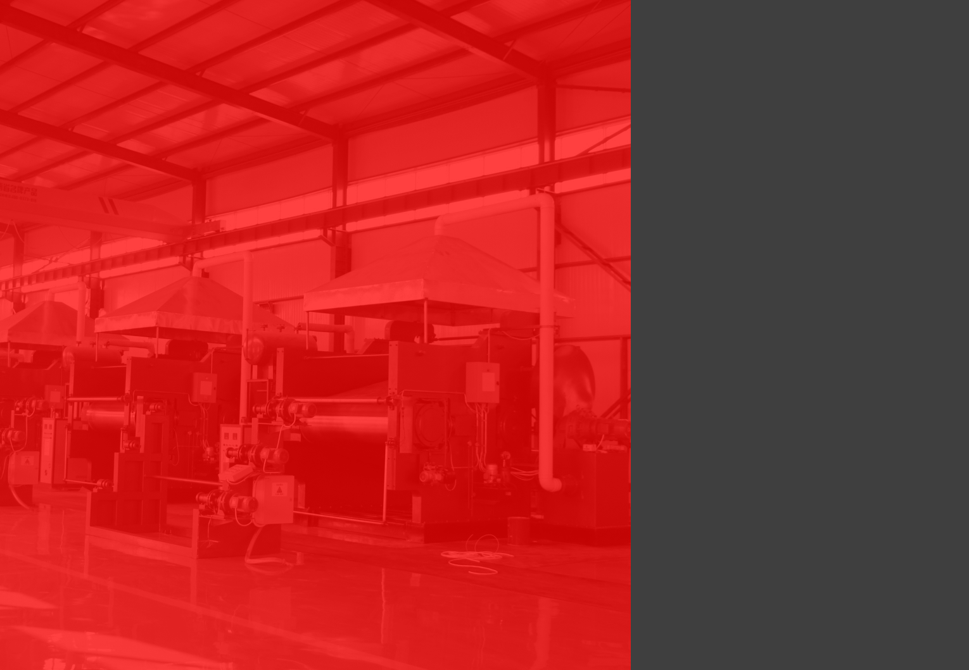
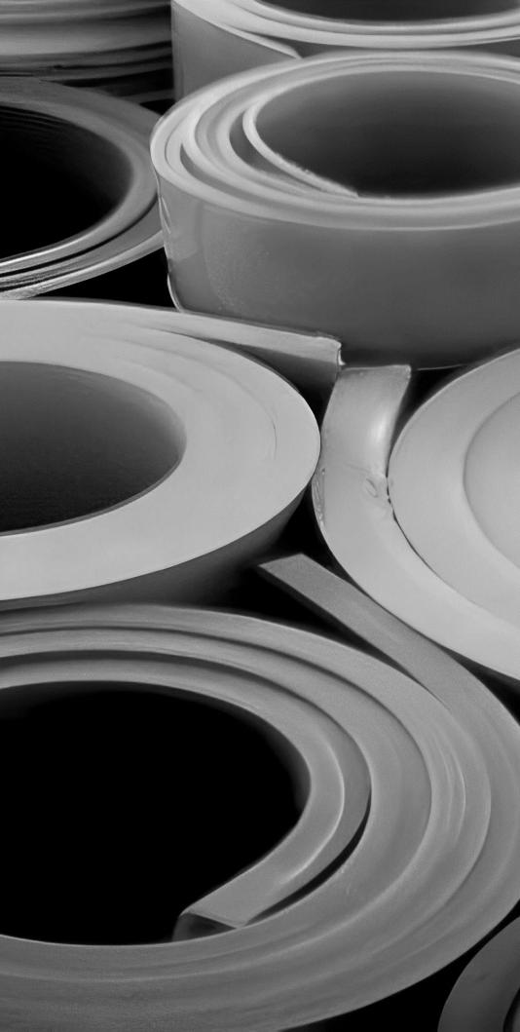
RUBBER SHEET
CATALOG
PRODUCT COLLECTION
Trust in the superior performance and quality of our state-of-the-art rubber
sheets, carefully crafted using state-of-the-art technology and rigorously tested to meet the highest industry standards, providing a reliable and long-lasting
solution for all your rubber sheet needs.
CAMI DE CAN CALDERS 10,1,1
08173 SANT CUGAT DEL VALLES(BARCELONA)
SPAIN
TEL.: +34 930238861
MOB.: +34 691263820
email: Ltort@decoriter.com
www.decoriter.com
GENERAL DE PRODUCTOS EXCLUSIVOS S.L.

Slide 2
QUALITY FIRST
CUSTOMER UPPERMOST
Table of Contents
Company Profile
Why Choose Us
Industrial Rubber Sheet
Rubber Mat for Agriculture
Rubber Flooring
Rubber Sheet for Mining
PVC Strip Curtain
About Customized
Certification

Slide 3
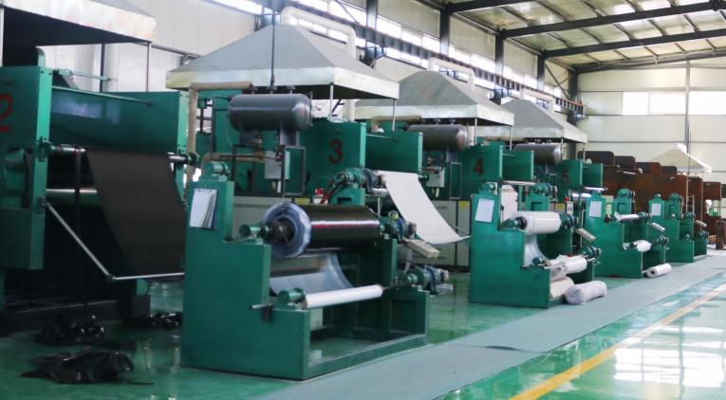
03
04
Company
Profile
Decoriter, General de Productos exclusivos S.L. has a long term contract manufacturing production agreement, with the world-leading rubber sheet manufacturer established in 1984, with more than 40 branch companies and 1000+ employees all over China. The company is located 25 km east of Beijing and 40 km from Beijing International Airport. The company has modern facilities, including 70 Rotocure
Machines, 40 Press Machines, 7 sets of Twin Screw Plastic Extruders, and more, to produce a wide range of industrial and specialty rubber products.
The company has been certified by ISO International Quality System since 2001 and
has import and export rights since 2003. Its high performance insulation rubber
sheet has also been certified by the EU. The company has been awarded the
"Reliable Quality Product Corporation" by AQSIQ, and has been rated the "Provincial Elite Brand", "Provincial Credit Unit", and "AAA grade credit unit" for 17 consecutive years.
The company's motto is "Quality First, Customer Uppermost" and is committed to
providing excellent quality, effective and efficient service, reasonable prices, and fast
delivery to its customers. The company welcomes business partnerships and communications with customers from all over the world.
Why Choose Us?
High-quality Products
We have advanced production technology and strict quality control system to ensure that
our products can meet the needs of customers. We pay attention to details in the production process and are committed to producing high-quality products.
Production Capacity and Scale
We have first-class production equipment and an excellent production team, which can
meet a large number of production needs in a short time. Our reliable production capacity and scale allow customers to rely on us when they need it.
Competitive Price
We have optimized our production process and procurement process to reduce costs and provide high-quality products at favorable prices. Our prices are highly competitive and
able to meet the needs of our customers.
Timely Delivery
We pay attention to production planning and arrangement of production process to ensure timely delivery. We promise to deliver within the agreed time and try our best to meet
customers'demands.
Excellent Customer Service
Our customer service team is always on call to provide customized services to customers. Whether in order processing or after-sales service, we pay attention to communication and collaboration with customers to ensure customer satisfaction.
Innovation Ability
We have a professional R&D team, constantly innovating and developing new products to help customers solve technical problems and improve product performance.

Slide 4
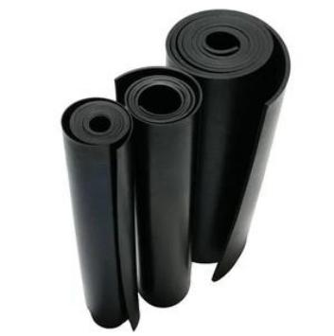
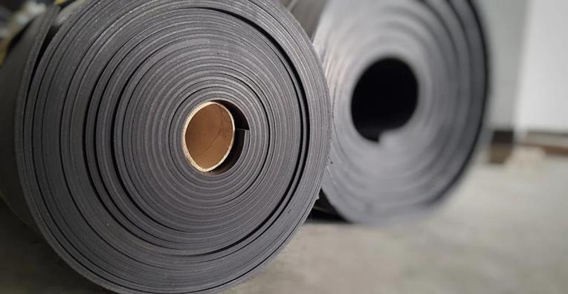
06
INDUSTRIAL RUBBER SHEET
SBR RUBBER SHEET
SBR rubber sheet is a synthetic rubber product
made from styrene and butadiene. It has good
abrasion resistance, impact resistance, and low
temperature flexibility, as well as moderate aging and weathering resistance. SBR rubber sheet is
widely used in the construction, automotive, and
industrial sectors for applications such as gaskets, seals,flooring, and conveyor belts.
Rubber sheets are widely used in industrial fields due to their high elasticity, wear resistance and chemical corrosion resistance. It is usually used to manufacture industrial parts such as gaskets, seals, baffles, scrapers, etc. Due to its good physical and chemical properties, rubber sheets are also widely used in many other industries.
APPLICATION
• Seal • Conveyor
• Electrical Insulation • Lining
• Damping • Ship accessories
• Sound Insulation • Medical equipment
Standard Product Sheet
 | SBR-01 | SBR-02 | SBR-03
Polymer | SBR/NR | SBR/NR | SBR/NR
Color | Black | Black | Black
(g/cm3) Density | 1.5 | 1.5 | 1.3
(Shore A) Hardness | 70 | 60 | 65
(MPa) Tensile Strength | 4 | 5 | 10
(%) Elongation | 200 | 250 | 350
(℃) Work Temp. | -20 - 70 | -30 - 80 | -35 - 85

Slide 5
07
08
CR RUBBER SHEET
Neoprene rubber sheet has excellent resistance to weathering, oil, and chemicals, as well as good
mechanical properties. Neoprene rubber sheet is
commonly used in the marine, automotive, and
industrial sectors for applications such as gaskets, seals, and protective clothing.
EPDM RUBBER SHEET
EPDM rubber sheet has excellent weather resistance, heat resistance and corrosion
resistance, and also has good elasticity and mechanical strength. Compared with other
synthetic rubber sheets, the weather resistance and corrosion resistance of EPDM rubber sheets are more prominent.
Standard Product Sheet
Standard Product Sheet
 | CR-01 | CR-02 | CR-03
Polymer | CR | CR | CR/SBR
Color | Black | Black | Black
(g/cm3) Density | 1.4 | 1.5 | 1.5
(Shore A) Hardness | 65 | 70 | 65
(MPa) Tensile Strength | 11 | 7 | 4
(%) Elongation | 300 | 250 | 200
(℃) Work Temp. | -35 - 120 | -30 - 100 | -30 - 80
 | EPDM-01 | EPDM-02 | EPDM-03
Polymer | EPDM | EPDM | EPDM/SBR
Color | Black | Black | Black
(g/cm3) Density | 1.2 | 1.5 | 1.5
(Shore A) Hardness | 65 | 65 | 70
(MPa) Tensile Strength | 11 | 7 | 4
(%) Elongation | 400 | 300 | 200
(℃) Work Temp. | -40 - 140 | -40 - 110 | -30 - 80

Slide 6
09
10
NITRILE RUBBER SHEET
Nitrile rubber sheet has oil resistance, wear
resistance, acid and alkali resistance, etc., and
also has good weather resistance and corrosion
resistance. Nitrile rubber sheets are widely used in petrochemical, automobile manufacturing, food
processing, medical equipment and other fields. It has relatively strong oil resistance, but may be less elastic and abrasion resistant.
CSM RUBBER SHEET
Chlorosulfonated polyethylene rubber sheet, also
known as Hypalon rubber sheet. It has excellent
oxidation resistance, ozone resistance, acid and
alkali resistance and ultraviolet resistance, as well as good mechanical strength and flame retardancy. CSM rubber sheet is widely used in aerospace,
automobile, construction and other fields.
Standard Product Sheet
Standard Product Sheet
 | NBR-01 | NBR-02 | NBR-03 | NBR-04
Polymer | NBR/SBR | NBR/SBR | NBR | NBR
Color | Black | Black | Black | Black
(g/cm3) Density | 1.5 | 1.5 | 1.5 | 1.35
(Shore A) Hardness | 70 | 70 | 70 | 70
(MPa) Tensile Strength | 4 | 6 | 5 | 10
(%) Elongation | 200 | 200 | 200 | 250
(℃) Work Temp. | -25 - 85 | -30 - 90 | -20 - 95 | -30 - 100
 | CSM-01 | CSM-02
Polymer | CSM | CSM
Color | Black | Black
(g/cm3) Density | 1.35 | 1.5
(Shore A) Hardness | 65 | 65
(MPa) Tensile Strength | 5 | 8
(%) Elongation | 200 | 300
(℃) Work Temp. | -40 - 130 | -40 - 130

Slide 7
11
12
HNBR RUBBER SHEET
HNBR rubber sheet has good thermal stability, oil
resistance, acid and alkali resistance and ozone resistance, and also has good mechanical
strength and wear resistance. Widely used in
automobile, machinery, chemical industry and
other fields. Compared with other rubber sheets, HNBR rubber sheets have better thermal stability and oil resistance, but the price is relatively high.
FKM RUBBER SHEET
Fluorine rubber sheet has excellent chemical
inertness, high temperature resistance, oil resistance, acid and alkali resistance and oxidation resistance,
and also has good mechanical strength and
electrical insulation performance. Fluorine rubber sheets are widely used in aerospace, automobile, petrochemical and other fields.
Standard Product Sheet
Standard Product Sheet
 | HNBR-01 | HNBR-02 | HNBR-03
(Shore A) Hardness | 70 | 70 | 70
(g/cm3) Density | 1.2 | 1.25 | 1.4
(MPa) Tensile Strength | 20 | 15 | 10
(%) Elongation | 500 | 450 | 400
(N/mm) Tear Resistance | 45 | 40 | 20
(mm³) Abrasion Resistance at 5N | 65 | 80 | 150
(℃) Work Temp. | -30 - 160 | -30 - 160 | -30 - 160
 | FKM-01 | FKM-02 | FKM-03 | FKM-04
Polymer | FKM | FKM | FKM | FKM
Color | Black | Black | Black | Black
(g/cm3) Density | 1.98 | 1.99 | 2 | 1.85
(Shore A) Hardness | 75 | 75 | 90 | 55
(MPa) Tensile Strength | 6 | 9 | 10 | 6
(%) Elongation | 200 | 250 | 100 | 500
(℃) Work Temp. | -20 - 205 | -20 - 215 | -20 - 215 | -20 - 215

Slide 8
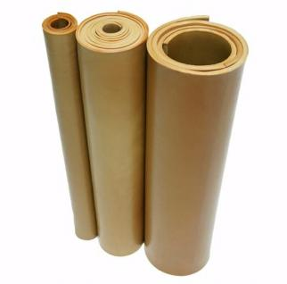
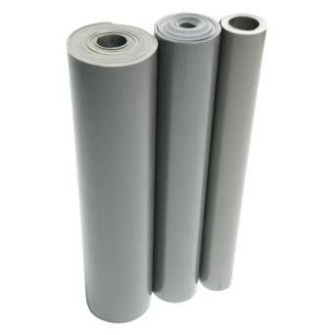
13
14
NATURAL RUBBER SHEET
Natural rubber sheet has high elasticity and wear resistance, but also has good cold resistance and waterproof performance, and is not easy to age
and corrode. Natural rubber sheets are widely
used in industry, construction, transportation and other fields, such as protective pads, rubber pads, sound insulation pads, sealing pads, conveyor
belts, etc.
SILICONE RUBBER SHEET
Silicone rubber sheet has excellent high and low
temperature resistance, aging resistance, oxidation resistance, radiation resistance, and also has good mechanical strength and electrical insulation
properties. Silicone rubber sheets are widely used in high-tech fields such as aerospace, electronics, and medical equipment.
Standard Product Sheet
Standard Product Sheet
 | NR-01 | NR-02 | NR-03
Polymer | NR/BR | NR | NR/SBR/BR
Color | Red/Brown/Grey | Red/Brown/Grey | Black
(g/cm3) Density | 1.05 | 1.05 | 1.15
(Shore A) Hardness | 45 | 40 | 60
(MPa) Tensile Strength | 22 | 18 | 20
(%) Elongation | 650 | 600 | 500
(℃) Work Temp. | -40 - 80 | -40 - 80 | -40 - 80
 | Silicone-01 | Silicone-02 | Silicone-03
Polymer | Silicone | Silicone (Gas phase) | Silicone (Fire resist.)
Color | Custom | Custom | Custom
(g/cm3) Density | 1.25 | 1.25 | 1.5
(Shore A) Hardness | 60 | 60 | 60
(MPa) Tensile Strength | 6 | 9 | 5
(%) Elongation | 300 | 600 | 300
(℃) Work Temp. | -60 - 200 | -60 - 230 | -60 - 230

Slide 9
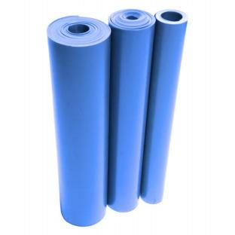
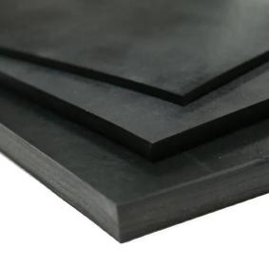
15
16
FLUOROSILICONE RUBBER SHEET
Fluorosilicone rubber is a type of synthetic
elastomer that exhibits similar properties to
silicone rubber, but with enhanced resistance to fuels, oils, and solvents. It is a durable material
that can withstand a wide range of temperatures,
from -60°C to 260°C, making it ideal for use in
high-performance applications such as aerospace, automotive, and industrial manufacturing.
BALLISTIC RUBBER SHEET
Ballistic Rubber Sheeting is a type of rubber material that is used to absorb the impact of high-velocity
projectiles. It is designed to withstand repeated
impacts from high-velocity bullets without breaking down or deteriorating. The material is also designed to reduce ricochets and airborne lead particles,
making it a safer option for shooting ranges.
Standard Product Sheet
Standard Product Sheet
 | Fluorosilicone-01
Polymer | Fluorosilicone
Color | Blue/Red/Black/White/Transparent
比重(g/cm3) Density | 1.5
(Shore A) Hardness | 60
(MPa) Tensile Strength | 7
%) Elongation | 200
度(℃) Work Temp. | -60 - 260
 | BRS-01 | BRS-02
Polymer | Natural Rubber | Natural Rubber
Features | Weather Resistance | Weather Resistance
比重(g/cm3) Density | 1.1 | 1.05
Shore A) Hardness | 45 | 40
(MPa) Tensile Strength | 15 | 20
(%) Elongation | 600 | 650
(℃) Work Temp. | -40 - 80 | -40 - 90

Slide 10
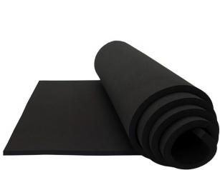
17
18
SPONGE RUBBER SHEET
Sponge rubber sheets are commonly used in various applications such as sealing, heat
insulation, sound insulation, shock absorption and gaskets. Its advantages include high compressive and elastic properties, excellent thermal insulation properties, good sound absorption properties, and excellent shock resistance.
FRAS RUBBER SHEET
FRAS (Fire-Resistant, Anti-Static) rubber sheet has good physical properties including mechanical
strength and moderate abrasion, impact and UV
resistance making it suitable for sealing, insulating and isolating applications in underground
applications or where ignition points and fire
potential area high risk such as coal mines or grain handling and processing.
Standard Product Sheet
Standard Product Sheet
 | Sponge-01 | Sponge-02
Polymer | EPDM | Natural Rubber
Color | Red/Black | Red/Black
Cell Structure | 开孔 Open cell | 开孔 Open cell
(g/cm3) Density | 0.5 | 0.5
(Shore C) Hardness | 30 | 30
(℃) Work Temp. | -40 - 135 | -30 - 80
 | FRAS-01
Color | Black
(g/cm3) Density | 1.35
(Shore A) Hardness | 65
(MPa) Tensile Strength | 8
(%) Elongation | 300
(mm³) Abrasion Resistance at 5N | 250

Slide 11
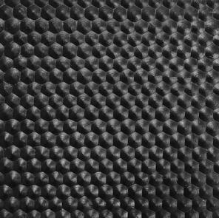
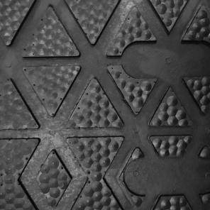
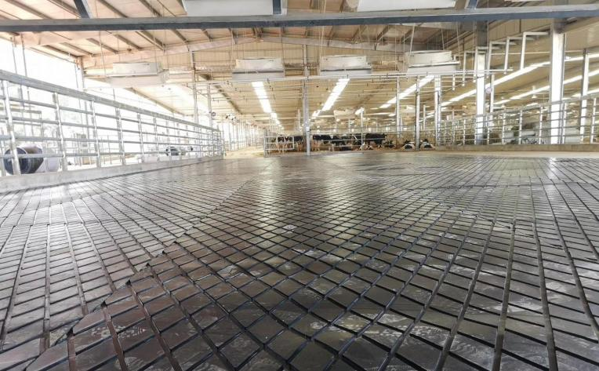
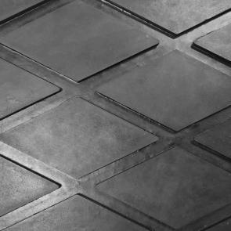
20
RUBBER MAT FOR AGRICULTURE
4001
Hammer
Rubber mats are a versatile and practical solution in the field of agriculture. Its excellent durability saves practical costs for customers. At the sametime, the rubber mat provides the animal with a comfortable, resilient surface that helps prevent animal injury and promotes better health. The
surface of the rubber mat has excellent anti-skid performance and is easy to clean and maintain.
Available Size
Thickness
10-25mm
Width
1-2m
Length
1-50m
4002
Cow Hoof
APPLICATION
• Cow Mattress
• Horse Stable Mat
• Pig Mat
• Alley Mat
• Equipment Protection
• Anti-fatigue Mat
Available Size
Thickness
19mm
Width
1.83m
Length
1-50m
4003
Diamond
Available Size
Thickness
17-25mm
Width
1-2m
Length
1-30m

Slide 12
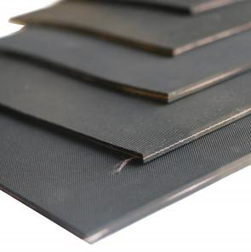
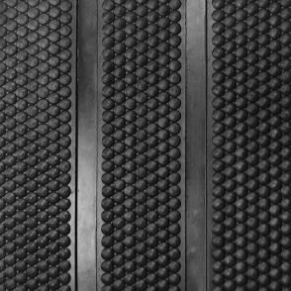
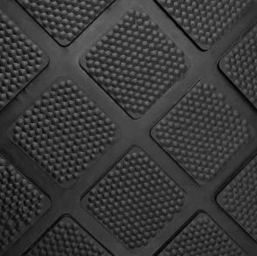
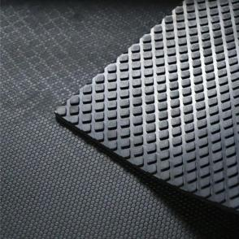
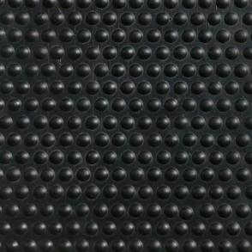
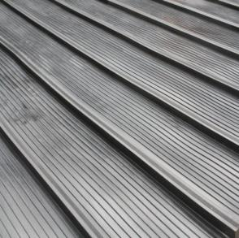
21
22
4005
Cow Mattress
4009
Ribbed Hammer
Available Size
Thickness
4-8mm
Width
1-2m
Length
1-50m
Available Size
Thickness
15-25mm
Width
1-2m
Length
1-50m
4006
Square Hammer
4011
Bee Comb
Available Size
Thickness
15-25mm
Width
1-2m
Length
1-50m
Available Size
Thickness
12mm/15mm/17mm
Width
1.22
Length
1.83m
4008
Stud
8002
Ramp Mat
Available Size
Thickness
12mm/17mm
Width
1.22m
Length
1.83m
Available Size
Thickness
14mm
Width
1.75m
Length
1.55m

Slide 13
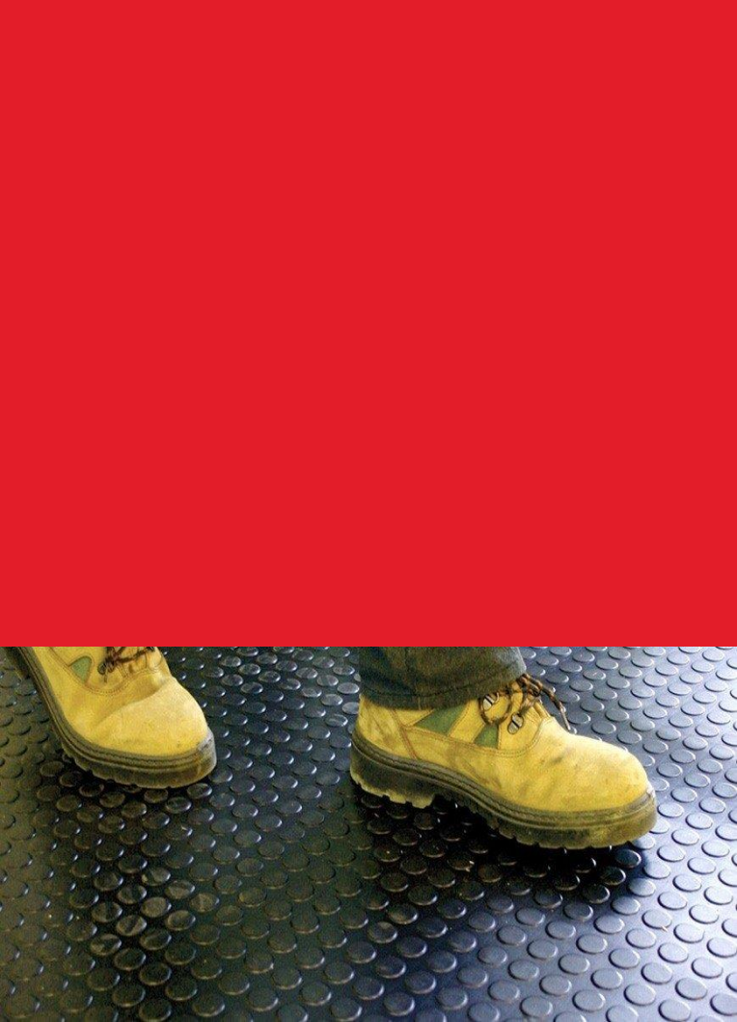
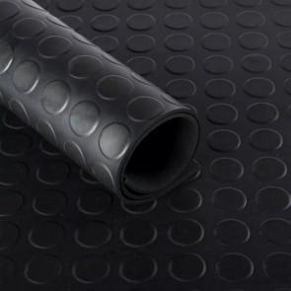
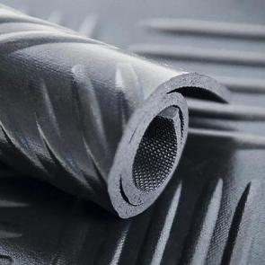
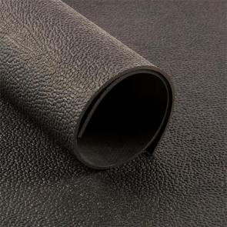
24
RUBBER FLOORING
3001
Round Button
Rubber flooring is a type of flooring material made from synthetic rubber. It is often used in
commercial or industrial settings due to its durability and resistance to wear and tear. Rubber flooring can also be found in gyms, playrooms, and other areas where impact resistance is
important. It comes in a variety of colors, patterns, and textures, and can be installed astiles, rolls, or mats. Additionally, rubber flooring can be slip-resistant, making it a popular choice for areas
that may become wet, such as bathrooms or pool decks.
Available Size
Thickness
3-8mm
Width
0.5-2m
Length
10m/20m
Products marked with “ " can also be made of TPE
(thermoplastic elastomer) in addition to commercial grade. This material has been improved in durability, and is more environmentally friendly, has only extremely low odor, and can be customized in various colors.
3005
Checker
Available Size
Thickness
3-8mm
Width
0.5-2m
Length
10m/20m
3006
Horse Rubber Mat
Available Size
Thickness
3-8mm
Width
0.5-1.5m
Length
10m/20m

Slide 14
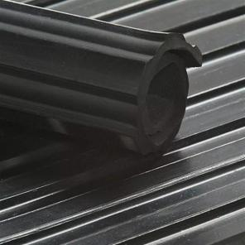
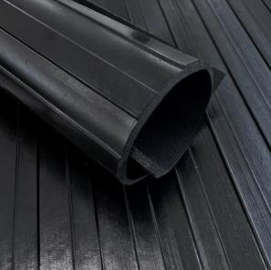
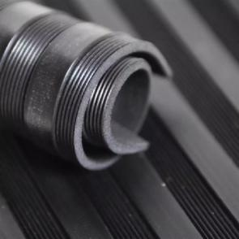
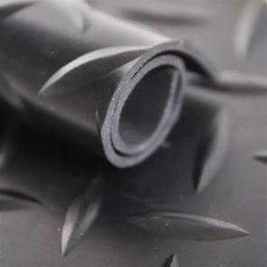
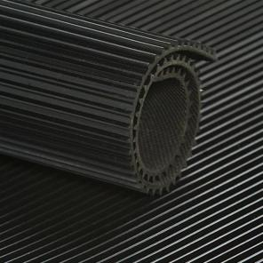
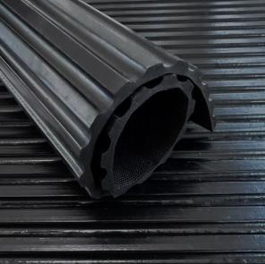
25
26
3008
Wide Rib (Deep)
Available Size
Thickness
6-12mm
Width
0.6-2m
Length
10m/20m
3012
Wide Rib (Shallow)
Available Size
Thickness
3-8mm
Width
0.5-2m
Length
10m/20m
3010
Composite Ribbed
3013
Willow/Leave
Available Size
Thickness
3-8mm
Width
0.5-1.5m
Length
10m/20m
Available Size
Thickness
3-8mm
Width
0.5-2m
Length
10m/20m
3011
Fine Rib
3014
Rib
Available Size
Thickness
3-8mm
Width
0.5-2m
Length
10m/20m
Available Size
Thickness
3-8mm
Width
0.6-1.5m
Length
10m/20m

Slide 15
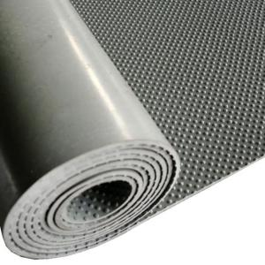
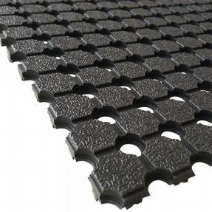
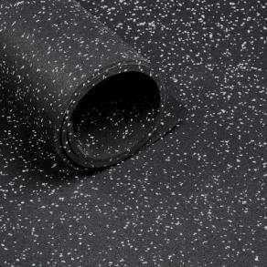
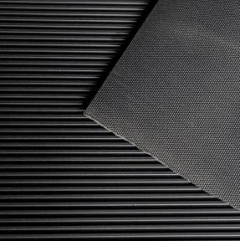
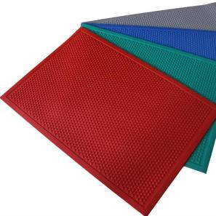
27
28
3004
Small Stud
3022
Truck Bed Mat
Available Size
Thickness
4-8mm
Width
0.5-1.8m
Length
10m/20m
Available Size
Thickness
10mm
Width
1.83m
Length
10m
3020
Gym Mat
5002
Electrical Insulation Rubber Mat
Available Size
Thickness
3-10mm
Width
0.5-1.5m
Length
10m/20m
Available Size
Thickness
3-10mm
Width
0.5-2m
Length
10m/20m
3021
Entrance Mat
Available Size
Thickness
4-8mm
Width
0.6m
Length
0.9m

Slide 16
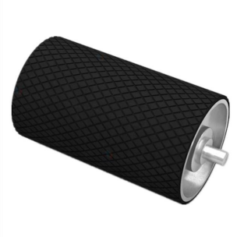
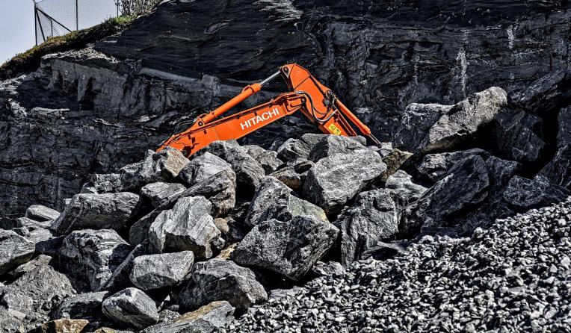
30
RUBBER SHEET FOR MINING
RUBBER PULLEY LAGGING
Rubber pulley lagging is made of high-quality
rubber material that resists wear, tear and other
forms of damage. It improves the friction and
traction between the pulley and the belt. This helps prevent the belt from slipping on the pulleys, which can damage the belt and pulleys and cause costly downtime.
Rubber sheets for mining are typically made from natural or synthetic rubber and come in a variety of thicknesses and grades, depending on the specific application. They can be used to line chutes, hoppers, and other high-wear areas to reduce the need for frequent maintenance and replacement. It can also be used as a lining material for tanks, pipes, and other equipment that may be exposed to corrosive materials or harsh chemicals. They can help prevent leaks and extend the lifespan of the equipment.
APPLICATION
• Wear-resistance
• Tear-resistance
• Damping
• Anti-corrosion
• Impact-resistance
• Lining
Technical Parameter
Property | Value
(Shore A) Hardness | 65 +/- 5
(g/cm3) Density | 1.35/1.3/1.25/1.2/1.15
(MPa) Tensile Strength | 6/8/10/12/15
(%) Elongation | 250/300/350/400/450
(N/mm) Tear Resistance | 25/25/30/30/35
(mm³) Abrasion Resistance at 5N | 350/300/250/200/150
(%) Compression Set after 22hat 70℃ | 50/45/40/35/30
(℃) Work Temp. | -40 - 90

Slide 17
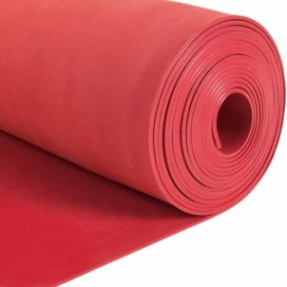
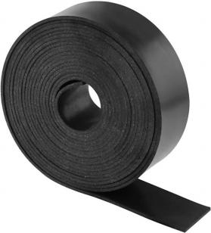
31
32
WEAR-RESISTANT LINING
Wear-resistant rubber linings are made of natural rubber and applied to the surface of equipment or structures to prevent damage from abrasion,
corrosion, impactor other forms of wear. Abrasion resistant linings can extend the life of equipment and reduce maintenance costs.
RUBBER SKIRT BOARD
The rubber skirt board is a sealing component that is commonly used in conveyor systems to prevent materials from spilling or escaping from the sides of the conveyor belt. It can also help to prevent
dust and other fine particles from escaping from the conveyor system. This can help to improve the
overall cleanliness and safety of the work environment.
CN Bonding Layer
Standard Product Sheet
Standard Product Sheet
 | RL-01 | RL-02
Material | Natural Rubber | Natural Rubber
(Shore A) Hardness | 38 | 40
(g/cm3) Density | 0.97 | 1.05
(MPa) Tensile Strength | 24 | 22
(%) Elongation | 800 | 700
(N/mm) Tear Resistance | 40 | 60
(mm³) Abrasion Resistance at 5N | 80 | 60
(%) Compression Set after 22hat 70℃ | 30 | 30
(℃) Work Temp. | -40 - 70 | -40 - 90
Property | Value
(Shore A) Hardness | 55/60/65 +/- 5
(g/cm3) Density | 1.5/1.45/1.35/1.3/1.25
(MPa) Tensile Strength | 4/6/8/10/15
(%) Elongation | 200/250/300/350/400
(N/mm) Tear Resistance | 18/20/25/30/35
(mm³) Abrasion Resistance at 5N | 500/350/300/350/200
(%) Compression Set after 22hat 70℃ | 60/50/45/40/35
(℃) Work Temp. | -40 - 90

Slide 18
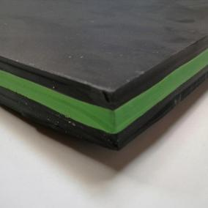
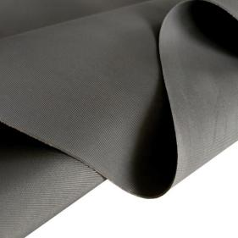
33
34
SANDWICH RUBBER SHEET
The sandwich rubber sheet adopts a three-layer
structure. The outer layer is black to help clean
and scratch the surface, while the middle layer is green for flexibility and impact resistance. Durable and resistant to abrasion and impact, the panel is ideal for use in industries such as mining and
construction. It can be used to clean conveyor belts and prevent dust and wet material from accumulating on the pulleys.
ANTI-CORROSION LINING
Anti-corrosion rubber lining is known for its
excellent gas and liquid impermeability. It is
usually used for storage tanks, pipelines and other equipment used to transport or store corrosive or dangerous materials. It is designed to protect the surface of tanks or pipelines from corrosion and
other forms of degradation, thus extending the service life of equipment and reducing the need for costly maintenance or replacement.
Standard Product Sheet
Standard Product Sheet
Property | Value
(Shore A) Hardness | 60/40/60
(g/cm3) Density | 1.15
(MPa) Tensile Strength | 15
(%) Elongation | 400
(mm³) Abrasion Resistance at 5N | 80
(℃) Work Temp. | -40 - 100
Color | Black/Green/Black
Property | Value
Material | Butyl
(g/cm3) Density | 1.2
(Shore A) Hardness | 60
(MPa) Tensile Strength | 8
Resistance | -Any concentration HCL(RT) - 40% H2So4 - 40% NaOH(RT) - Any concentration H3Po4(RT) - Sea Water

Slide 19
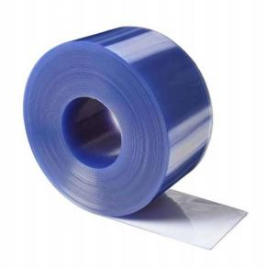
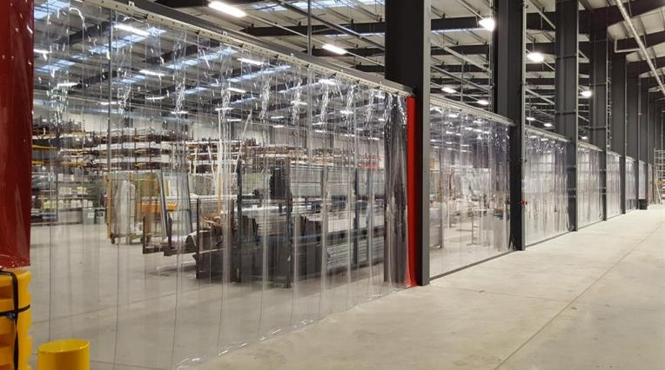
36
PVC STRIP CURTAIN
STANDARD PVC CURTAIN
Available Size
Thickness
2mm/3mm/4mm
Width
200mm/300mm/400mm
Length
50-90m
PVC FREEZER CURTAIN
Available Size
厚度 Thickness
2mm/3mm/4mm
宽度 Width
200mm/300mm/400mm
长度 Length
50-90m
FOODSAFE PVC CURTAIN
Available Size
Thickness
2mm/3mm/4mm
Width
200mm/300mm/400mm
Length
50-90m
PVC curtains, also known as strip curtains, are made from clear or colored polyvinyl chloride (PVC) material and are used to create a barrier between two areas while still allowing visibility and access. They are commonly used in industrial and commercial settings, such as warehouses, factories, and walk-in coolers, to regulate temperature, block noise, prevent the entry of dust and insects, and
improve overall energy efficiency. PVC curtains are typically easy to install, maintain, and replace, and can be customized to fit specific doorways or openings.
APPLICATION
• Factory
• Cold room
• Supermarket
• Laboratory
• Agricultural greenhouse
• Logistics center

Slide 20
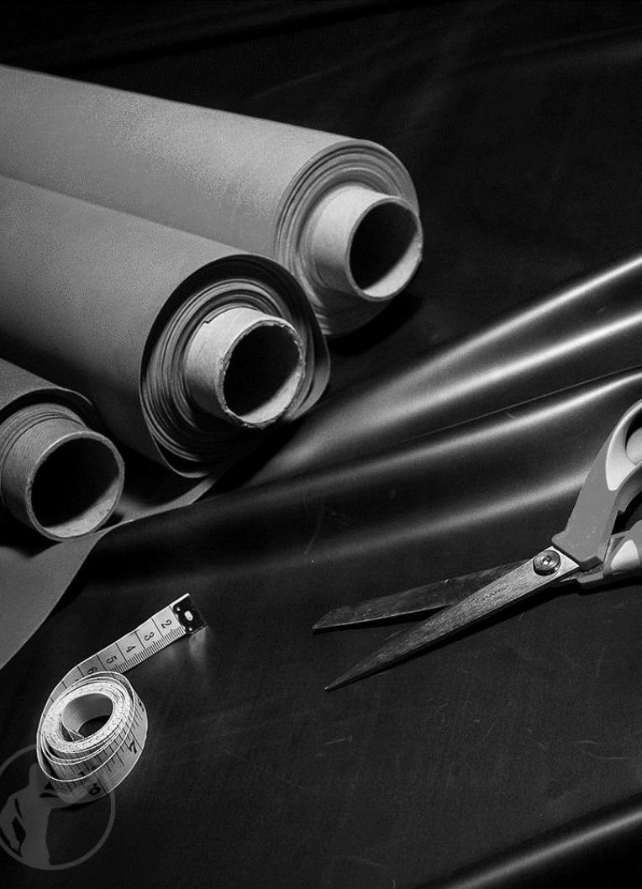
38
About Customization
As a manufacturer of high quality custom rubber sheets, means
providing you with industrial rubber sheets that meet all the requirements you specify. To accomplish this, our sales engineers will work tirelessly with you to determine what your definition of a quality product is and provide you with that product.
Certification
Cut for Pieces Cut for Strip Fabric Insertion Custom Size | Custom Physical Properties Logo Custom Logo on Product or Label Custom Color Custom Packaging
You can tell us the following information:
1. The working temperature range of the rubber sheet
2. The environment in which your product will operate, including any chemicals, gases or light sources to which it will be exposed.
3. Material Specifications Your Rubber Sheet Must Meet
4. The physical properties that your rubber sheet must meet (including but not limited to Hardness, Elongation, Tensile Strength, etc.)
Once our sales engineers understand the basic operating conditions required for your part, they can provide you with options so that you can choose the option that best
suits your application.

