Slide 1
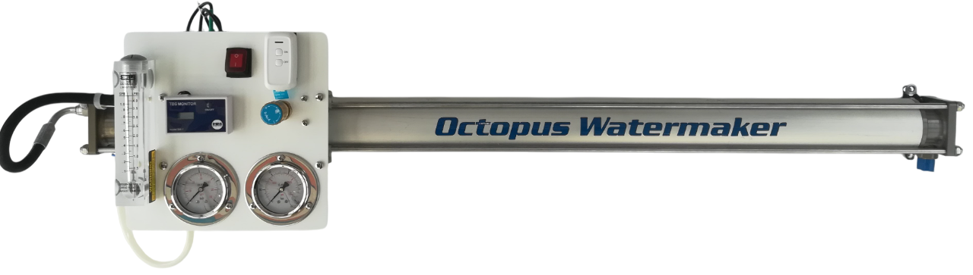
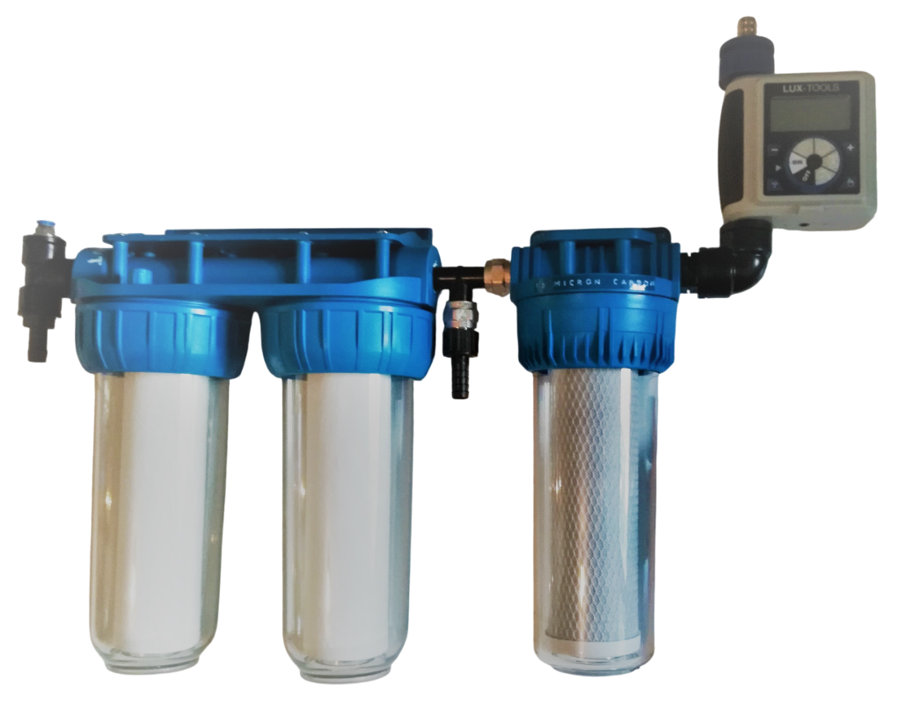
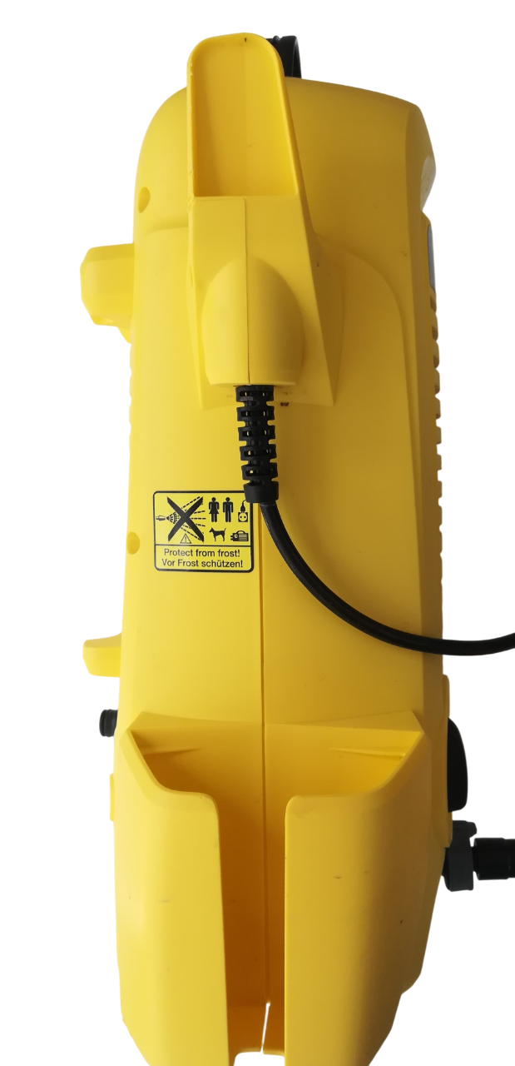
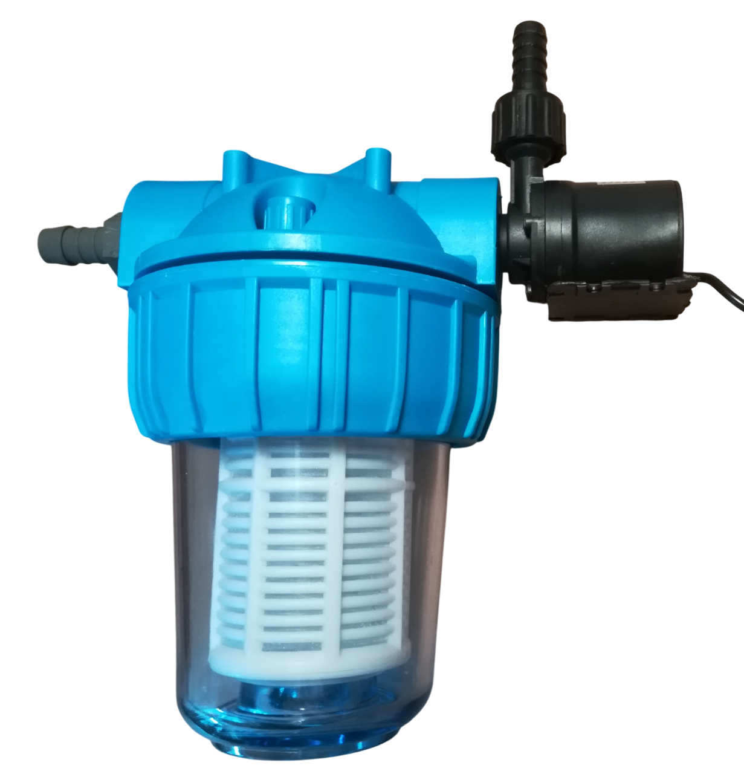
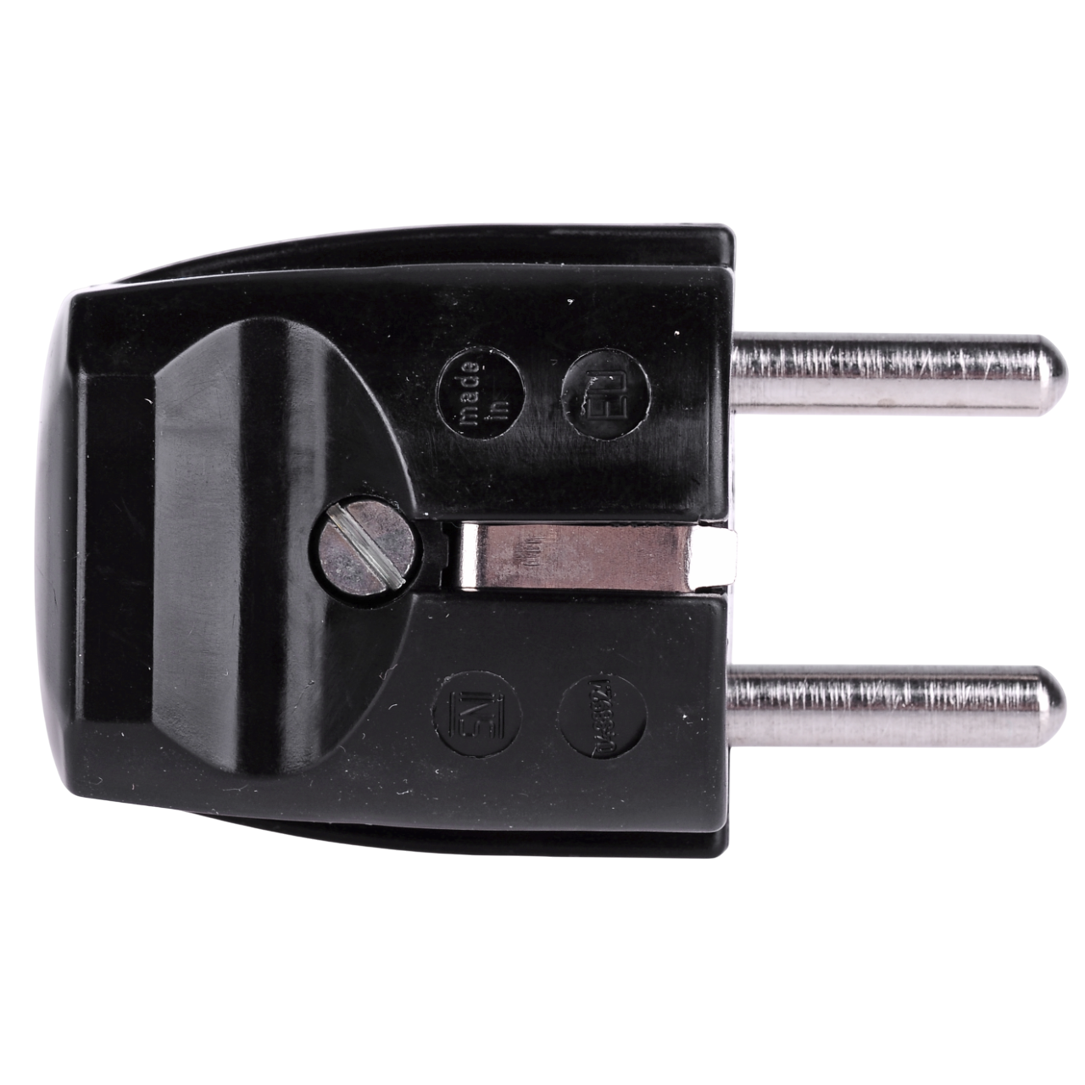
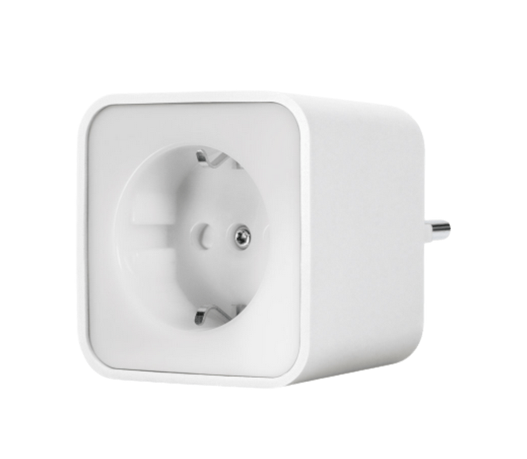
PLACE THE K2 ON A BASE TO AVOID VIBRATIONS AND FIX IT
FLOW CHART
FRESH WATER FOR RINSE
HOSE FROM TDS SENSOR GOES TO THE FRESH WATER TANK
HOSE FROM THE PRESSURE VALVE GOES OVER BOARD
SECURE THE HIGH PRESSURE HOSE WITH THE TWO PINS
BEFORE YOU SWITCH ON THE K2,SWITCH ON THE BOOST PUMP AND VENT THE SYSTEM.
CHECK THE SYSTEM FOR LEAKS.
KÄRCHER K2 230V / 120V
ALWAYS SWITCH THE K2 ON
12V / 24V
ENSURE AIR CIRCULATION TO PREVENT OVERHEATING
SEA WATER
PRE FILTER / BELOW THE WATERLINE
230V 120V
BLUE LINES ½ INCH HOSE
HYDRAULIC HOSE
GREEN LINES 8MM PNEUMATIK HOSE
ORANGE LINES 10MM PNEUMATIK HOSE

