Slide 1
Boris Kitov outside hitter

Slide 2
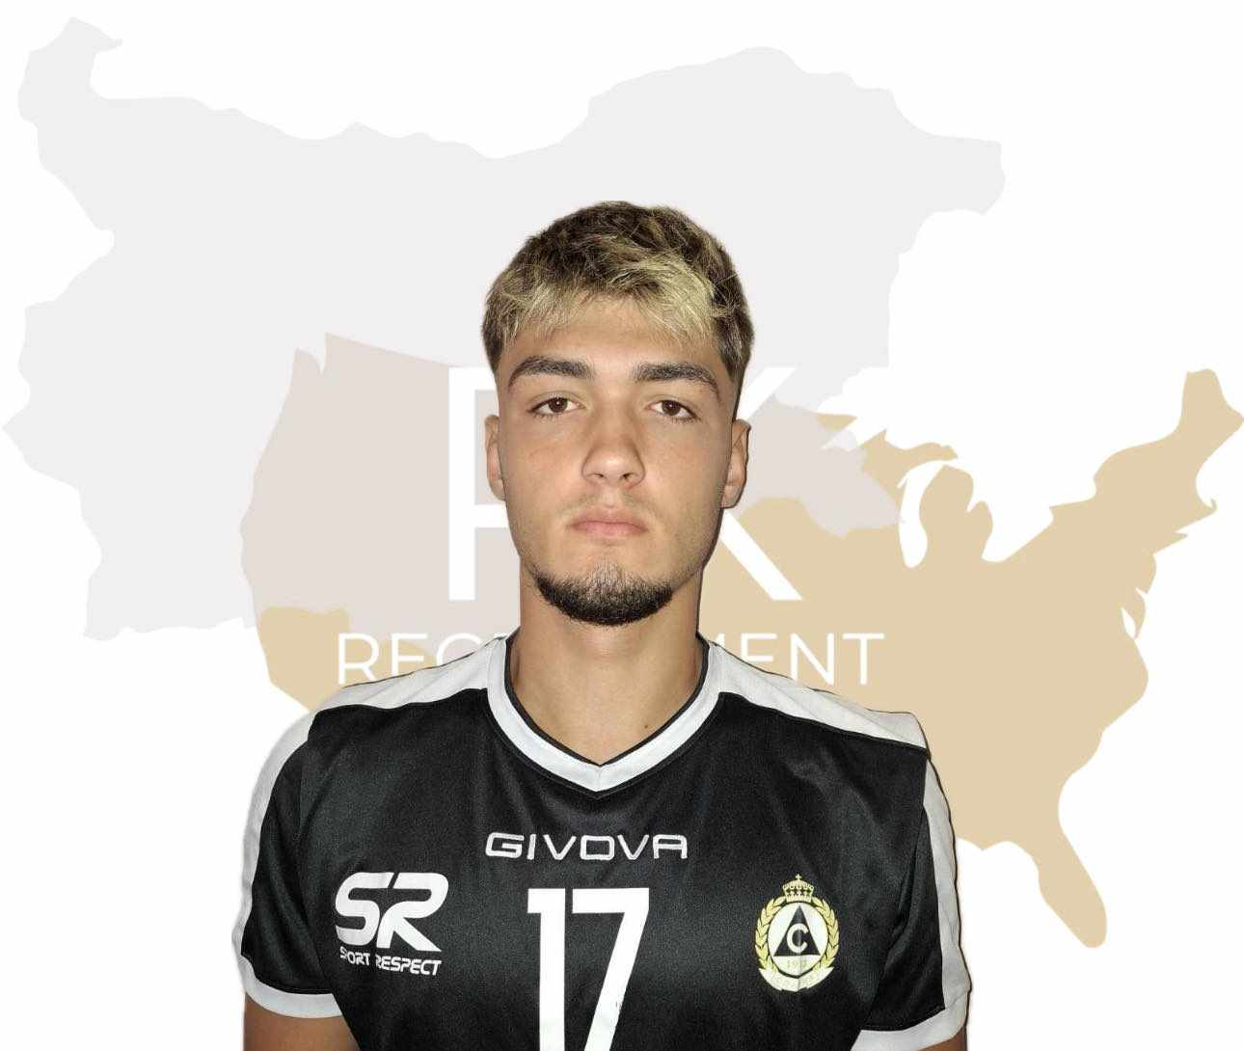
Status: Available
Gender: Male
Position: Outside Hitter
Date of Birth: 20.12.2006
Graduation date: June, 2025
Club team: Slavia, Sofia

Slide 3
Additional Information
Height: 190 cm.
Weight: 82 kg.
Reach: 242 cm.
Approach high jump: 340 cm.
Standing block jump: 320 cm.
High school: Secondary: 57th Sports Secondary School „Saint Naum Ohridski“
Languages: Bulgarian and English
Desired degree: undeclared
SAT grade/date: TBA
TOEFL grade/date: TBA

Slide 4
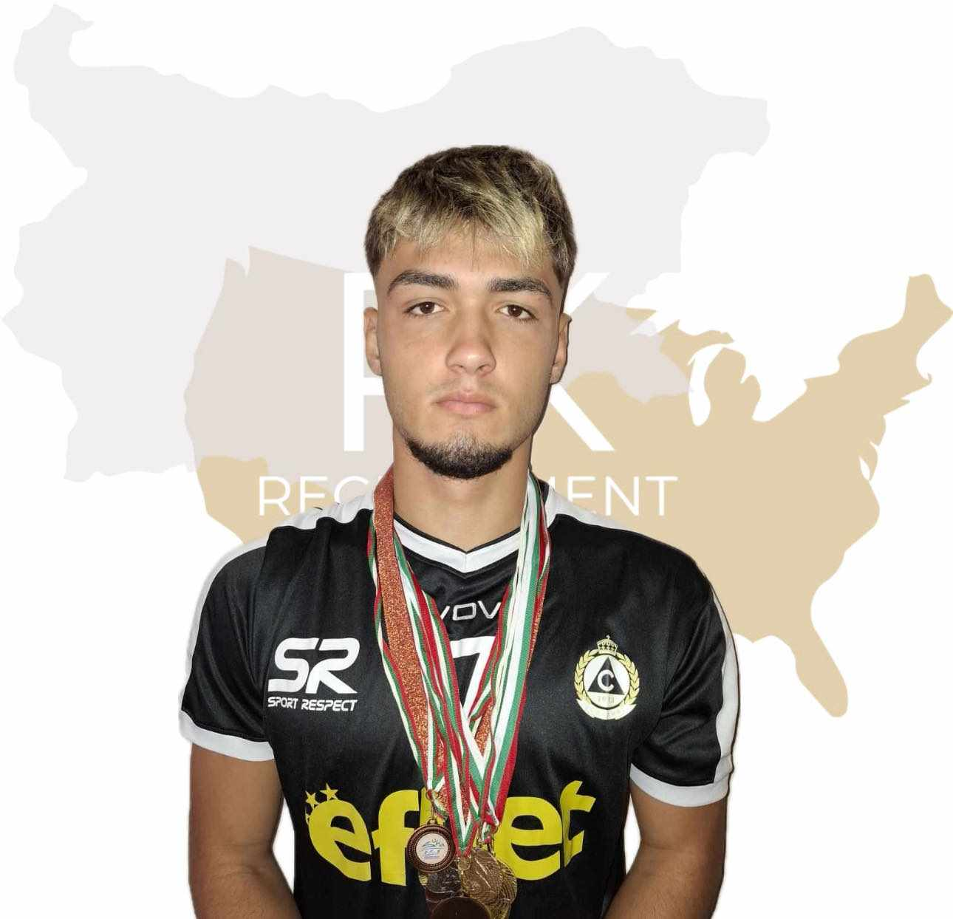
Volleyball Achievements
Bulgarian Republican championship 2016: - 1st place
Bulgarian Republican championship 2017/18: - 1st place
Bulgarian Republican championships 2019-2024:
2 2nd places, 2 4th places, 1 6th place
Vazrazhdane Fest 2024 -3rd place,
VGF Tournament 2024 - bronze medal

Slide 5
Interview questions
Describe yourself with a few sentences:
I am an ambitious young athlete who started serious training at the age of 9. Since then, volleyball has been the most important part of my life. If I have to describe myself in a few words they are purpose, desire to succeed, perseverance and discipline. Sport is also the reason I met my best friends - I think it gives us not only the satisfaction of success, but also the valuable people you meet along the way. I am a team player.
Apart from volleyball, my favorite sports that I practice non-professionally as a hobby are swimming and skiing. I love my family and my friends.
What does volleyball mean to you?
Sport is more than just a physical activity to me - it's a passion that has shaped who I am. It's a platform for personal growth, teaching me discipline, perseverance and teamwork. Through sport, I discover my limits and try to push beyond them, building confidence and resilience. As I already noticed - It's a source of joy and excitement allowing me to connect with people who share my enthusiasm. I strongly believe that sport is my chance to achieve the success I dream of and work for every day.

Slide 6
What does your education mean to you?
Naturally, education is an equally important part of a person and athlete's path to success. Sometimes it's hard to combine daily training with studying, but at this stage I'm managing and I'm sure I'll get better and better.
What are your main goals as a student-athlete in the USA?
My primary goals as a student-athlete in the USA are to reach my full potential as a volleyball player while pursuing a degree. I aim to contribute significantly to my team's success through hard work, dedication, and teamwork. I want to develop my skills and become a well-rounded athlete.
Beyond the court, I hope to excel academically and become a valuable member of the university community, leave a positive impact and prepare myself for a successful career after that. I believe that I will fit into the academic society and the team and together with the other players we will build strong team.

Slide 7
Video Analysis
Highlight Videos:
https://www.youtube.com/watch?v=F04WAjSDmUk
Full match:
https://www.youtube.com/watch?v=NMq5lyOGAJc

Slide 8
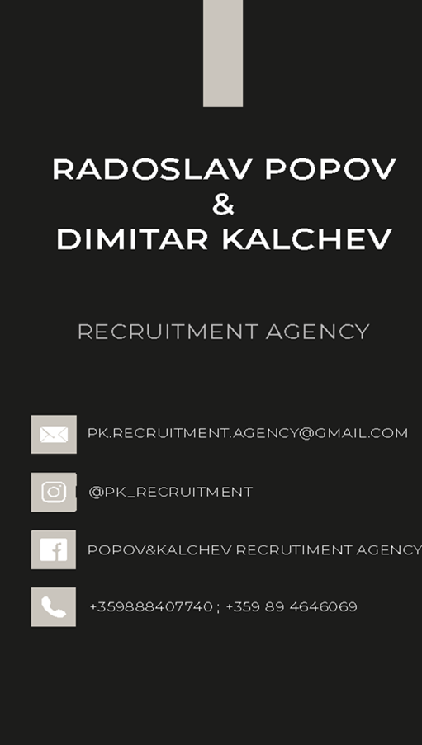
The presentation provides all the basic information for the student-athlete. More details and video can be provided if needed. Contact us.

