Slide 1
Ion Spectroscopy
Multilaser methods

Slide 2

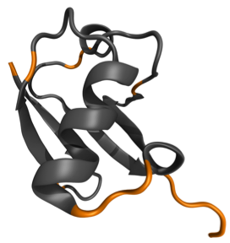
The Goal of Vibrational Spectroscopy
Theory
Experiment
3D structure
IRtheor
IRexp

Slide 3
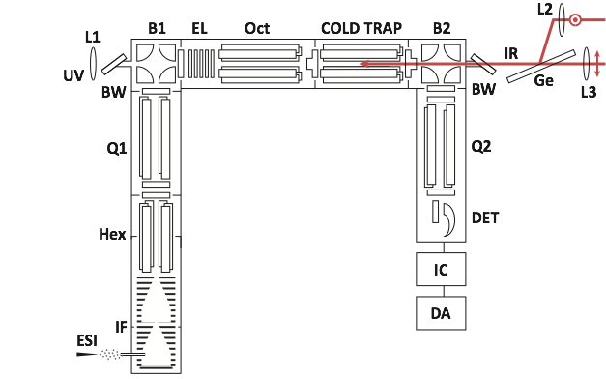
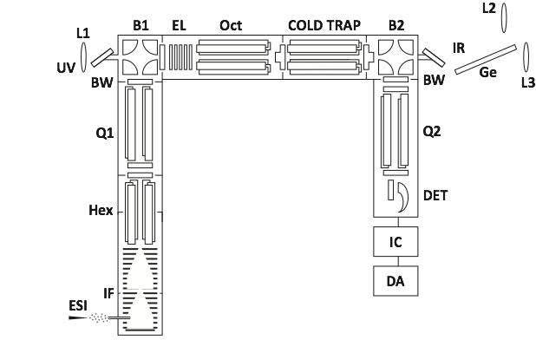
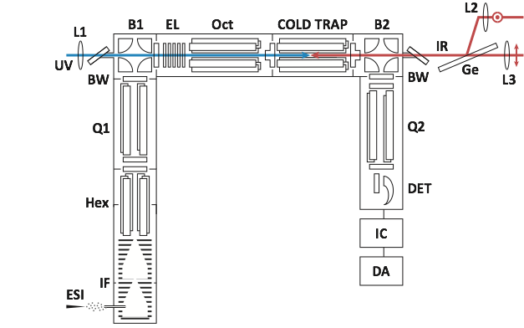
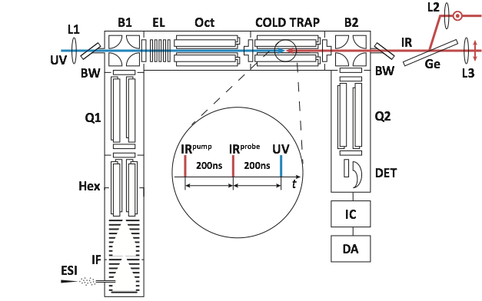
Tandem Mass Spectrometer

Slide 4
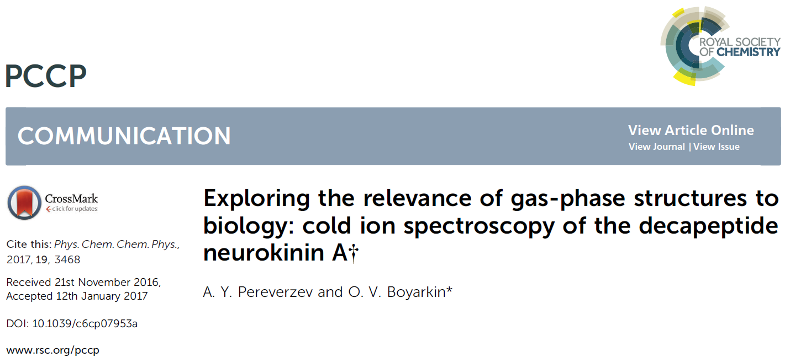
Paper 1

Slide 5
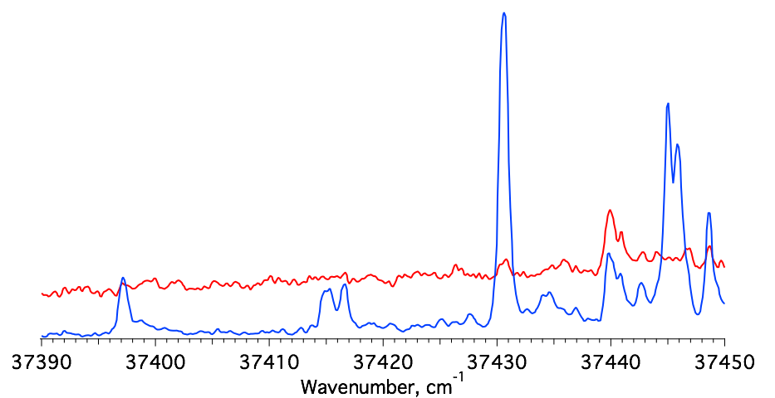
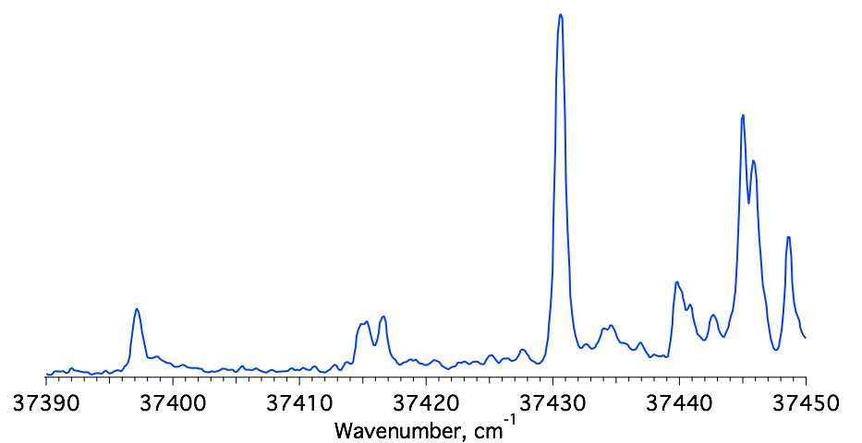
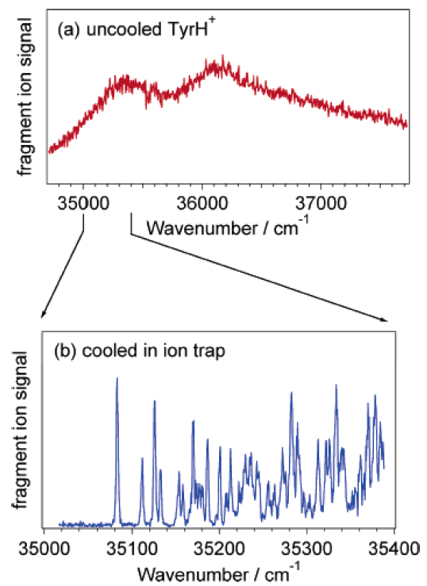
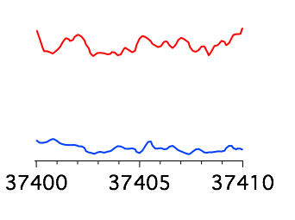
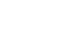
Why do we need to cool ions?
gain
depletion
Electronic spectra of protonated Tyr
at (a) room temperature and (b) 6K¹
1. O.V. Boyarkine, S.R. Mercier, A. Kamariotis,T.R. Rizzo. J. Am. Chem. Soc. 2006, 128, 2816-2817
2. N.S. Nagornova, T.R. Rizzo, O.V. Boyarkin. Angew. Chem. 2013, 52, 6002-60005

Slide 6
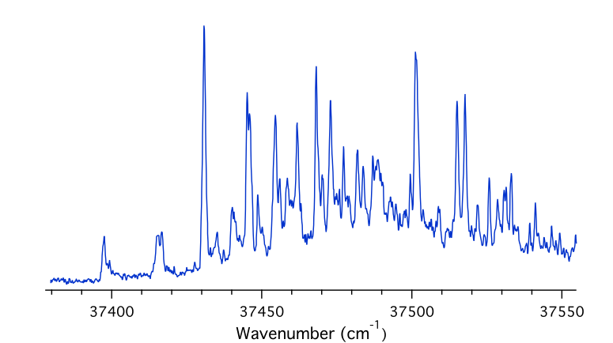


UV spectroscopy of NKA²⁺
Scan UV
S1
S0

Slide 7
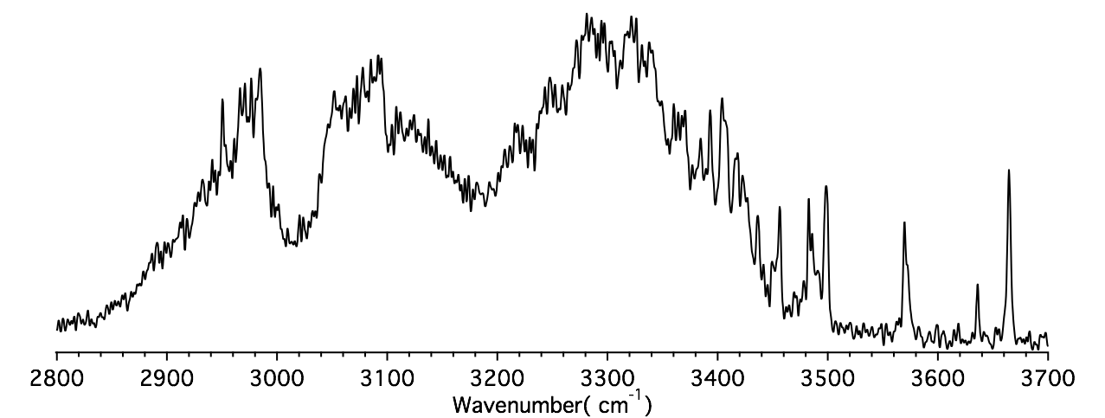
IR-UV gain spectroscopy of NKA²⁺
Fix UV
S1
Scan IR
S0

Slide 8
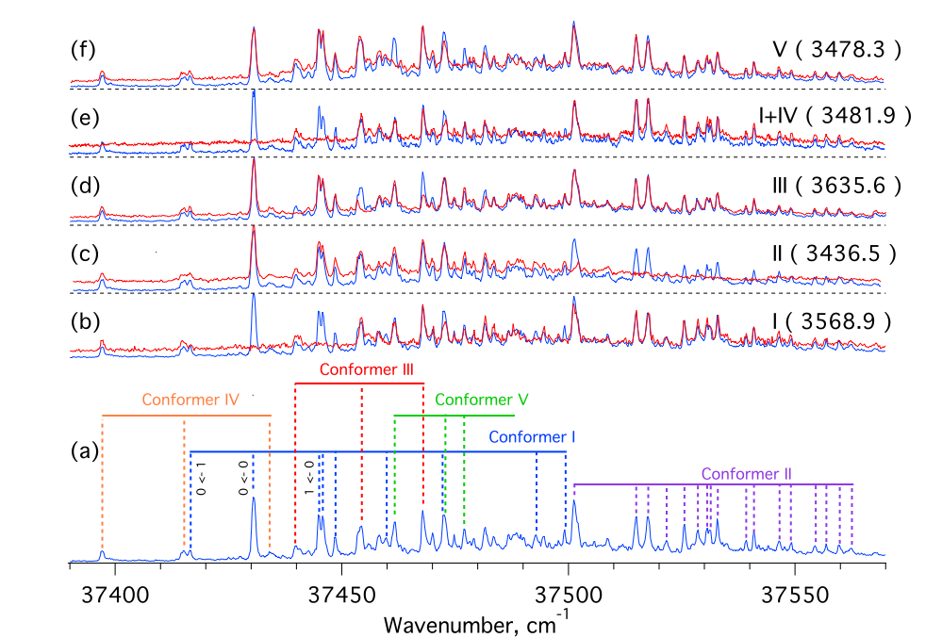
IR-UV hole-burning spectroscopy
Scan UV
Scan UV
Fix IR
Fix IR

Slide 9
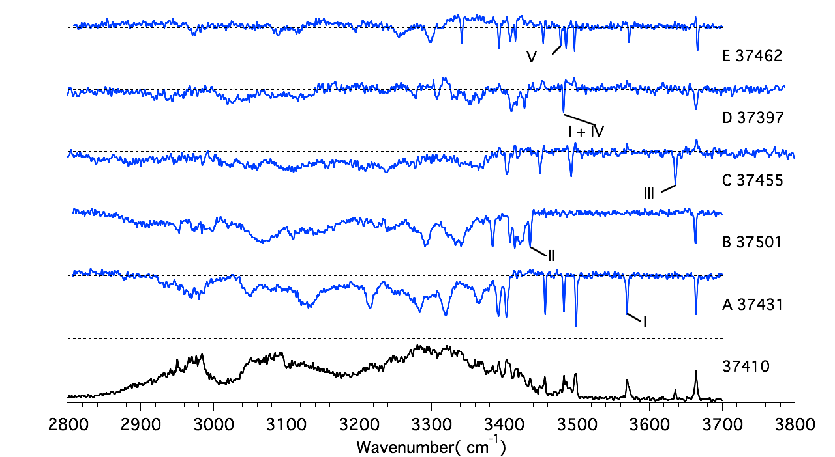
IR-UV Depletion Spectroscopy of NKA²⁺
Fix UV
Scan IR

Slide 10
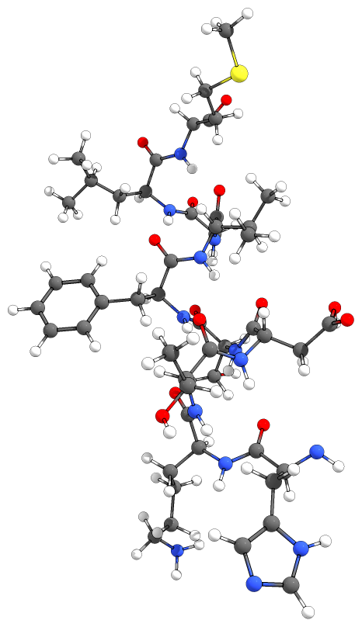
IR-UV double-resonance CIS
His-Lys-Thr-Asp-Ser-Phe-Val-Gly-Leu-Met-NH2
Address domain,
responsible for receptor selectivity
Message domain,
common for all tachykinins
1. I. R. Chandrashekar and S. M. Cowsik, Biophys. J., 2003, 85, 4002-4011.

Slide 11
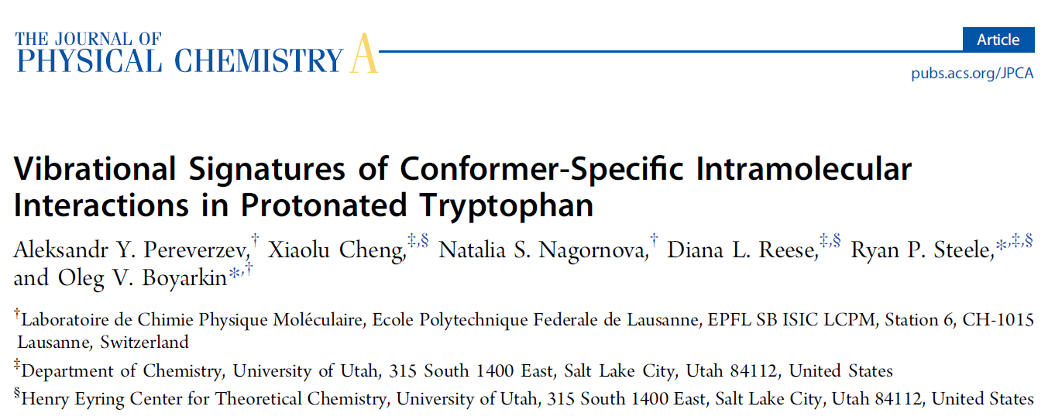
Paper 2

Slide 12
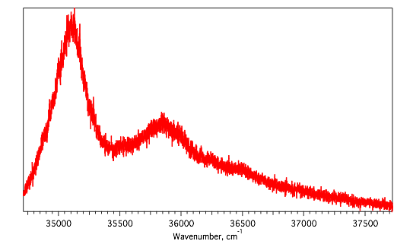
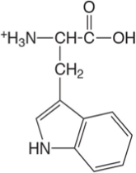
Lifetime broadening in TrpH⁺
UV photofragmentation spectrum of TrpH⁺ at T = 6K
1. O.V. Boyarkine, S.R. Mercier, A. Kamariotis,T.R. Rizzo. J. Am. Chem. Soc. 2006, 128, 2816-2817.

Slide 13
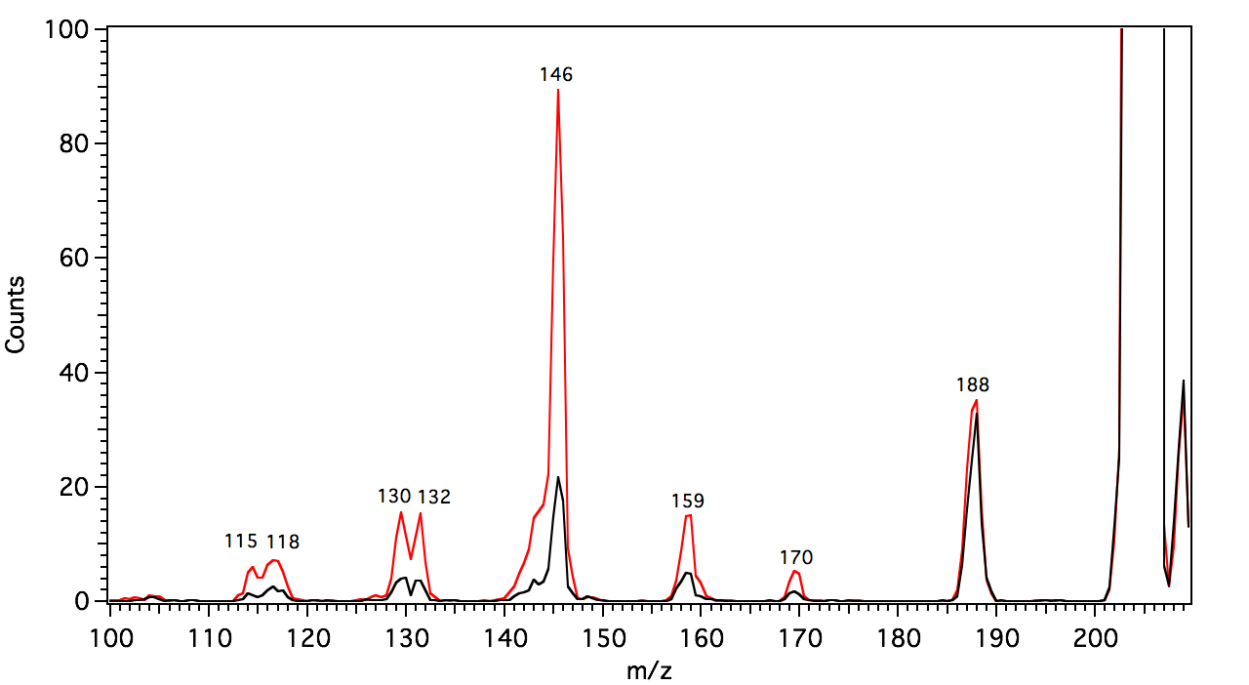
UV and IR-UV MS of TrpH⁺
UV only MS
IR-UV MS
-CH2CO
-NH3

Slide 14
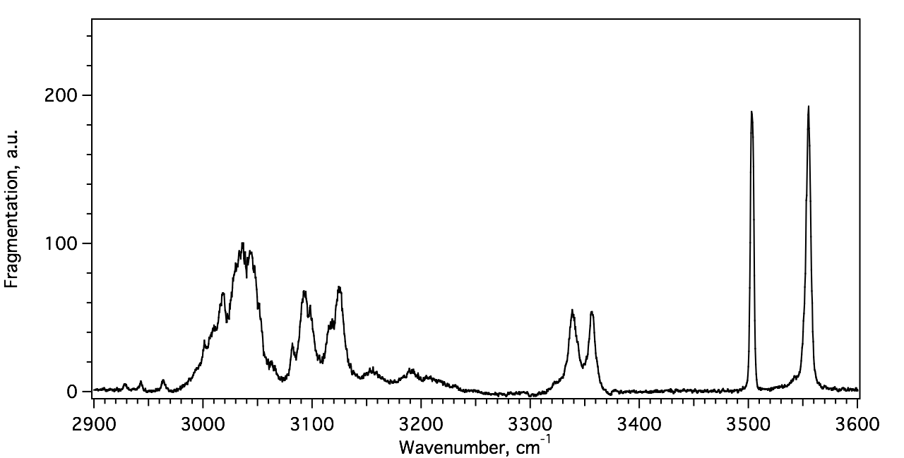
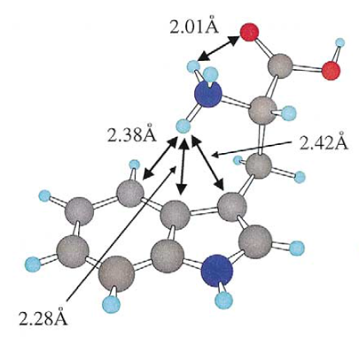
TrpH⁺ IR gain in 3 m spectral region
Indole NH
Free OH
Bound NH
stretching
Free NH
stretching
1. A.Y. Pereverzev, X. Cheng, N.S. Nagornova, D.L. Reese, R.P. Steele, O.V. Boyarkin. J. Phys. Chem. A 2016, 120, 5598-5608.

Slide 15
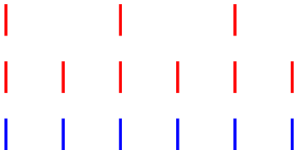
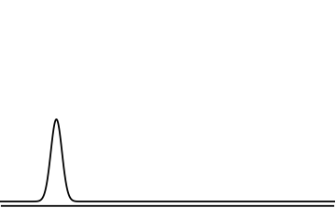
IR-IR-UV Hole-Burning Technique
Pulse scheme
Pump IR
Probe IR
UV
IR^{pr}-UV

Slide 16
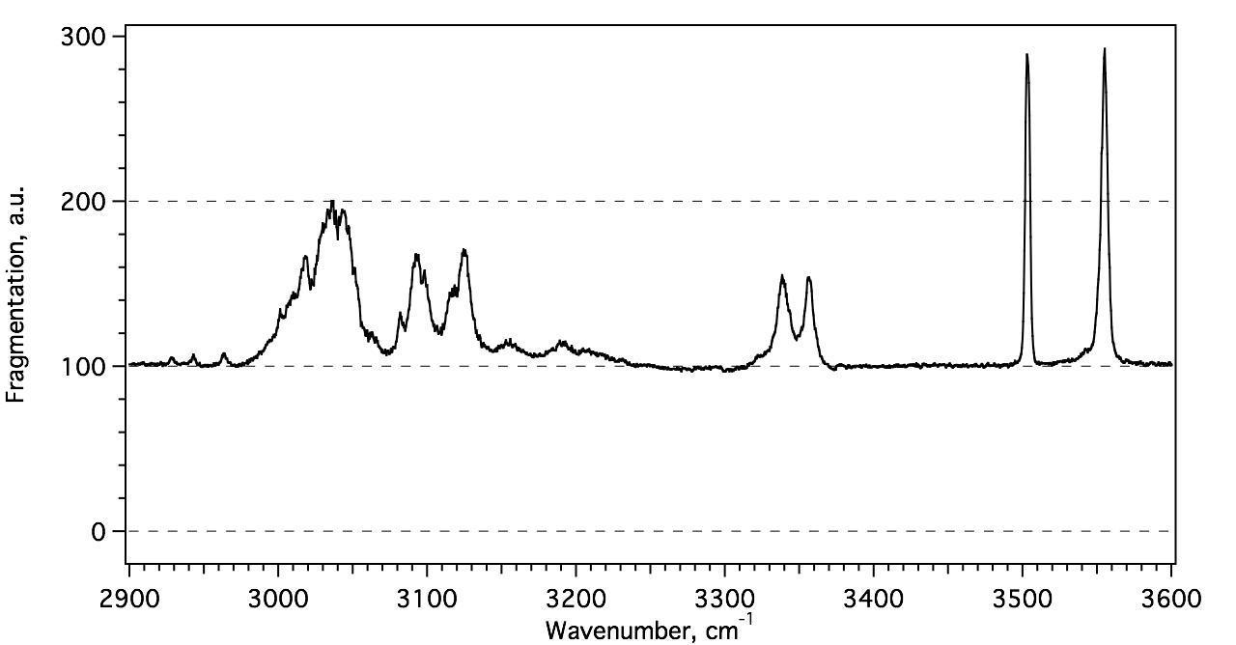
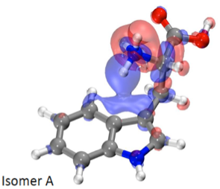
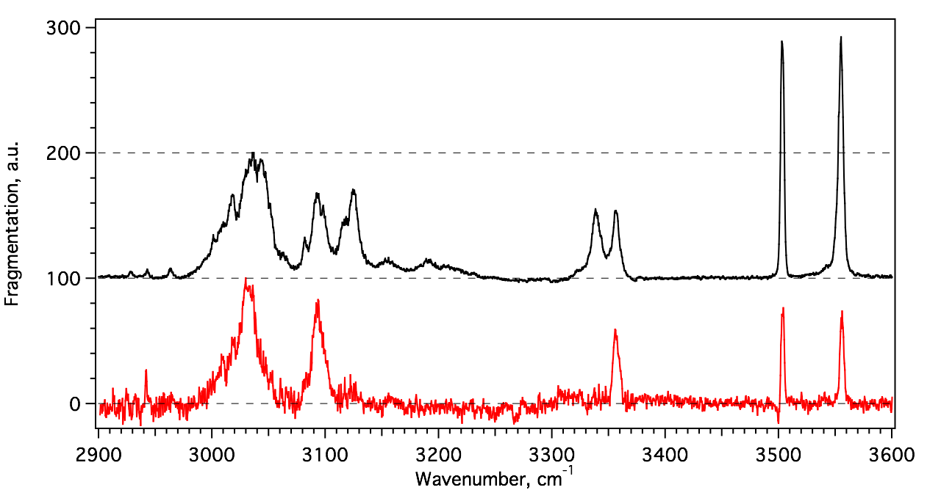
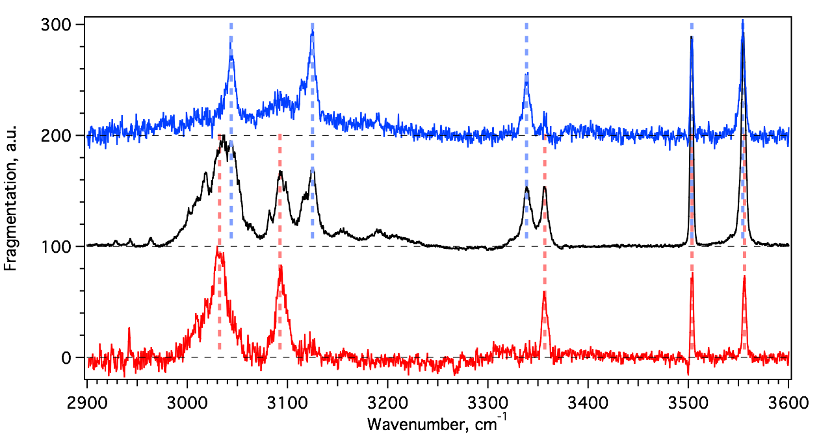
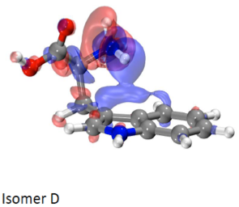
IR-IR-UV HB Spectroscopy of TrpH⁺
1. A.Y. Pereverzev, X. Cheng, N.S. Nagornova, D.L. Reese, R.P. Steele, O.V. Boyarkin. J. Phys. Chem. A 2016, 120, 5598-5608.

Slide 17
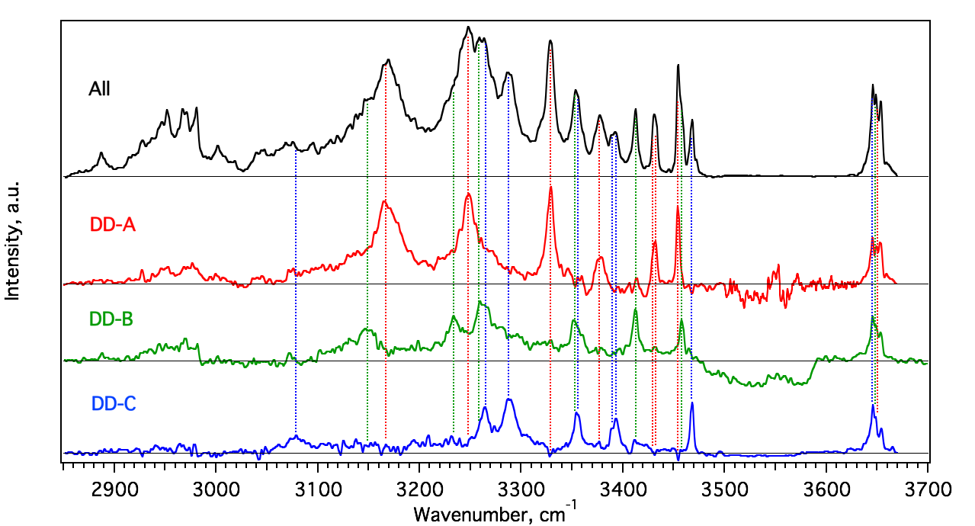
IR-IR-UV HB of [D-Ala²-D-Leu⁵]-Enk¹⁺

Slide 18
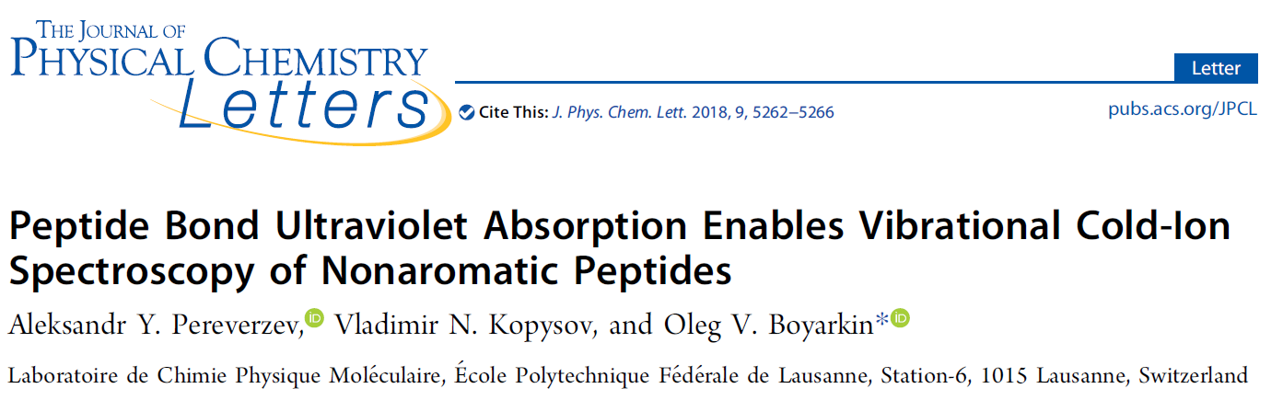
Paper 3

Slide 19
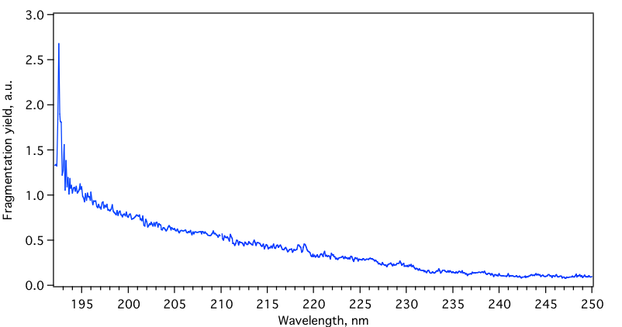
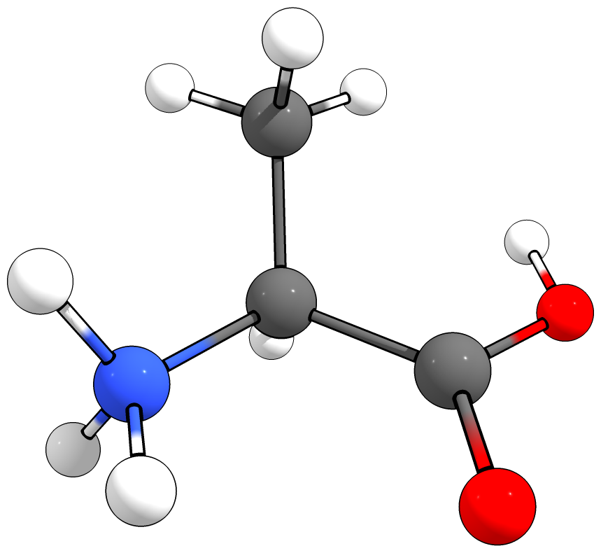
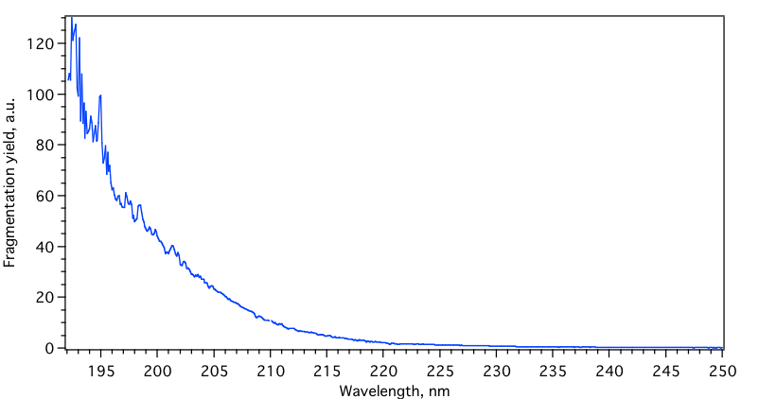
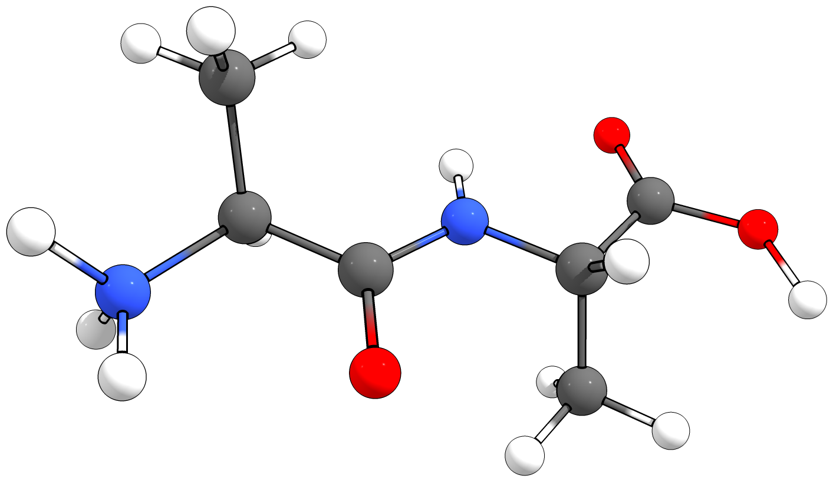
Absorption of the peptide bond
AlaH⁺
AlaAlaH⁺

Slide 20
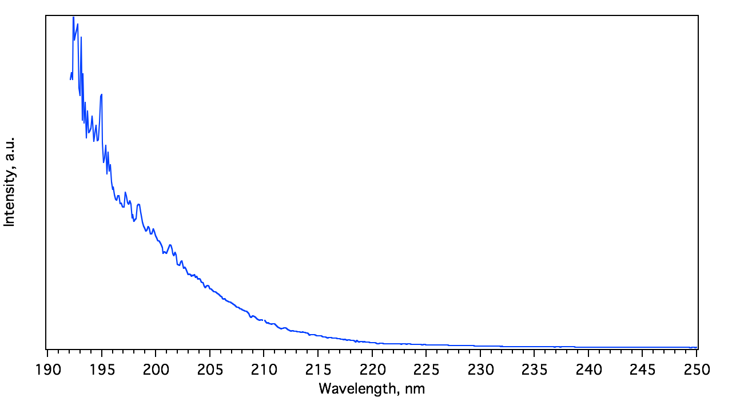
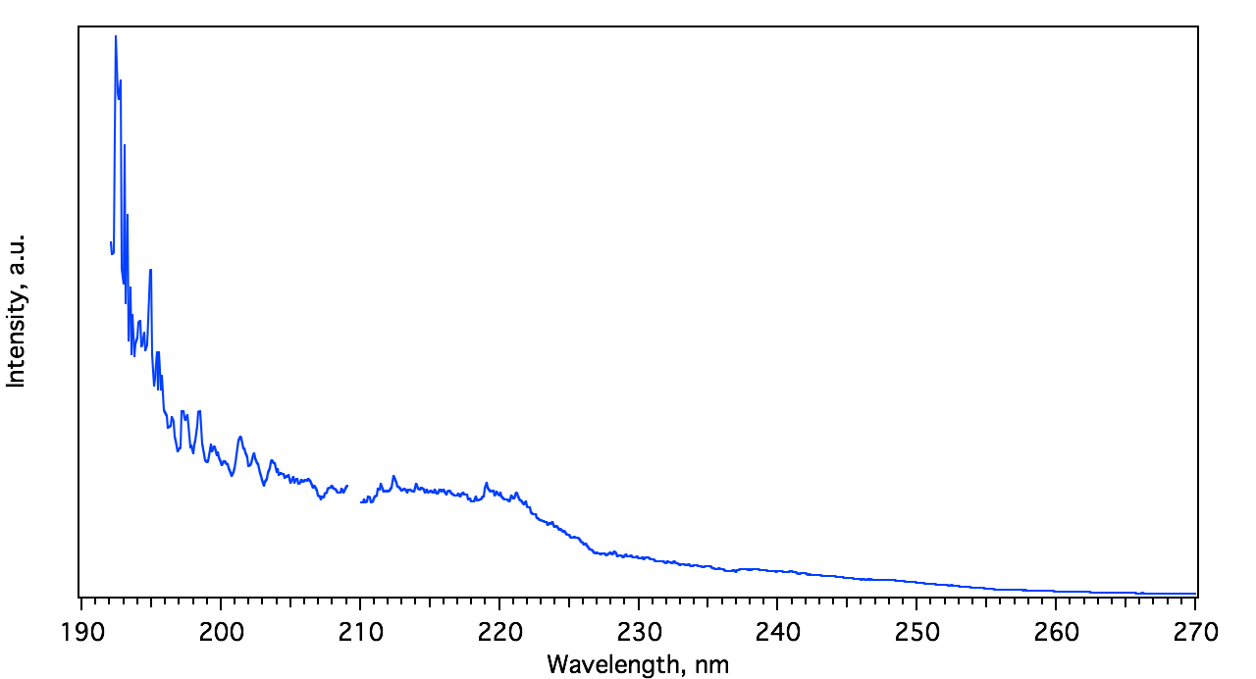
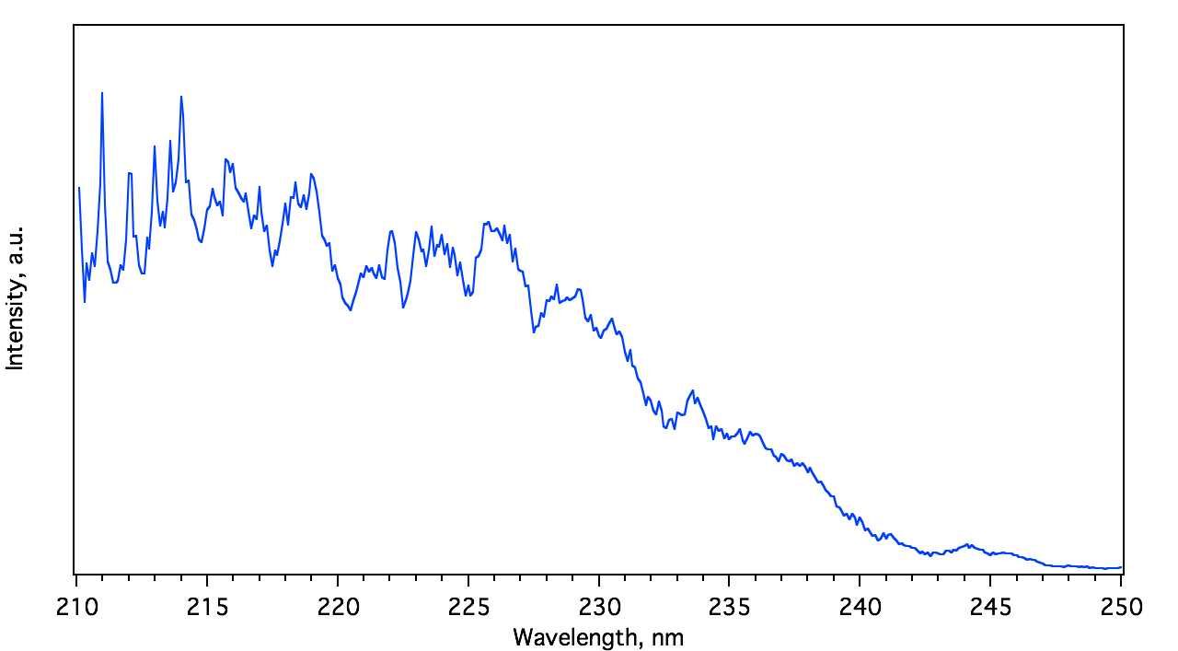
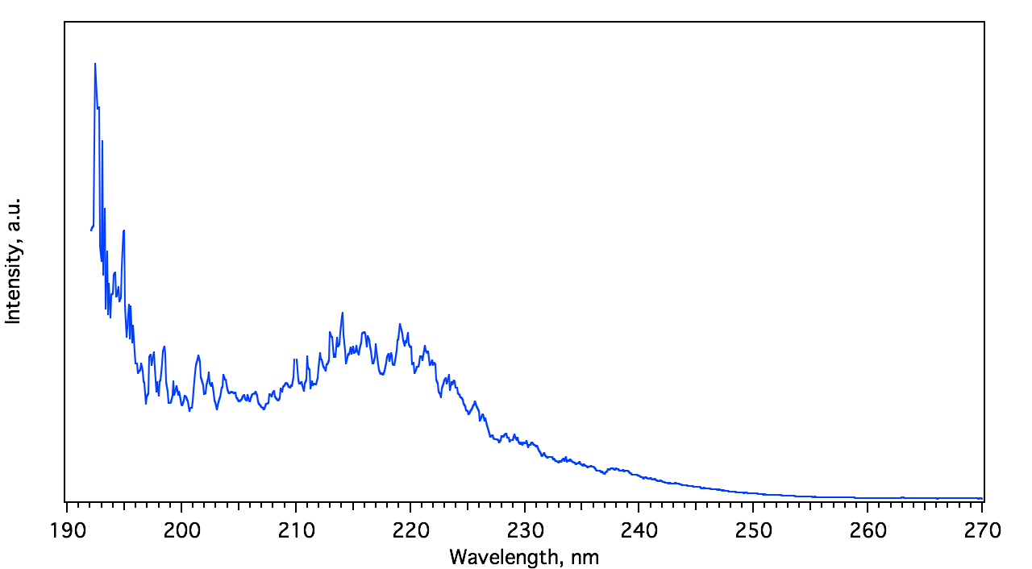
VUV spectroscopy of peptides
AA-H⁺
GPGG-H⁺
Ac-A6K-H⁺
Cyclo-GRGDSP-H⁺

Slide 21
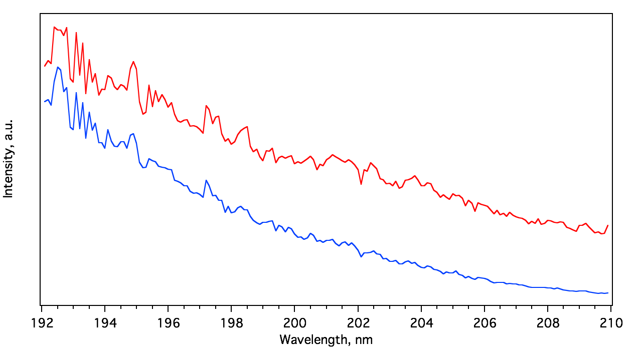
IR-VUV gain spectroscopy
IR-UV
UV

Slide 22
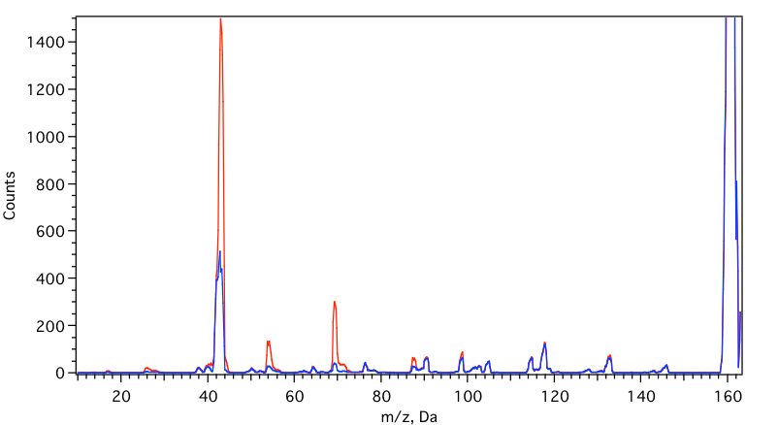
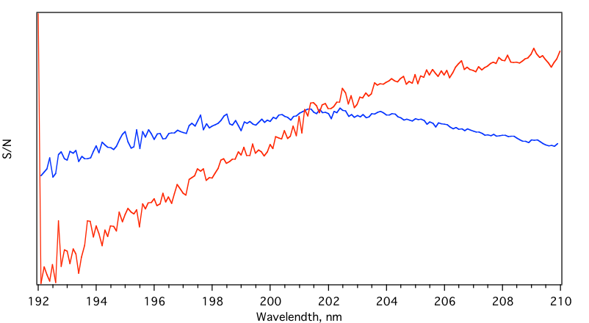
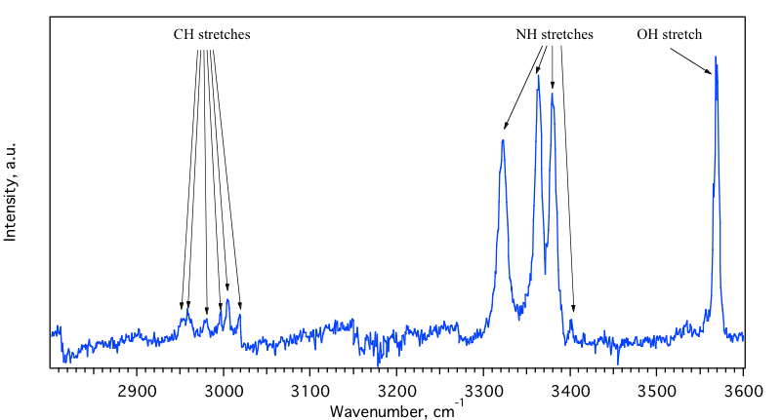
IR-VUV gain spectrum of Ala-AlaH⁺

Slide 23
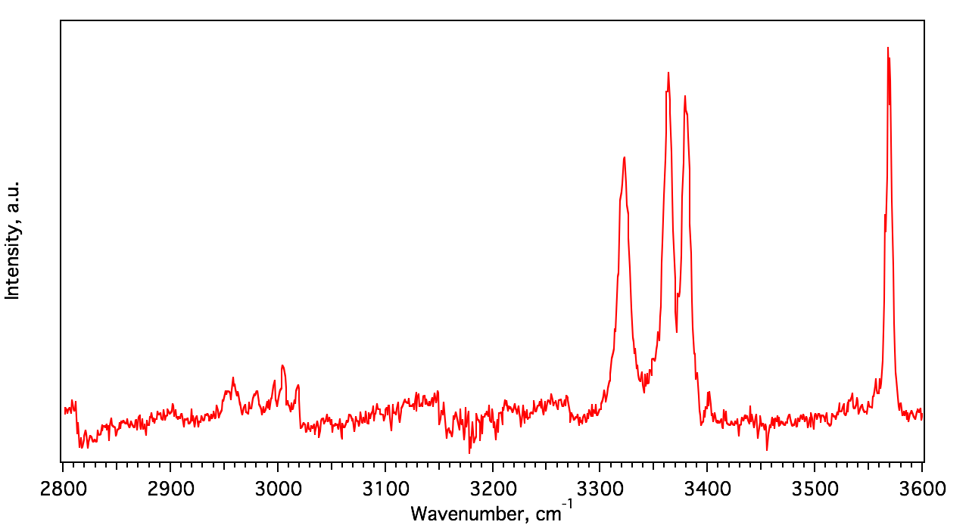
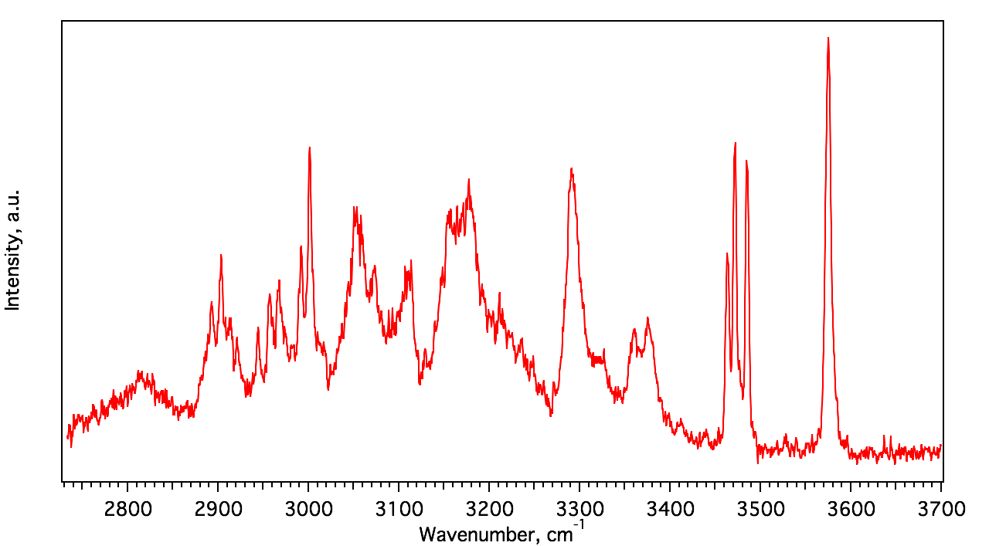
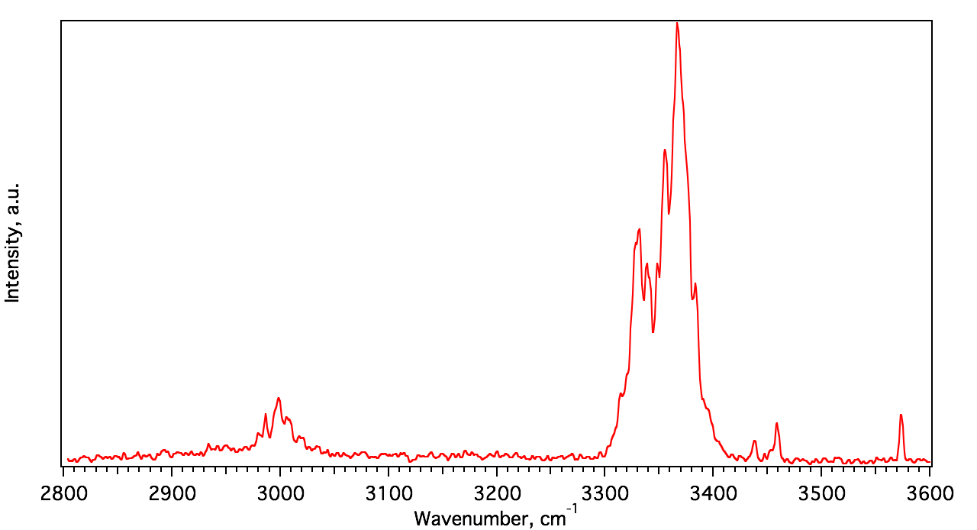
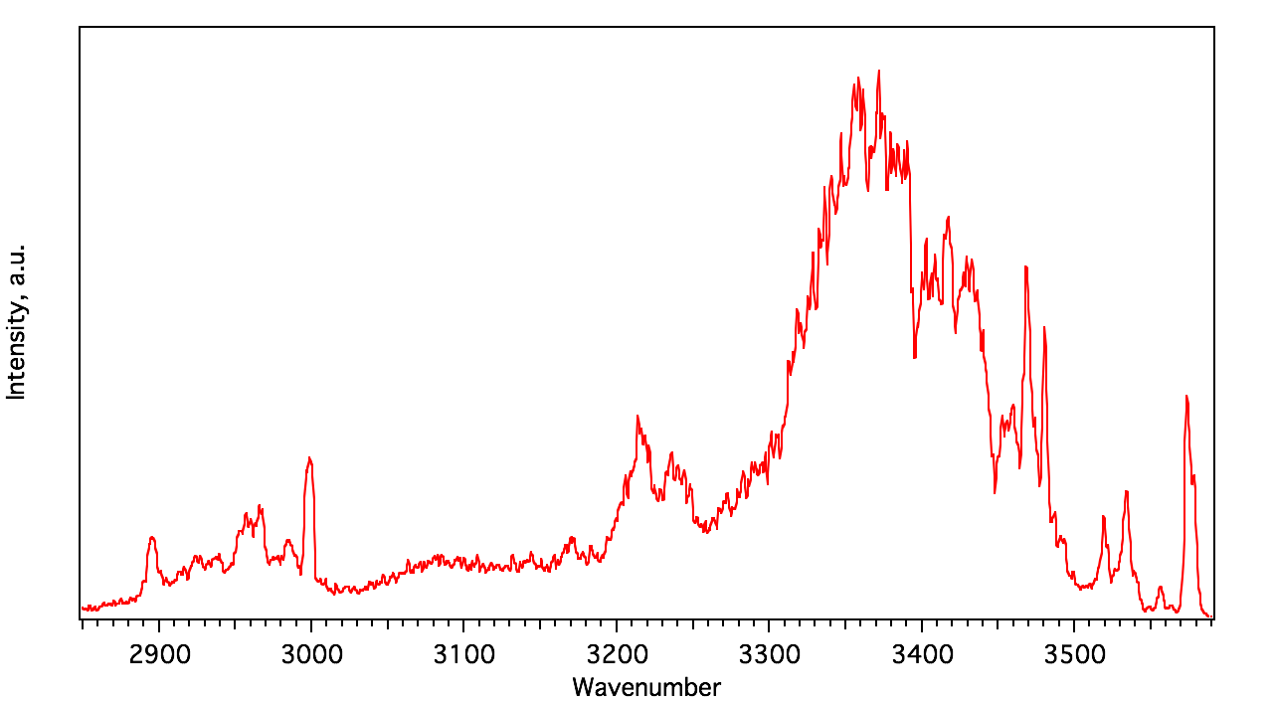
More IR-VUV spectra
AA-H⁺
GPGG-H⁺
Ac-A6K-H⁺
Cyclo-GRGDSP-H⁺

Slide 24
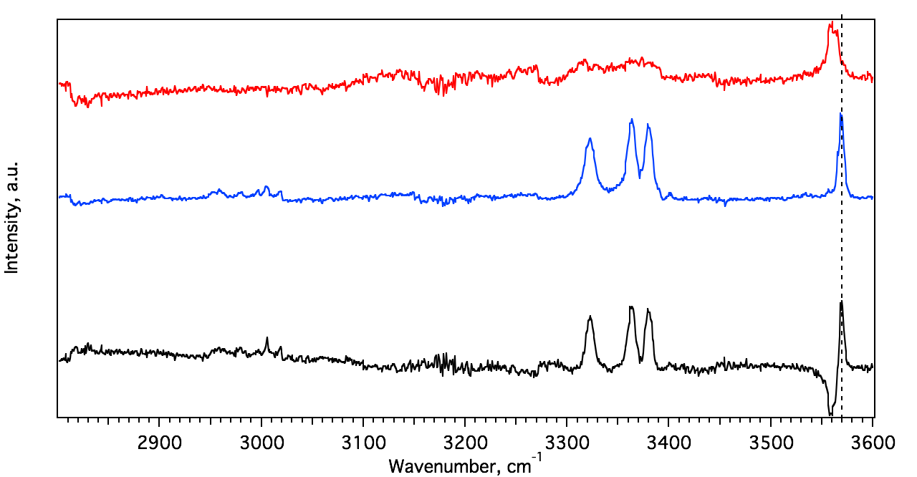
IR-IR-VUV HB of AA-H⁺
IR-IR-UV HB
gain
difference

Slide 25
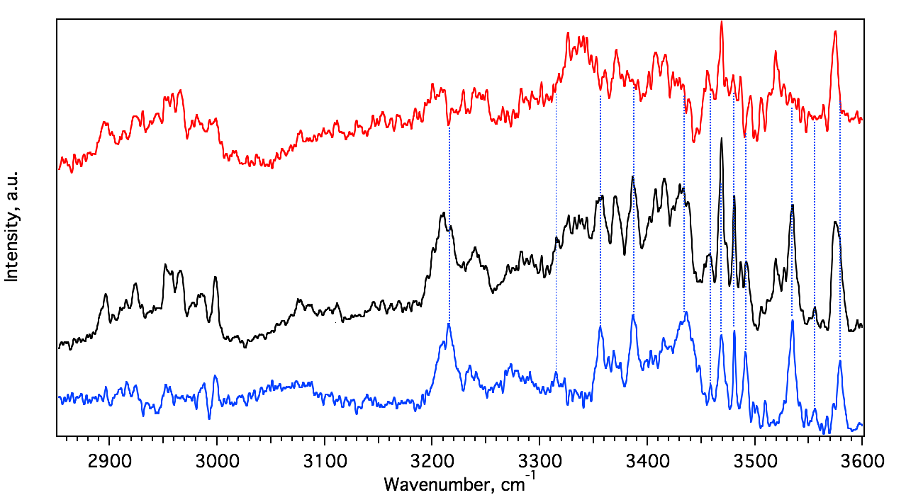
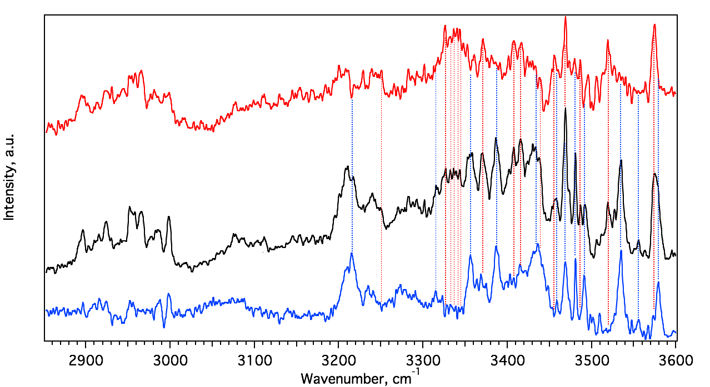



IR-IR-VUV HB of cyclo-GRGDSP-H⁺
IR-IR-UV HB
gain
difference
- H2O

Slide 26
Thank you
for your attention!

