Slide 1
Advances in mass spectrometry
Bioanalytical mass spectrometry

Slide 2
De-novo sequencing
Most fragment ions are b- or y-ions. a-ions are also frequently seen by the loss of CO from b-ions.
Satellite ions(wn, vn, dn-ions) are formed by high-energy CID.
Ser-, Thr-, Asp- and Glu-containing ions generate neutral molecular loss of water (-18).
Asn-, Gln-, Lys-, Arg-containing ions generate neutral molecular loss of ammonia (-17).
Neutral loss of ammonia from Arg leads to fragment ions (y-17) or (b-17) ions with higher abundance than their corresponding ions.
When C-terminus has a basic residue, the peptide generates (bn-1+18) ion.
A complementary b-y ion pair can be observed in multiply charged ions spectra. For this b-y ion pair, the sum of their subscripts is equal to the total number of amino acid residues in the unknown peptide.
If the C-terminus is Arg or Lys, y1-ion can be found in the spectrum to prove it.

Slide 3
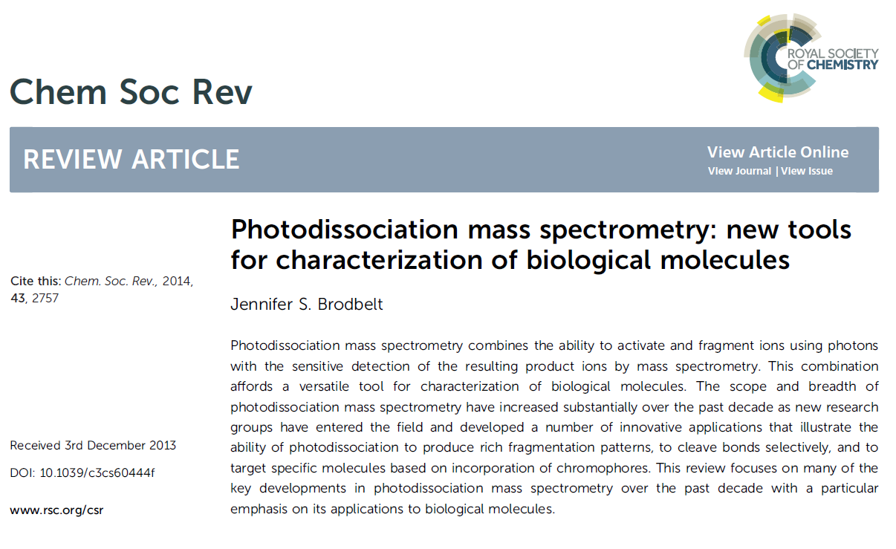

Slide 4
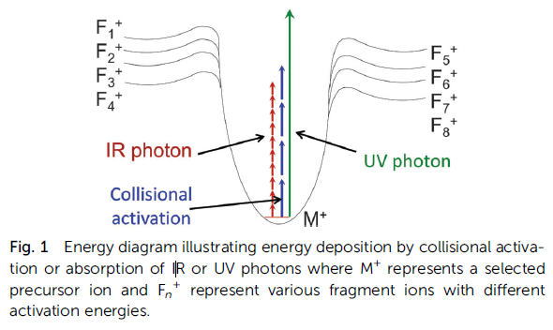
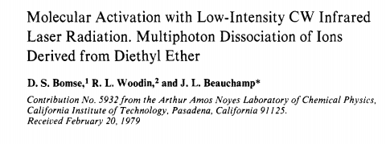
10600 nm, 0.12 eV – CO2 laser
266 nm, 4.7 eV – 4th harmonic of a Nd:YAG laser
355 nm, 3.5 eV – 3rd harmonic of a Nd:YAG laser
351 nm, 3.5 eV – XeF excimer laser
157 nm, 7.9 eV – F2 excimer laser
193 nm, 6.4 eV – ArF excimer laser

Slide 5
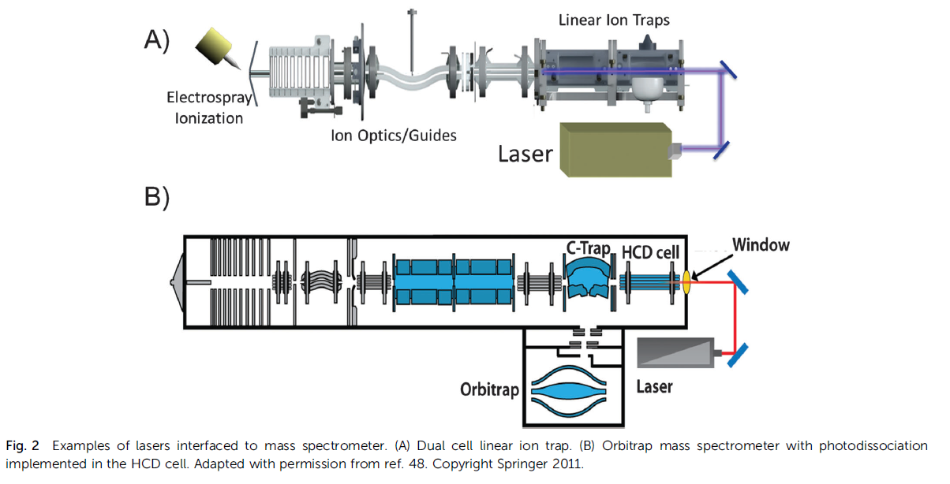

Slide 6
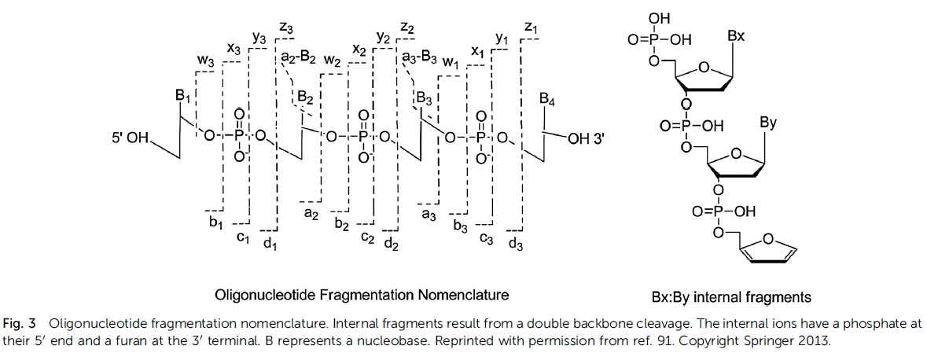
IRMPD of oligonucleotide

Slide 7
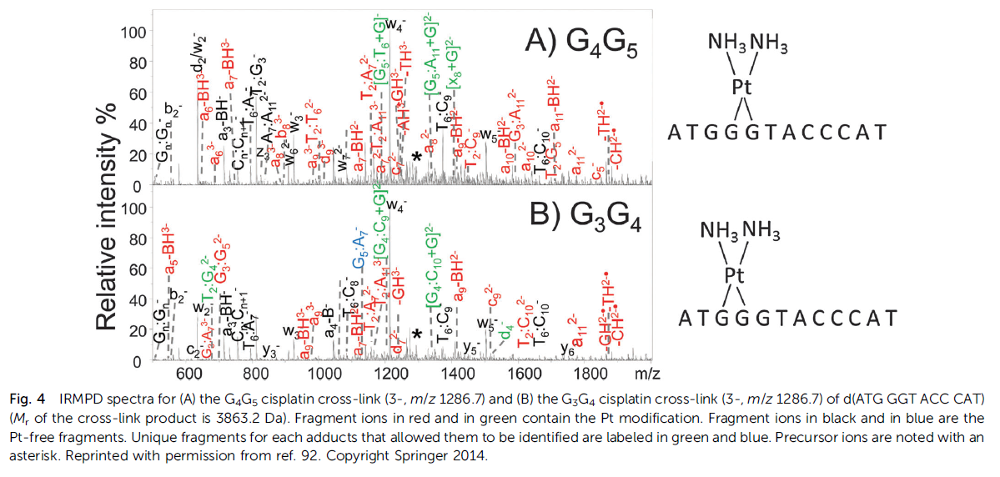

Slide 8
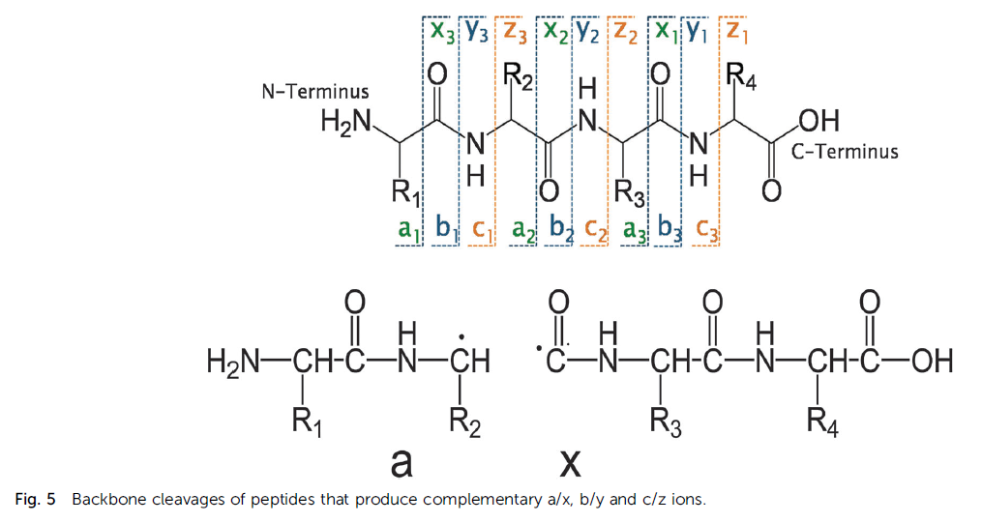
IRMPD of peptides

Slide 9
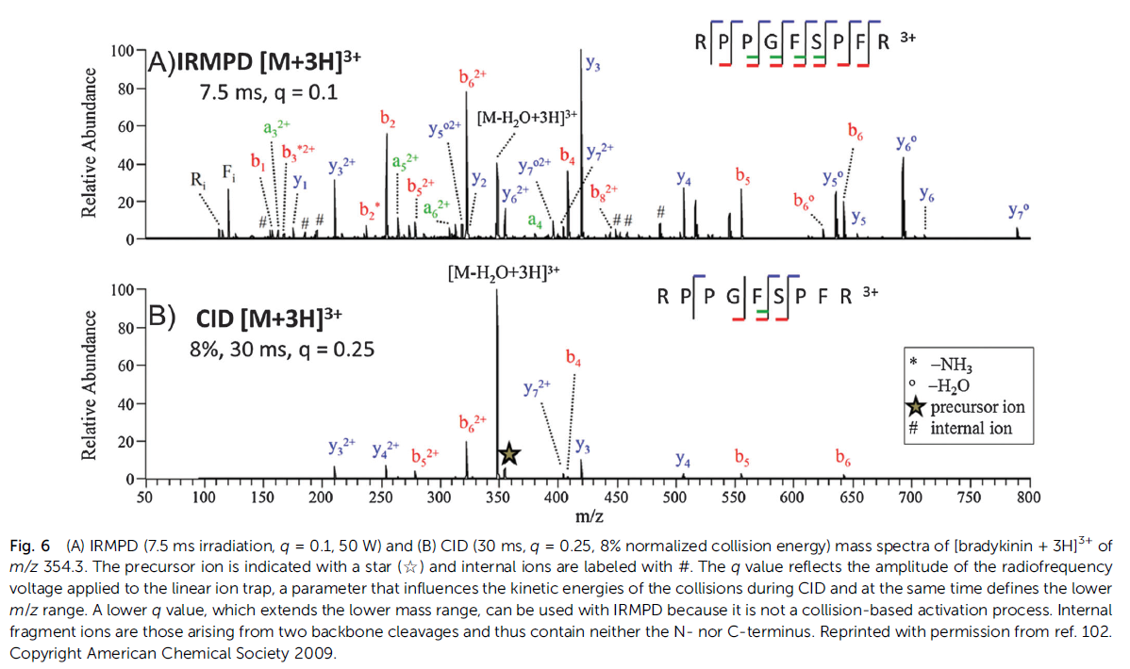

Slide 10
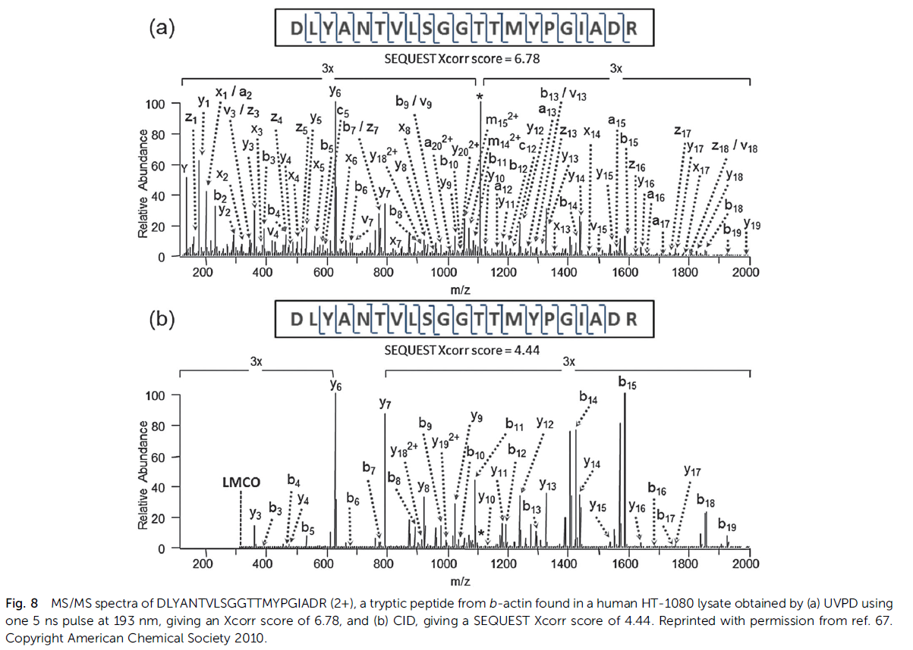

Slide 11
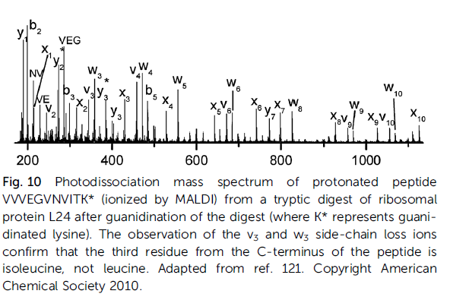
UVPD at 157nm

Slide 12
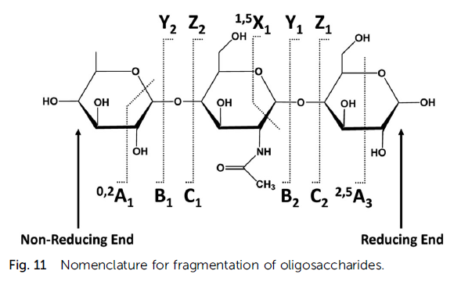
UVPD of oligosaccharides

Slide 13
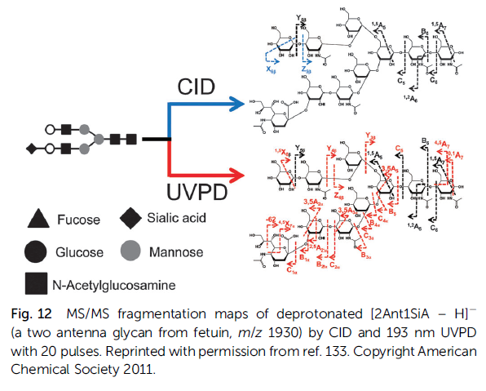

Slide 14
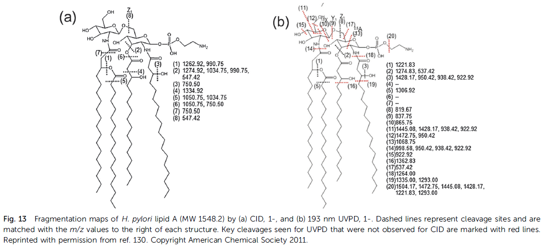
UVPD of lypopolysaccharides

Slide 15
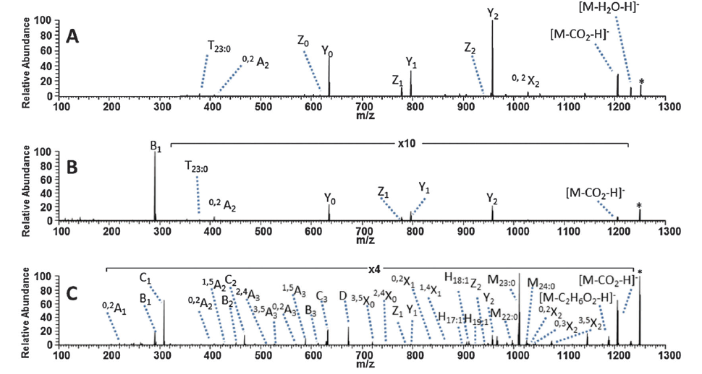
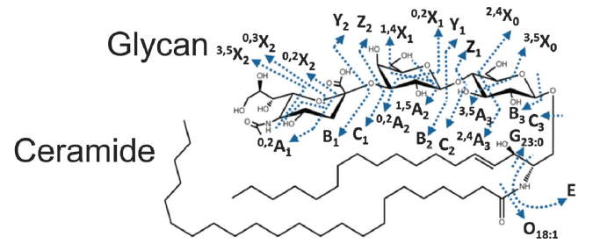
UVPD of ganglyosides

Slide 16
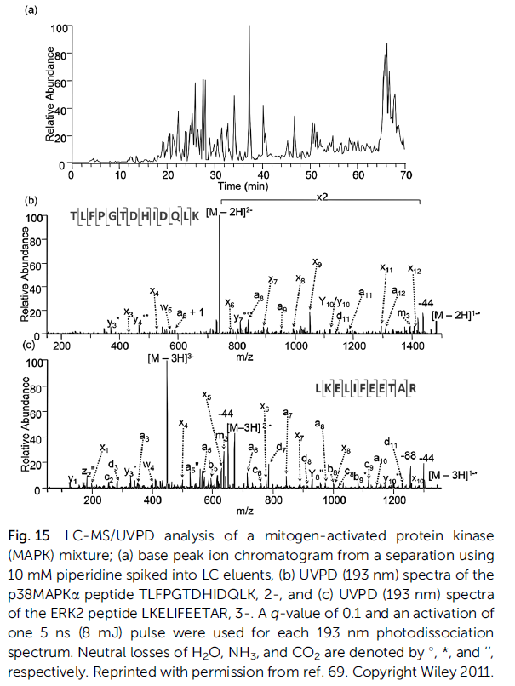
LC-UVPD MS of deprotonated peptides

Slide 17
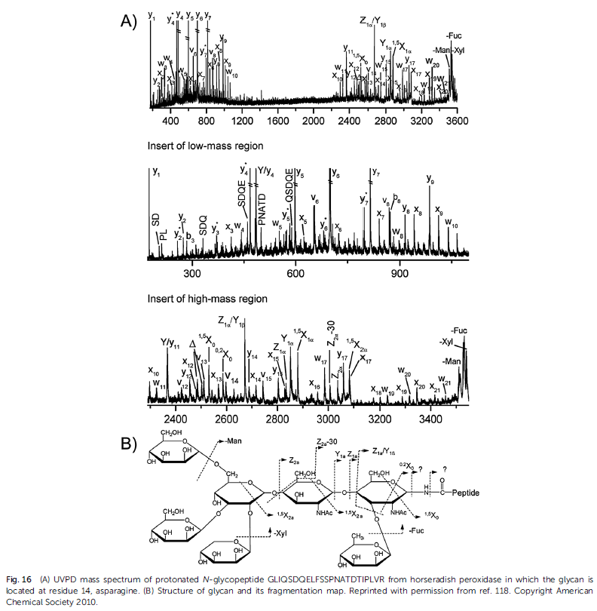
UVPD of PTMs glycosilation

Slide 18
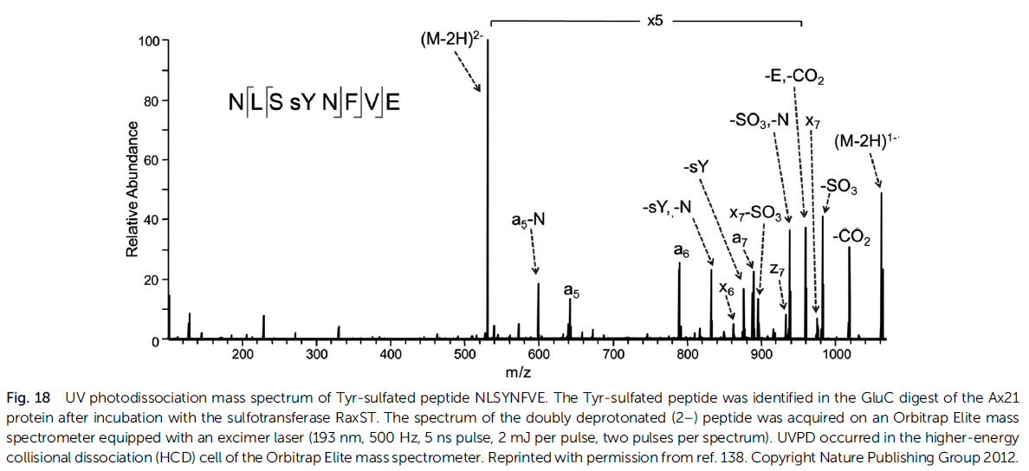
UVPD of PTMs – Tyr sulfation

Slide 19
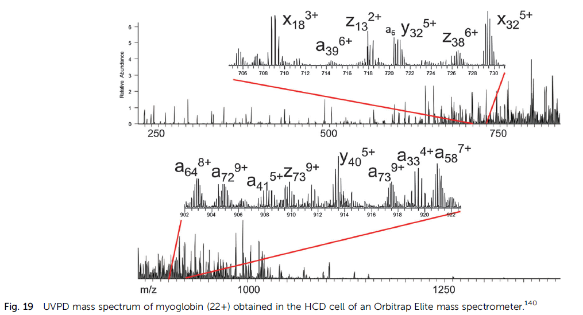
UVPD for top-down strategy
157 Aas
17.1 kDa
SINGLE UV PULSE!!!

Slide 20
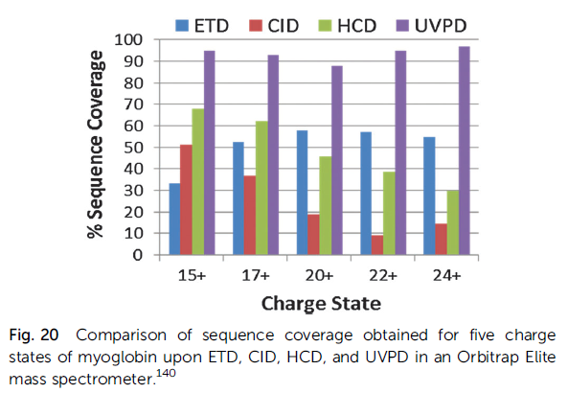
Can we stop praising UVPD?

Slide 21
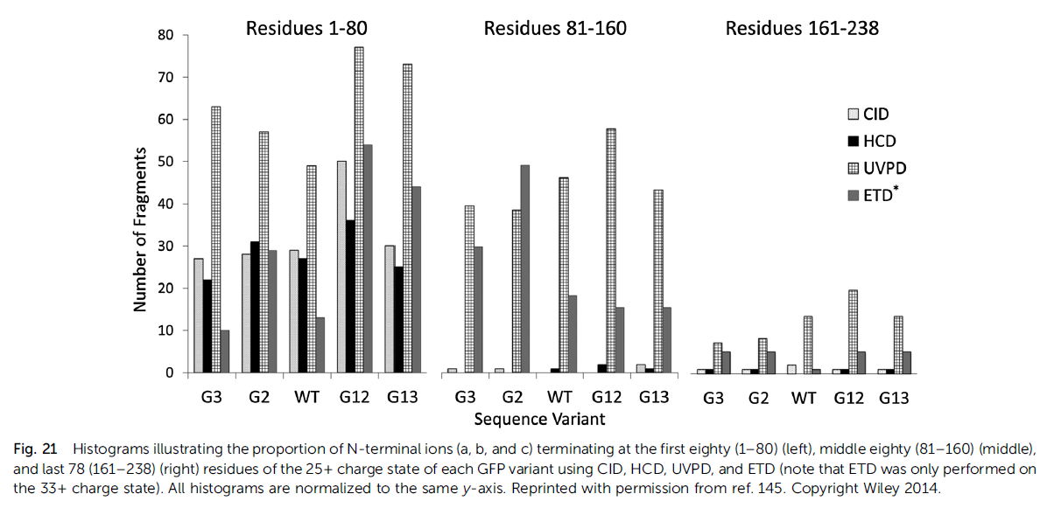

Slide 22
Bond-specific cleavages
Side-chain loss (d,w)
a_{n}-97 for phosphorylated amino acids (Tyr, Tre, Ser)
C-I cleavage in iodo-derivatized tyrosines and histidines
C-S cleavage in cysteine residues modified by quinone
S-S disulfide bonds at 266 nm
Chromophore-selective UVPD

Slide 23
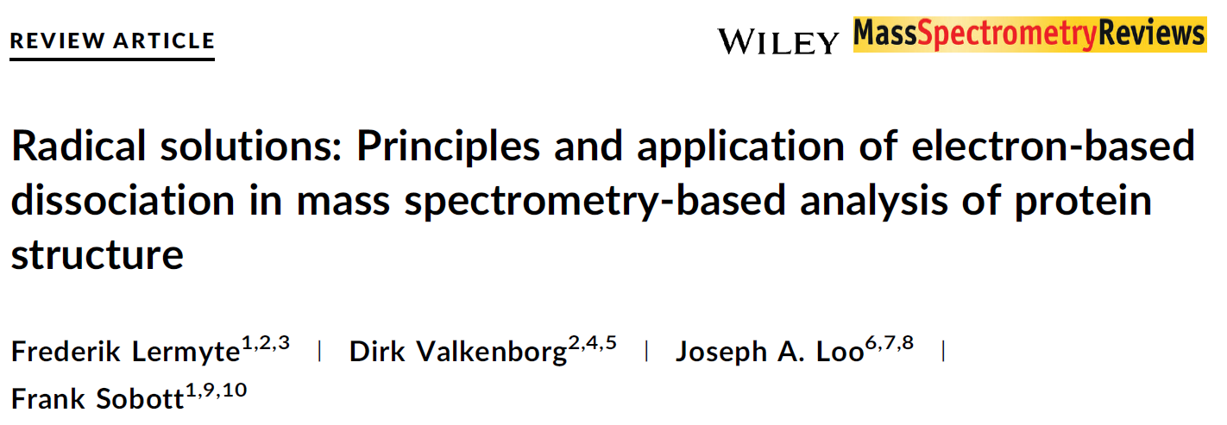

Slide 24
