Slide 1
Emil Kirchev
Middle blocker

Slide 2
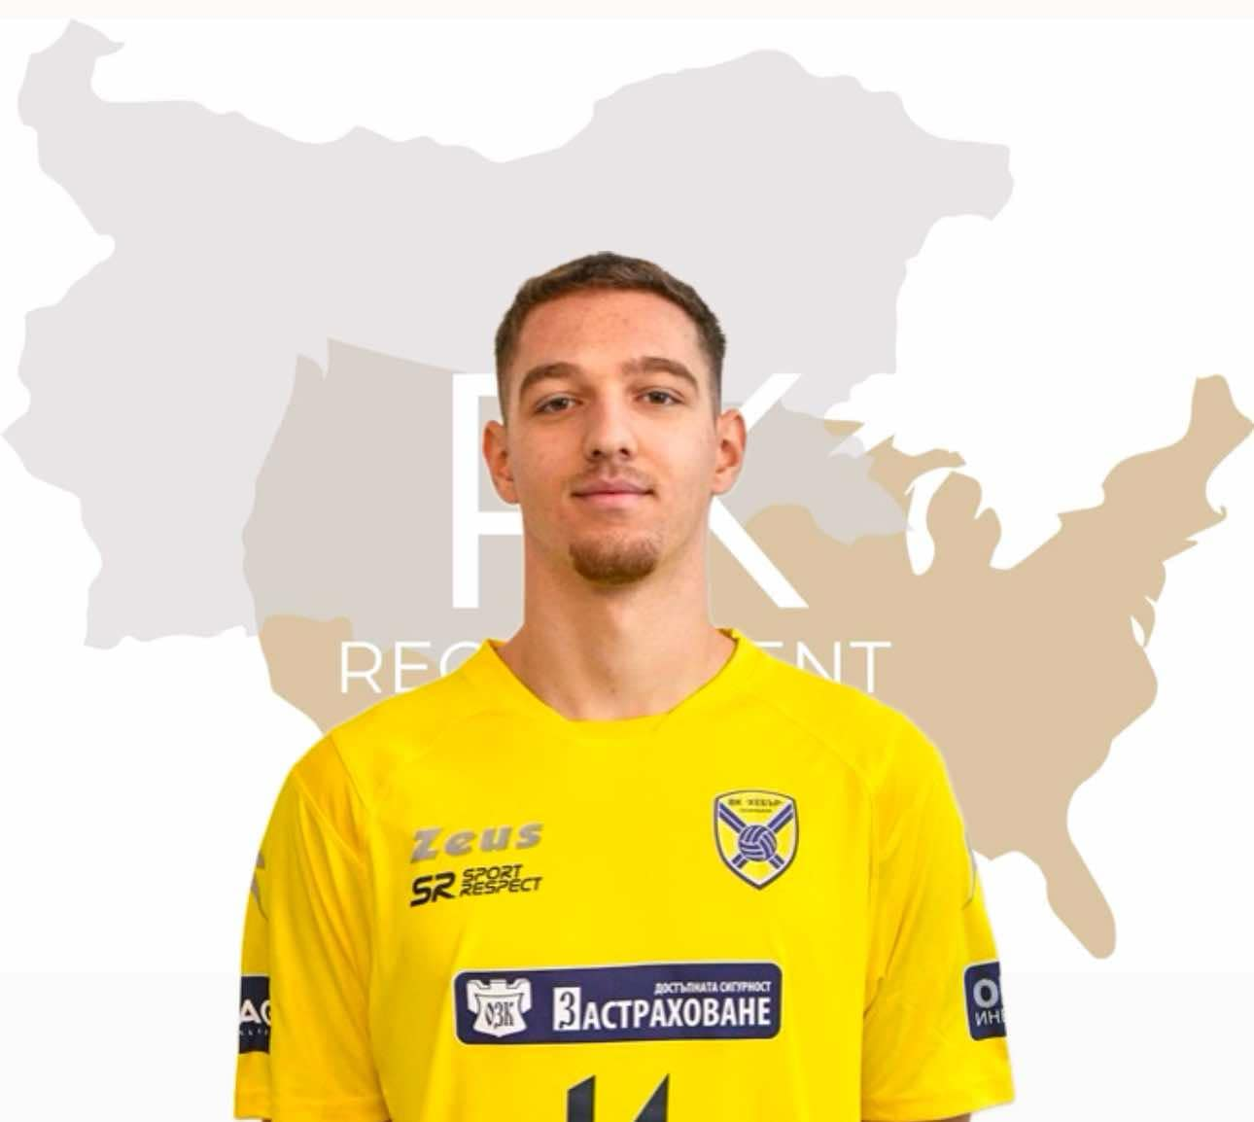
Status: Available Gender: Male Position: Middle Blocker Date of Birth: 04. 10. 2006 Graduation Date: June 2026 Club Team: Volleyball Club Hebar Pazardzhik

Slide 3
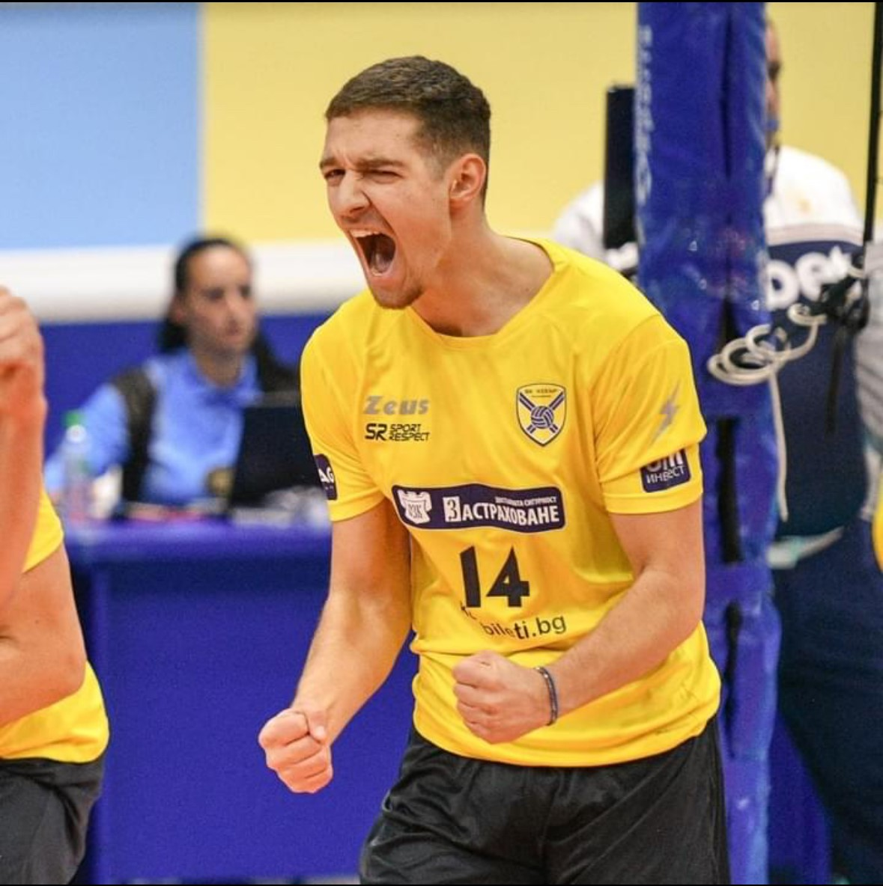
Height: 197cm. Weight: 81 kg. Reach: 255 cm. Approach High Jump: 345 cm. Standing Block Jump: 317 cm. Languages: Bulgarian, English Desired Degree: Business Administration TOEFL: 99/120
ADDITIONAL INFORMATION

Slide 4
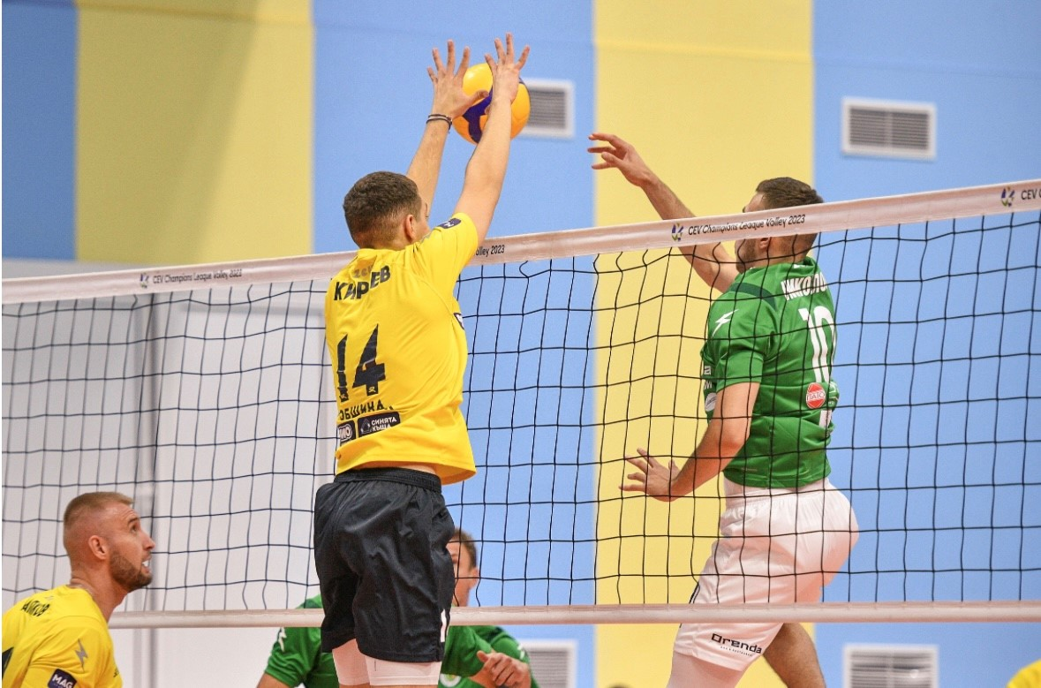

Slide 5
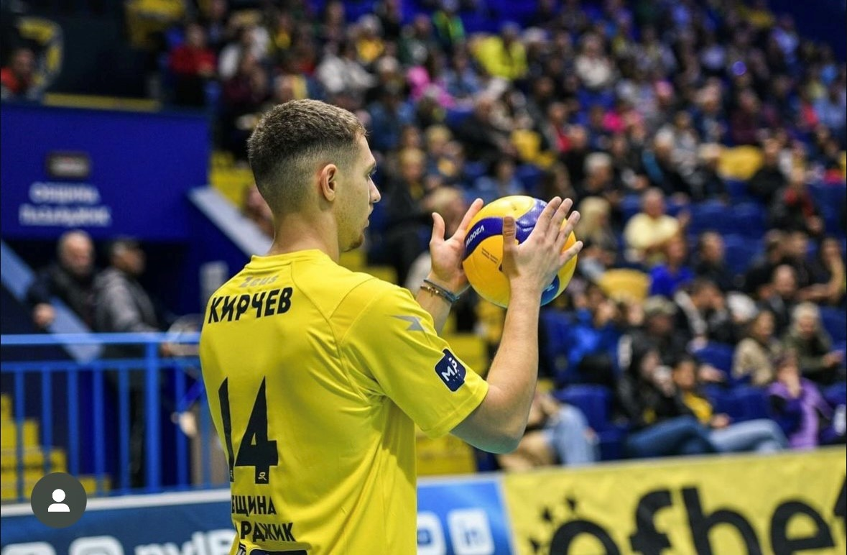

Slide 6
Athletic Achievements:
Club Team:
2018/2019 U13 Champions of Bulgaria,
2019/2020 U14 Champion of Bulgaria;
2020/2021 U18 and U16 Champion of Bulgaria;
2021/2022 U18 Champion of Bulgaria;
2022/2023 U20 and U18 Champion of Bulgaria and U18 Cup of Bulgaria winner;
2023/2024 U20 Champion of Bulgaria

Slide 7
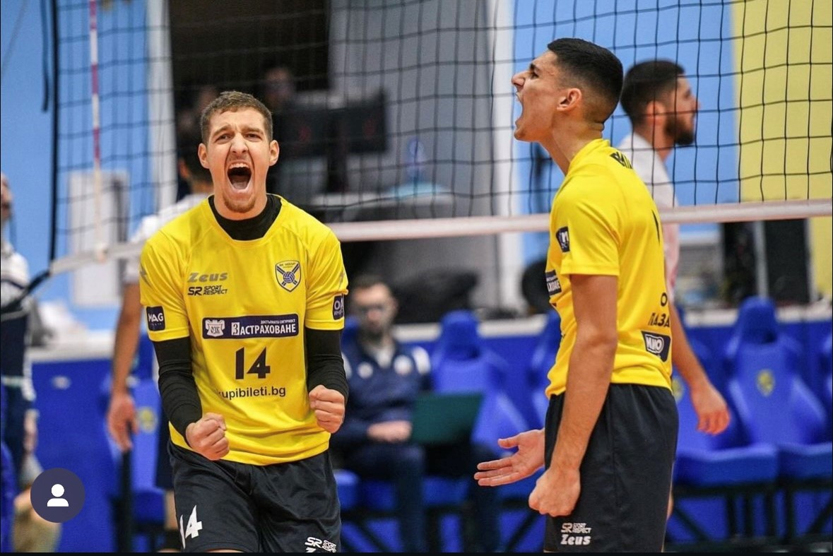

Slide 8
Interview Questions:
Describe yourself with a few sentences.
I am a determined person who does whatever it takes to accomplish his goals. I am also a very positive person that always tries to see the good even in bad situations in life. I am an open-minded person that is always ready to learn new things when I lack knowledge in that area. I am a person who is not afraid of challenges and always looking for ways to improve and help others to do the same.
What does volleyball mean to you?
The sport of volleyball has given me so many opportunities to grow and have the chance to meet incredible people such as coaches, volleyball legends and teammates. I am forever grateful to meet those people because they are the reason I have grown not only as a player but also as a person. Through volleyball, I have learned valuable lessons about teamwork, discipline and perseverance. Every match and practice have taught me the importance of dedication, cooperation and mutual respect

Slide 9
Interview Questions:
What does your education mean to you?
For me personally it’s important to have a good education because with such I would be able to accomplish my dreams. Many athletes overlook their education and after they retire, they don’t know what is next in their lives and regret not being serious about it. A good education will give confidence and assurance that I can handle any challenge that life throws at me. It gives me the opportunity to develop and achieve success not only in sports, but also in other areas of life. After all, education is an investment in my future that helps me be more prepared and confident in myself.
What are your main goals as a student-athlete in the USA?
My main goal as a student-athlete in the USA is to learn as much as possible from everybody I meet along the way and to improve as a player and gain as much knowledge as possible that would help me in a career aspect. I have always dreamed of being a student-athlete and I would want to accomplish one of my childhood dreams. I want to take advantage of the opportunities presented to me by studying in the US to expand my horizons and develop both academically and athletically. I believe that the combination of quality education and intensive sports training will help me achieve success in both areas. Also, I want to build a network of contacts and friendships that will be useful both during my studies and in my future career. I believe that the experience and knowledge I will gain as a student-athlete in the USA will help me become a better and more successful person in all aspects of life.

Slide 10
Video Analysis
Highlight Videos:
https://www.youtube.com/watch?v=HmfYwCxoI5g
Full match:
https://www.youtube.com/watch?v=W7wkIByRqGA&t=4969s

