Slide 1

Boris Ivanov
Swimming – Freestyle, butterfly

Slide 2
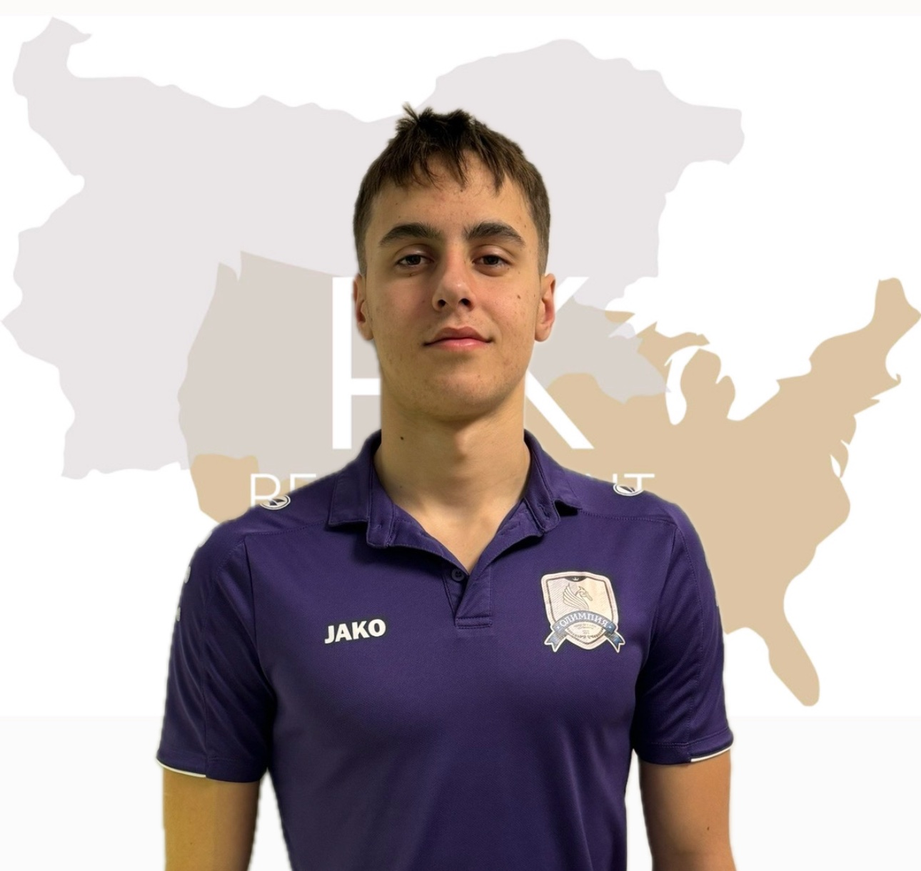
Status: Available
Gender: Male
Disciplines: Freestyle, Butterfly
Date of Birth: 01. 02. 2006
Graduation Date: June 2025
Club Team: KPS Olimpia

Slide 3
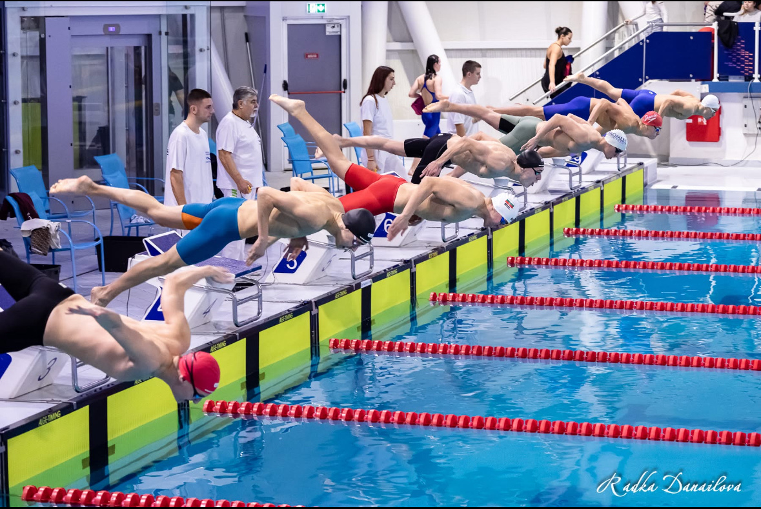

Slide 4
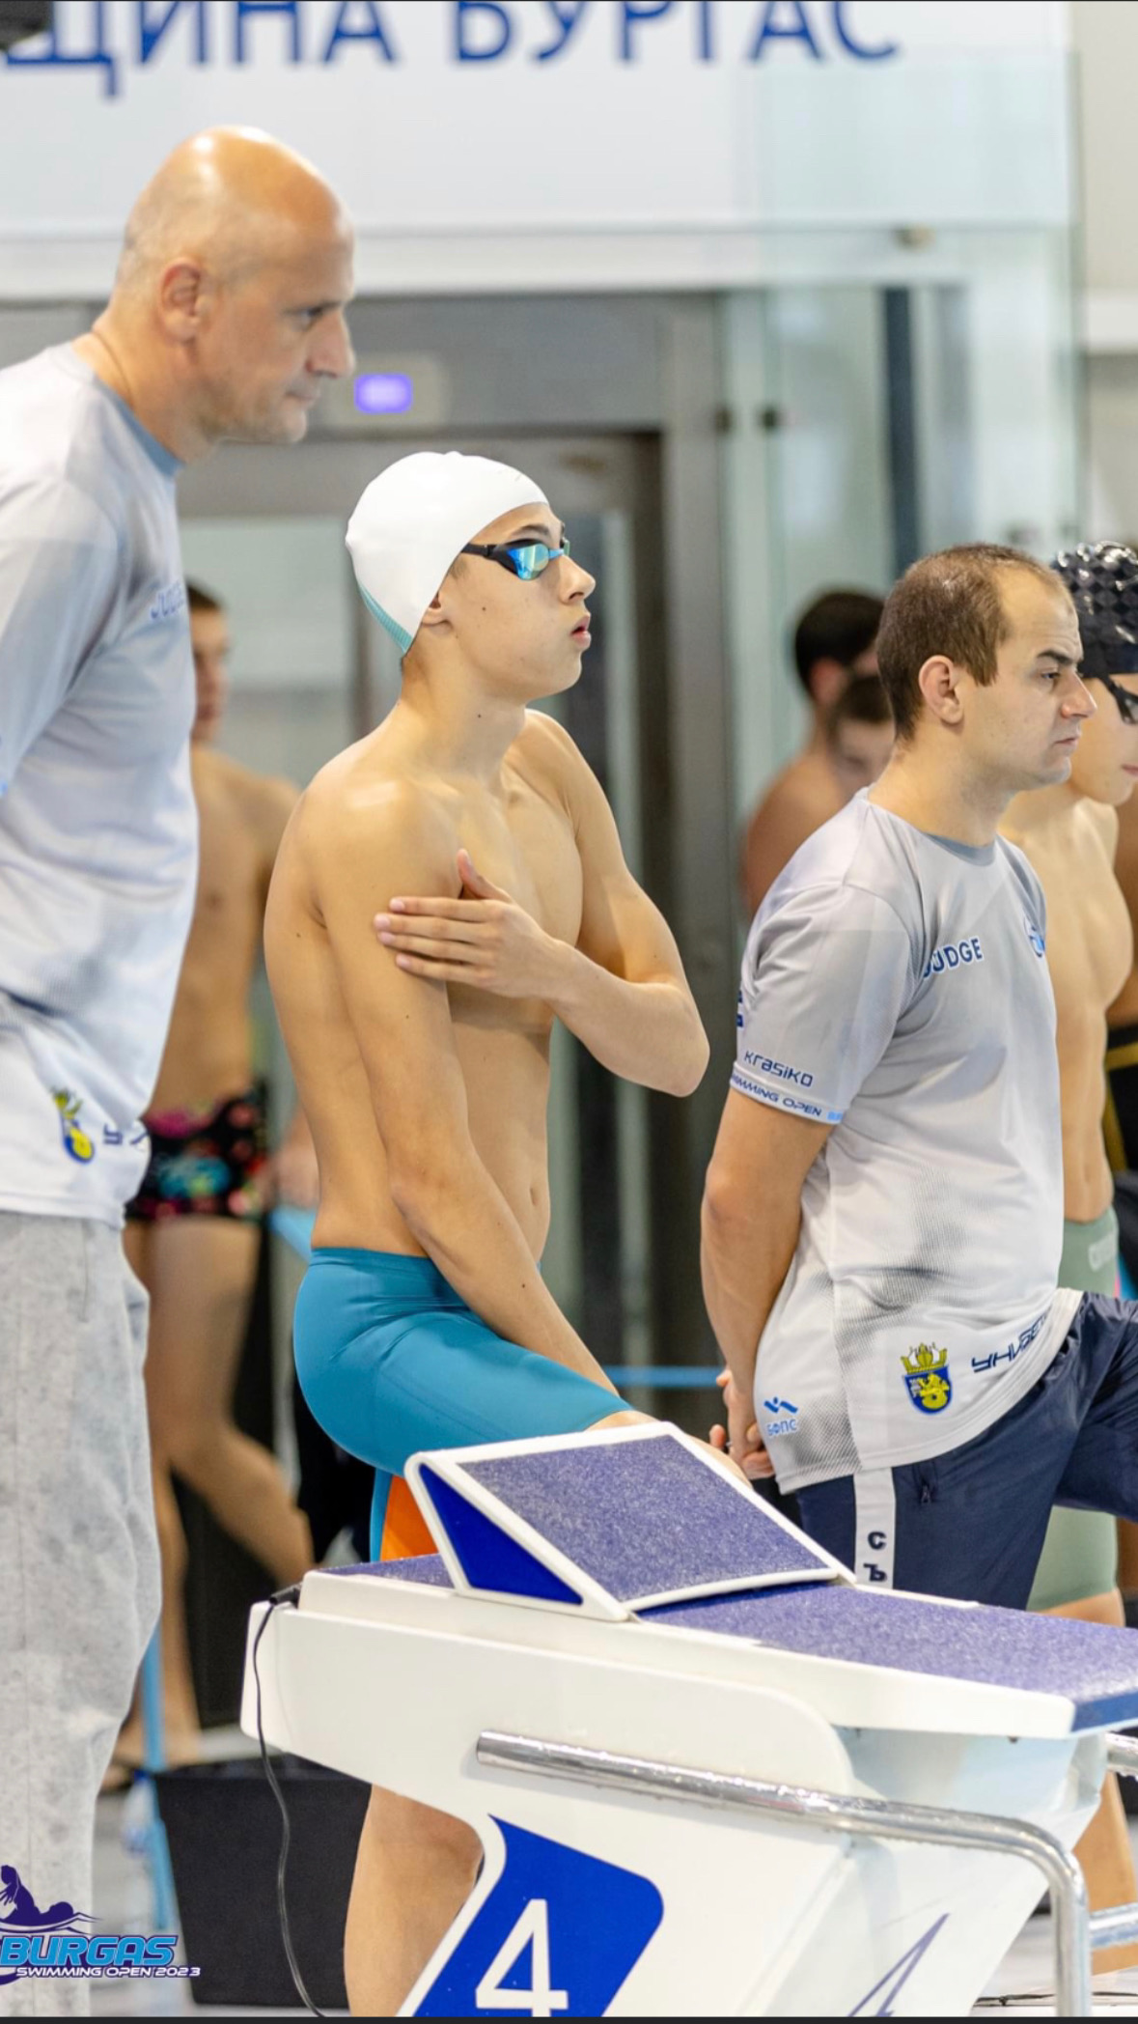
Height: 190 cm.
Weight: 72 kg.
Languages: Bulgarian, English, French
High School: 9th French Language School ,,Alphonse de Lamartine”
Desired degree: Psychology, Kinesiotherapy
ADDITIONAL INFORMATION

Slide 5
Personal best times
200free-1.54.67(SCM) 2023
400free-4.01.84(SCM) 2023
100fly-58.08(LCM) 2024
100fly-57.27(SCM)2023
200fly-2.11(LCM) 2024
200fly-2.07(SCM) 2023

Slide 6
Personal best qualifications
3rd place in 200m butterfly (LCM); Nationals (Under 18)
3rd place in 100m butterfly (SCM); Nationals (Under 18)
4th Place in 200m butterfly (SCM); Nationals (Under 18)
6th Place in 200m butterfly (LCM)Nationals (Man & Women) – 2times in one year1
6th Place in 400m medley (LCM) Nationals (Man & Women)
1ST Place in 4x200m freestyle (LCM) Nationals (Man & Women)
1St Place in 4x100m freestyle (LCM) Nationals (Man & Women)
3rd Place in 4x100m freestyle (LCM) Nationals (Under 18)
2nd Place in 4x200m freestyle (LCM) Nationals (Under 18)
Finalist in Freestyle events in 200&400m freestyle Nationals (Man & Women)
Multiple medalists at international competitions and Bulgarian championships

Slide 7
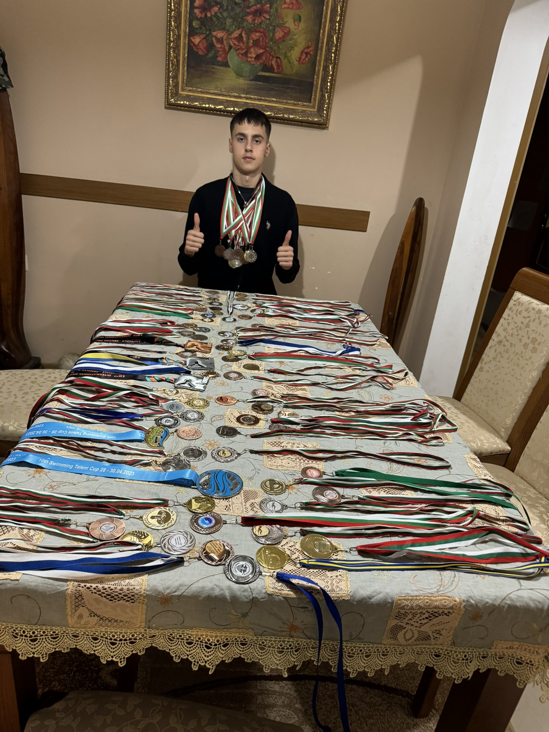
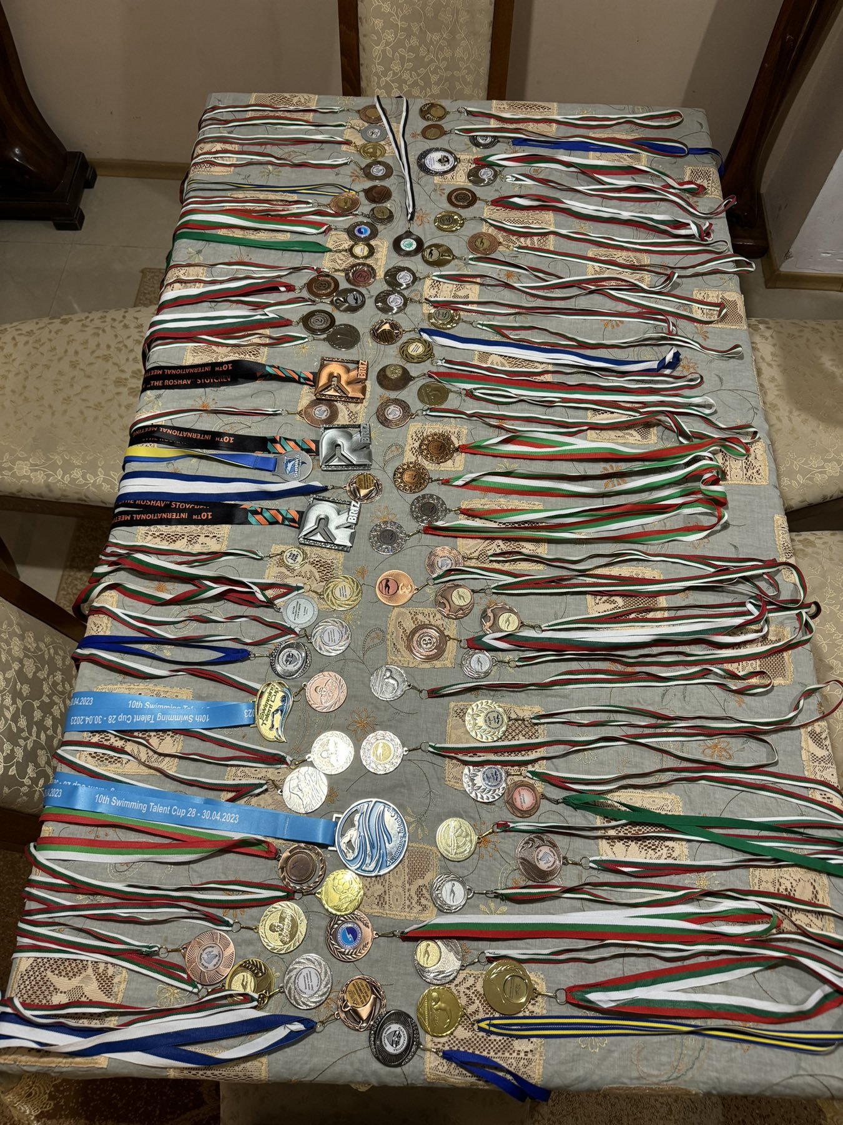

Slide 8
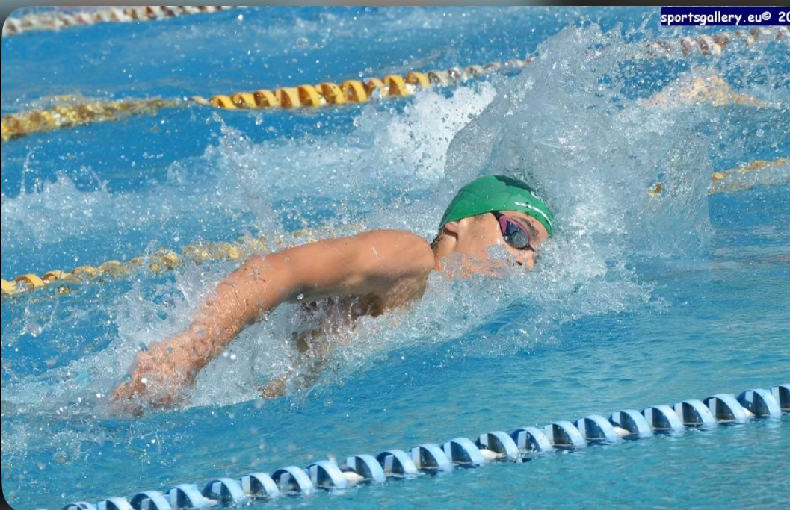

Slide 9
Interview:
Describe yourself with a few sentences:
I am Boris, 18 years old, a swimmer from Sofia, Bulgaria. I’ve been training swimming since I was 5. I love to train and compete. In my free time, which is only on Sundays, I enjoy watching sports, playing football, and walking in the nature.
What does swimming mean to you?
Swimming means a lot to me, and sports in general are an essential part of my day life. When I am in the water, I disconnect from everything else and focus entirely on the goals I’ve set for each practice. I love swimming, and it occupies a large part of my thoughts throughout the day.

Slide 10
Interview:
What does your education mean to you?
Education is also very important for me. I try to balance school and swimming. I study at one of the most prestigious schools in Bulgaria, The French High School -,,Alphonse de Lamartine” The studies are very difficult because all the subjects are in French, and it is really challenging to combine school and sports. My school helps me learn languages that will open many doors for me in the future.
What are your main goals as a student-athlete in the USA?
For me studying and training in USA is a great opportunity that I want to pursue. I believe that in the USA, I will meet many people and improve my swimming skills, as the sport is highly respected there, and I think I will be able to develop well. Academically, I expect to learn new things and have the chance to combine sports and education, which have always been very important to me. I believe that in USA , I will be able to achieve my academic and athletic goals.

Slide 11
Video Analysis
Highlight Videos:
https://www.youtube.com/watch?v=THqoqurFEys

Slide 12
