Slide 1
Presenting: Ivaylo Zlatev Position: setter

Slide 2
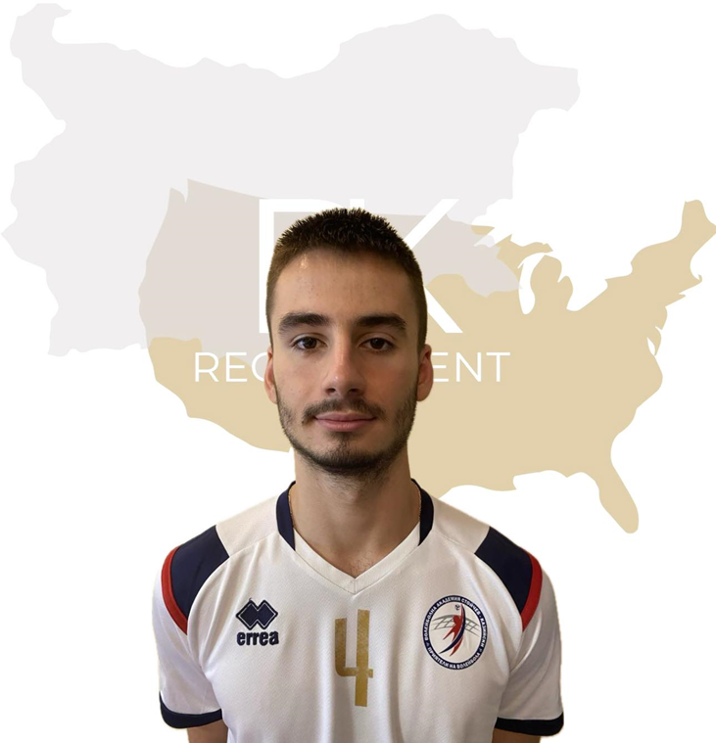
Status: Available
Gender: Male
Position: Setter
Date of Birth: 20.08.2005
Graduation date: June, 2024
Club team: Volleyball Academy
Stoychev Kaziyski

Slide 3
Additional Information
Height:187 cm.
Weight: 76 kg.
Reach: 246 cm.
Approach high jump: 325 cm.
Standing block jump: 315 cm.
High school: 119 SU “ Michael Arnaudov”
Languages: Bulgarian, English
Desired degree: TBA
SAT grade/date: TBA
TOEFL grade/date: TBA

Slide 4
Volleyball achievements:
Bulgarian Youth National Volleyball Championship 2017- 3rd place
Bulgarian Youth National Volleyball Championship 2018- 2nd place
Bulgarian Youth National Volleyball Championship 2019- 1st place
Bulgarian Youth National Volleyball Championship 2021- 2nd place
Bulgarian Youth National Volleyball Championship 2022- 3rd place

Slide 5
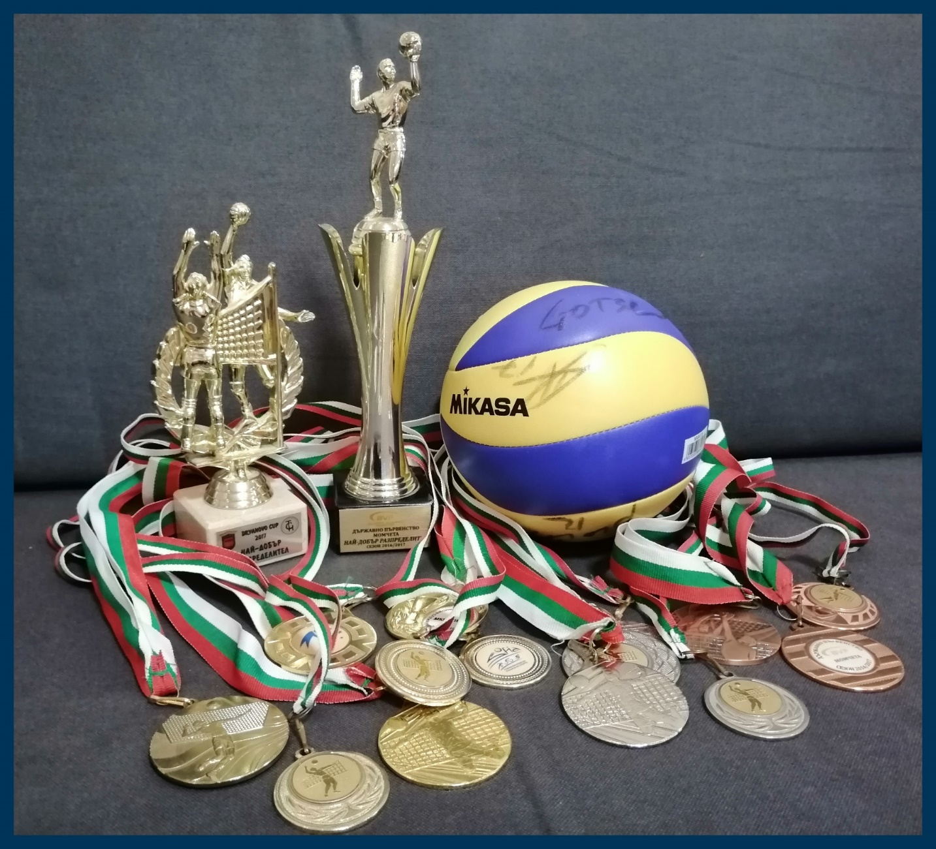
Medals:
7 gold medals
4 silver medals
3 bronze medals
2 individual awards:
Dryanovo Cup 2017, Bulgaria- BEST SETTER
Bulgarian Republican Championship 2016/2017- BEST SETTER

Slide 6
Interview questions
Describe yourself with a few sentences:
I am funny and positive, but after all I can be serious and very disciplined, responsible, I work hard and never give up. My motto is "Ask for the impossible, to achieve the maximum".
What does volleyball mean to you?
For me, volleyball is a way of life. I can't imagine my life without volleyball.
What does your education mean to you?
For me, my education is more important than my athletic life, because I can't play volleyball forever and I need knowledge.
What are your main goals as a student-athlete in the USA?
My main goal is to combine sport with education and develop my skills, but also to visit more countries.

Slide 7
Video Analysis
Highlight video:
https://www.youtube.com/watch?v=Y4fM182XXeE NEW VIDEO!
https://www.youtube.com/watch?v=lrhXz3T2EBU https://www.youtube.com/watch?v=Q_6bcHcOXt0

Slide 8
The presentation provides all the basic information for the student-athlete. More details and video can be provided if needed. Contact us.

