Slide 1
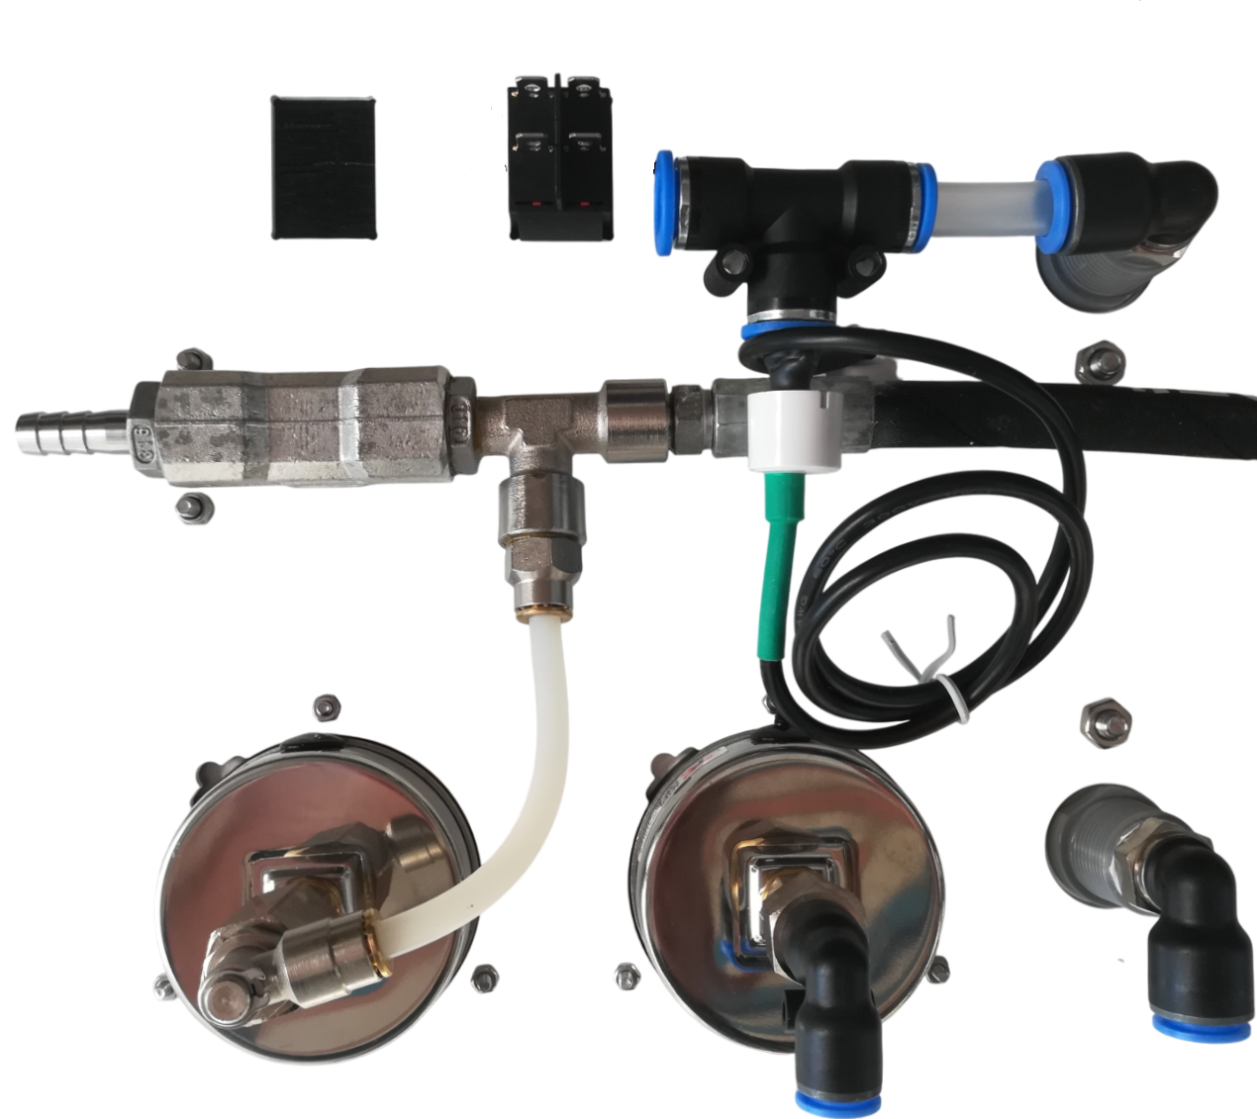
BACKSIDE CONTROL PANEL
LEGEND :
A : over board
10mm hose
withe bulkhead fitting
B : to the fresh water tank
10mm hose
black bulkhead fitting
C : to the membrane housing
10 mm hose
D : to the filter housing
8mm hose
E : to the membrne housing
1 : boost pump
2 : battery
1
1
2
2
B
A
E
D
C

