Slide 1
Martha Baharova 60m hurdles, hexathlon, long jump, pentathlon, heptathlon, high jump

Slide 2
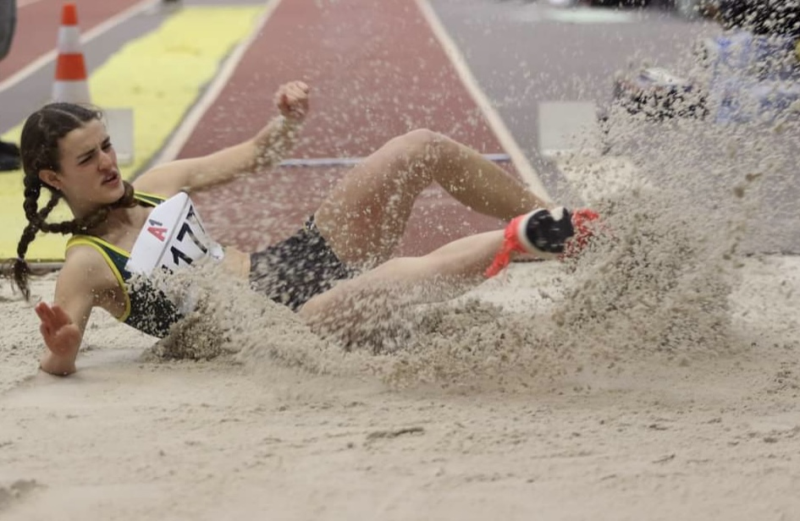

Slide 3
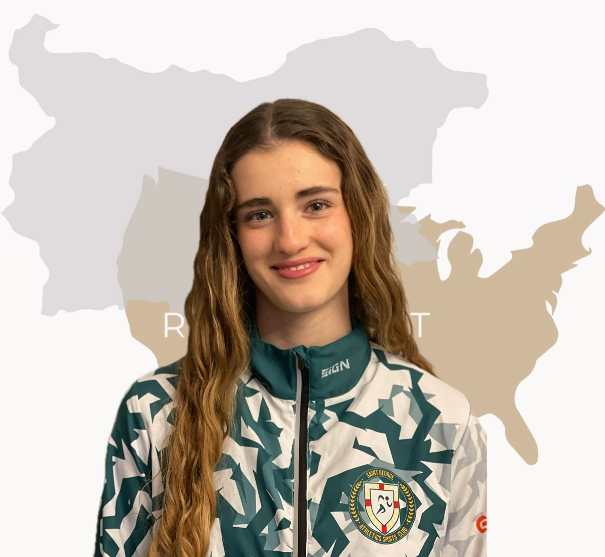

Slide 4
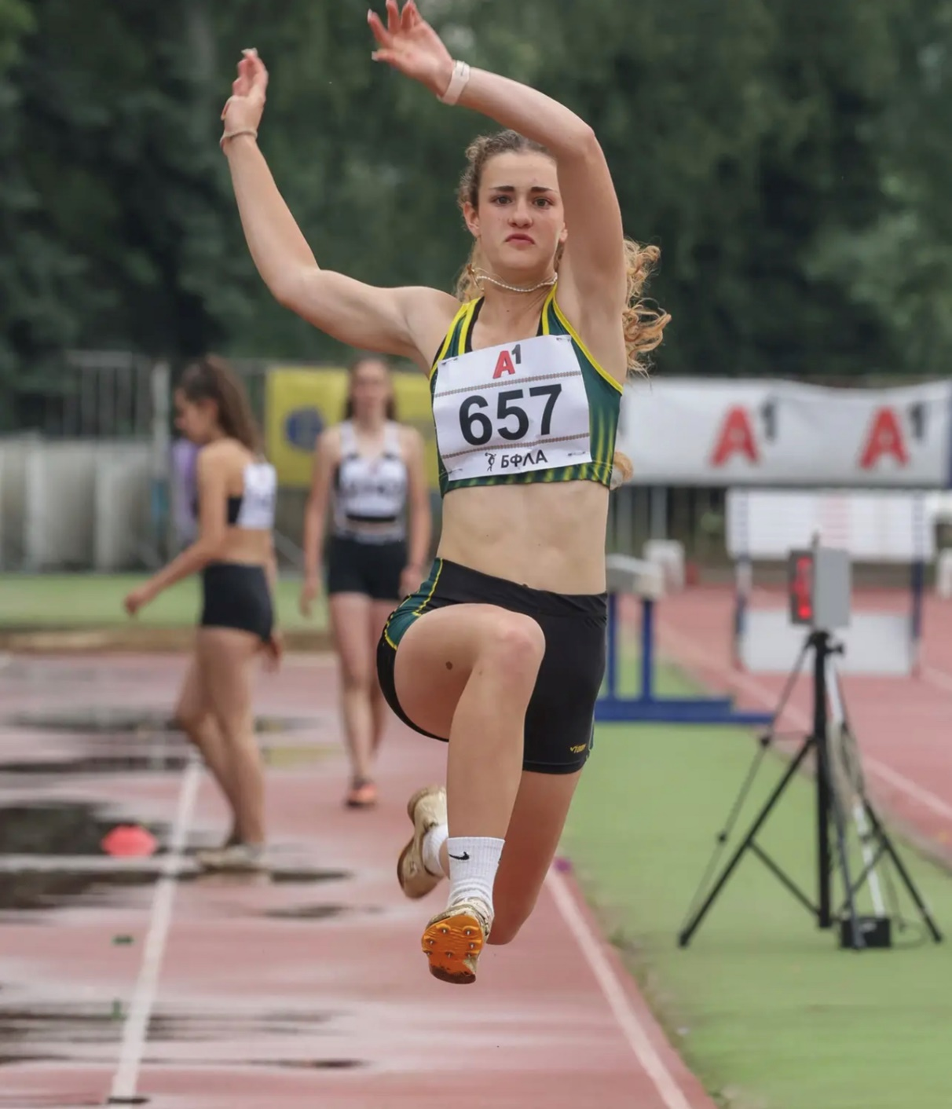
Gender: Female
Disciplines: 60m hurdles, hexathlon, long jump, pentathlon, heptathlon, high jump
Date of Birth: 26.01.2006
Graduation date: June, 2024
Club team: St. George track and field club

Slide 5
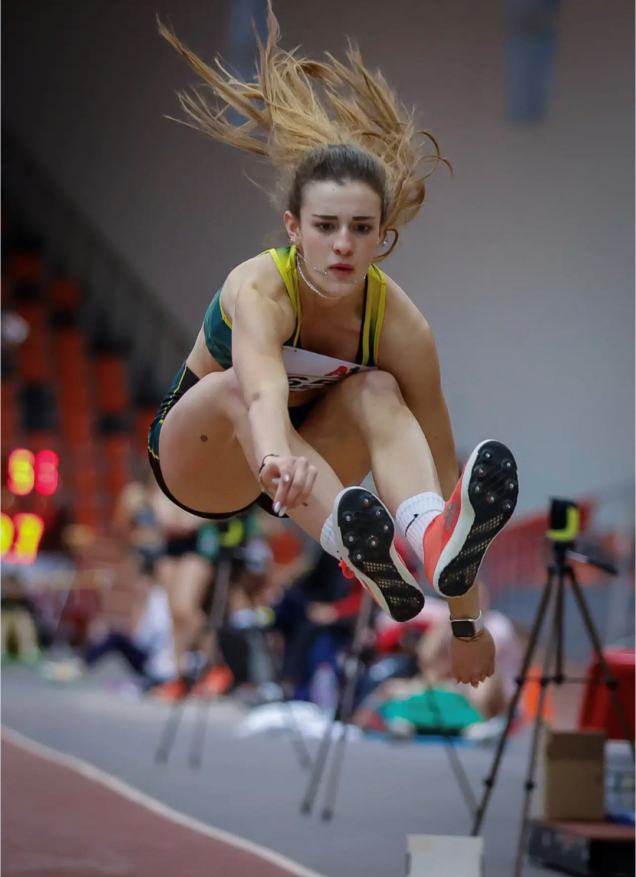
Video:
https://www.youtube.com/shorts/yvXLEtyUNd4

Slide 6
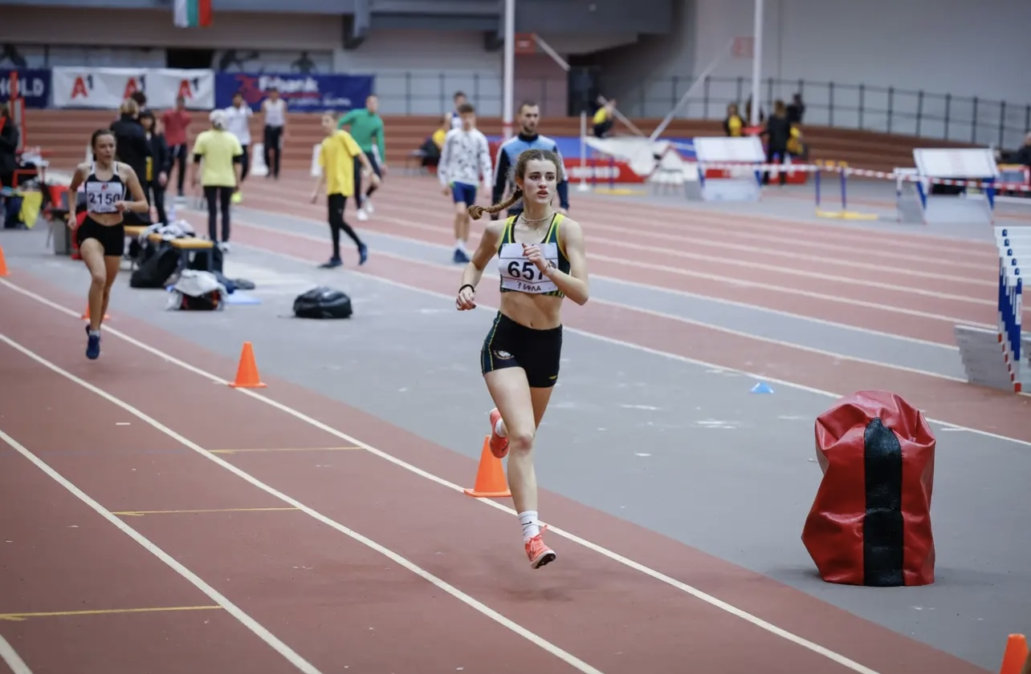

Slide 7
Additional information
Height: 173 cm.
Weight: 56 kg.
Athletic achievements: 71 medals
High school: Uwekind International School, Sofia
Languages: Bulgarian, English, German
Desired degree: TBA
SAT grade/date: TBA
TOEFL grade/date: TBA

Slide 8
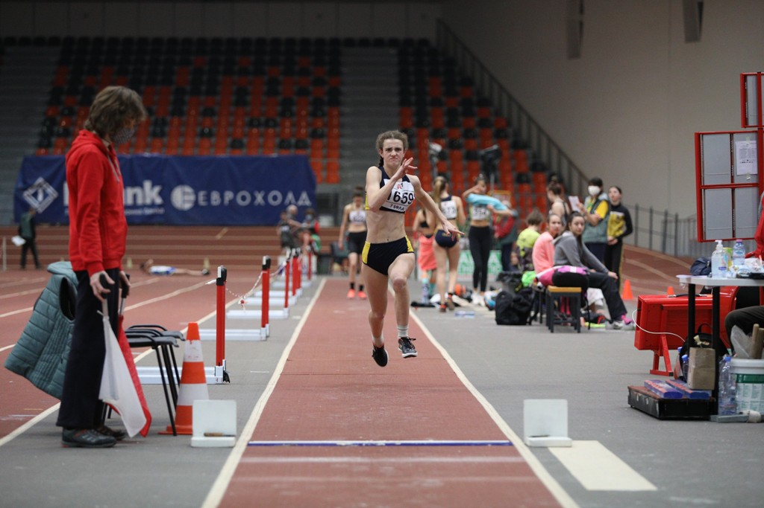

Slide 9
2020 - 60m hurdles winter season, National athletics championship - 9.34s. – 2nd place
2020 - hexathlon winter season, National athletics championship - 310 points - 1st place
2020 - hexathlon summer season, National athletics championship - 289 points - 3rd place
2021 - 60m hurdles winter season, National athletics championship - 9.23s. - 1st place
2021 - long jump, National athletics championship - 5.67m. - 1st place
2021 - hexathlon winter season, National athletics championship - 347 points (equaled National record) - 1st place
2021 - hexathlon summer season, National athletics championship - 388 points - 3rd place
2021 - long jump, National athletics championship - 5.44m. - 3rd place
U16 National athletics championship summer season 2021 - 100 hurdles - 14.88s. with - 1.7 wind - 2nd place

Slide 10
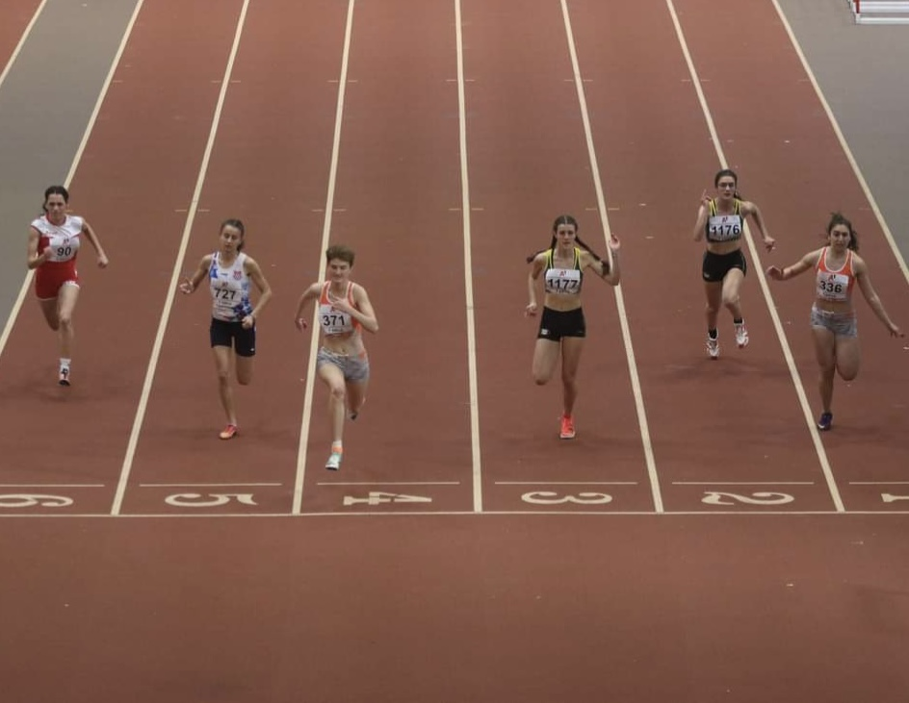

Slide 11
2022 - 60m. hurdles, National athletics championship - 9.57s. –
1st place
U18 National athletics championship winter season 2022 - 3082 points pentathlon –
1st place
U20 National athletics championship summer season 2022 - 3442 points heptathlon –
4th place
U18 National athletics championship winter season 2023 - 3054 points pentathlon –
3rd place
U20 National athletics championship summer season 2023 - 3488 points heptathlon –
3rd Place
U20 National athletics championship winter season 2024 - 3222 points pentathlon -
1st place
Senior National athletics championship winter season 2024 - 3118 points pentathlon -
3rd place
U20 National athletics championship summer season 2024 - 3567 points heptathlon –
2nd place
High jump - 1.61m. - result from multi-event, National athletics championship 2024

Slide 12
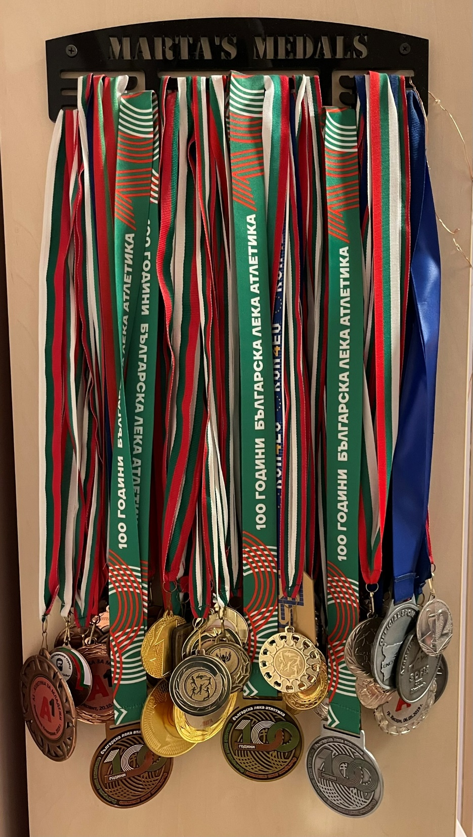
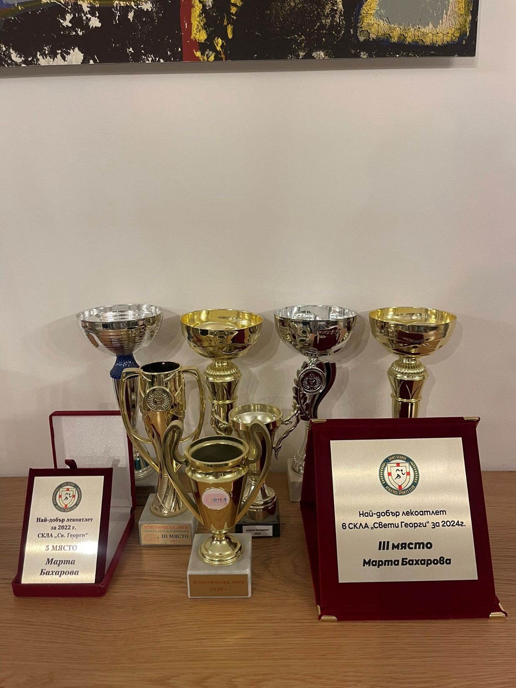

Slide 13
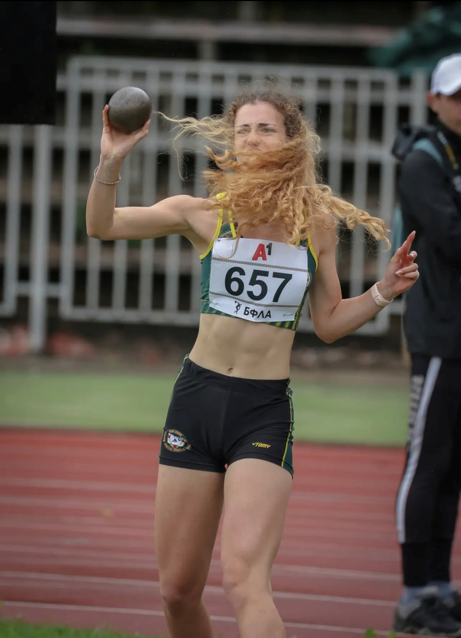
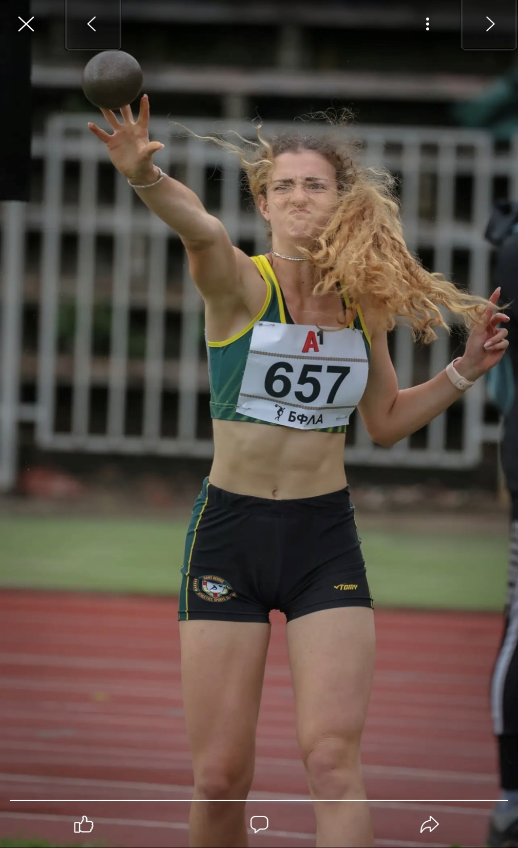

Slide 15
Academic achievements:
- Bulgarian High school diploma
- IB bilingual diploma
- MYP diploma
- Part of the high school parliament
- Participated in organizational and charity activities like donations for “The Red Cross”, foundation “Four Paws”
- Part of UN Model (Model United Nations) representing Egypt

Slide 16
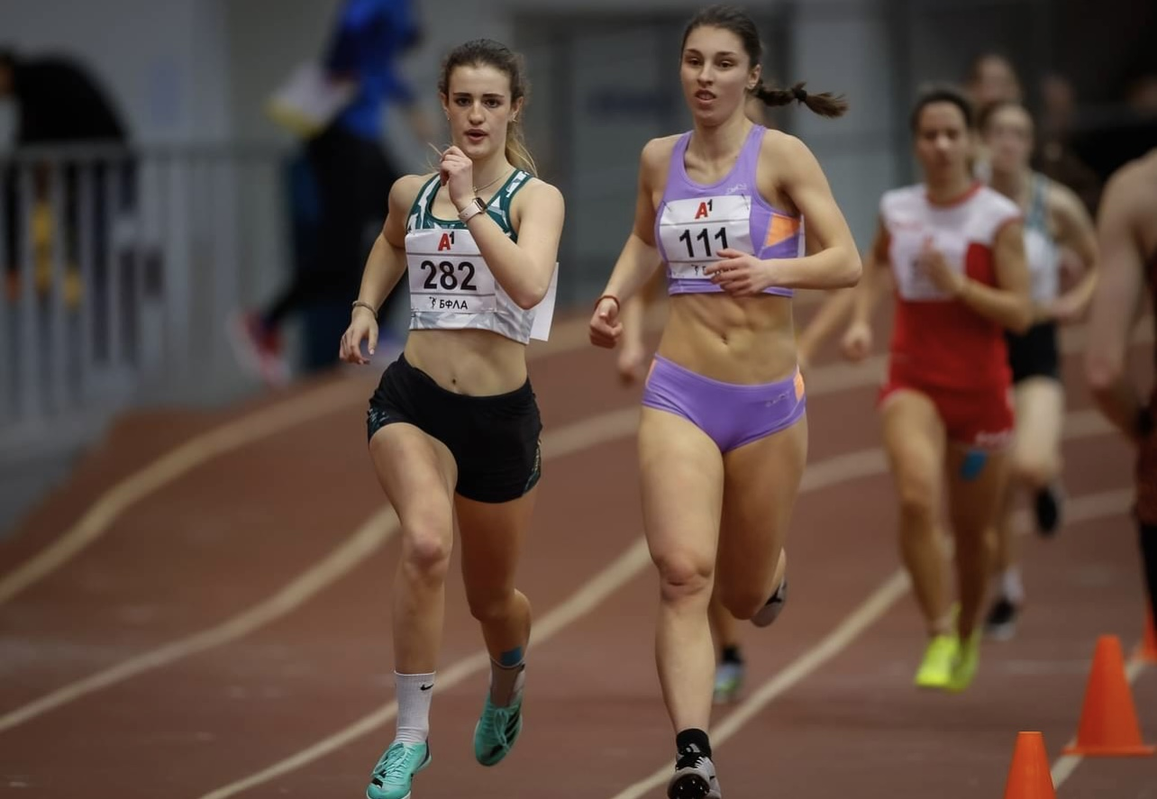

Slide 17
Interview questions
What does athletics mean to you?
Track and field is everything to me. After my first race when I won a medal, just a few weeks after I started training, I knew I found something I really enjoyed and felt good at. After all the years of searching for the right sport for me, I discovered athletics. Or maybe athletics discovered me? Training sometimes felt tedious and there have been periods when I thought I wasn’t making even the slightest progress. During all these years of hard work, I have experienced serious injuries, lack of good coaching and poor preparation, but this has never stopped me from fighting to achieve my goals. In this sport I discovered what love is, what pain and disappointment are. It has built me ​​as a person. Athletics is like school -it teaches you discipline, gives you a healthy body, it trains your psyche and how to deal with difficult situations. In training, you train your endurance and your body. In competition, you show how mentally resilient you are. Track and field is an indispensable part of my life, which I want to develop as much as possible. In the moments when I am down and miserable, when life is hitting hard, I remind myself that I have my sport - track and field. I have and do what I love most.

Slide 18
Describe yourself with a few sentences:
I am Martha and people describe me as smiling, happy, radiant. But sometimes I am
furious at the world. I am competitive, persistent, diligent and patient. I am a fighter. I am
dedicated and I know both success and disappointment. I have achieved victory in sport
or in my studies but I have also experienced failure. I have had bad races, injuries and
periods of stagnation. All these have shaped me ​​and will continue to shape who I am. I
have learned to enjoy little things but I am most grateful for all the hard moments which
helped me summon resources I did not suspect I have.
I am not perfect but I love what I do, who I am and I will keep trying to become better at
everything I do.

Slide 19
What does your education mean to you?
All these years I have had to combine sports with school, and it has not always been easy.
Sport has always been a breath of fresh air after the school day. But for me education is
what builds your future and getting educated is the most important thing. Sports can
rarely be a lifelong profession, this is why education is important for your future career.
Education can open many doors to a stable future and different paths to find what you are
good and passionate about. There are areas that interest me, for example psychology, or
criminology, but I am still not clear what I want to study at university.

Slide 20
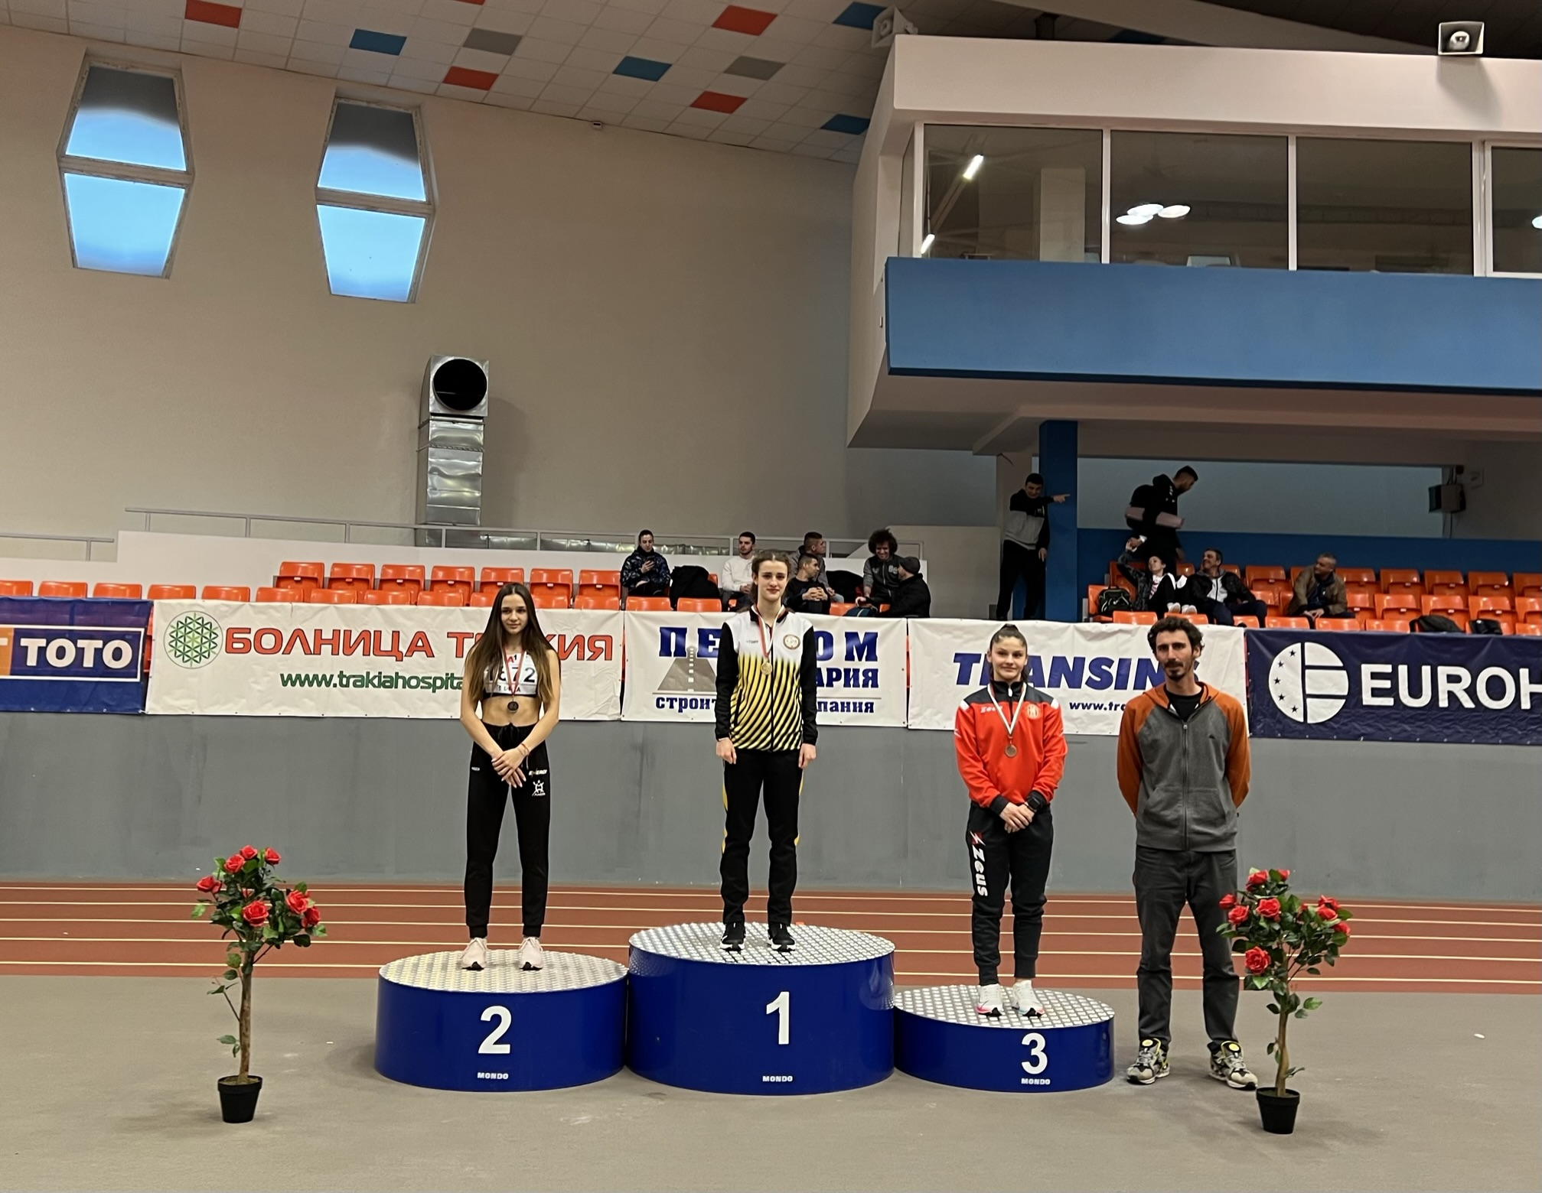

Slide 21
What are your main goals as a student-athlete in the USA?
Being a student-athlete in the US has always been a big dream of mine and one that I hope to make come true. As a student-athlete I will improve skills like discipline, time management and goal setting. For me, America is still the land of opportunity and if you are focused and try hard you can achieve anything. So many of the best athletes train in the USA and I believe there I can find the best coaching and environment to grow as an athlete. With my future still unfolding, I want to pursue a higher education while at the same time doing what I am most passionate about. My goals are to maximize my potential and to know that I am giving my all both in education and athletics. To be a student-athlete is not just about excellent grades and top performance on the track, it is also about learning and experiencing a new world with new people, culture and most importantly - growth. Going to the USA will be an opportunity for me to prove to myself and to my family that I am capable of anything I put my mind to and that dreams do come true.

Slide 22
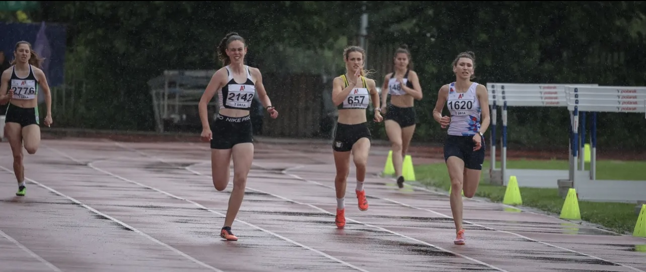

Slide 23
The presentation provides all the basic information for the student-athlete. More details and video can be provided if needed. Contact us.

