Slide 1


MS for Parkinson’s disease diagnosis
Research from Perdita Barran’s group (Manchester University, UK)
Ted^{X} talk on YouTube
https://www.youtube.com/watch?v=IbmJ9eZpMJw

Slide 2


MS for Parkinson’s disease diagnosis
How the story started…
Joy Milne : A nurse whose husband was diagnosed with PD
Change of smell was noticed by Joy before the diagnosis
T-shirt experiments to show that Joy is a “super smeller”
Early diagnosis !
https://www.manchester.ac.uk/discover/news/smell-of-skin-could-lead-to-early-diagnosis-for-parkinsons/

Slide 3
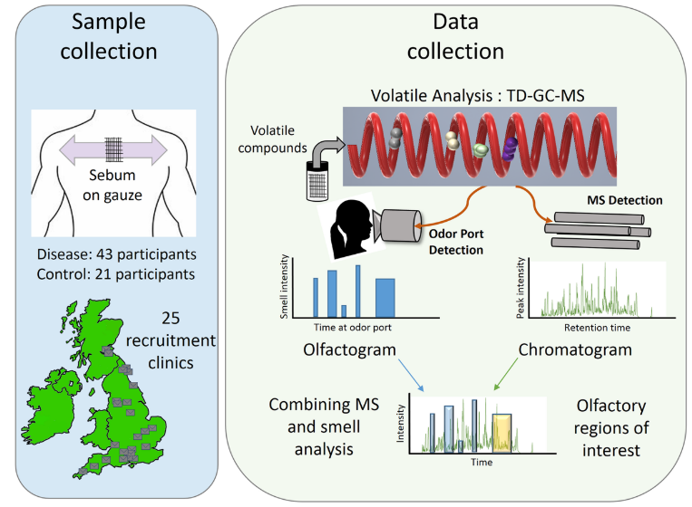




MS for Parkinson’s disease diagnosis
Change of smell related to the presence of volatile organic compounds (VOCs) in sebum
Thermal desorption – GC
Odor port
EI-Q MS
Analysis of a discovery cohort
17 metabolites
Comparison with validation cohort + statistics
4 metabolites
Trivedi, D. et al. ACS Central Science (2019), 5(4), 599-606.

Slide 4
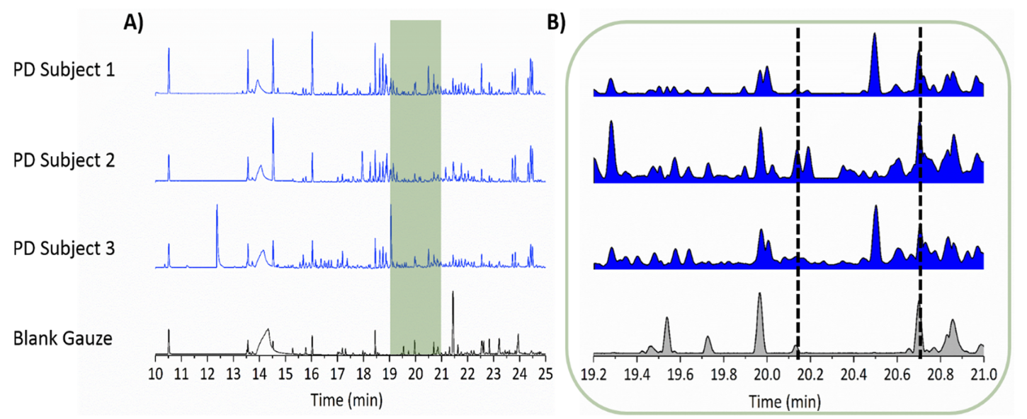
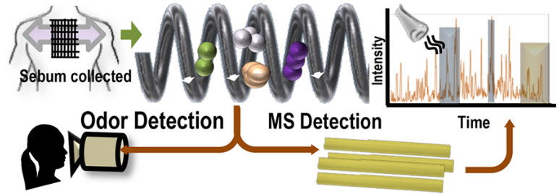
MS for Parkinson’s disease diagnosis
Change of smell related to the presence of volatile organic compounds (VOCs) in sebum
Thermal desorption – GC
Odor port
EI-Q MS
“Artificial” mixtures of metabolites associated with PD smell
Trivedi, D. et al. ACS Central Science (2019), 5(4), 599-606.

Slide 5

MS for Parkinson’s disease diagnosis
LC-MS of large cohorts of PD subjects ; Medicated, drug naïve and control
Differences in composition of sebum due to alteration in lipid metabolism
... The path to an early diagnosis of Parkinson’s disease ?
Sinclair, E. et al. Nature Communications (2021), 12(1), 1592.

