Slide 1
Nikolay Kotevski Middle blocker/opposite

Slide 2
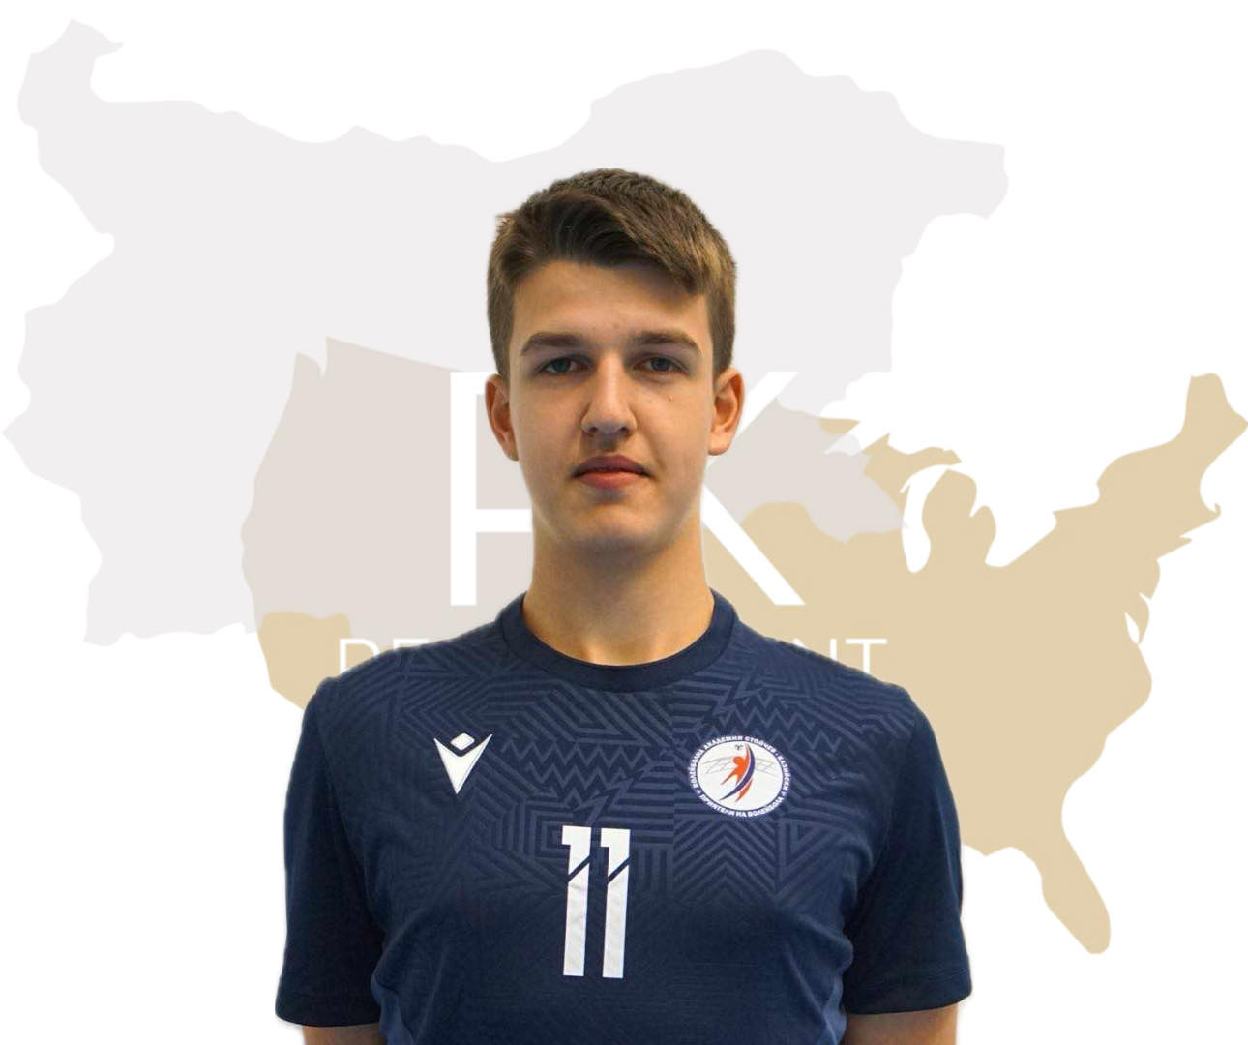
Status: Available
Gender: Male
Position: Middle Blocker
Date of Birth: 10.11.2006
Graduation date: June, 2025
Club team: Volleyball academy “Stoytchev-Kaziyski” (VASK)

Slide 3
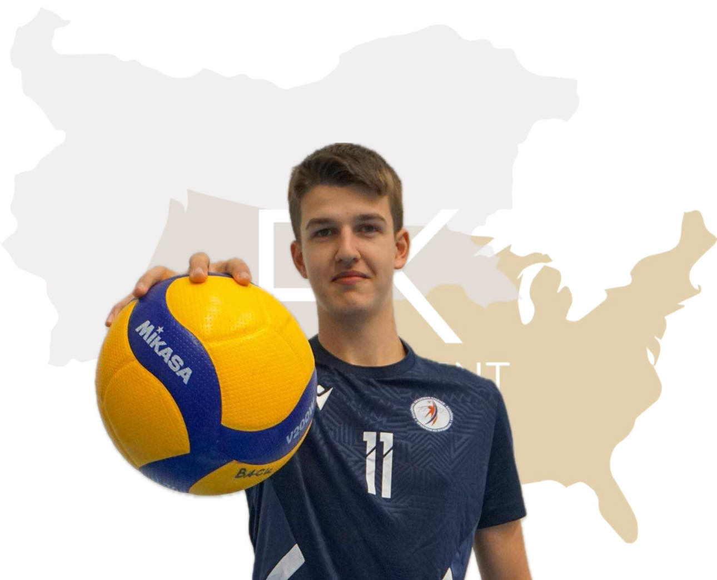
Additional Information
Height: 205 cm.
Weight: 84 kg.
Reach: 267 cm.
Approach high jump: 340 cm.
Standing block jump: 320 cm.
High school: Britanica Park School
Languages: Bulgarian, English, German
Desired degree: TBA
SAT grade/date: TBA
TOEFL grade/date: TBA

Slide 4
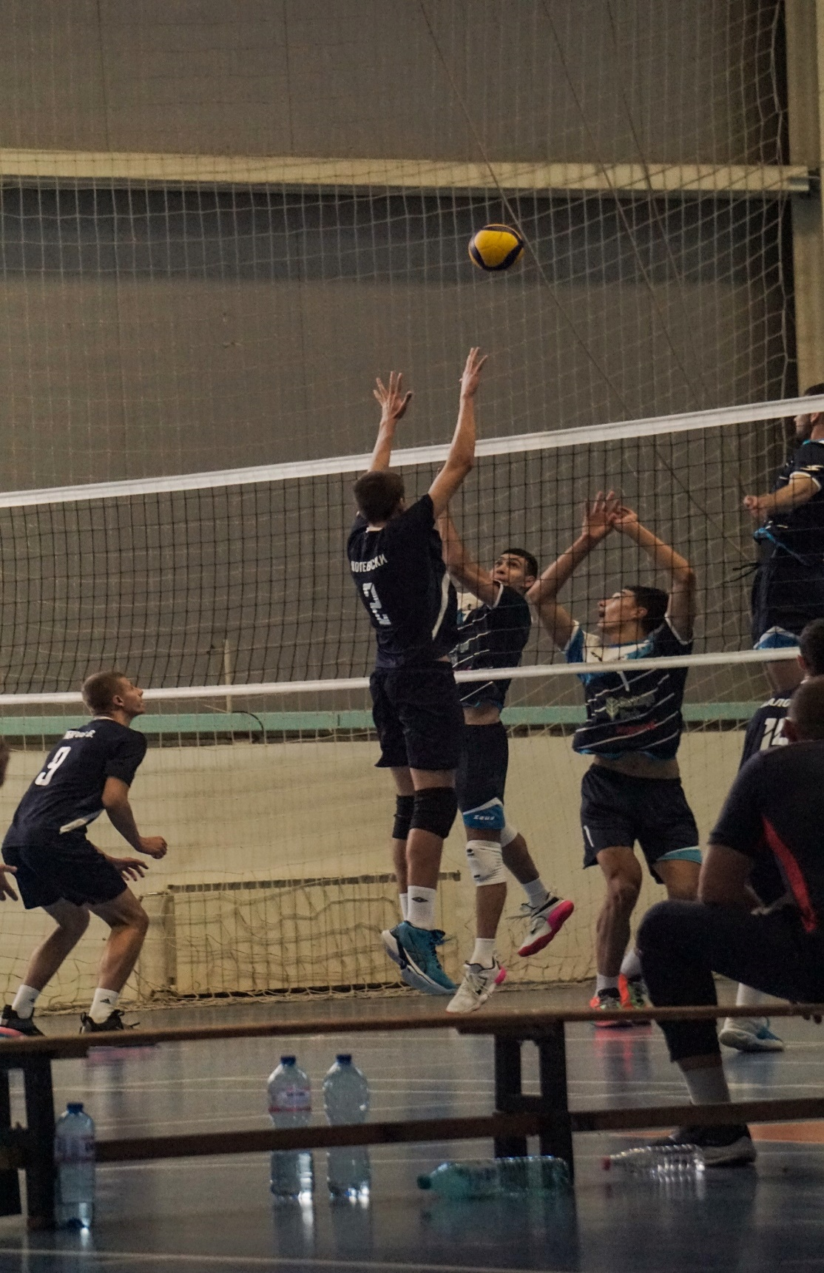

Slide 5
Athletic achievements:
City of Jablanica Cup Season 2019/2020- 1st place
National Championship in Sofia -3rd place Season 2019/2020
National Championship in Dryanovo- 1st place Season 2019/2020
ProMarket Cup- 1st place Season 2019/2020
National Championship Bulgaria- 2nd place Season 2020/2021
National Championship Bulgaria- 5th place Season 2021/2022
Nation Championship Bulgaria- 8th place Season 2022/2023

Slide 6
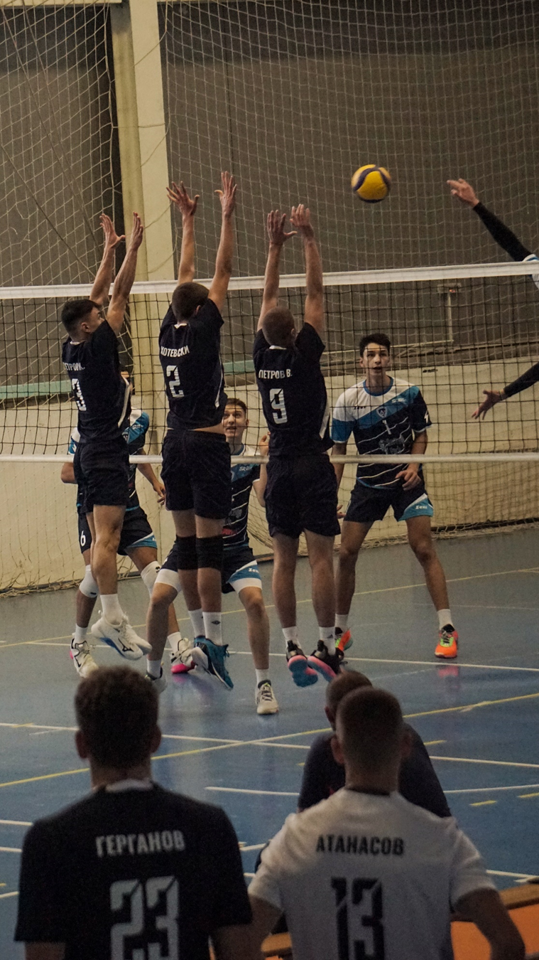

Slide 7
Academic achievements:
The latest achievement of mine is CAE Cambridge Certificate in English. Another thing is that I was one of 20 people chosen in my school to participate in the IB Diploma program. The requirements here in Britanica Park School are- an average grade of 5.5, excellent discipline and to maintain a good moral and ethical system, which are in accordance with the ones in the IB.

Slide 8
Interview questions
Describe yourself with a few sentences:
Currently I am a student at Britanica Park School in Sofia, Bulgaria. I am a well-organized person, who has leadership, time-management and excellent teamwork skills. Furthermore, I am a hard worker who is ready to pay the price of hard work and make enough sacrifices to achieve my goal. In terms of my long-standing passion and goal I am highly motivated to further my volleyball career. My main goal is to become a player in series A1 in Italy and to compete with the best players worldwide.

Slide 9
What does volleyball mean to you?
For me volleyball is a great passion. I first started playing volleyball at 11 years of age and only from my first training I felt the desire to compete with the other players and improve myself. I consider myself to be a good player, so I want to further develop my abilities and prove myself world widely. As part of a team, I have taken part in numerous competitions, which enhanced my ambitions to success and helped me grow as a team player, also as a motivated and responsible person. Volleyball also helped me develop skills such as effective communication, time-management skills, open-mindedness, respect and discipline. For instance, last year my team experienced problems at the start of the season. From my previous experience I was able to influence them by motivating, listening, helping them and in the first half of the season ranking we finished 2nd. This trend continued further in the second half of the season, and we qualified for our country’s competition. I am convinced that I will continue to put extra effort into being a better version of myself, which is going to help the team in the long run.

Slide 10
What does your education mean to you?
For me education is freedom. It gives me more opportunities and perspectives on development in life. I dream of being prepared and educated and to further develop myself outside of the sports sphere after I finish my volleyball career. Education allows me to fulfil my dreams and ambitions and foster skills such as critical thinking, interpersonal skills also develop knowledge further. Good education such as the IBDP provides me an opportunity to earn higher scholarship which is going to aid my family budget.

Slide 11
What are your main goals as a student-athlete in the USA?
As a student-athlete my focus is going to be on volleyball, but I am ambitious to earn a bachelor's degree because education is going to give me further opportunities in life. My overall goal is to become a player in series A1 in Italy and compete with the best players in the world. The main reason for my ambition to study in the USA because after carefully exploring my options I am confident that the USA league is an excellent choice for pursuing my volleyball career and continuing my education. It is going to provide me with opportunities such as good sport halls, gyms, rehabilitation, coaches, which are eager to teach and help me become the best version of myself as a player. I am a hard worker, who hasn’t ever thought of giving up and is ready to achieve his goal at all cost.

Slide 12
Video Analysis
Highlight video: https://www.youtube.com/watch?v=h7dKxte4m5o NEW
https://youtu.be/quhpQAxof2E
Two full games:
Season 23-24:
https://www.youtube.com/watch?v=SlAV-DZnrhM
https://www.youtube.com/watch?v=EGD6yj8IzuM&t=1181s
Season 22-23: https://www.youtube.com/watch?v=didb27wkU8w&t=386s&ab_channel=KrassimirBrendyorfer
https://www.youtube.com/watch?v=XzDPxVZrELo&t=4795s&ab_channel=KrassimirBrendyorfer

Slide 13
The presentation provides all the basic information for the student-athlete. More details and video can be provided if needed. Contact us.

