Slide 1
Aleksana Petkova 200m, 400m, 400m hurdles, hexathlon

Slide 3
Status: Available
Gender: Female
Disciplines: 200m, 400m, 400m hurdles, hexathlon
Date of Birth: 09.08.2006
Graduation date: June, 2025
Club team: Ivet Lalova Sprint Academy

Slide 4
Videos:
1st place 400m hurdles - 62.08 outdoor U20 nationals 2024
https://www.youtube.com/watch?v=0hYeJ0IM_Ms
2nd place 400m - 57.02 outdoor U20 nationals 2024
https://www.youtube.com/watch?v=Gh2aaTUl7LY

Slide 5
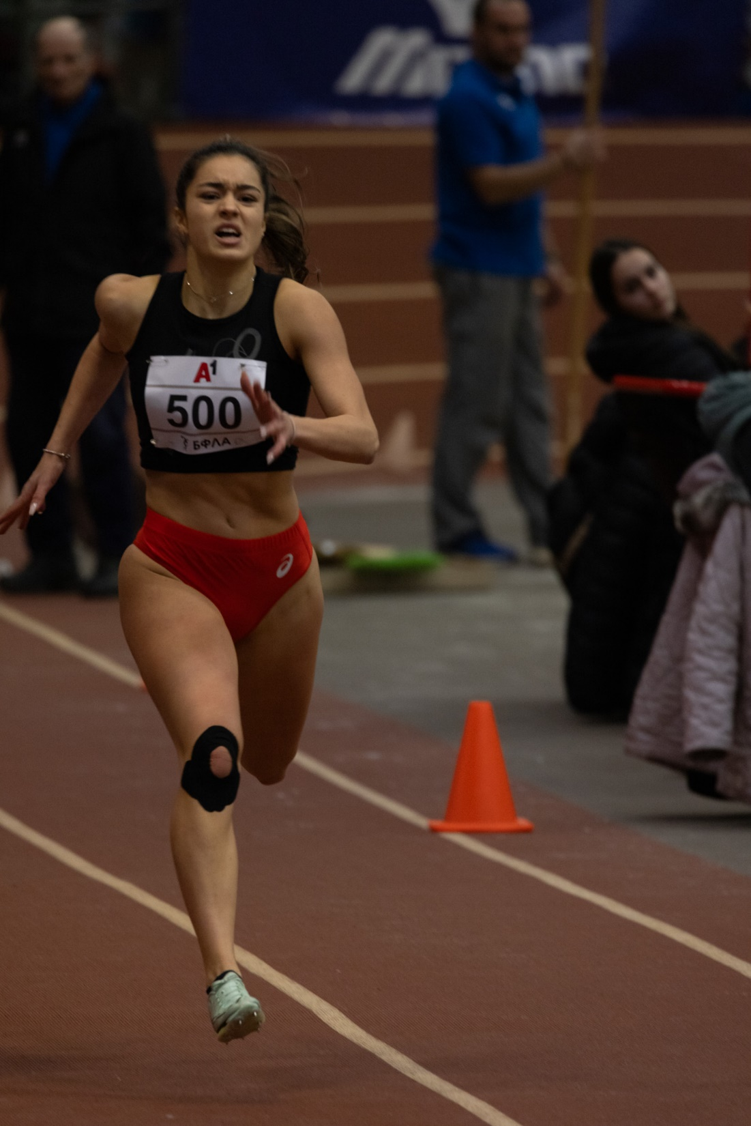

Slide 6
Additional information
Height: 167 cm.
Weight: 56 kg.
Athletic achievements: 62 medals
National titles for Bulgaria in 200m, 400m, 400m hurdles, hexathlon
High school: 51 st Secondary School “Elisaveta Bagriana”
Languages: Bulgarian, English
Desired degree: TBA
SAT grade/date: TBA
TOEFL grade/date: TBA

Slide 7
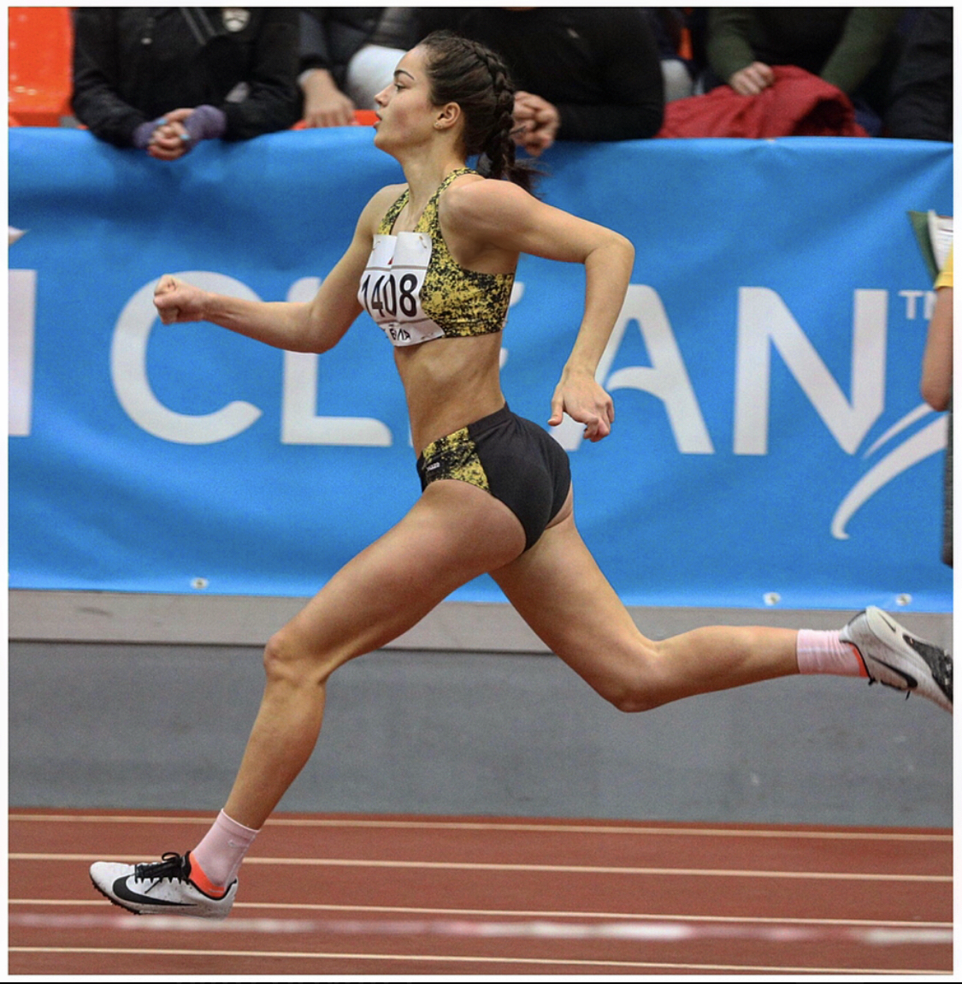
National Titles - 400m
2022 - 58.39 (U18 - indoor)
2022 - 58.20 (U18 - outdoor)
2023 - 58.00 (U20 - outdoor)
2024 - 57.02 (U20 - outdoor)

Slide 8
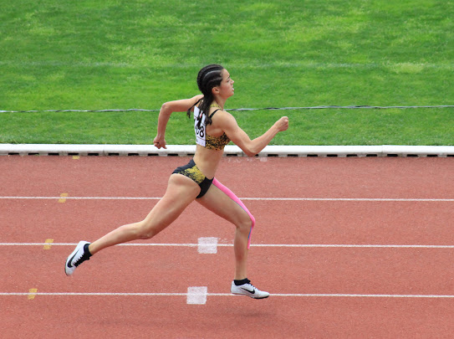
National Title - 400m hurdles
2024 - 62.08 (U20 - outdoor)
2023 - 64.31 (U20 - outdoor)
National Title - 200m
2021 - 26.37 (U16 - indoor)
National Title - hexathlon
2021 - 390 points (U16 - outdoor national record)

Slide 9
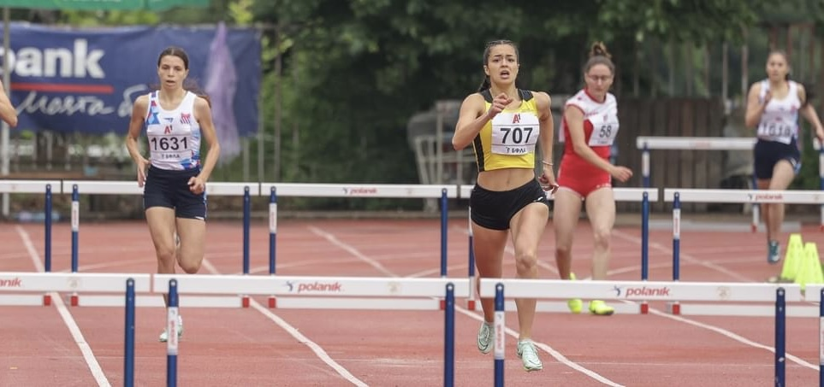
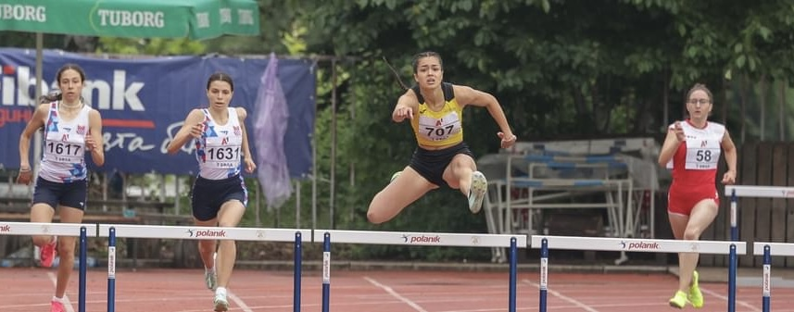

Slide 10
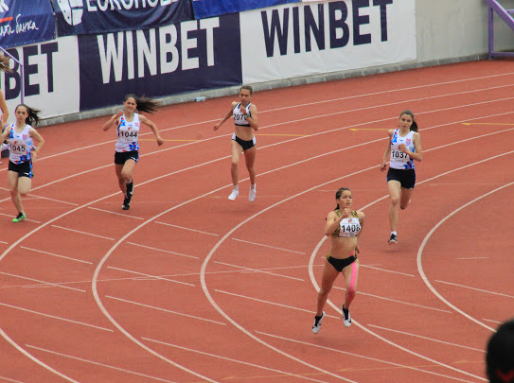
Second places
200m
2020 - 27.49 (U16 - outdoor)
2022 - 26.11 (U16 - indoor)
400m hurdles
2023 - 64.48 (U18 - outdoor)
hexathlon
2020 - 289 points (U16 - outdoor)

Slide 11
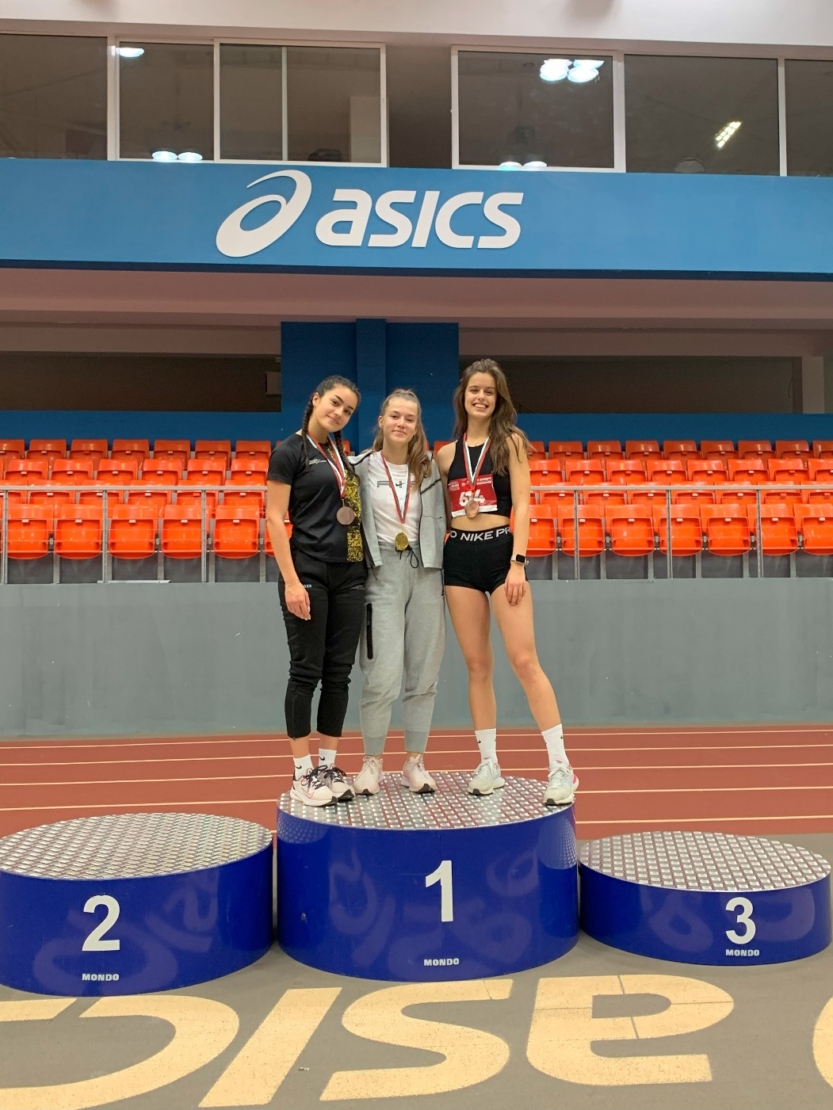
Second places
200m
2020 - 27.49 (U16 - outdoor)
2022 - 26.11 (U16 - indoor)
400m hurdles
2023 - 64.48 (U18 - outdoor)
hexathlon
2020 - 289 points (U16 - outdoor)

Slide 12
Third places
200m
2022 - 26.22 (U20 - indoor)
400m
2023 - 59.69 (U18 - indoor)
Other (international competitions)
2019 - 3th place U13 - 800m - European Kids Athletic Games - Brno, Czech Republic - 2:24.60
2021 - 3th place U15 - 300m - European Kids Athletic Games - Brno, Czech Republic - 41.00
2023 - 11th place U18 - 400m - Balkan Athletics Championship - Sivas, Türkiye - 60.85

Slide 13
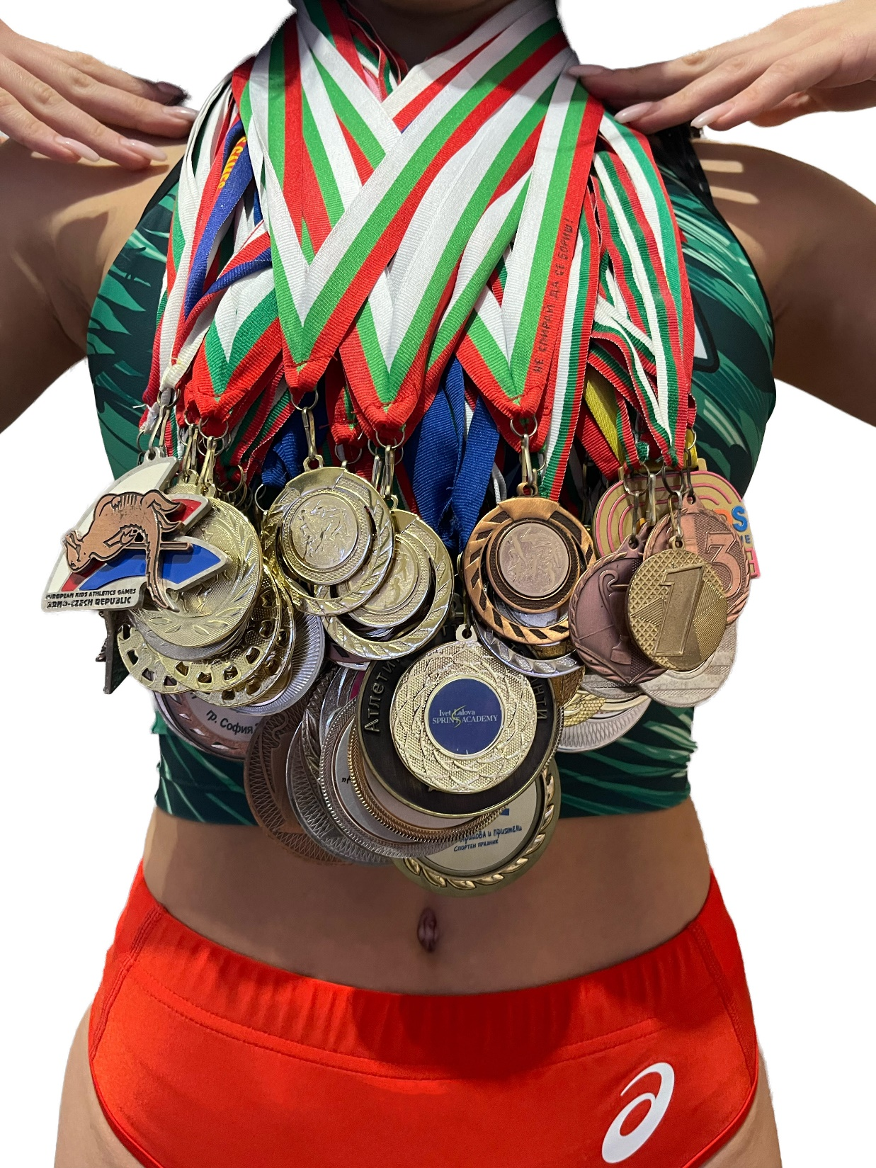

Slide 14
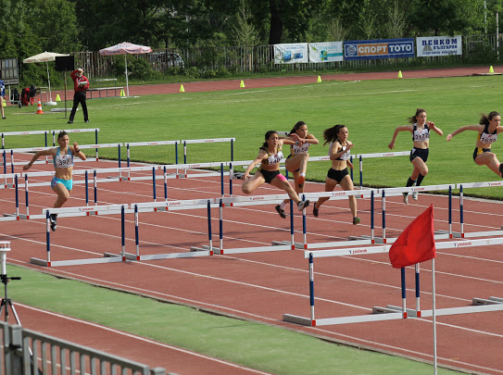

Slide 15
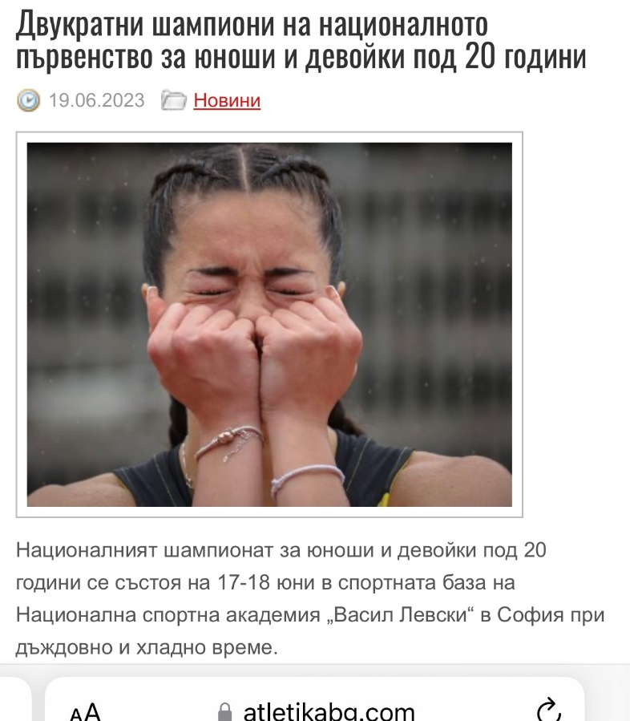
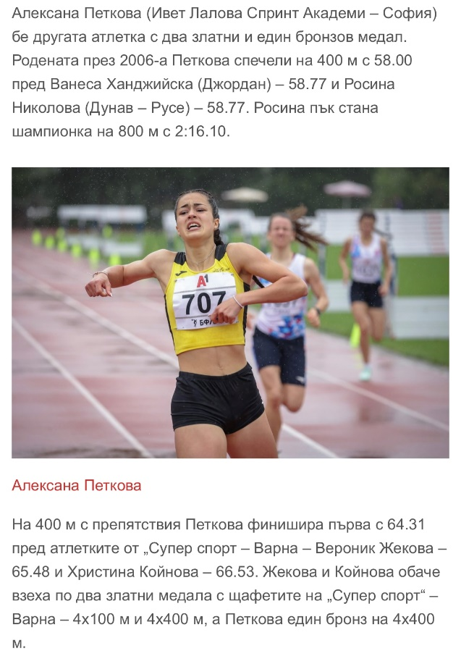
Articles:
https://www.atletikabg.com/2023/06/19/%D0%B4%D0%B2%D1%83%D0%BA%D1%80%D0%B0%D1%82%D0%BD%D0%B8-%D1%88%D0%B0%D0%BC%D0%BF%D0%B8%D0%BE%D0%BD%D0%B8-%D0%BD%D0%B0-%D0%BD%D0%B0%D1%86%D0%B8%D0%BE%D0%BD%D0%B0%D0%BB%D0%BD%D0%BE%D1%82%D0%BE-%D0%BF/
https://www.atletikabg.com/2021/02/21/%D0%B2%D1%82%D0%BE%D1%80%D0%B8-%D1%82%D0%B8%D1%82%D0%BB%D0%B8-%D0%B7%D0%B0-%D0%BC%D0%B0%D1%80%D1%82%D0%B8%D0%BD-%D0%B4%D0%B8%D0%BC%D0%B8%D1%82%D1%80%D0%BE%D0%B2-%D0%B0%D0%BB%D0%B5%D0%BA%D1%81%D0%B0/
https://insport.bg/2020/07/12/%D1%82%D0%B8%D1%82%D0%BB%D0%B0-%D0%B8-%D1%81%D1%80%D0%B5%D0%B1%D1%80%D0%BE-%D0%B7%D0%B0-%D0%B8%D0%B2%D0%B5%D1%82-%D0%BB%D0%B0%D0%BB%D0%BE%D0%B2%D0%B0-%D1%81%D0%BF%D1%80%D0%B8%D0%BD%D1%82-%D0%B0%D0%BA/

Slide 16
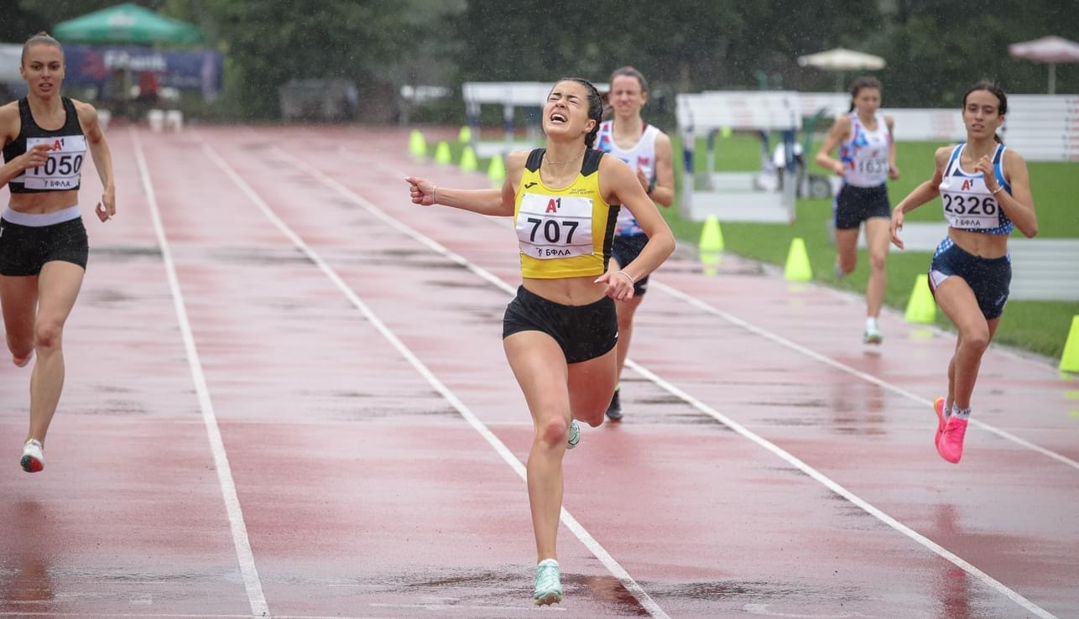

Slide 17
Interview questions
What does athletics mean to you?
In the 10 years that I have had the opportunity to experience athletics, I can say that it has taught me to be strong, to fight, to be brave and to never give up on my goals. I have been through a lot of hard training, competitions, injuries, but over time I have learned that you just must grit your teeth and fight until the end, because no one is going to do it for you. I would confirm that besides physical training, athletics also builds a strong physic. The most enjoyable part of this sport is the racing. This feeling is indescribable. Standing at the start knowing how much training it has cost you and the only thought being the desire to achieve and show your best.

Slide 18
What does your education mean to you?
As a student athlete, education means more than just hitting the books. It&#39;s the foundation that supports my dreams and goals both on and off the field. It&#39;s the tool that empowers me to excel academically while pursuing my passion for sports. Education not only enhances my knowledge but also teaches me discipline, time management, and perseverance. It provides me with opportunities to grow, develop essential life skills, and prepare for a successful future. For me, education is the key that opens doors and unlocks endless opportunities.

Slide 20
What are your main goals as a student-athlete in the USA?
As an international student athlete in the USA, my main goals revolve around personal and athletic growth, cultural integration, and academic success. I aim to excel in my chosen sport, pushing myself to reach new heights and contribute to the success of my team. I want to try and experience the American way of life, immerse myself in the local culture, and build strong relationships with teammates and coaches. Academically, my goal is to maintain a high GPA, actively engage in my studies, and leverage the educational opportunities available to me. I aspire to leave a lasting impact both on the track and on my education in the USA.

Slide 21
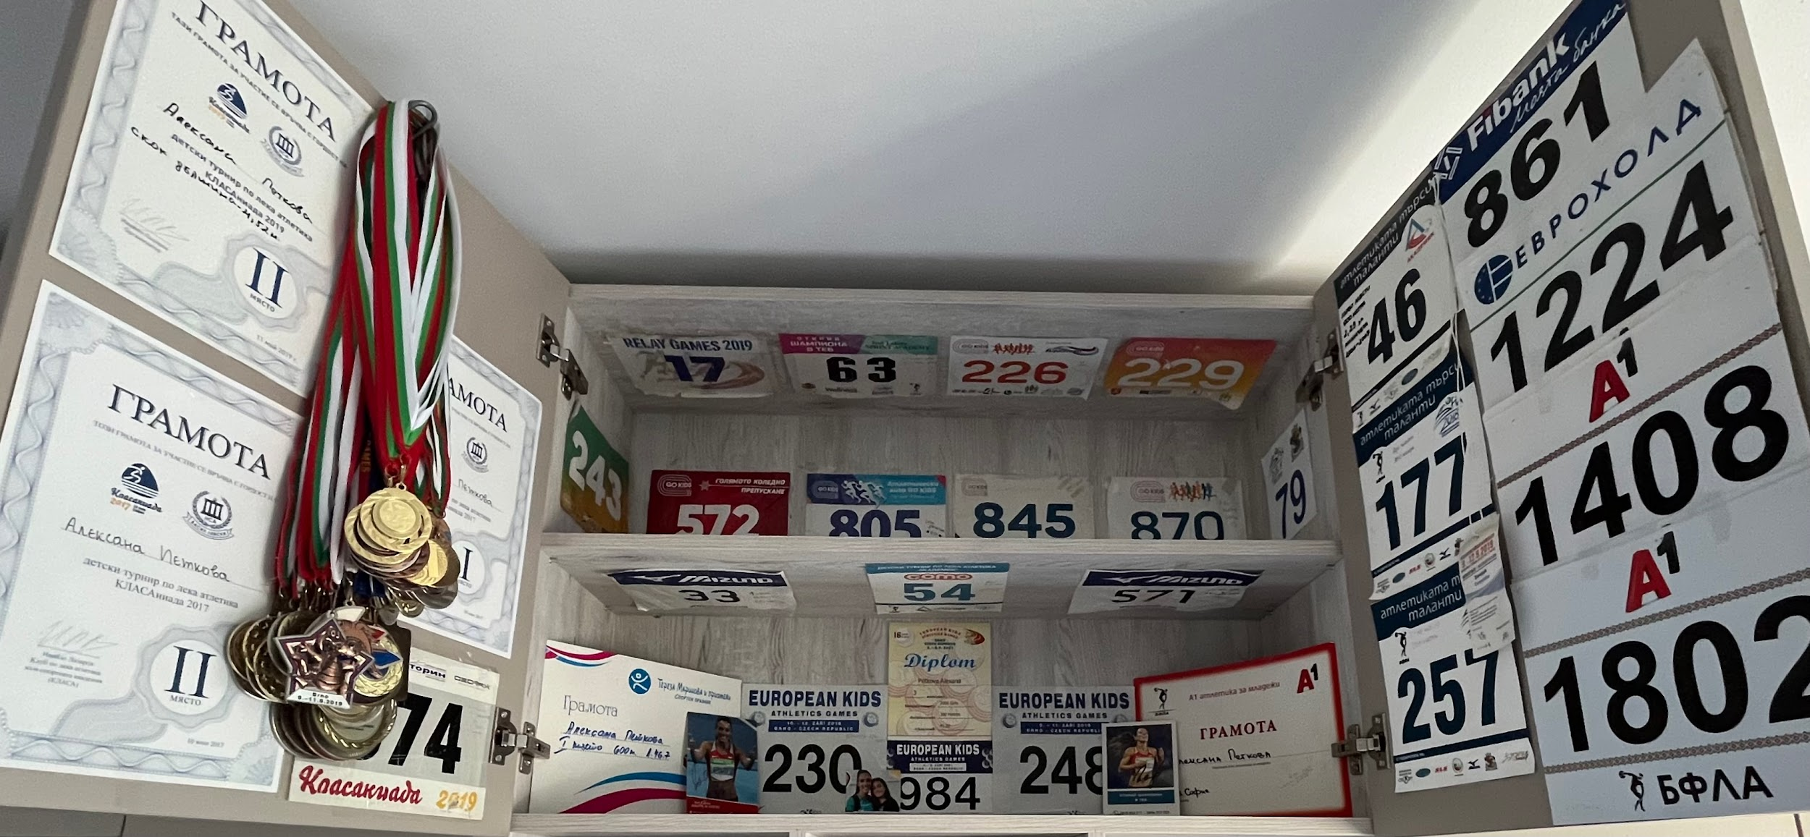

Slide 22
The presentation provides all the basic information for the student-athlete. More details and video can be provided if needed. Contact us.

