Slide 1
Tibial Nail, Cannulated

Slide 2
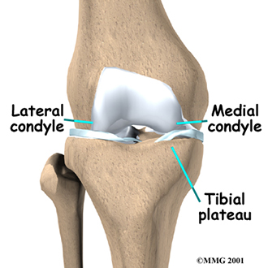
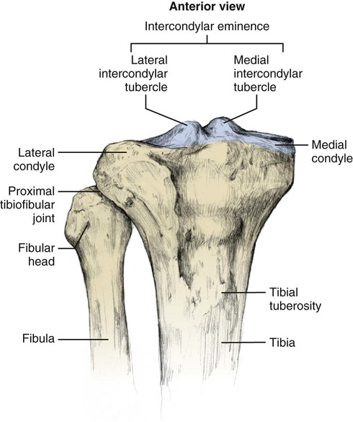
Anatomy of tibia
Proximal
Distal
Notes:
Tibial plateau: the smooth bony surface of either the lateral condyle or the medial condyle of the tibia that articulates with the corresponding condylar surface of the femur

Slide 3
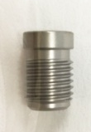
Components
Tibial Nail, Cannulated
Anatomic bend for ease of nail insertion
Cannulated nails, diameters from 8.2 to 11 mm
4.8 mm Tibial Locking Screw
Used for the proximal three holes for proximal locking
Dual-core designed
Cancellous & cortical thread designed
Tibial Nail End Cap
End caps prevent ingrowth of tissue
5, 10 and 15 mm end caps extend nail height if nail is overinserted.
4.5 mm Tibial Locking Screw

Slide 4
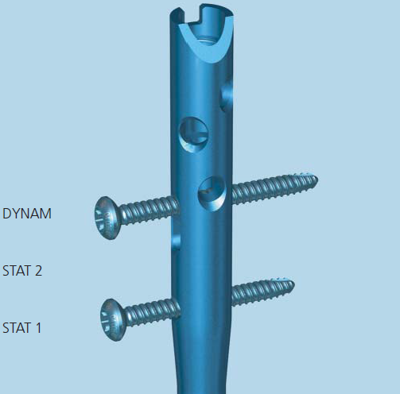
Locking option
Three proximal locking options
Dual-core locking screws
4.8mm screws
The dynamic locking option(DYNAM) is in the upper position of the proximal locking slot, it allows primary compression
Static 2(STAT 2) is the lower position of the procximal locking slot, it does not allow primary compression
Static 1(STAT 1) is the distal proximal locking hole
Distal locking
Two mediolateral (ML) and two anteroposterior (AP) locking options
4.5mm screws

Slide 5
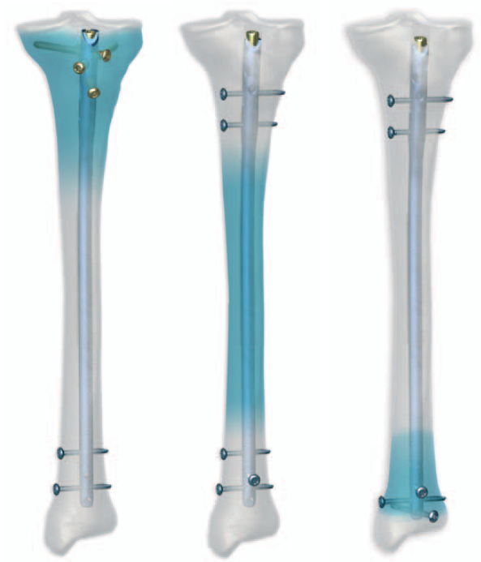
Indications
Various range of indication
Extra-articular fractures of the proximal and distal tibia
All shaft fractures
Versatile locking options:
Proximal locking: 4.8mm cancellous screws & 4.5mm locking screw
Distal locking: 4.5mm locking screw

Slide 6
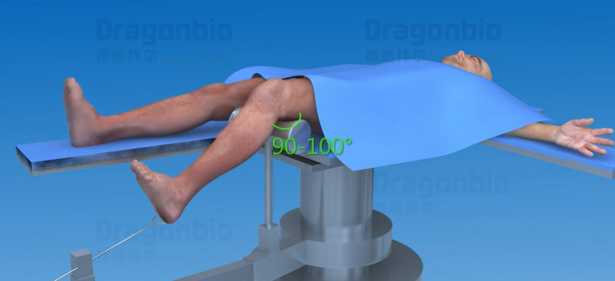
Patient Position & Fracture Reduction
Place the patient on the supine position.
The knee of the injured leg can be flexed at 90°-100°placed in traction.
Perform closed reduction of the fracture under image intensifier control. Perform open reduction when necessary.

Slide 7
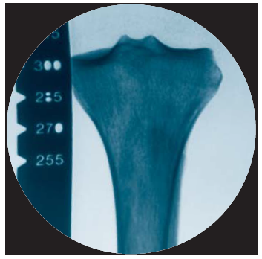
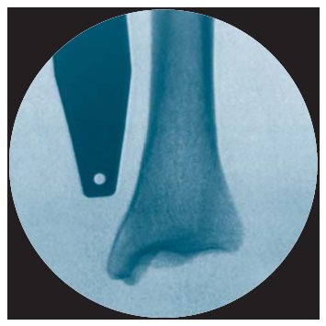
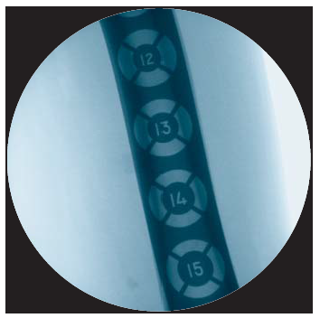
Confirm nail length and diameter
Use the Radiographic Ruler to determine the length and the diameter of the nail under the C-arm
Radiographic Ruler

Slide 8
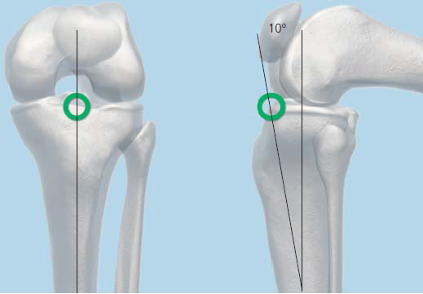
Determine the entry point
In AP view, the entry point is in line with the axis of the intramedullary canal and with the lateral tubercle of the intercondylar eminence.
In lateral view the entry point is at the ventral edge of the tibial plateau.
The angle is about 10° to the shaft axis in the lateral veiw
AP View
Lateral View

Slide 9
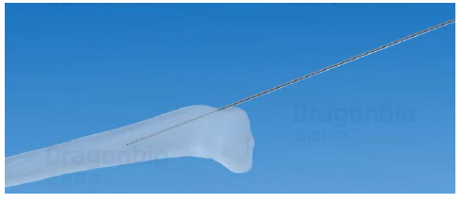
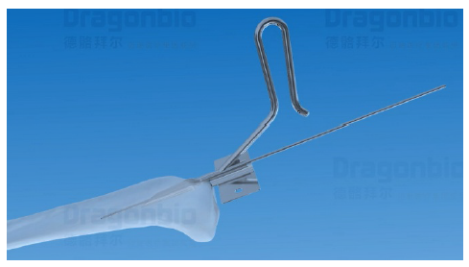
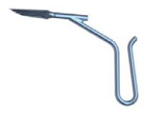
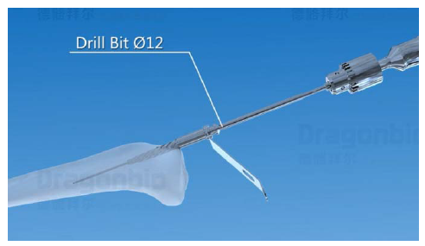
Opening the tibia
Step 1: Insert guide wire
Step 2: Use the awl to open the tibia, Tissue Protector can be used when necessary
Step 3: Open tibia with the Drill Bit Ø12 and Protection Sleeve
Guide Wire Ø3.2*300
Awl, Cannulated
Tissue Protector
Drill Bit Ø12/Ø3.2
Protection Sleeve Ø12

Slide 10
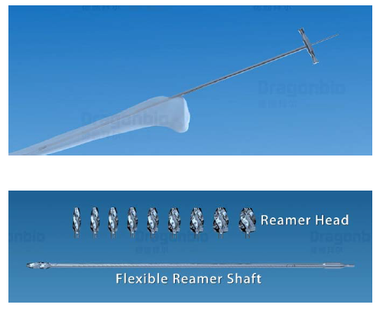
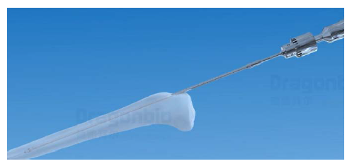
Ream medullary canal
Step 1: Insert wire guide
Step 2: Insert Guide Wire with olive head and remove the wire guide
Step 3: insert the flexible reamer with the reamer head along the Guide Wire to the desired depth
Starting with the small diameter reaming head, ream to a diameter of 0.5 to 1.5 mm greater than the nail diameter
Wire Guide
Guide Wire Ø2.5/Ø4.0, with olive head
Flexible Reamer Shaft

Slide 11
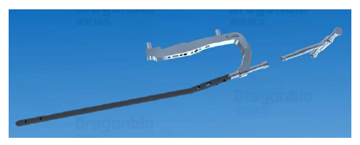
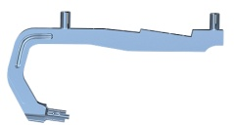
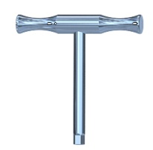
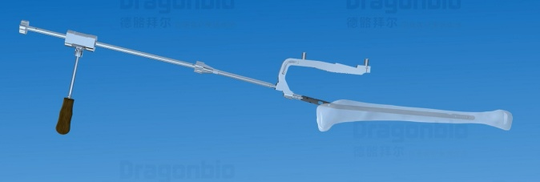
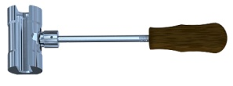
Insert Nail
Step 1: Assemble tibial nail into the insertion handle
Step 2: Carefully insert the tibial nail manually into the medullary canal.
Connector
Insertion handle
Wrench 6.5
Connector
Combined Hammer
Hammer Guide

Slide 12
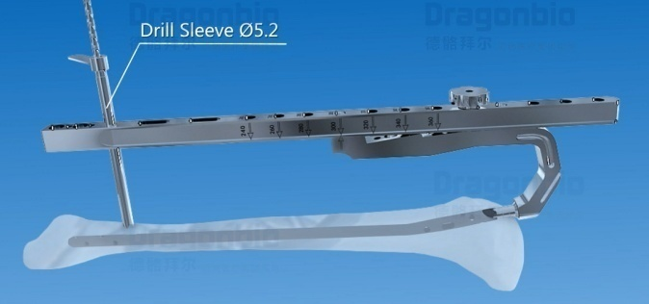
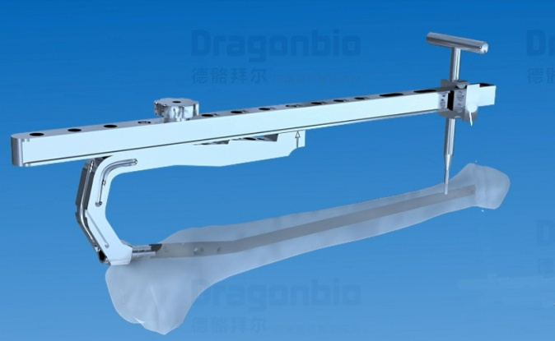
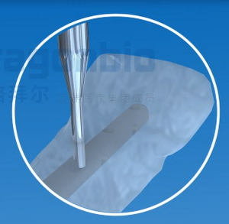
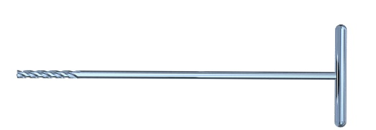
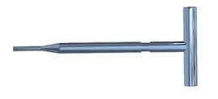
Assemble distal aiming devices
Step 1: Assemble the distal aiming arm according to the selected nail length. Drill with the drill bit Ø5.2 until to the tibial nail platform
Step 2: Insert the Positioning Rod and fix it to the platform with the Locking Block
Connecting Rod
Drill Bit Ø5.2
Drill Bit, Flat Tip Φ5.2*250
Drill Sleeve Ø5.2
Locking Block
Positioning Rod

Slide 13
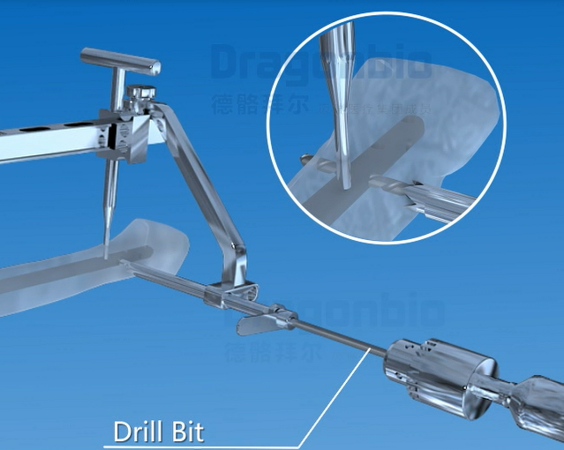
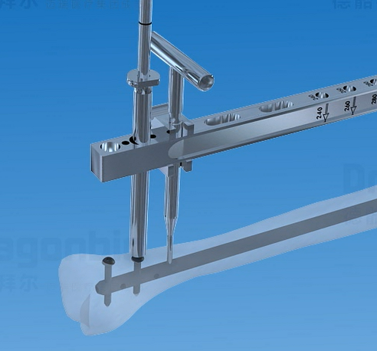
Distal Locking
Option 1: Medial side locking
Attach the distal target device to the connection rod, the drill with the dill bit Ø4.0 protected by the drill sleeve.
Then measure and insert the 4.5mm locking screw
Option 2: Anterior locking
Remove the distal target device, drill with the drill bit Ø4.0, measure and then insert the screw
Protection Sleeve
Distal Target Device
Drill Sleeve Ø4.0
Screwdriver with T handle 3.5
Drill Bit Ø4.0*350
Depth Gauge

Slide 14
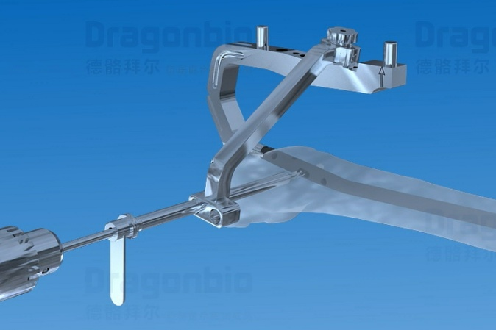
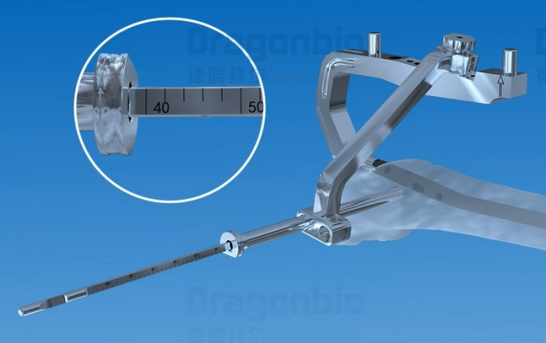
Proximal Locking of 4.5mm locking screw
Step 1: Assemble the aiming arm for the 4.5mm locking screw firmly to the insertion handle, Drill with the drill bit Ø4.0 through the dynamic locking hole
Step 2: Measure and then insert the first locking screw in the top of the dynamic locking hole
Arming Arm for 4.5 locking screw

Slide 15
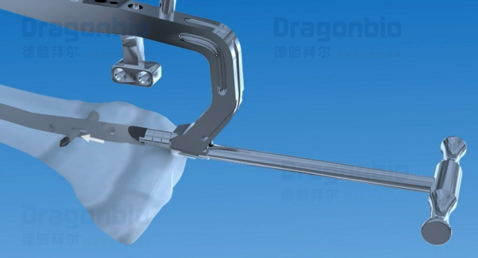
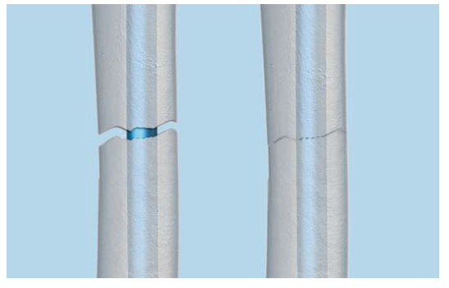
Compression locking mode (optional)
For situations where the fracture gap needs compression after nail insertion
Insert the compression nut through the connecting screw and into the nail using the screwdriver. Advance the compression nut until the fracture gap is reduced
Compression Nut Ø4

Slide 16
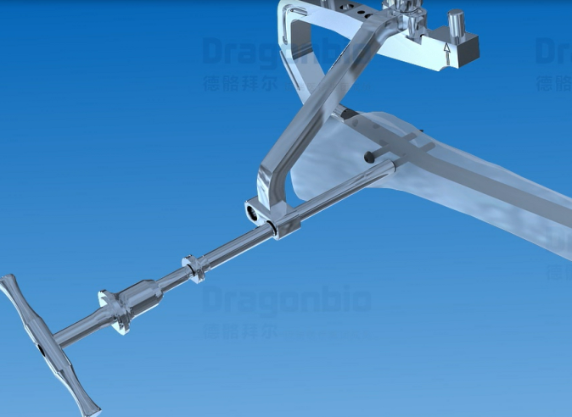
Insert static locking screw
Insert second proximal locking screw in the most distal hole

Slide 17
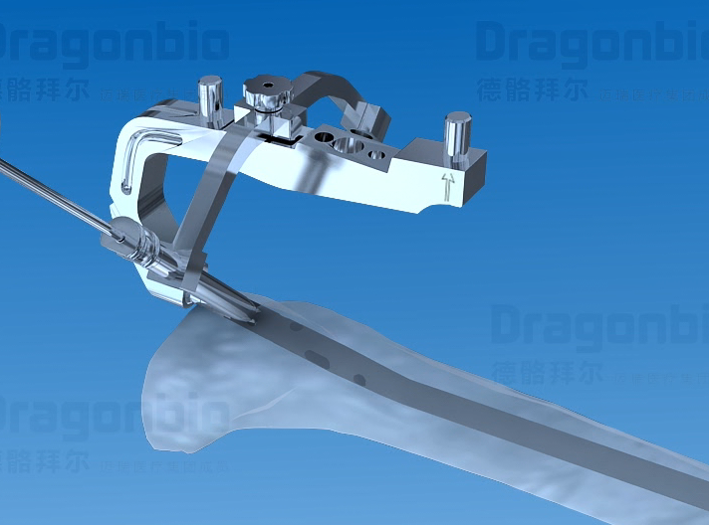
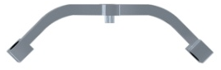
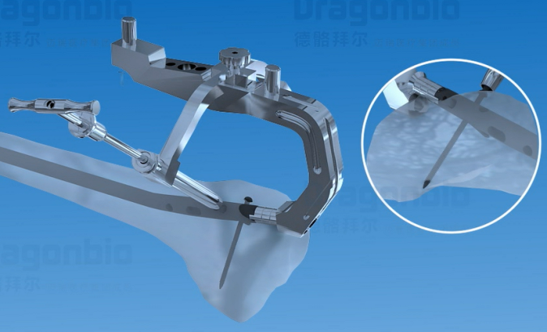
Proximal Locking of 4.8mm locking screw
Step 1: Assemble the Arming Arm for 4.8 Locking screw to the insertion handle
Step 2: Insert the drill sleeve Ø3.2 and drill with the drill bit Ø3.2, make sure do not penetrate the far cortex
Step 3: Then measure and insert the 4.8mm locking screw
Arming Arm for 4.8 Locking screw
Combination of Procetion sleeve, Drill sleeve and Trocar
Drill Bit Ø3.2

Slide 18
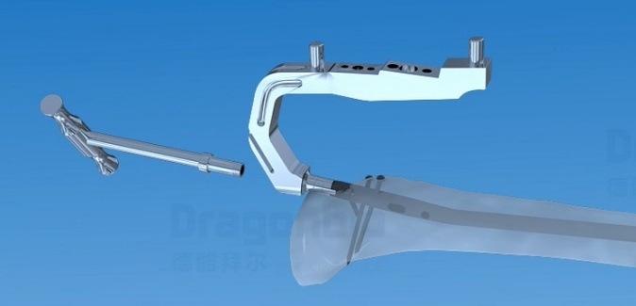
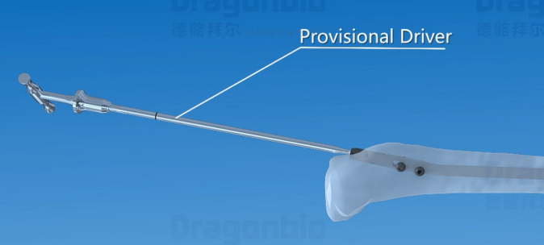
Insert End Cap
Step 1: Remove the aiming arm
Step 2: Insert the appreciate end cap with the provisional driver
Provisional Driver 3.5

Slide 19
Specification
Diameter: φ8.2, φ9, φ10, φ11
Length: 240-360 mm Increased every 20mm
Diameter: φ4.8
Length:25-90mm, Increased every 5mm
Long End
Length: 0, 5, 10, 15
Diameter: φ4.5
Length:25-70mm, Increased every 5mm

Slide 20
Thank You

