Slide 1

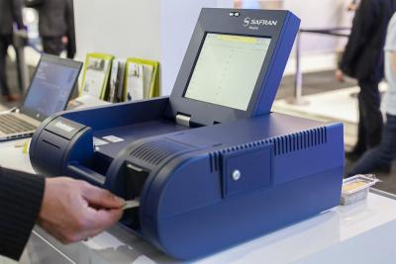
IMS for detection of explosives
Did you undergo this kind of control in an airport ?

Slide 2
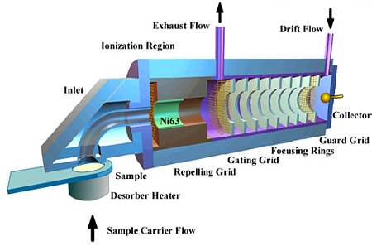
IMS for detection of explosives
It is actually an ion mobility experiment !
Ionization sources : ⁶³Ni, HePI or corona discharge
Emission of β particles
www.smithsdetection.com // Yang and Attygalle, J. Am. Soc. Mass Spectrom. (2011) 22, 1395-1402.

Slide 3
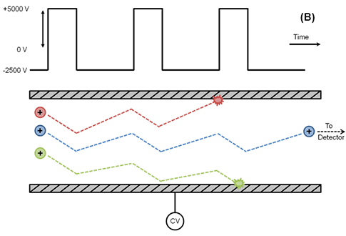
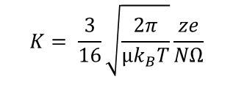

IMS for detection of explosives
It is actually an ion mobility experiment !
Ionization sources : ⁶³Ni, HePI or corona discharge
Emission of β particles
Ion mobility analysis : Separation based on m, z and shape
FAIMS
Gated drift tube
$$K= \frac{3}{16}\sqrt{\frac{2π}{µk_{B}T}}\frac{ze}{NΩ}$$
$$v=\frac{L}{t_{D}}=K.E$$
https://www.dhs.gov/sites/default/files/publications/HH-IMS-Detector-TN_0712-508.pdf
Roscioli, et al. Analytical Chemistry (2011), 83, 5965-5971.

Slide 4
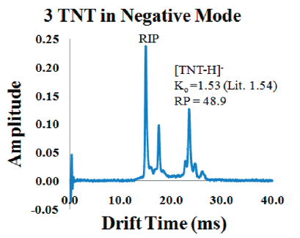
IMS for detection of explosives
Detection of explosives/drugs by comparison with database
Why ion mobility ?
Easy to use by untrained operators
Quick analysis (~s)
Operates at atmospheric pressure
BUT : Risks of false positive and limitations to compounds recorded in the database …
https://locardslab.com/2017/05/
Roscioli, et al. Analytical Chemistry (2011), 83, 5965-5971.

Slide 5



IMS for detection of explosives
Current research & development to improve sensitivity and resolution

