Slide 1
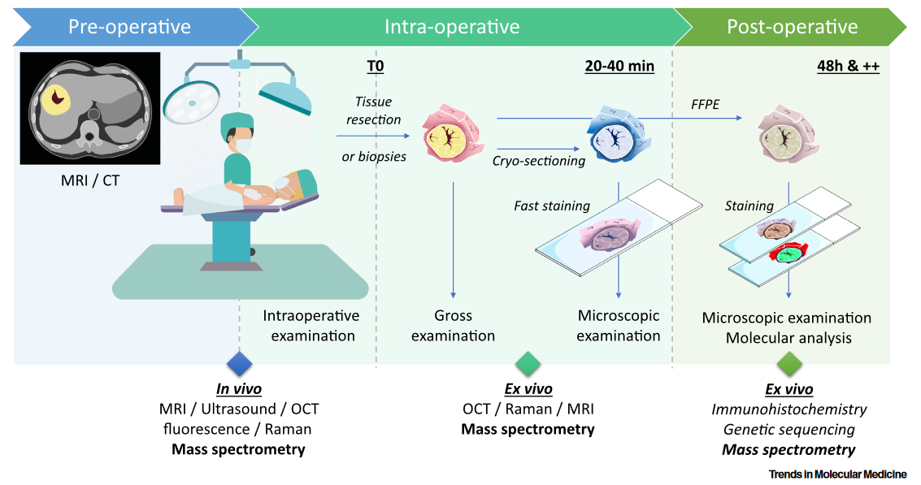
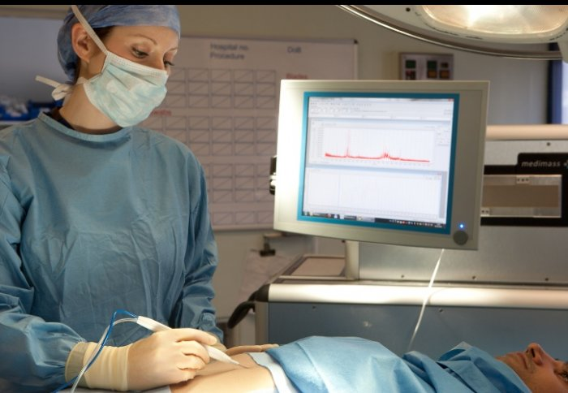

A mass spectrometer in the operating room
Ambient ionization MS : Minimal sample preparation
Ogrinc, N. et al. Trends in Molecular Medicine (2021), 27(6), 602-615.

Slide 2
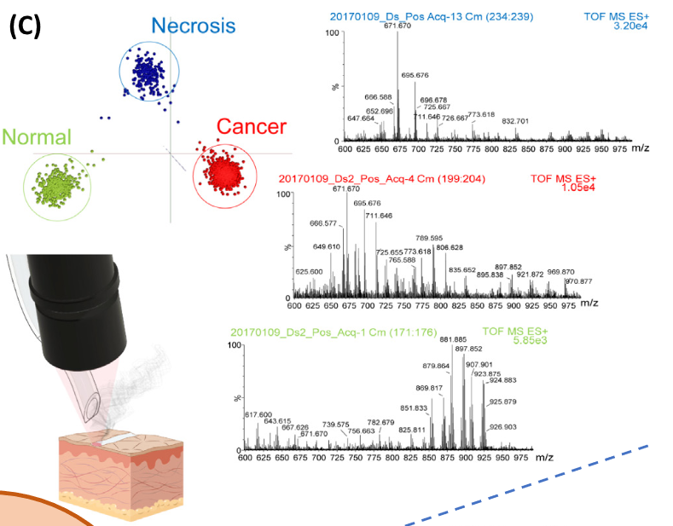
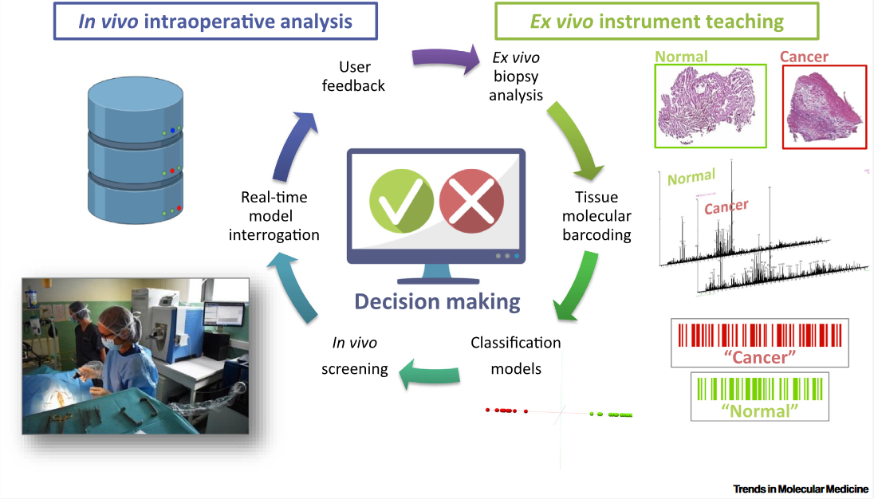
A mass spectrometer in the operating room
SpiderMass
PRISM Laboratory (Prof. Isabelle Fournier - France)
Ogrinc, N. et al. Trends in Molecular Medicine (2021), 27(6), 602-615.

Slide 3
A mass spectrometer in the operating room
In vivo analysis using laser ablation with minimal damages : Use of WALDI (Water-assisted laser desorption/ionization)
Laser tuned to excite O-H stretching of water
Small m/z range : Analysis of lipids and metabolites
Fatou, B. et al. Scientific Reports (2016), 6, 25919
Ogrinc, N. et al. Nature Protocols (2019), 14, 3162-3182.

Slide 4
A mass spectrometer in the operating room
Proof of concept : Analysis of biopsies from a single patient
Molecular profiles confirmed by MS/MS
Building of datasets for machine learning for various types of cancer
Fatou, B. et al. Scientific Reports (2016), 6, 25919
Ogrinc, N. et al. Nature Protocols (2019), 14, 3162-3182.

Slide 5
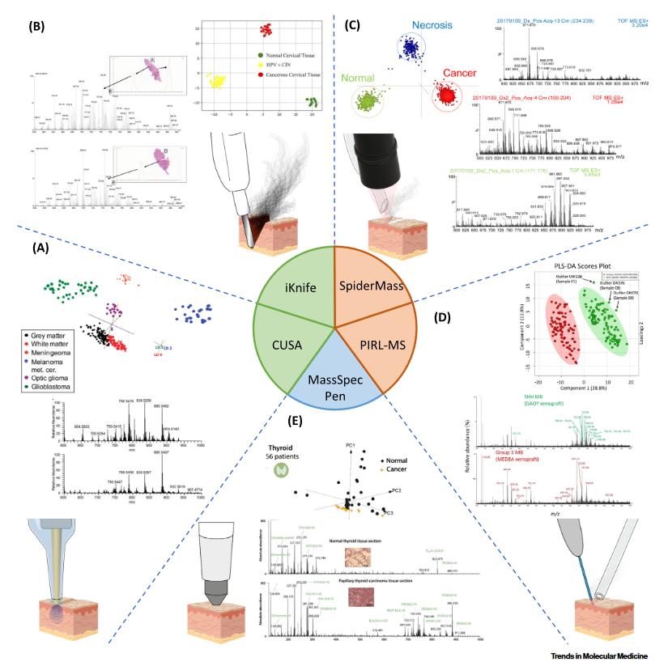
Rapid Evaporative Ionization MS
Cavitron ultrasonic surgical aspirator
Picosecond Infrared Laser MS
Ogrinc, N. et al. Trends in Molecular Medicine (2021), 27(6), 602-615.

